Slide 1
Implementation of the optics
TDR_0.17_0.64_r56_0.4_sx_Dff41.2_DipMagnL.str : MCF=0.0231 chro=0/0
Data from 2023-08-03

Slide 2
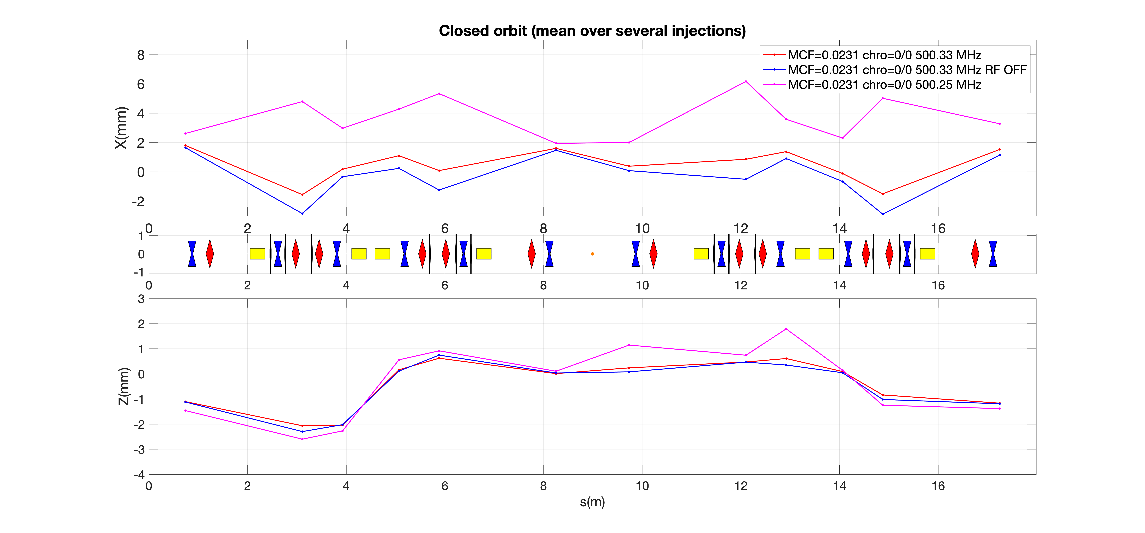
Optics MCF 0.0231: Orbit

Slide 3
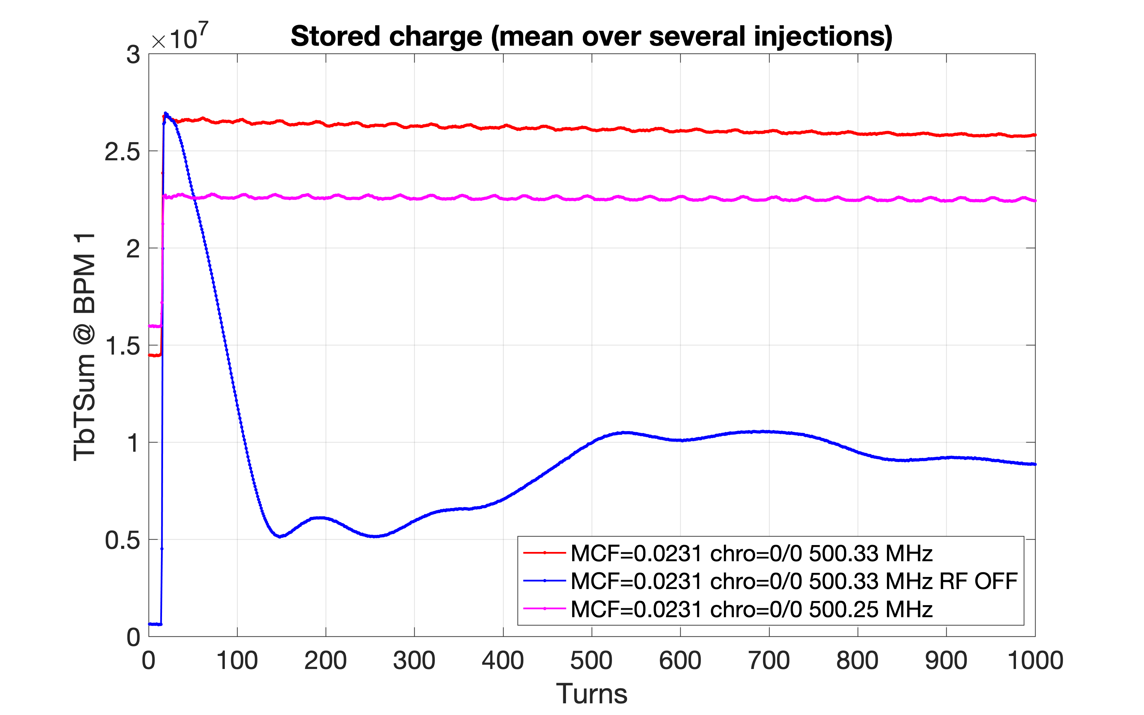
Optics MCF 0.0231 : stored charge

Slide 4
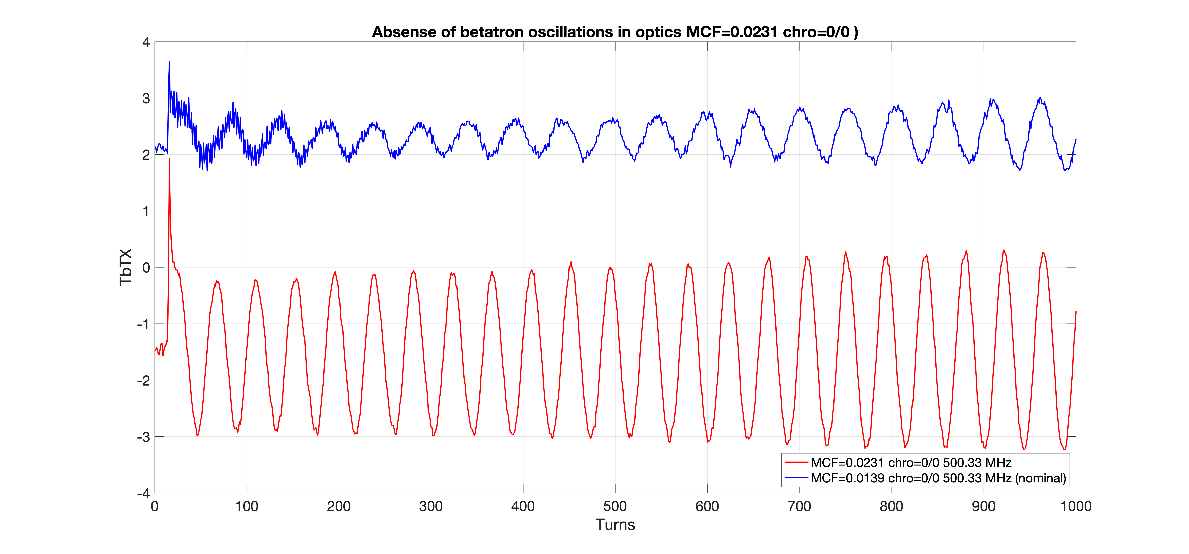
Optics MCF 0.0231 : betatron oscillations

Slide 5
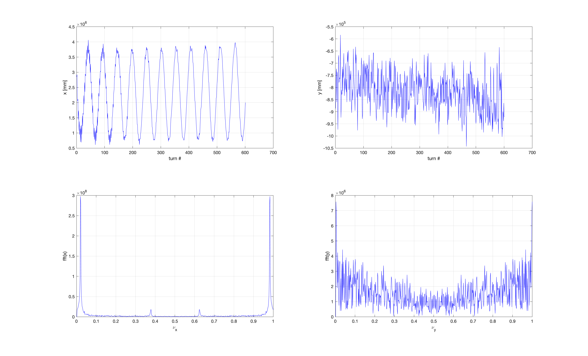
Nominal Optics: tune @500.33 MHZ
(2023-08-03)
Horizontal Tune = 0.188784
Vertical Tune = ????

Slide 6
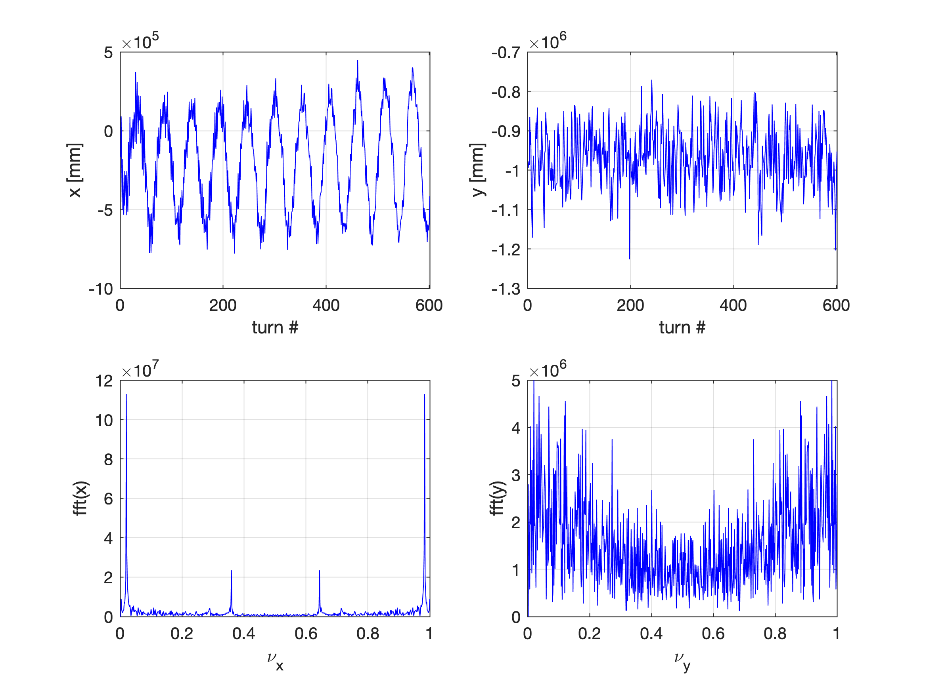
Nominal Optics: tune @500.33 MHZ
(2023-08-04)
Horizontal Tune = 0.178834
Vertical Tune = ????

Slide 7
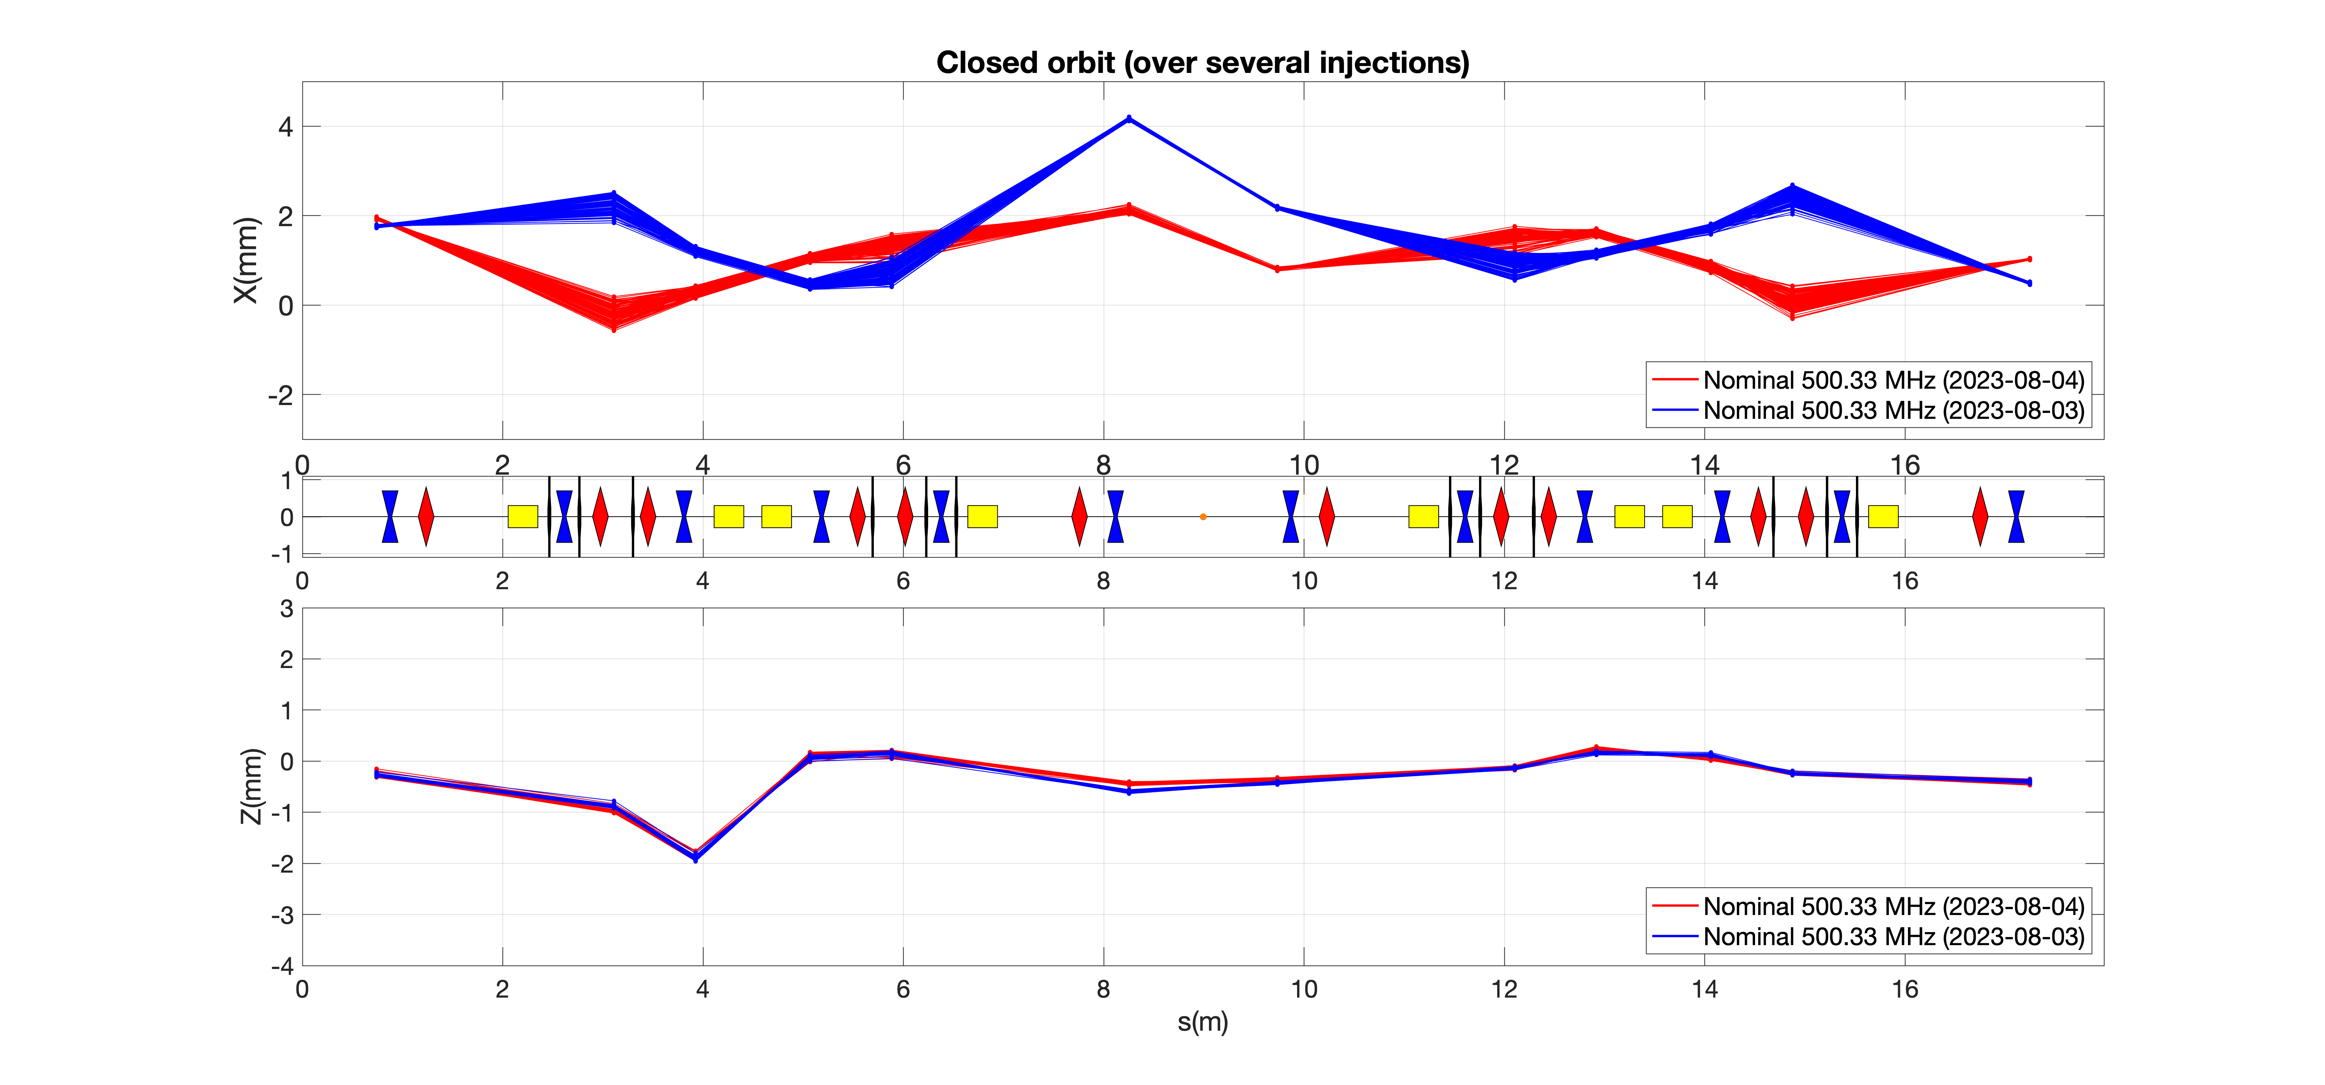
Nominal Optics: orbits @500.33 MHZ

Slide 8
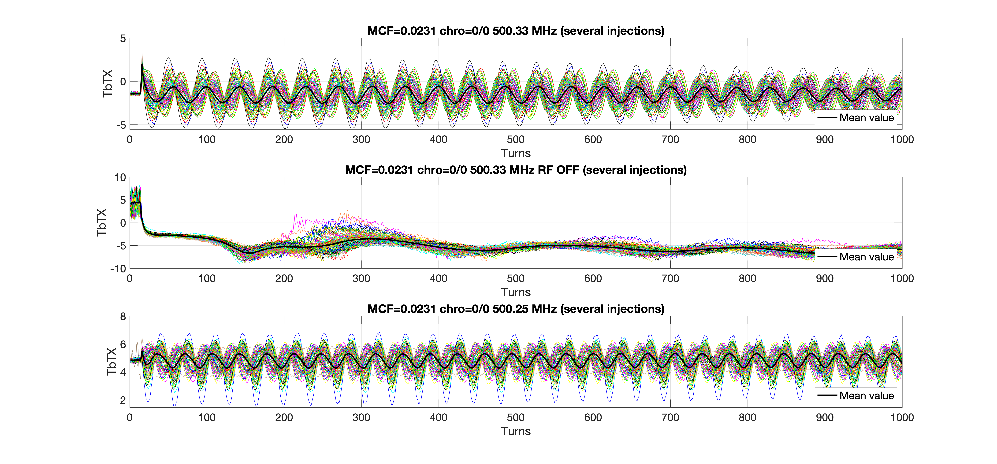
Optics MCF 0.0231 : synchrotron oscillations

Slide 9
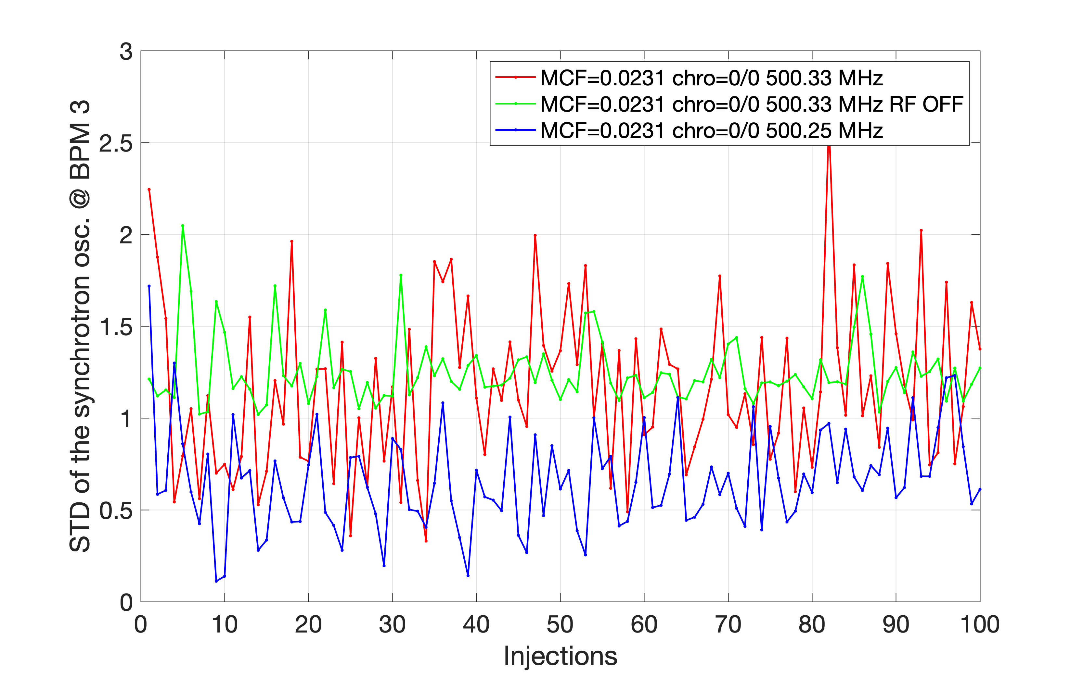
Optics MCF 0.0231

Slide 10
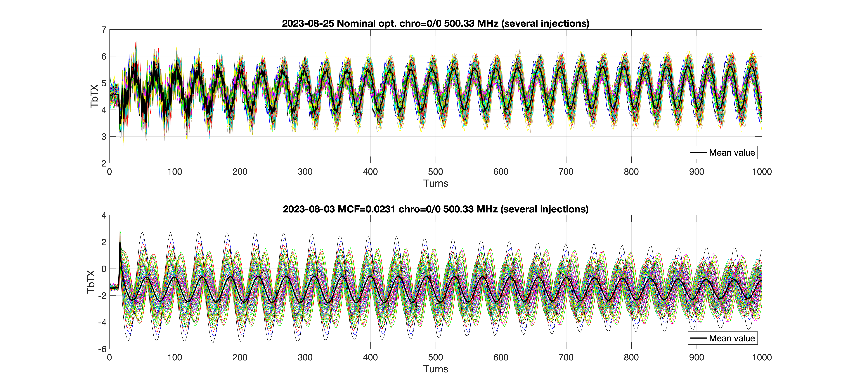
Phase jitter ?

Slide 11
Results for BPM no. 1, 500.25 MHz 03/08/2023
Amplitude deviation = 39.36%
Frequency deviation = 0.13%
Phase deviation = 91.6 degrees
Average position deviation = 0.27%

Slide 12
The Last data (500.33 MHz) 25/08/2023
Amplitude deviation = 33.7%
Frequency deviation = 0.08%
Phase deviation = 26.0 degrees
Average position deviation = 0.53%

