Slide 1
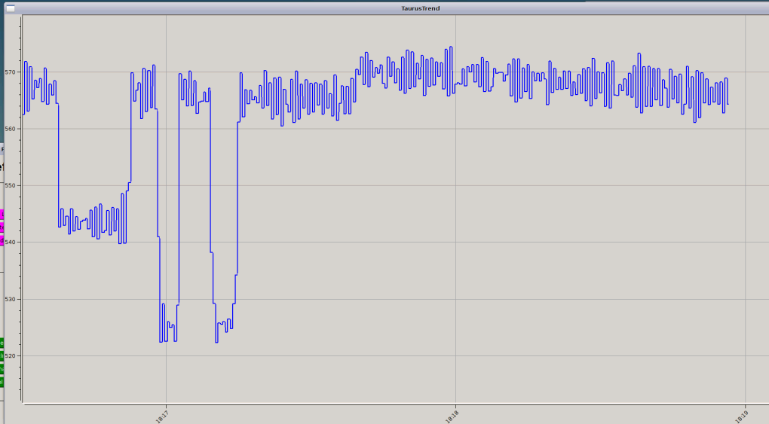
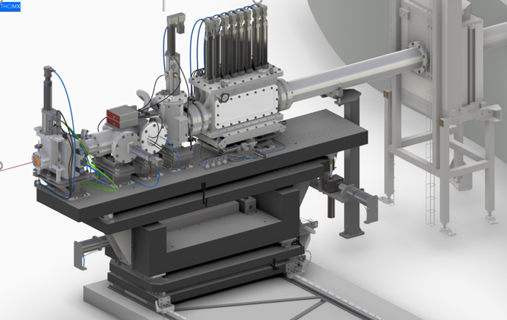
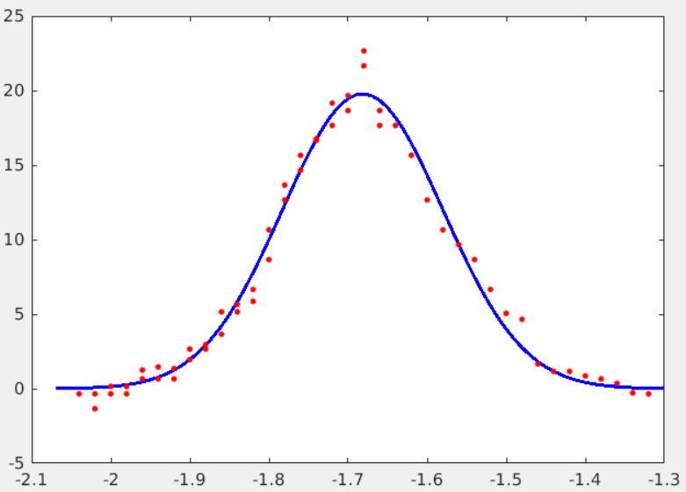
First detection of X-rays in bunker (23/06/2023)
Laser LOCKED + Electron
(~25-30 kW stored) Beam stored
PicoAmps signal vs time
Xray
signal
picoAmps intensity (pA)
X-rays
Electron shutter
CLOSED
Xray detector
(fluo screen + pdiode)
Laser
diffusion
bkg
Laser
DELOCKED
time (few minutes)
Measurement of σ_{e-} at IP
X-ray flux measurement in bunker
Measured Flux = 5.8 10⁶ ph/s (bunker photodiode)
Expected ~ 4-10 10⁶ ph/s (uncertainty storage e-)
Near futur:
with 100 kW laser CFP + synchronisation e-/laser
→ Expected Flux ~ 10¹⁰ - 10¹¹ ph/s
picoAmps intensity (pA)
σ ~ 100 µm
FPC table vertical position (mm)
➔ σ_{e-} ~ 80 µm
σ_{laser} = 60 µm (measured before)

Slide 2
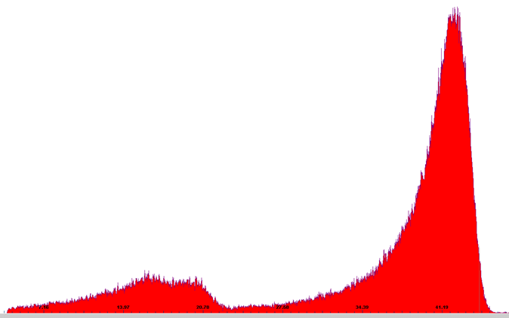
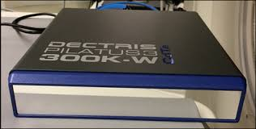
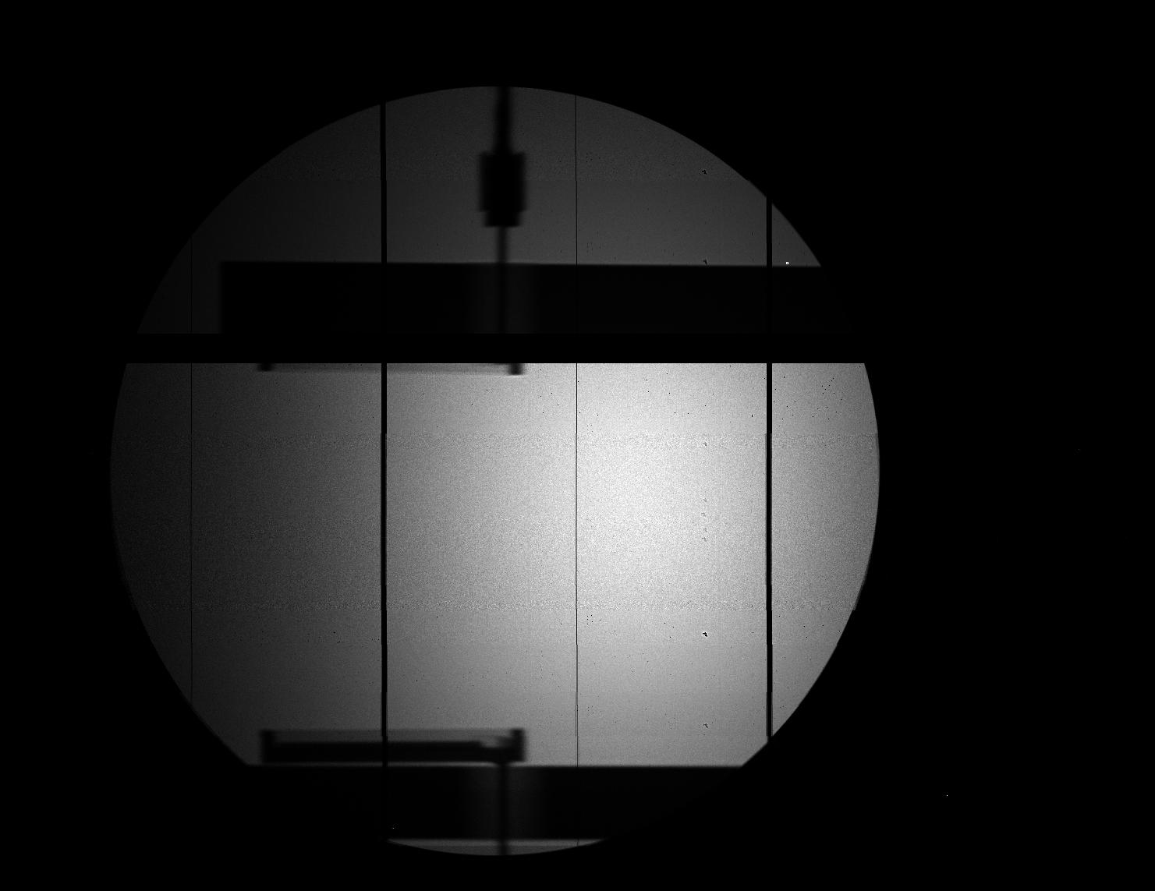
First spectra in X-hutch
First X beam image in X-hutch (26/07/2023)
Pixel Camera CdTe
Spectro CdTe
energy (keV)
Diffusion of the X-ray inside the pipe

