Slide 1
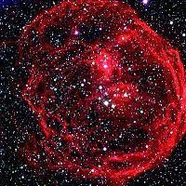
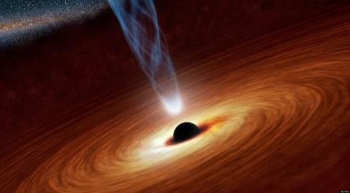

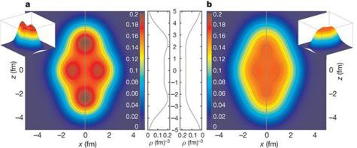
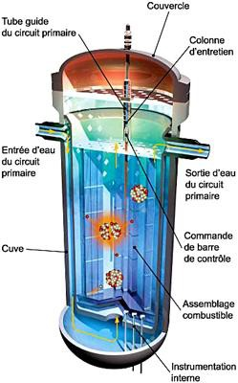
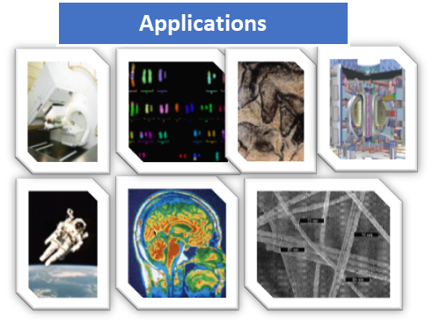
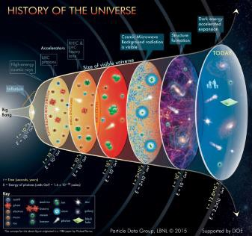
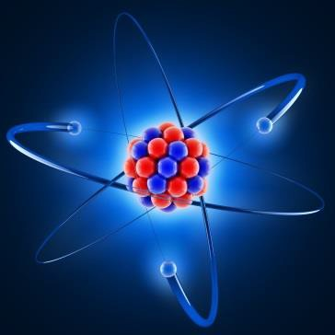
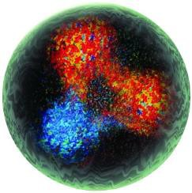
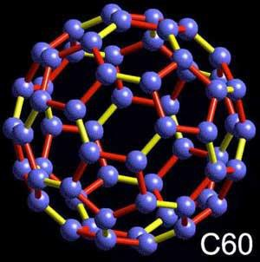
IPN half a century of Scientific Highlights
At the forefront of the subatomic physics research
IPN-Orsay has been shaping the vision in Nuclear Physics
and sharing a future in its applications
To infinitely big…
Astro-Particle and Cosmology
Nuclear Structure and Dynamics
Applications
Hadrons and Hadronic matter
Material and surface science
From infinitely small…
Notes:
Invitation to the journey through nearly half a century illustrating the scientific advances made by the ipn teams. impossible to be complete since all this period is so rich and so many new branches have grown. I would not approach without exception the more recent period of 10-15 years . Moreover for a good distribution of the spots,The following presentation of S.Leoni will develop themes that I will only touch.
Here we can start

Slide 2
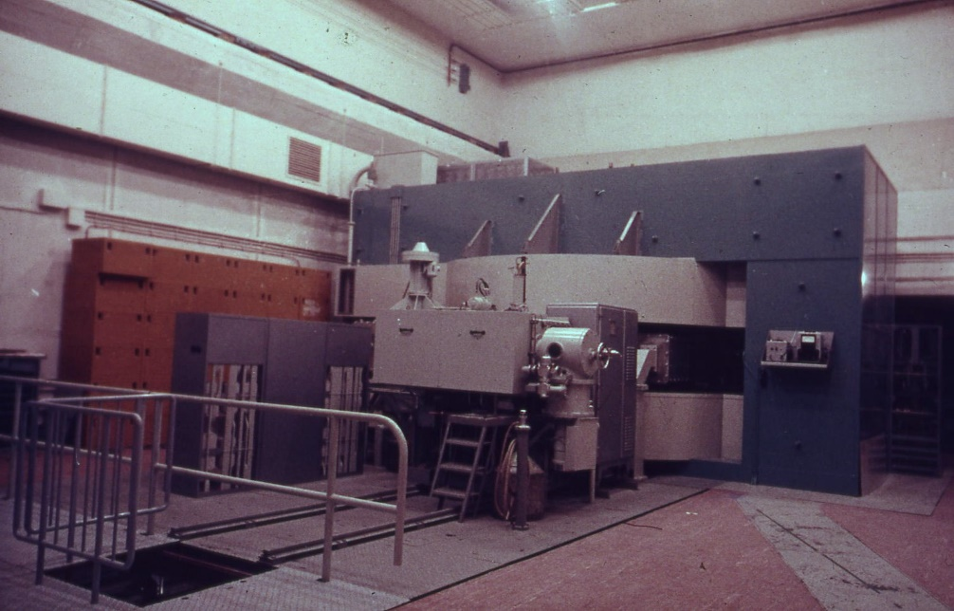
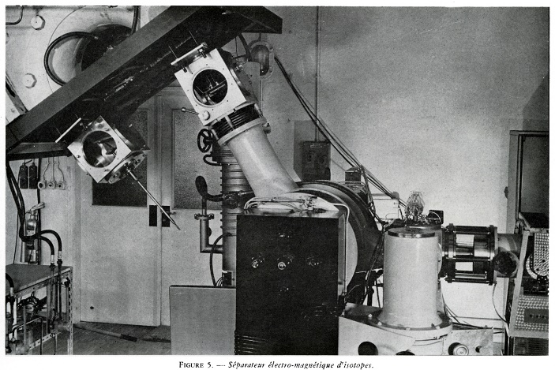
Pre-History : The early days - Synchrocyclotron 160 MeV p
1960-1970: A quick start of scientific and technical developments
1957 F. Joliot-Curie succeeds Irene and with the teams of the “Institut du radium “and the “Collège de France” obtains the first beam of the SC at Orsay in June 58.
1959: ISOL before ISOL T1/2 Isotopes du Hg :
G. Albouy, R.Bernas, M.Gusakow, N.Poffe et J.Teillac
C.R Acad.sci.249 (1959) 407
1965: a new technique, online mass spectrometry, is set up at SC Orsay (Isocele1) to study new radioactive isotopes far from stability, with a very short lifetime, prefiguring the ISOLDE type facilities at CERN.
Notes:
Pre history as Joel told you with the installation of big accelerators ,a révolution in that time .everything have to be done design , construction , instruments with an amazing quick start as this first paper called isol before isol in new technique on line mass spectrometry (isocel1)

Slide 3

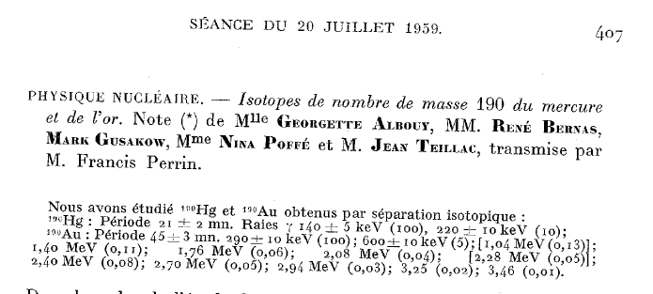
ISOL before ISOL at IPNO: heroic dawn
1959
From D. Verney “ISOL legacy”
Gold targets bombarded with 155 MeV protons from the Orsay synchro-cyclotron and (spallation reactions) → Hg isotopes
Half-life and γ-ray measurements following double magnetic separation
Notes:
Frrom David Verney , this first Irr of gold target with SC Protons beam , lifetime ( mn) and gamma decays of Hg and Gold isotopes

Slide 4
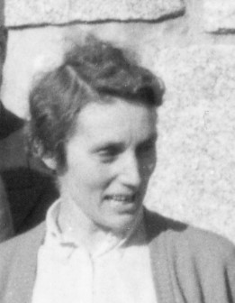
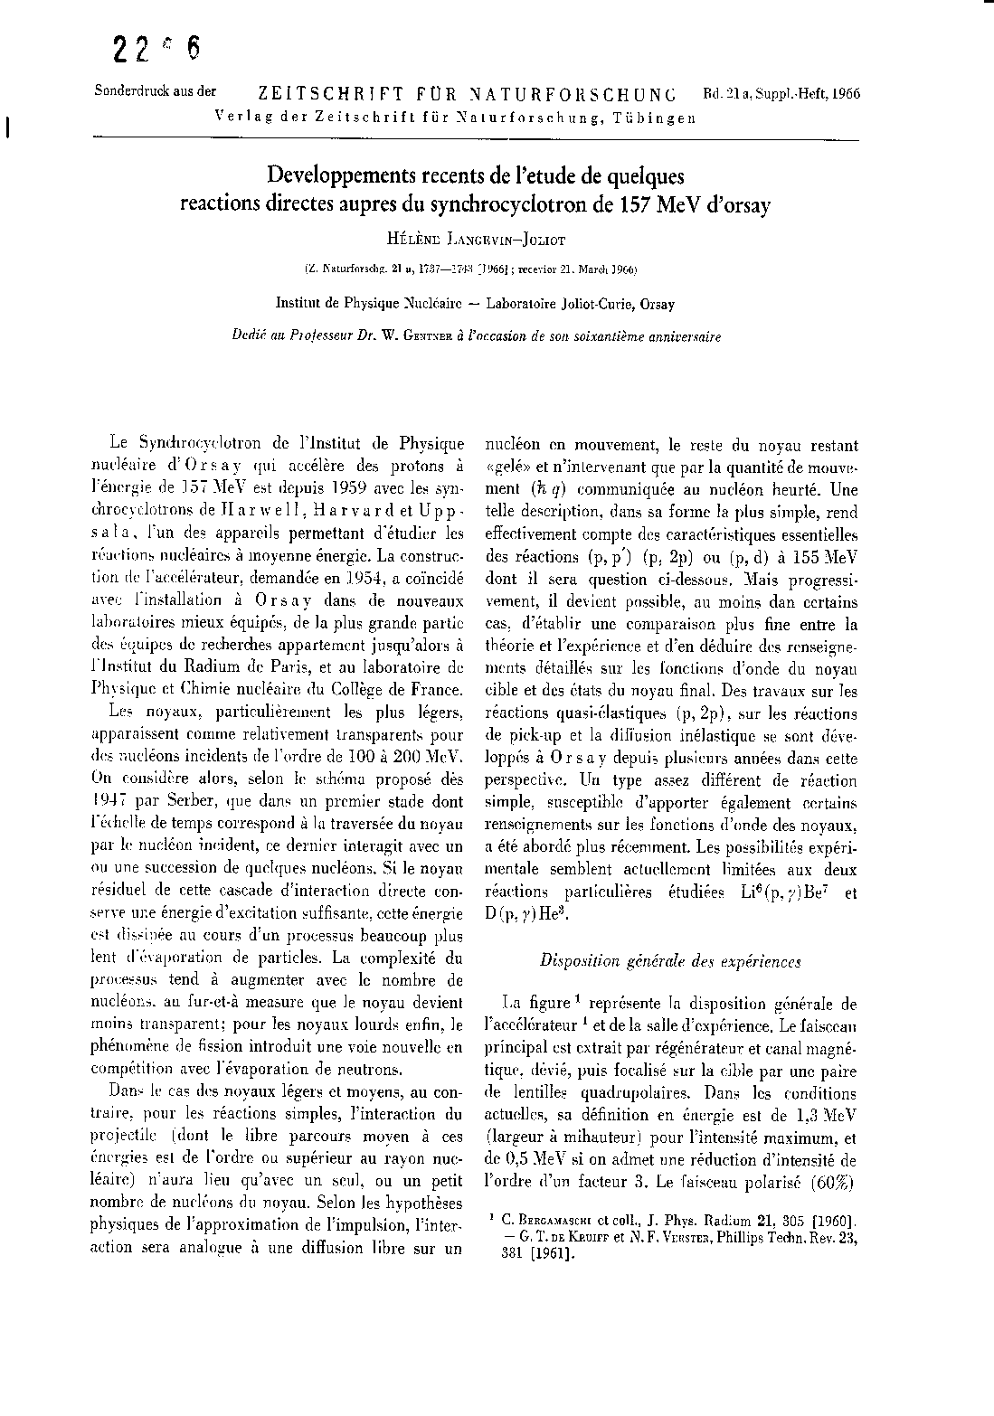
Pre-Modern Era for reactions Orsay SC 157 MeV p, 82 MeV d
DISTORTED-WAVE ANALYSIS OF
⁴⁰Ca (d, 3He) REACTIONS AT Ed = 82 MeV
H. DOUBRE, D. ROYER, M.ARDITI, L. BIMBOT, N. FRASCARIA J. P. GARRON and M. RIOU
Institut de Physique Nucleaire, B.P. No. I-(91) Orsay, France
Received 9 May 1969
Synchrocyclotron - Physics Program 1960-1970
*Internal beam, Gamma Spectroscopy (N.Perrin, J.Teillac)
Spallation reactions, fission, fission-evaporation (Boussieres, Lefort, Stephan)
*External beam. radiative proton capture (Hélène Langevin-Joliot and colleagues)
Elastic and inelastic scattering first levels of light nuclei Li ,C (team of Nadine Marty)
Transfer reactions (pick-up) of one or two neutrons (team of Pierre Radvanyi),
(p,2p) reactions (teams of Michel Riou and the Japanese team of Toshiko Yuasha).
Official birth ‘’Institut de Physique Nucléaire” January 1966
12C(p,2p)157 MeV 1961
Notes:
A look at the first years of reactions studies orsay SC a paper by HLJ in 1966 and p,2p and proton pich up reactions established the sp excitations and shell model in ligth nuclei and Ca . Just a list of starting tems and reactions topics in this first decade Name IPN 1966 -A word about Mlle Yuasa ()

Slide 5
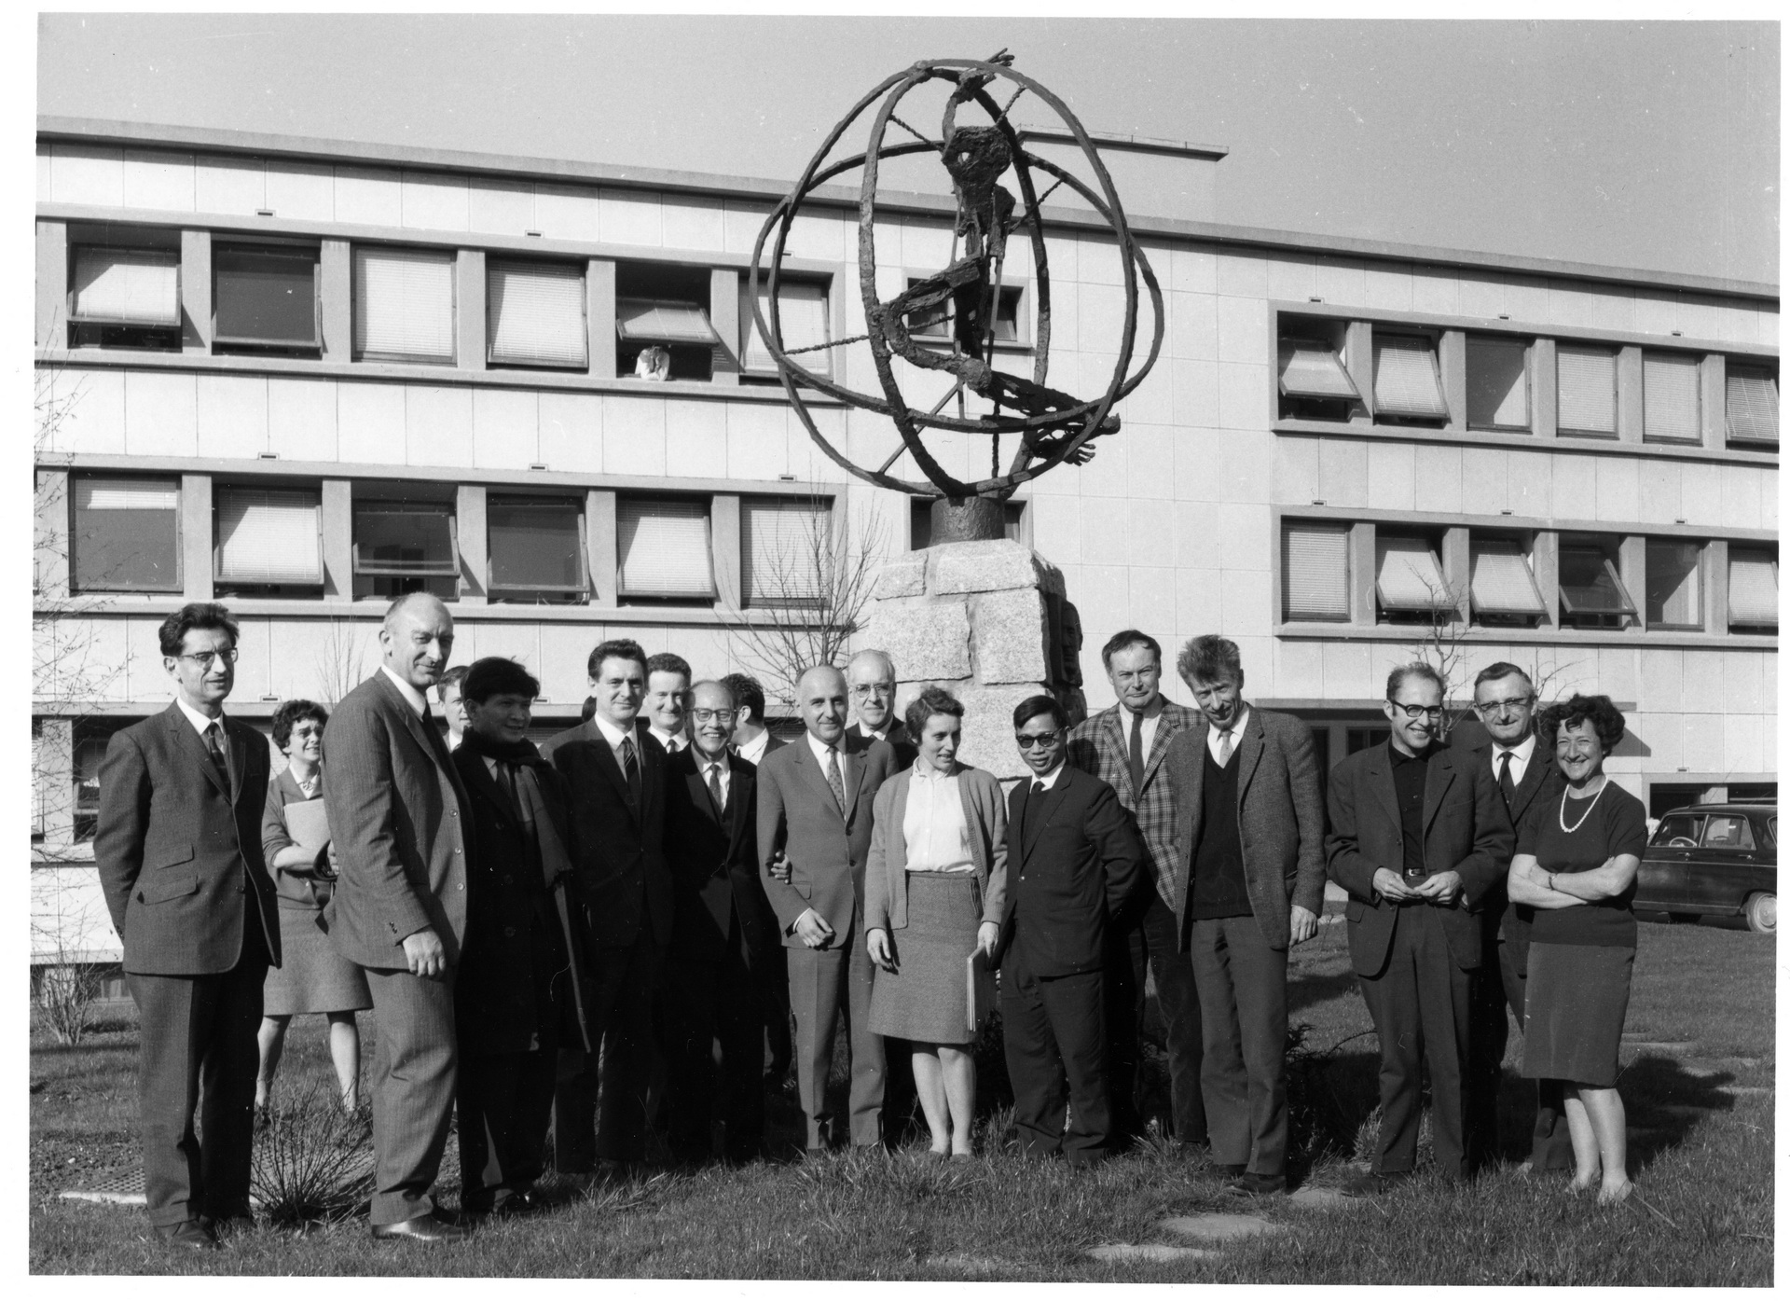
IPN Main founding members
Notes:
A photo of that decade Main founding members of IPN orsay ( Researchers first director , HL,NM,ML, MJ, VM ,RB ,RN,etc;;

Slide 6
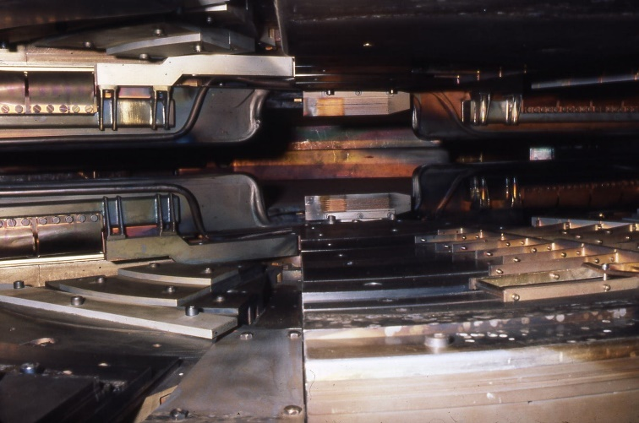
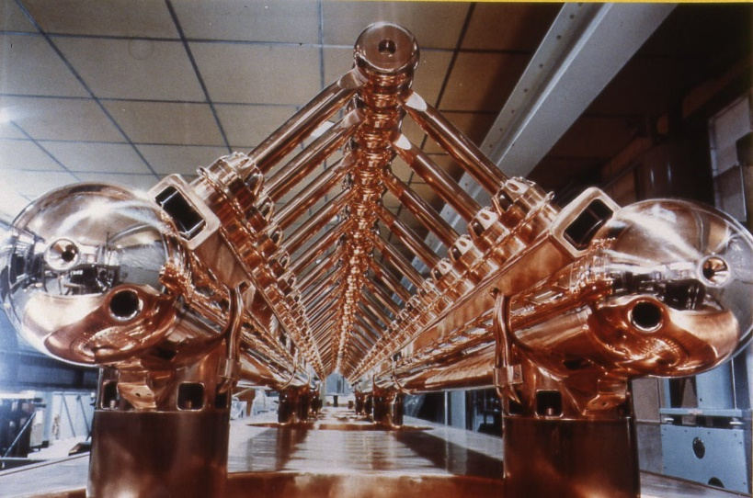
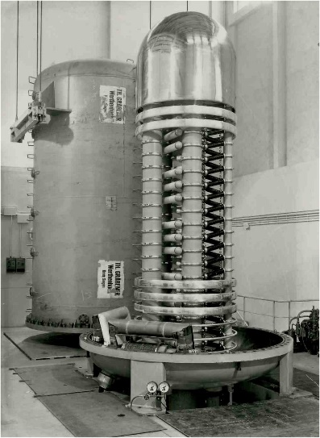
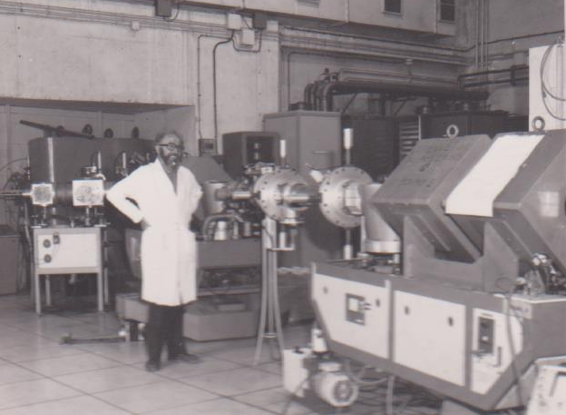
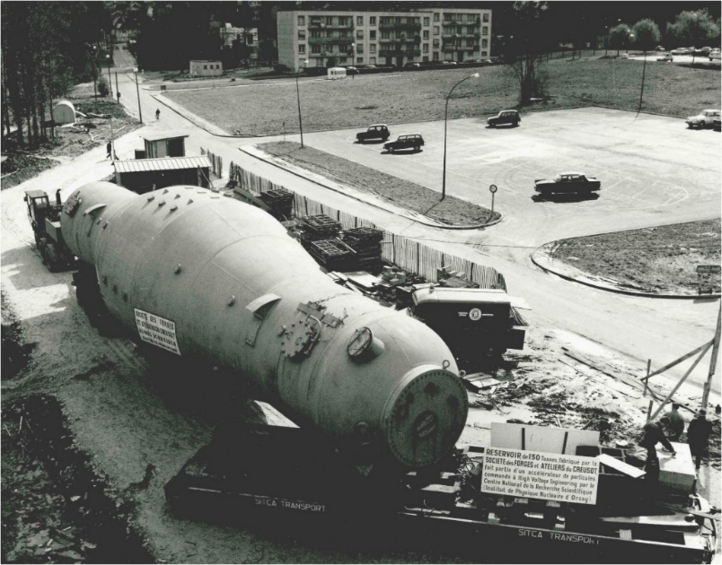
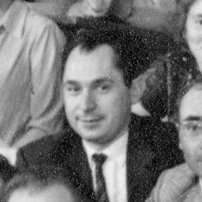
IPN Half a century of Scientific Highligths
1965-1985
The IPN «National Laboratory» of nuclear physics, with four accelerators.
Synchro p 156 MeV , reactions and «few body» - The revolution of heavy ions and the CEV-ALICE.
The Golden Age of spectroscopy, the 4 MeV and the Tandem d'Orsay, the Isocele 2 separator
CEV 1965
LINAC ALICE 1969
4 MeV 1962
Van de Graff MP 10 MV
1970
Marc Lefort
The founding father of Heavy Ion physics
Michel Langevin
Notes:
IPNO gradually acquires 4 accelerators that will cover all ions from proton to Kr and eV to almost GeV Construction of the CEV and then world first by the IPNO coupling Linear IL + Cyclo ALICE Kr 82 to 7 MeV/ n =0.58 GeV (Basile and Bieth) , ALICE first access of heavy ions above the Coulomb barrier for M> 40 with Berkeley LBL
Note also the van de graaff from 60KeV to 4MeV (tower) then the tandem emperor 10 MV in 1970 , and the physics of low energy and high resolution reactions (These of 3rd cycle 1970)
I

Slide 7
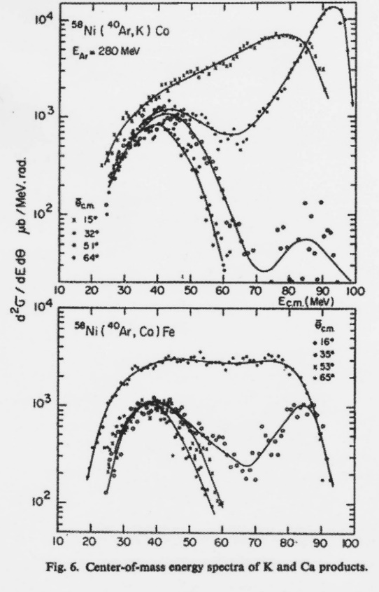
CEV – ALICE- a New era: Heavy ions Physics
The quest for Super Heavy Elements
Y. Oganessian, M. Lefort, M. Riou et al IPNO 1971
The discoveries are not where we expect them!
Collisions «deep-inelastic» and Viscosity of the nuclear fluid
About 10 years later Collaboration IPNO-Dubna
Radiochemistry with few atoms Identification of SHE Z=104-109
World premiere Kr beam of CEV-ALICE at 8 MeV/A
⁸²Kr+²³²Th—³¹⁰ X (Z=126) + 4n
Expected fusion cross section 1971 0,5mb!
Measured at Dubna and GSI 2000-2010 10⁻⁸ weaker
Gatty, Guerreau, Galin, Lefort , Tarrago 1975
Radiochimica Acta 37, 113 (1984)
SHE Z=104-109 IPNO-JINR Dubna
Yu. Oganessian, M. Hussonois et al
Decades later ECR ION SOURCE, Cyc (U400Dubna ,K160 LBL ,Linac+Sync@GSI , SS-SCyc Riken )were the right tools to hunt for SHE in cold and hot fission with cross-sections of 50pb down to 1pb
Notes:
The experiment that triggered everything SHE with ALICE (what is the mass and Z limit of the elements , led to the discovery of very inelastic reactions and initiated research on the nuclear matter «hot» and later «dense»
Finally to highlight the radiochemistry of Super-Lourds in Dubna by the radiochemists of Orsay; IJC lab continues in Dubna with the spectroscopy of very heavy and Super heavy nuclei thanks to much higher production by heavy ion accelerators of low energy and very high intensities (tens of Micro amp compared to the few tens of nAmp of ALICE )

Slide 8
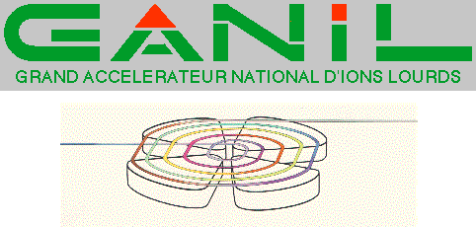
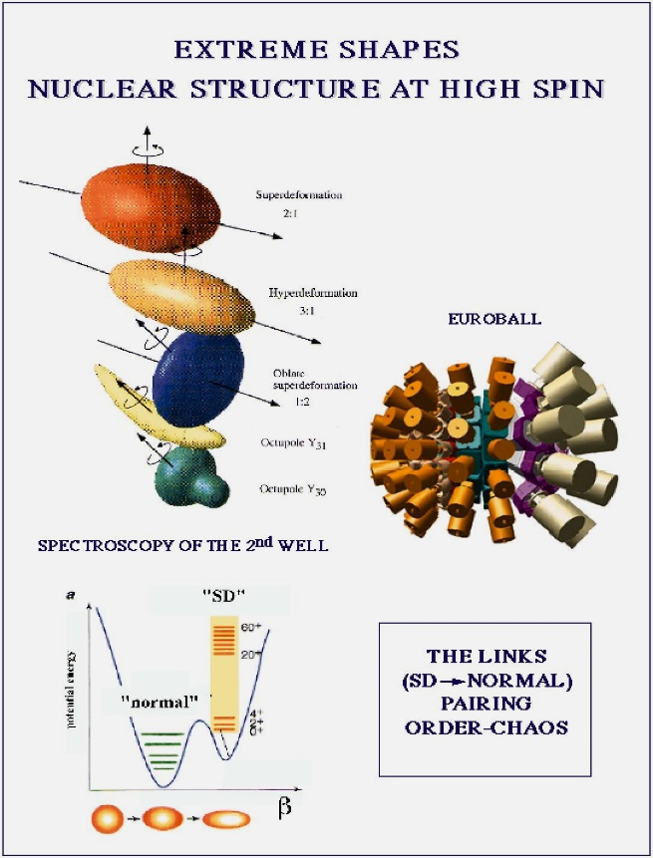
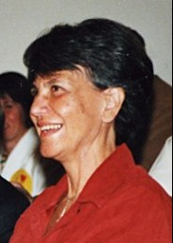
Many other branches of physics will start at CEV- ALICE facility and pursued at
Exotic nuclei start !
A (HI, xn ) reactions
But also Gamma Spectroscopy and High-spin Physics
HS,CB,JML@ CEV ALICE
MP Tandem, Strasbourg …
Giant Resonances and Multiphonons Saga
CEV-ALICE 1980
N.Frascaria et al .
Notes:
Many other branches of physics will start at CEV- ALICE facility and pursued at GANIL , MP Van de Graaff and elsewhere exotic masses , GR , gamma arrays and high spin physics due to large angular momenta that HI bring in the reaction

Slide 9
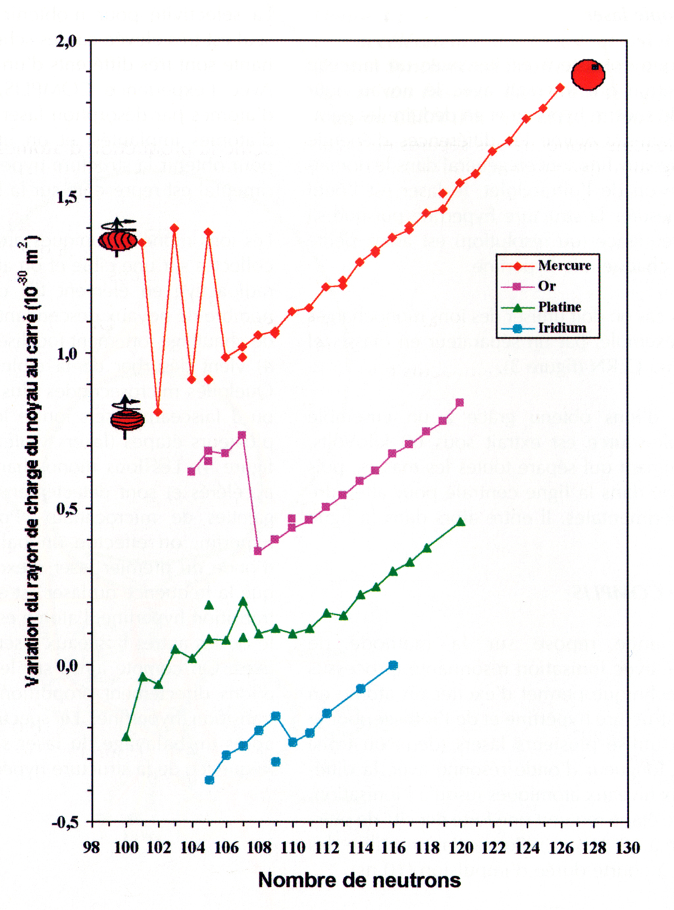
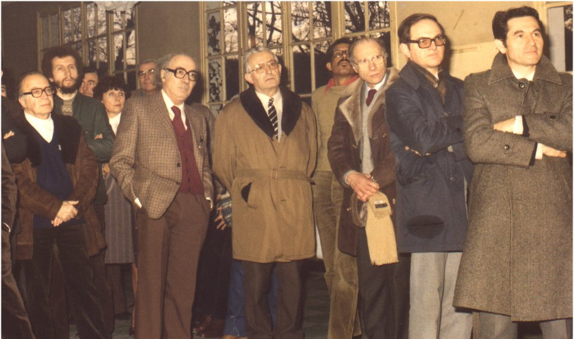
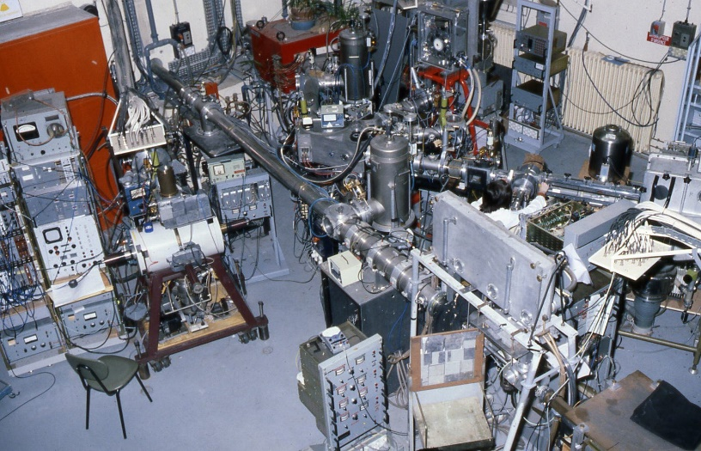
Synchrocyclotron upgrade SC K220 and ISOL from Orsay to CERN
1975-1978: Synchro upgrade to « Isochronous » mode
Project Leader Helene Langevin-Joliot
CSNSM-IPNO Innovation and discoveries
Masses , T1/2, Decays
β, γ , β-p,..New radioactives modes far from stability
Complis CERN
1998-2002
1975: Installation of the Isolde mass spectrometer at CERN
neutron-rich sodium isotope mass measurements ( ms)
N=20 has lost its magic character ( CSNSM ) (R.Klapish , C.Thibault et al).
1979 and 1984
On Line spectroscopy and deformation at N=20 Coll. IPNO
(C. Détraz, D. Guillemaud ,M. Langevin et al )
Towards the “exotic” in Orsay and Ganil: SPIRAL1 ,PARNNE, ALTO, etc.
The “IPN Isocèle” team develops at Isolde (CERN) Laser technologies for hyperfine interaction with the COMPLIS installation (1992)
(R. Foucher, J. Letessier-Sauvage, B.Roussiere, F.Leblanc, F. Ibrahim , J.Obert, Decourtieux)
Shape transition in Hg,Pt,Au,Ir isotopes
ISOCELE 2 1986
Notes:
SC upgrade great success CNSnM and IPNO ISOLDE CERN N=20 beautiful results at CERN mean charge radis in Mass region Pt,AU Hg Ir shape transitions

Slide 10
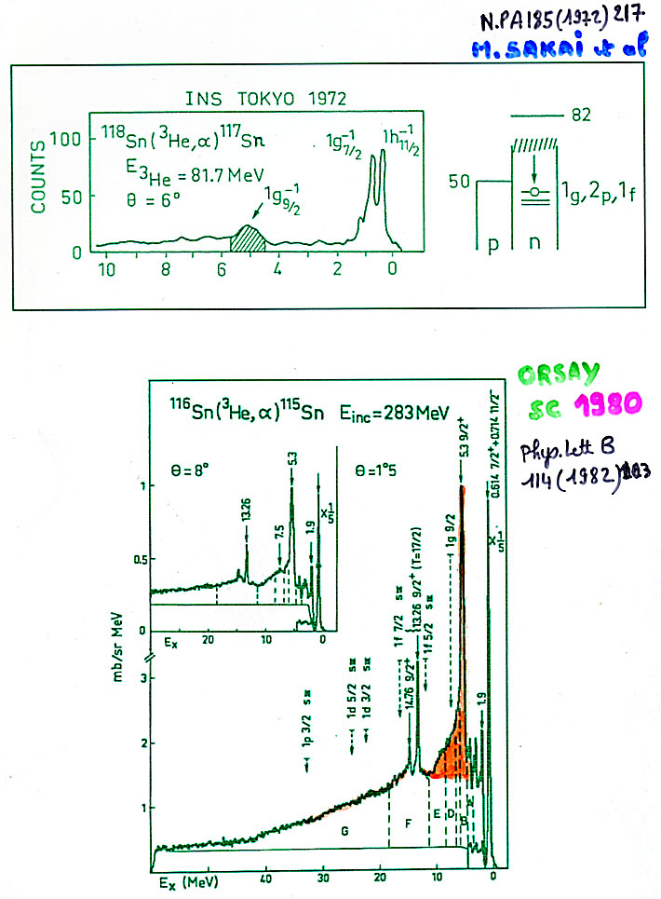
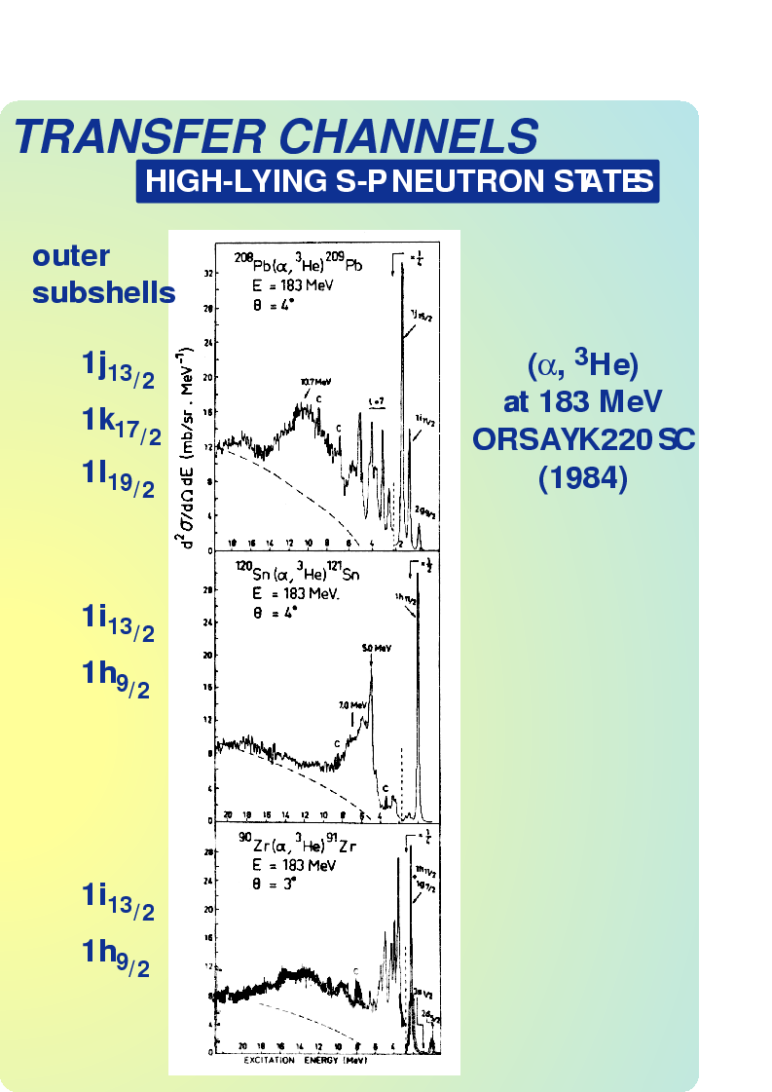
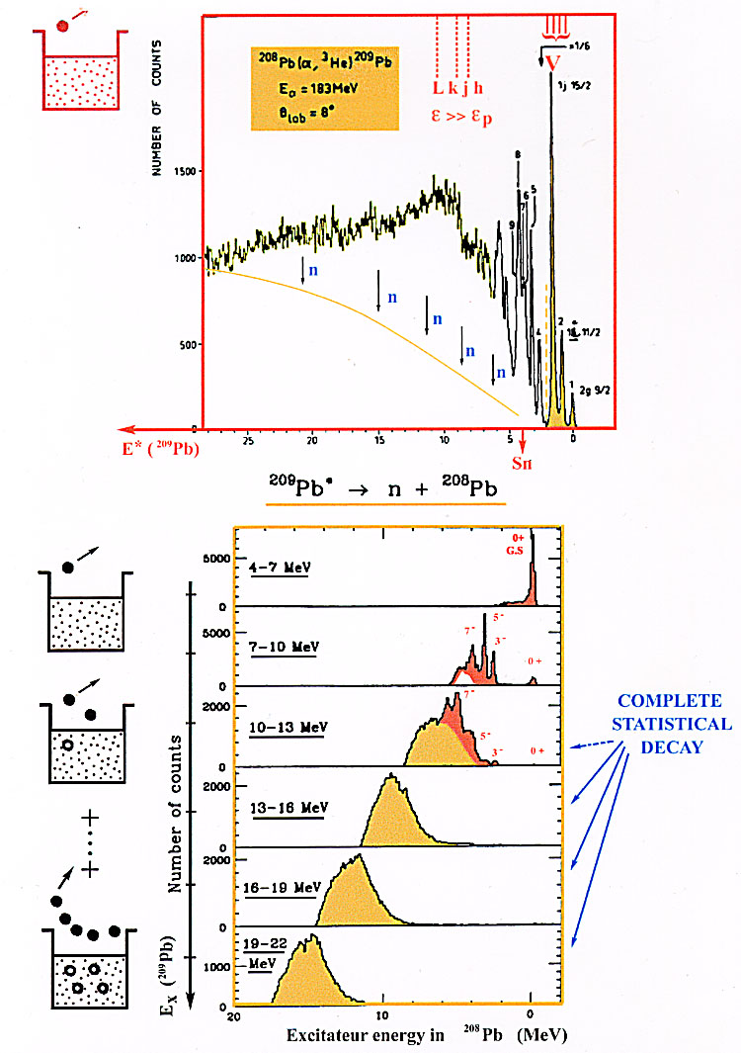
Nuclear Structure: Beyond the mean field
Damping single of particle motion: deep hole and high-lying s-p states
Selectivity for large L transfer (5-8)
Later 1991 with EDEN neutron
Multi detectors
_{Direct observation of}
_{Spin-orbit partners}
S Gales, Ch. Stoyanov and A.I. Vdovin,
Phys. Rep. 166, 127 (1988).
H. Langevin et al. , Phys.Lett. B114, 323 (1982).
Notes:
Deeply bound states and high lying resonances. Limit of the shell model . the SP states has a hole/particle far from the Fermi Sea that are very damped until disappear in the continuous

Slide 11
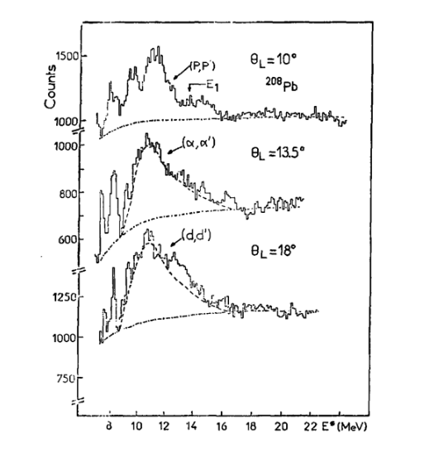
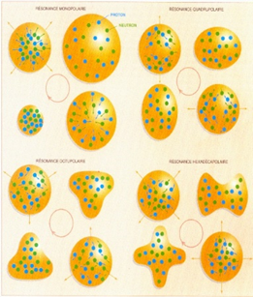
Nuclear Structure: Beyond the mean field
Collective excitations
The compressibility of nuclear matter. The breathing mode! L=0
N.Marty et al -SC K220 ( 1976)
From Giant resonances to Multiphonons
N. Frascaria , Y. Blumenfeld , J.A .Scarpaci et al .
GANIL –SPEG (1991)
S. Gales IPN Orsay EPS "Historic site" Half a century of scientific highlights
Notes:
Interplay between state has sp particle and liquid drop model .Physics at SC the nucleus breathes Mrs marty , GQR+GQR giant resonances, multi phonon and harmonic collectivity in nuclei

Slide 12
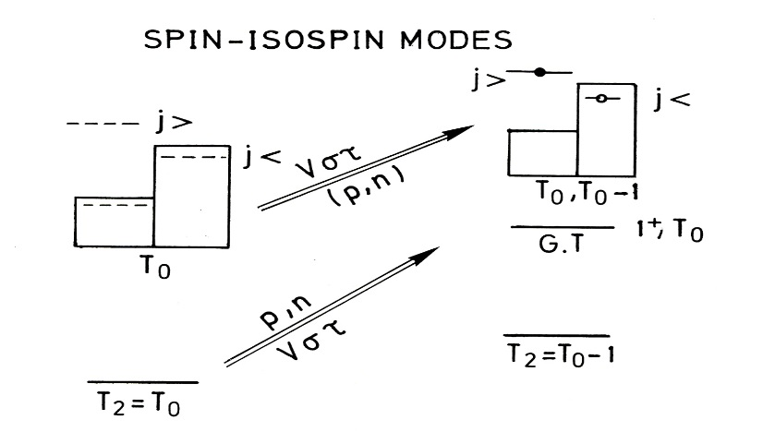
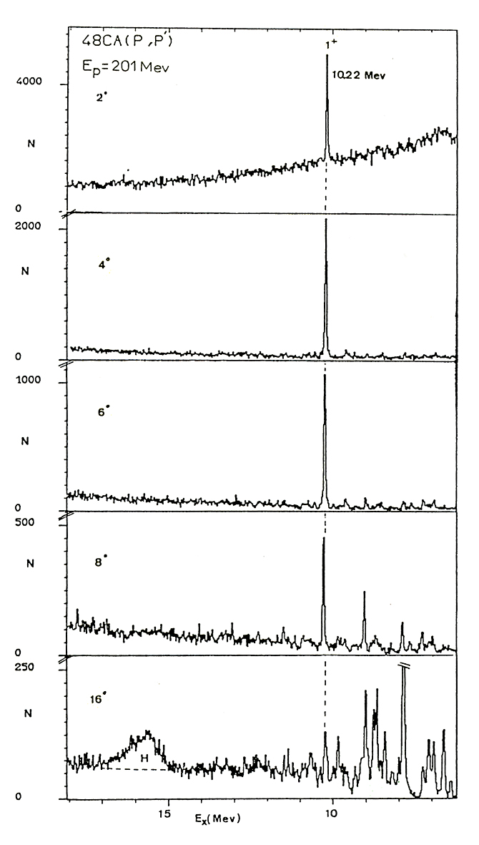
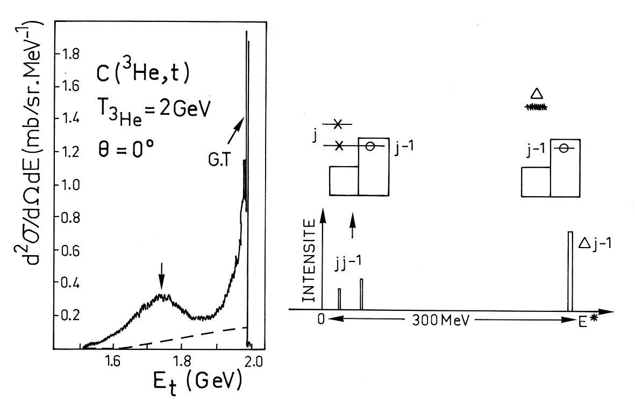
Spin-Isospin Excitations in Nuclei
Or how to selectively excite σ.τ components of N-N interaction
Synchro (PRL Crawley,Djalali 1981)
L=0, ΔS=1, ΔT=1
2°
4°
SATURNE2: M. Roy-Stephan PRL 50, 1745 1983
Nuclei
Nucleon
⁴⁸Ca (p, p’)
201MeV 10°
10 °
Notes:
Spin-Isospin Excitations in Nuclei and nucleon at SaturneII
Or how to selectively excite σπιν ισοσπιν components of N-N interaction

Slide 13
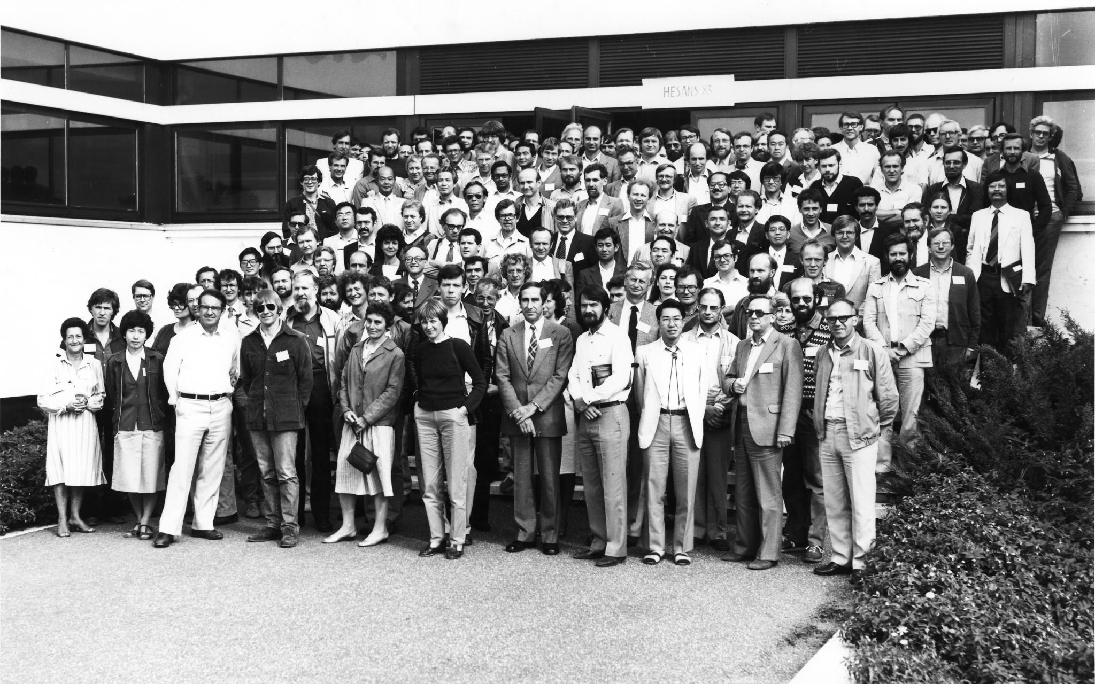
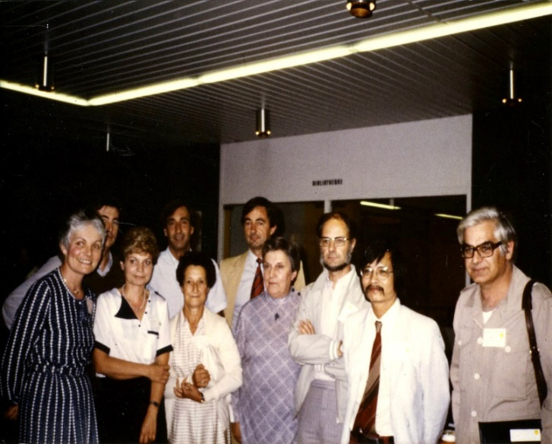
IPNO hosts the International Conférence on:
« Highly Excited States And Nuclear Structure » at ORSAY 1983
HESANS 83 Chairperson N.Marty
The Organizers
Notes:
A large international success HESANS 83 on Orsay physics amphi de maths Paris SUD XI with particpation from 4 continents . Every body is there . Will be the root of topical conferecnes on GR for 20 y and will rereturn to FR in 2001 as COMEX 1 ( La Sorbone Paris)

Slide 14
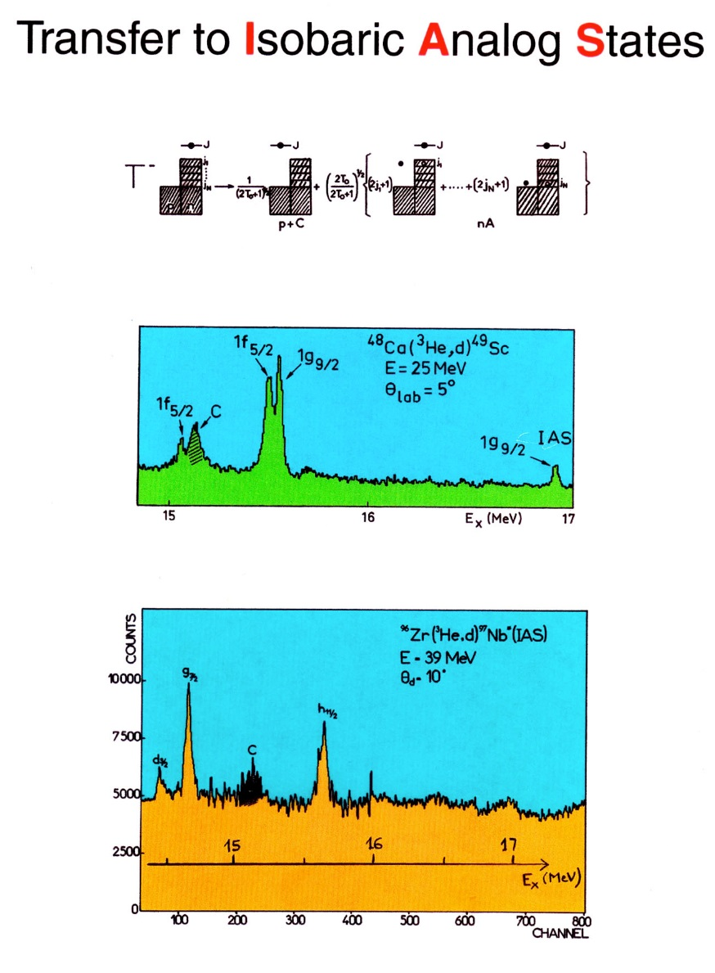
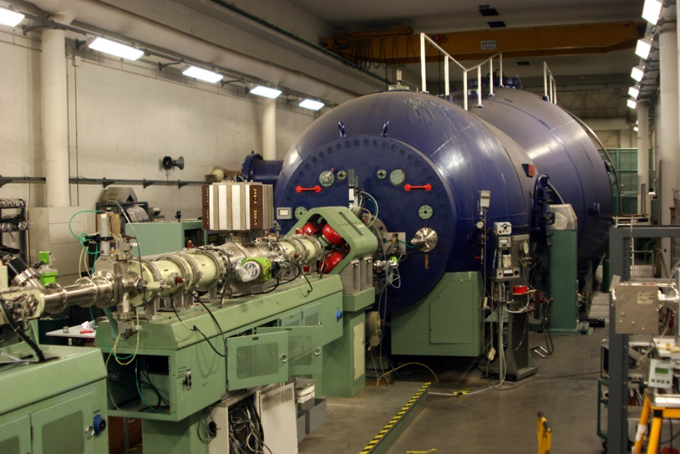
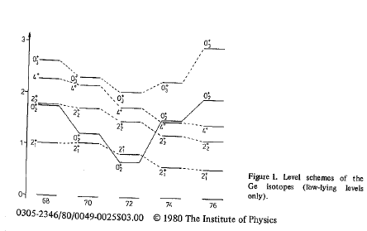
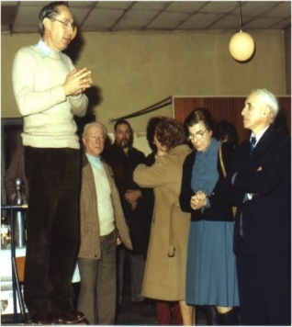
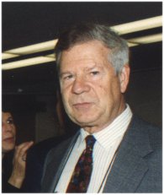
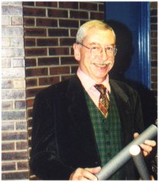
Orsay MP 15 MV – Few selected Highlights (1)
1971-….. MP Orsay @IJCLab –Bat 109
Accélérateur Tandem Van de Graaff 15MV
Still in operation today !!
Shape transitions in Ge and Pt isotopes
IBA Theoritical interpretation
M.Vergnes et al
Notes:
The best 15 MV Van de Graaff in the world – the golden age of resolution (isospin symmetry ) shape transitions at high resolution and IBM theoretical interpretation
some unique expts (unique combination of techniques on the same site with radioactive beams and targets, exotic 14C beam, Hf 16y transfer cluster, radiochemistry and radioactivity

Slide 15

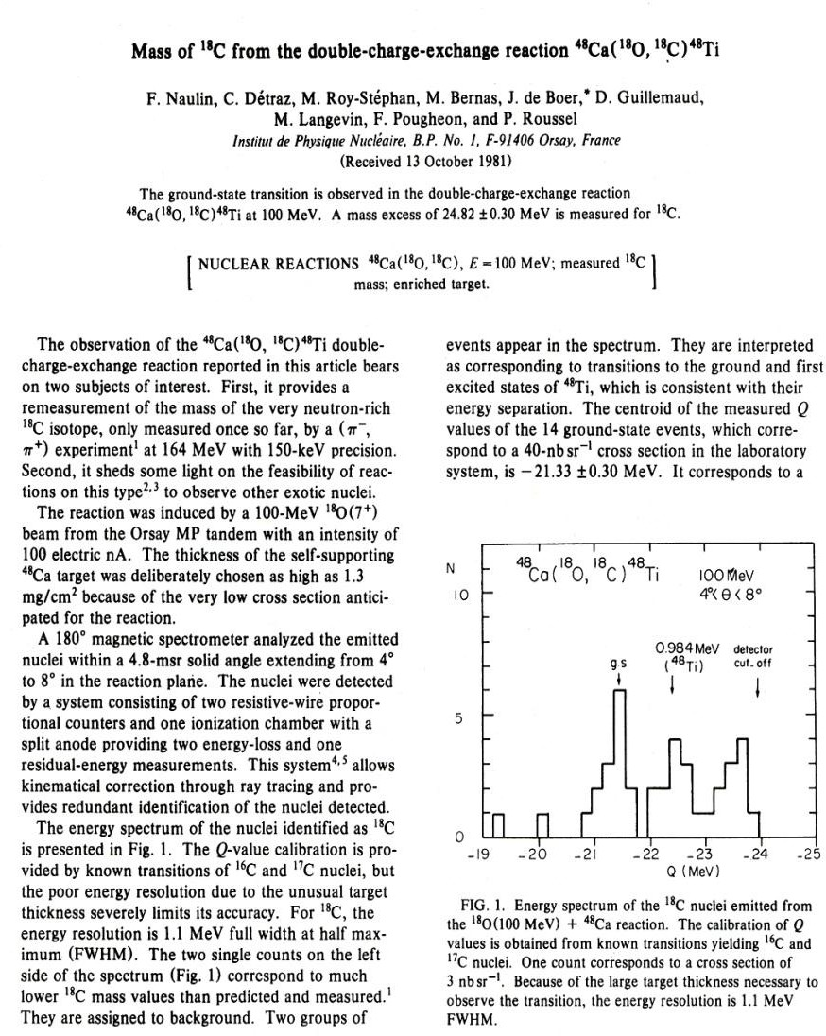
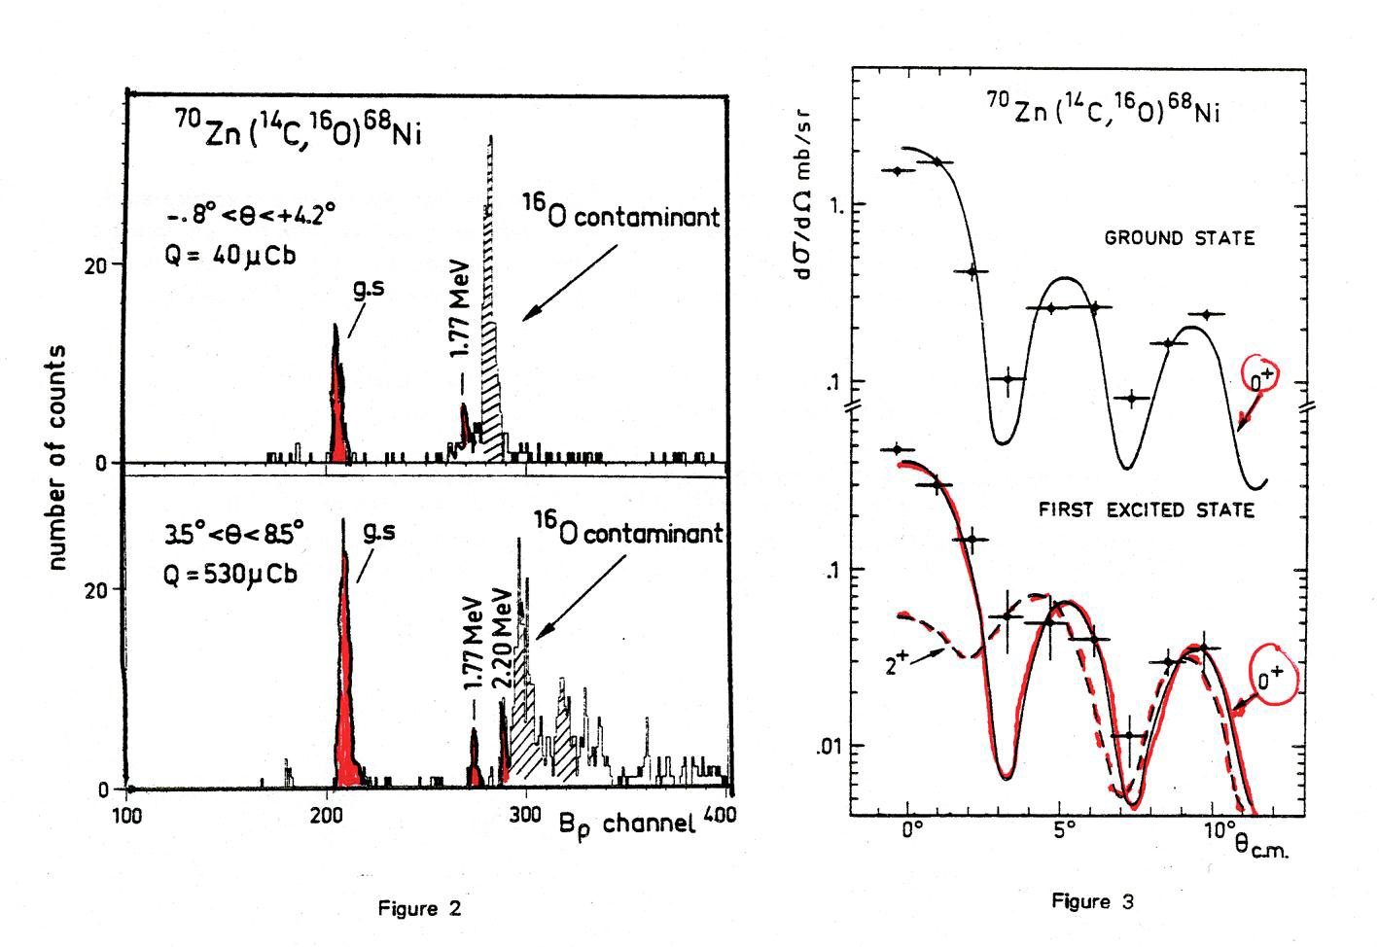

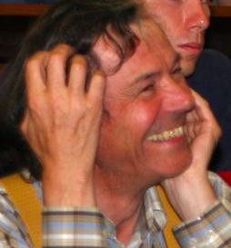
Orsay MP 15 MV – Few selected Highlights (2)
Bacchus Spectrometer and ¹⁴C beam
The start of « exotic » era at the Orsay MP Tandem
ML,CD,PR,FP,FN,DGM
Many mass measurements ¹⁸C, ¹⁹N, ²¹O…and first spectroscopy of ⁶⁸Ni by charge exchange reactions
Notes:
Bacchus Spectrometer and ¹⁴C beam
The start of « exotic » era at the Orsay ML,CD,PR,FP,FN,DGM
The first excited state of Ni68 neutron rich is O+

Slide 16
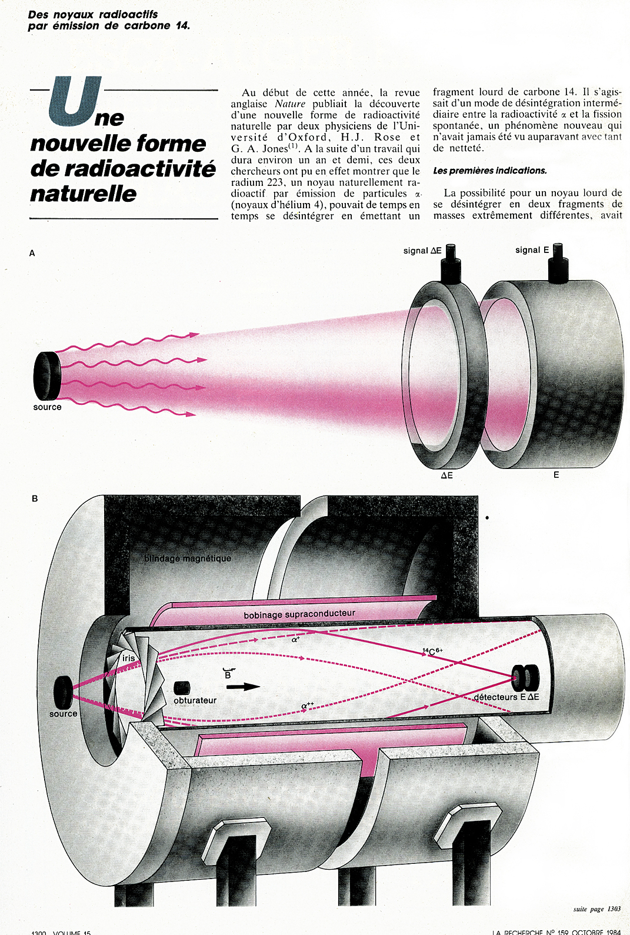
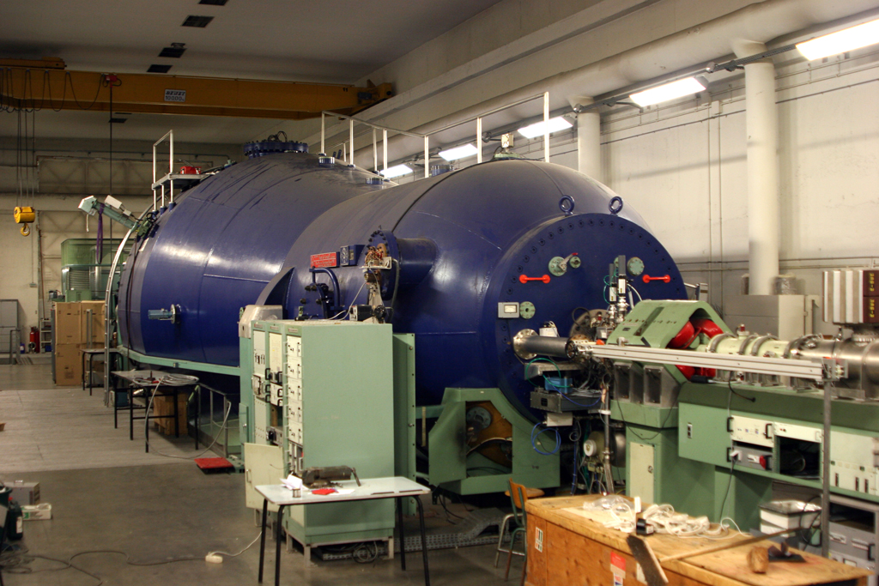
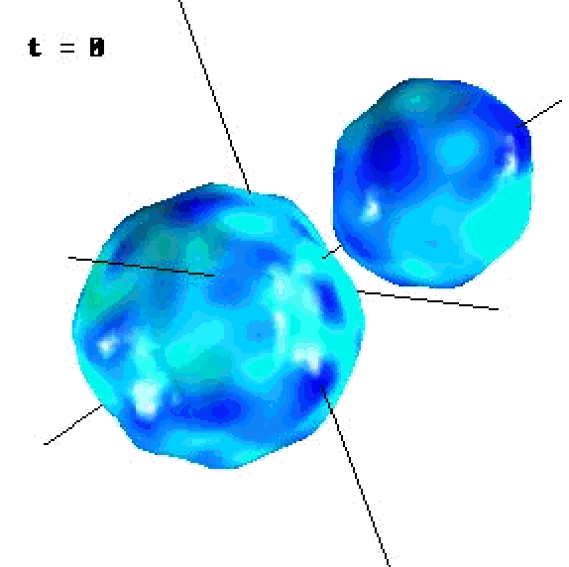


Orsay MP 15 MV – Few selected Highlights (3)
Superb confirmation of ¹⁴C ground state radioactivity of ²²³Ra
Discovery made by Rose et Jones after 500 days of data taking by Si telescope!!
World premiere at Orsay MP Tandem
Acceleration of C60 –Clusters (fullerenes)
Tens of MeV - ion-surface interaction
S. Della Negra et al
Vergnes,Hourani,Hussonnois,SG…PRL 53(1984).
ORION 1991
Tandem 14C beam
calibration of our
Focal plane telescope
Notes:
Superb confirmation of ¹⁴C ground state radioactivity of ²²³Ra Discovery made by Rose et Jones after 500 days of data taking by Si telescope!! How to confirm that in 5 days (soleno radiochemistry )
World premiere at Orsay MP Tandem
Acceleration of C60 –Clusters (fullerenes)
Tens of MeV - ion-surface interaction
S. Della Negra et al

Slide 17






















A new era for γ spectroscopy: « Crystal Ge balls »
(1990-2000 Extreme nuclear shapes)
Golden age of superdeformation (L~70h)
Eurogam I et II @ Daresbury,Strabourg Tandem
Euroball @Legnaro/Strasbourg Tandem
AGATA the era of travelling large arrays of γ detectors
(Legnaro-GSI-GANIL)
IN2P3 (IPNO-CSNSM-IPHC-IPN Lyon - GANIL)
AGATA « Hubble » of
γ -Spectroscopy
AGATA@GANIL
The teams
Coll IN2P3/UK-Orsay-Strasbourg-Lyon-Bordeaux…
Digital electronics and Pulse Shape Analysis algorithms
Operation of Ge detectors → γ-ray tracking
See Silvia Leoni Talk
Decay channels of super deformed bands in 194Hg et 194Pb Thanks to combined studies with EUROGAM2 et GAMMASHERE.
Notes:
Another major discovery in nuclear spectrocopia of the last decades has been the evidence of super-deformation in medium and heavy nuclei (the nucleus takes a very elongated ellipsoid shape 2/1 ratio) by transfer of a very high angular momentum (70h ) by reaction fusion evapration between heavy ions of the beam and the target . This is characterized by a very high spin band in the so-formed core that disintegrates by emission of high multiplicity gammas M20-30 (see spectrum ). The teams of the IN2P3 d'Orsay de strasbourg lyon bordeaux et plus have built in a European collaboration The Eurogam detector in two phases then Euroball, high resolution ge balls, efficiency and high multiplicity that are at the origin of its discoveries; Actors A.Richard ,les coll , pilot directors or team leaders
This This physics continues with a new generation of Ge ball by the major European project AGATA , AGATA allows to reconstruct the angle and position of the photon a multi European traveler detector which was installed successively in Legnaro, GSI and GANIL . In addition, neutron and/or particle detectors are combined for more exclusive physics in order to achieve rare pls reaction pathways

Slide 18


1985-1995 A profound evolution of science and technology at IPNO
1985: CEV-ALICE is stopped and the physics of heavy ions flourishes at GANIL
1991: The Orsay SC is transferred with operators to the Institut Curie for proton therapy. a new page will be written.
The SC : what a great story from physics to the fight against cancer
in 33 years!!
Saturn II + Mimas are shut down in 1997 –Hadronic Physics towards Mainz(De) and Jlab in the USA
1991 SC becomes CPO
2011 New proton therapy hospital
The Radiochemistry group and a new physics group start an original and ambitious program on nuclear energy (nuclear data, storage of nuclear, waste, transmutation by accelerator and ADS cycle of the Th, etc.)
Very significant national impact (CNE Parliament, Loi Bataille 1991) R. Guillaumont, J.P Schapira, S.David, etc.)
N-TOF au CERN
RC-Matrix for nuclear waste
Thorium phosphate diphosphate (PDT)
1985-1995: A decade with the emergence of new accelerator and instrumentation technologies: (cryogeny and superconductivity) (SOLENO, CRYEBIS, AGOR)
2000: Creation of the Accelerator Division (A. Mueller, T. Junquera, SG)
Notes:
Closure ALICE , 1991 closure synchr0, closure 1997 Saturn II and Mimas
The decade of cold with the first supra solenoid for nuclear reactions whose role I have described tth in heavy cluster radioactivity (14C emission) , and the project of a new superconducting accelerator set of the IPNO to allow the physics of synchro and saturn and that of Alice to develop in Orsay turns into an international Franco-Dutch collaboration, birth of Agor.

Slide 19





AGOR-Accelerator Groningen Orsay 1986-1994
First supraconducting European Cyclotron-
From p to Pb beams
200 MeV protons
95MeV/n d , ⁴He, C
25 MeV/n Xe
10 MeV/n U
1986-1994
First beam out Orsay April 1994
Notes:
AGOR First supra European cyclotron, designed and built from A to Z by a group of phys and ing of the IPNO in the tradition of what had been realized 20 years earlier with ALICE.
Cryebis, Soleno and especially AGOR have been the basis of a real modern dept accelerator, an asset and strength of the IN2P3 and IJC lab until today
Later the first success will be followed by the realisations of SPIRAL1 ,TTF and the French contribution to the LHC ( A.Mueller, T.junquera and SG then Sebastien Bousson et al)

Slide 20


Physique – Biology 1980-2006
IPB team @IPNO
L. Valentin, Y.Charron, P. Laniece
This laboratory brought together biologists, physicists in the same interdisciplinary framework and around questions on the complexity of living things:
in vivo imaging of small animals or ambulatory clinical imaging
Modelling tumor processes and its applications to cancer diagnosis
Radiotherapy aimed at the development of radiotherapy systems/methods based on new approaches
2006 Birth of the IMNC
The unit leaves IPN Orsay
2020 Back to IJClab (Pole Physique Santé)
Brain probe « in vivo »
Small animal model
DNA Sequencer Prototype

Slide 21

















Half a century of Scientific Highligths
National Laboratories
1983
C à U 0,1-100 MeV/A
SATURNE II 1978 -1998
3 GeV p, pol +MIMAS 1988 - Ar, Kr > 1GeV/n
GANIL
CIRIL
(MoU, LEA, LIA, DG Recherche-UE, ESFRI) CERN, ECFA, DESY, NuPECC, IUPAP,JINR, RIKEN.
Initiatives and new projects worldwide
Within large international collaborations
Notes:
The Physics at national labs and IPN teams –accelerators , HI collisions and low energy diagram of phase of nuclear matter , exotic terra incognita

Slide 22




Heavy ion collisions (10-100)MeV/A ) at and Nuclear matter (EOS)
B.Borderie, M.F .Rivet et al in coll with GANIL teams
From Low-energy to the Fermi regime
Thermodynamics of Finite systems
Hot Nuclei &Vaporization
Multi fragmentation &
Liquid-Gas Phase transition
Hot GR-Clustering
see Silvia Leoni Talk
t=0 s
t=2*10⁻²² s
t=10⁻²² s
t=3*10⁻²² s
Xe+Sn
Correlations
between fragments
The workhorse of the INDRA
collaboration
INDRA Multi-detectors
Notes:
At the start almost all physicists in this domain has emigrated to GANIL , a small fraction stays in Orsay and where keys partners to do not say more in the development of the work horse Indra and theoretical interpretation more of the phyiscs by Silvia

Slide 23
















Far from stability « Terra Incognita »
Emergence of new phenomena challenging nuclear models
Super-Heavy Elements
New radioactive modes
291 stable Nuclei
exotic
How heavy elements are formed in the Universe
Neutron « Halo »
Clusters
New symmetries
New collectives excitations
N=28 magicity lost
Pairing correlations
Notes:
Here is now well established the field of research of the exploration of this «terra incognita» which is now well advanced, we arrive at the heart of the new continent and are born the new ways and discoveries

Slide 24




Projectile fragmentation at Intermediate energies@
The neutron drip line with LISE
M. Langevin et al, Phys. Lett. 150B (1985) 71
⁴⁰Ar(44MeV/A)
Magnetic + velocity filter + dE /Time of flight identification at
LISE Introduce to the world the first « Fragment separator »
Notes:
The invention of the fragment separator

Slide 25



1985-2000…….« Exotic era … » IPN teams @Ganil
Haloes
Magicity and the puzzle ²⁴O,²⁸O
⁴⁸Ca+¹⁸¹Ta D. Guillemaud-Mueller et al (1990) N=28
Double step Fragmentation
F. Azayez , O. Sorlin et al
N=20
²⁸O is unbound
Notes:
Haloes and dilute neutron matter new form coupling to contium , lost of magicity , Not only existence but also level scheme , gamma decays confirming the new phenoma double step fragmentation

Slide 26



1985-2020…….« Exotic era … » IPN teams @Ganil
Réactions in inverse Kinematics
Y. Blumenfeld, D. Beaumel , M. Assie et al
Breakdown of Z=8
Developments of next generation of Si strips arrays MUST2
And Fully integrable i PARIS/AGATA/EXOGAM2 charged particle- gamma coincidences array
MUGAST-AGATA at VAMOS
MUST
D.Suzuki et al. Phys. Rev. Lett. (2009)
See Silvia Leoni talk

Slide 27



> 2000 SPIRAL1 @GANIL Followed by PARRNe
Towards SPIRAL 2 and ALTO
ISOL avec SPIRAL1 (2000)
First reactions with secondary re-accelerated ISOL pure RIB up to 15 MeV/n
Alex and DG-Mueller ,F. Clapier ,Obert , F. Ibrahim, D. Verney et al
nominal intensity:
10 μA ⇒~ 10¹¹ fissions/s
10⁷ ¹³²Sn/s
Measured productions yields at the detection point on line with the PARRNe mass separator Neutrons -induced fission
Notes:
In this same period physics at Ganil starts and diversifies , collisions and transition study of liquid-gas phase in the nuclei we will see the birth of the physics of so-called «exotic» nuclei ephemeral but which will open the way has many discoveries and unpublished developpements -SP1 and exotic post accelerate , R&D targets and production of fission fragments very rich in neutron towards ALTO and SPIRAL2
Isol facility at ganil ,SPIRAL 1 post acc to low energy excellent result in low mass magic number 8, 20, access heavy masses above Ni the parnne initiative towards spiral 2 Neutron and fission and finally photofission its potential for exotic in heavy mass region the concept of ALTO facility and back to future

Slide 28





2000 and Beyond ALTO
A new Orsay ISOL installation at the MP Tandem
e-LINAC
10 µA 50MeV
(former 1st section of the LEP injector)
BEDO
beta decay spectroscopy
secondary
beam lines
TIS vault
~5.10^11 fissions/s
POLAREX
nuclear orientation on line
PARRNe
mass separator
See Silvia.Leoni talk
Target Ion-source ensemble
kicker – bender
identification station
Notes:
Linac from cern , full construction of the facility ,a learning curve and prepare new generation of equipments , High ligths from phyiscs from S. Leoni ,we are entering in a harvest season …and preparation of Next generation at GANIL

Slide 29




Hadronic Physics, Nucleon Structure
~1995 - ~2005; GRAAL@ESRF: photoproduction of mesons & nucleonic resonances
J.P Didelez , E.Hourani et al
~1997 - ~2007; PVA4@MAINZ & G0@JLab: parity violation in e-p elastic scattering &
the strange content of the nucleon
Notes:
The group of hadronic physics of Orsay after the shut down of saturn II was deployed at the international a Mainz then associated with the group of the IRFU atJLAB acc supra CW of electrons of 6 then 12 GEV in the USA (Virginia) with a role of recognized leader in the physics of the nucleon (proton) and who obtained thanks to the realization of a part of the CLAS detector to the DVCS experiments and to their theoretical interpretation ( ) a true 3D tomography of quarks in the nucleon in terms of departures in the last 15 years in the GPD program
Finally, another component of this group has launched over the years a research program on the production of mesons vectors in nuclei and the modification of their properties (mass ,width) in the nucleal matter. The international collaboration Hades is one of the pillars of physics that started with the international infrastructure GSI/FAIR

Slide 30






Hadronic Physics, Nucleon Structure
1997… Nucleon Tomography 3D
M.Guidal et al @JLAB (USA)
6 GeV (→ 12 GeV) CW high power SC e- Linac
Observables DVCS
→ GPD
→ proton tomography
JLab: Leading role of IPNO in the JLab GPD program for the last 20+ years: Deeply Virtual Compton scattering (DVCS, ep→epγ) via Generalized Parton Distributions
Quark transverse position
Jefferson Lab
(Newport News, VA, USA)
PRL 115 (2015)
Quark longitudinal momentum
2005
2017
2023
A
B
C
20+ years of technical contributions to JLab
IPNO: involvement in the experimental program of 3 halls at JLab@12 GeV
Inner Calorimeter for CLAS
Central Neutron Detector for CLAS12
Neutral Particle Spectrometer for Hall C
13/10/2023

Slide 31







Hadronic Matter at large baryon densities
~2000-…; HADES@GSI, Darmstadt : High Acceptance Di-Electron Spectrometer
e⁺e⁻ + hadrons (strangeness) T. Hennino and B. Ramstein et al
Baryon rich matter
T~70 MeV
ρ∼3ρ₀
In-medium studies
ρ meson « melting »
Au+Au@1.25A GeV
HADES
Baryon resonance studies
Construction of the 4th tracking plane
(MDC4) at IPNO
Effect of intermediate ρ mesons
(Vector Dominance Model)
Secondary pion beam π + p p_{π}= 0.7 GeV/c
On electromagnetic time like transition form factors
+ LH2 target + Forward Detector mechanics
+ π beam optics

Slide 32








Le plasma de quarks et de gluons (QGP)
C. Briançon, B. Espagnon ,C. Hadjidakis,, C. Suire et al
1988: NA38@SPS
Then NA50@SPS and PHENIX@RHIC
Taking data with ALICE: 2008-…
Characterize the QGP, the initial state of nuclei, the mechanisms of production of open charm and charmonia
Probes: charmonia (J/ψ, ψ(2S), double J/ψ), open charm (D), Z0
Types of collisions: Pb-Pb, p-Pb, p-p
@LHC
Di-Muons Spectrometer
Design of trajectory detectors
Responsible for the first station (closest to the absorber) and electronics
  small p_{T}: less suppression → regénération de J/ψ
  Large p_{T}: strong suppression J/ψ →
  dissociation by color screening and loss of energy of partons in the medium

Slide 33





Pierre Auger Observatory
Network of 1600 water detectors
Équipe de l’IPNO dans la Pampa
10/12/2023
33

Slide 34








Auger Emblematic work at IPNO
T. Suomojarvi, I. Lhenry-Yvon, J. Biteau et al
Milestones
Start of the deployment of d’AugerPrime.
Publication of the
extra-galactique origin of cosmic rays above 8ᐧ10¹⁸ eV.
End of the construction :
S_{eff}= 3000 km²! Confirmation of
The cutoff at 40ᐧ10¹⁸ eV.
. The observatory becomes the largest ever build for cosmic rays.
Start of the construction, IPNO takes charge PMT bases and electronics
des cuves.
2018
2017
2008
2003
Responsabilities
Coordination scientific teams. Performance, Data analysis
Construction of Auger and AugerPrime.
1999

Slide 35







Theoritical Physics IPN Orsay
The beginnings (1956,1962): the collaborators of I. and F. Joliot-Curie left the Collège de France to come at Orsay with some theorists M. Jean, P. Benoist-Gueutal, R. Nataf, M. Veneroni, J.Arvieux,…
1963-1970: DEA and R .and N. Vin Mauh join IPN
1970 High energy theory group moves to a new lab LAPPP at ANNECY
1970 -1998 IPN creates a division of theoretical physics with 50 researchers
*Paris Potential . Robert Vinh Mau et al
*Orsay *Harthree – Fock « Factory » - Skyrme force microscopic models , RPA Resonances , EOS ……
M. Vénéroni , D. Vautherin, H. Flocard , P. Quentin, P. Schuck, N. Van Giai , …..
*Nuclear reactions , Exotic , Clusters
C. Marty , N. Vin Mauh ,….
*Heavy ions collisions , Statistical Physics
Oriol Bohigas , M-J-Giannoni, Xavier Campi, P.Schuck
1990-1992 O. Bohigas et D. Vautherin key actors in Europe : ECT* à Trento(It)
Division of Theoretical Physics spilt in two components
Statistical physics component leaves IPN and creates LPTMS and the other part becomes a Theory group, which currently has about fifteen researchers (nuclear structure and reactions, hadronic physics, etc..)
Notes:
Early 60s division of theoretical physics at Orsay has inside the IPNO themes and prominent figures
.Betting potential , Harthree –Fock factory , Statistical and mathematical physics , hadronics physics, creation of ECT*
Key figures Ret N Vin mauh ,M.Veneroni , D.Vautherin , O.bohigas, etc..
Since 1998 division separation: creation of the LPTMS and a group of theoretical physics at the IPNO
In 2020 a pole of theoretical physics back to the future

Slide 36




Some theory group studies : new and older themes
Beyond-mean-field models and the nuclear interaction for higher-order calculations
Marcella Grasso
New views on clusterization
Elias Khan and Peter Schuck.
Nuclear physics from Lattice QCD
U. van Kolck
Pairing effects in nuclear dynamics
Denis Lacroix and Yusuke Tanimura
Illustration of the ²⁵⁸Fm fission obtained with the time-dependent mean-field+pairing theory. From top to bottom, density profiles are shown at different times along the compact symmetric fission path.
Fi Energies of dineutron, deuteron, trinucleon, alpha particle and two lightest p-shell nuclei at a pion mass of 800 MeV calculated in LQCD by the NPLQCD collaboration (blue) and in EFT (red). Figure courtesy of W. Detmold (MIT).
Quadrupole response provided by the RPA and the SRPA models
F Ikeda diagram calculated with a microscopic relativistic model.

Slide 37






1990-2010 IPNO – Accelerator Division
T. Junquera-S. Bousson
Tesla Test Facility (TTF) 1990 and X-FEL –LAL-IPNO
Contribution To MYRRHA (ADS, Mol)
MYRRHA: ADS (Transmutation of Nuclear waste) p SC Linac 600 MeV, > 3 MW in beam 1000 M€. Intensive R&D phase de R&D. IPNO is, since 2003 a major contributor to this project
Cavite Spoke
IPNO Accelerator Division starts its SC-RF R&D activity
with TTF collaboration at DESY
in view of SC LINAC @
1,3 Ghz (Futur e⁺-e⁻ collider)
IN2P3-CERN agreement 1994-2004 IPNO- LAL
« France’s exceptional contribution to the LHC »
Contribution To ESS (Lund, Suède)
ESS: European Neutrons Spallation Source construction at Lund (Sw): 5 MW, linac protons de 2 GeV. IPNO strong contribution to the design & construction of the 13 cryomodules spoke (major challenge) and of Cryogenic disitribution, Vacuum vessels + C&C cryo for the whole linac supra ! Major miletone: 1st protons en 2019
Design, construction of
Dipole Short Straight sections
474 units, 8 m lenght & 7 tons each
Conception and calibration of 6000 température cryogenic probes for LHC 300 K – 1,6 K

Slide 38






2005-2020 IPNO – Accelerator Division and new Plateform
Contribution To Spiral-2
NEC 4 MV
Protons to Nanoparticles
LMIS ,ECR
Accelerator division took the responsibility to design ,build and test ½ of SPIRAL 2 SC. Linac
1st beam proton beam accelerated in 2019
Ionic Imaging
Biology,Health, Exobiology
nucleosynthesis
Carbon burning
Molecular Fragmentation 2017
Atomic molecules collision
4 MV, SF₅⁺, C₆₀³⁺ , Au_{n}⁺, Au₄₀₀⁴⁺
3-4 MV, C^{1,2,3,4+}
3-4 MV, CH_{1,2,3,4} ⁺, C₂H₁₋₆⁺

Slide 39

Concluding remarks
At the start of the new millennium IPNO has deployed its wings much beyond France and low energy nuclear physics.
IPNO is a major European research center , educating the young generation through research and for research , leading and/or collaborating to bring answers to the major science questions and to societal issues of today world
Two decades later as one of the component of the new laboratory IJC lab a new page is being written but this is another story…
Warm thanks to all my IPN colleagues whose research, achievements and innovations allowed me to prepare this presentation, too many to make a list , sorry for that , and a special mention to Luc Petizon for big help in making it so nice to look at .

