Slide 1



The Impact of IPN
on European Nuclear Physics
Silvia Leoni – University of Milano and INFN

Slide 2
Low-Energy Nuclear Physics (last 20 years)
              Nuclear Structure
              Reaction Dynamics
Applications: Nuclear Astrophysics, Nuclear Medicine, Accelerator, Energy …
Basic Science
A very personal selection is presented, mainly on Basic Science

Slide 3
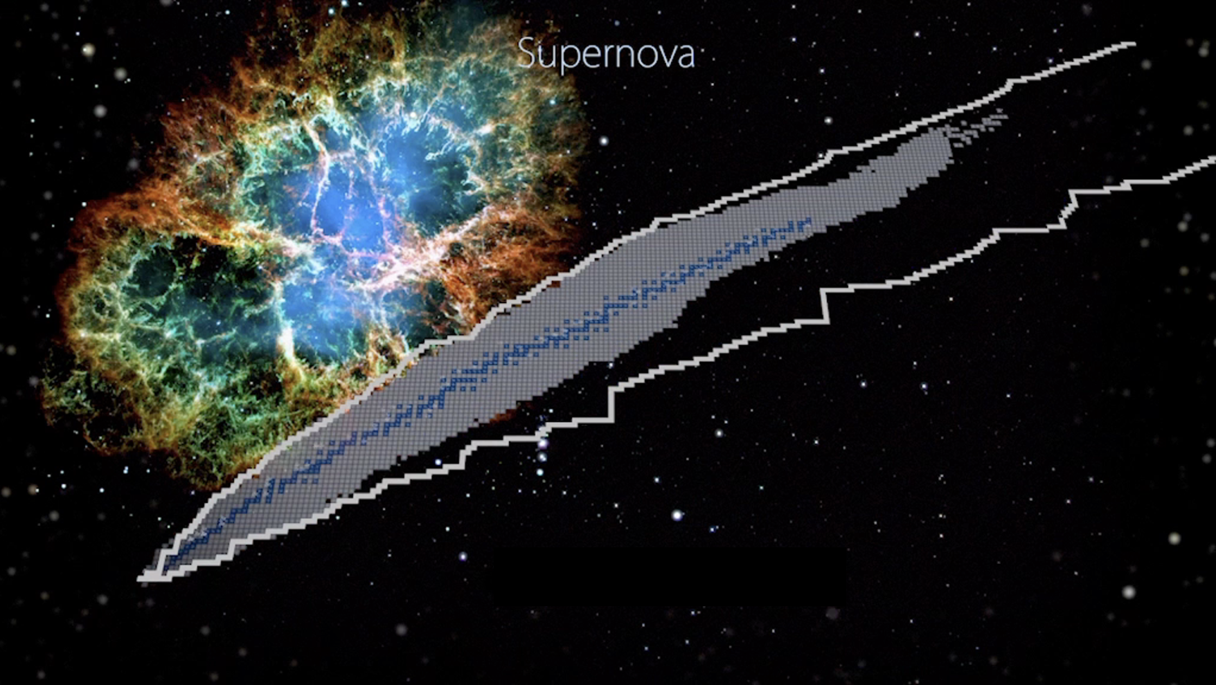
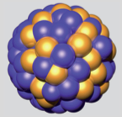
Nuclear Structure
~3000
discovered
r
r - process
dripline
> 7000 estimated
in the Universe
Proton number Z
a research field
with enormous
discovery potential
248 Stable
IPN always contributed with pioneering, top-class research
Neutron number N

Slide 4
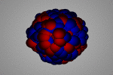
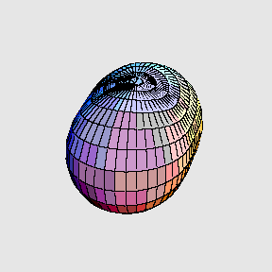
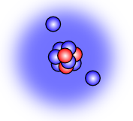
Nuclear Structure
~3000
discovered
r
^{Vibrations}
^{Temperature}
r - process
^{GIANT DIPOLE}
^{RESONANCE}
dripline
> 7000 estimated
in the Universe
^{Rotations}
Proton number Z
a research field
with enormous
discovery potential
248 Stable
^{Isospin (exoticity)}
^{angular momentum}
IPN always contributed with pioneering, top-class research
Neutron number N

Slide 5
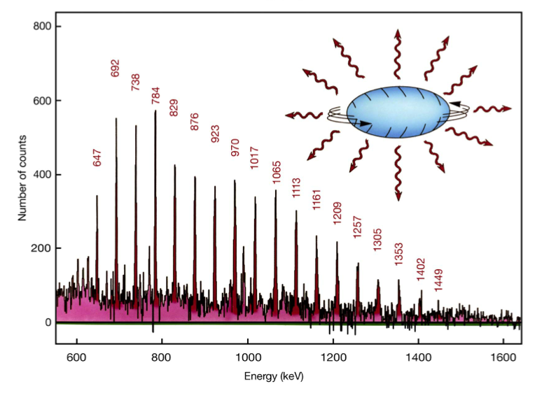
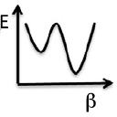

SPINNING the Nucleus to HIGHEST Angular Momenta (1985-2010)
Superdeformed States in secondary minima of potential well
>350 SD bands discovered with HPGe Arrays (up to 200 detectors)
¹⁵²Dy
P.Twin, PRL57(1986)
Main Issues:
Population
Structure
Decay
(quantum tunneling
through potential barrier)
20
Energy [MeV]
x
10
z
SD yrast
x
ND yrast
z
0
10
20
30
40
50
Spin

Slide 6
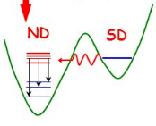
SPINNING the Nucleus to HIGHEST Angular Momenta (1985-2010)
Superdeformed States in secondary minima of potential well
>350 SD bands discovered with HPGe Arrays (up to 200 detectors)
¹⁵²Dy
P.Twin, PRL57(1986)
Main Issues:
Population
Structure
Decay
(quantum tunneling
through potential barrier)
20
Energy [MeV]
x
10
z
SD yrast
x
IPN extensive investigation in A~190
Superdeformation at HIGH SPINS and
Shape coexistence at ZERO SPINS
are two faces of the same medal
Decay
Out
ND yrast
z
0
10
20
30
40
50
Spin

Slide 7
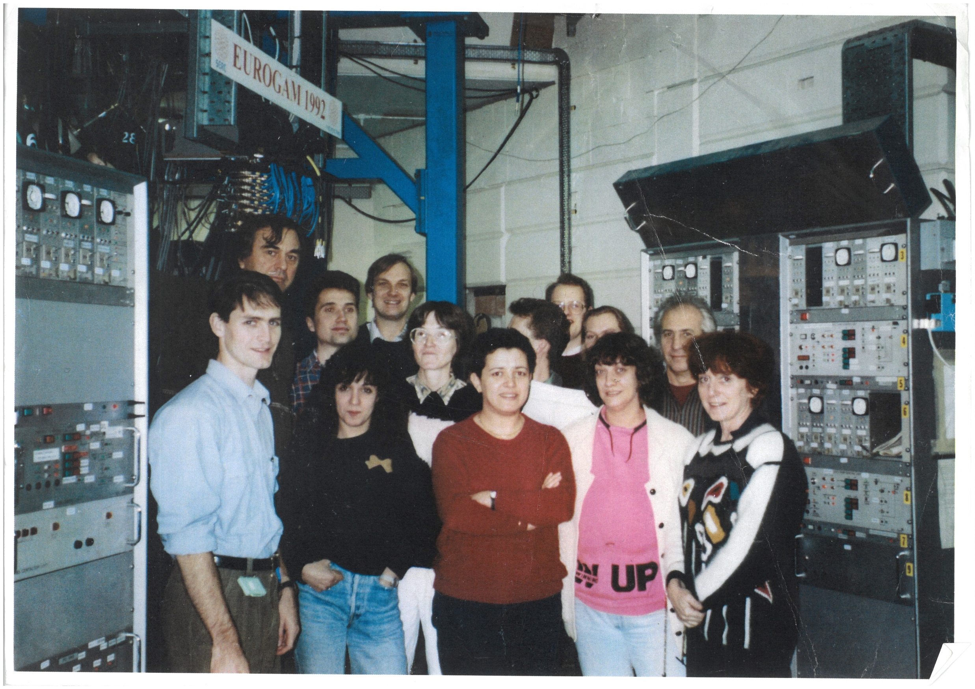
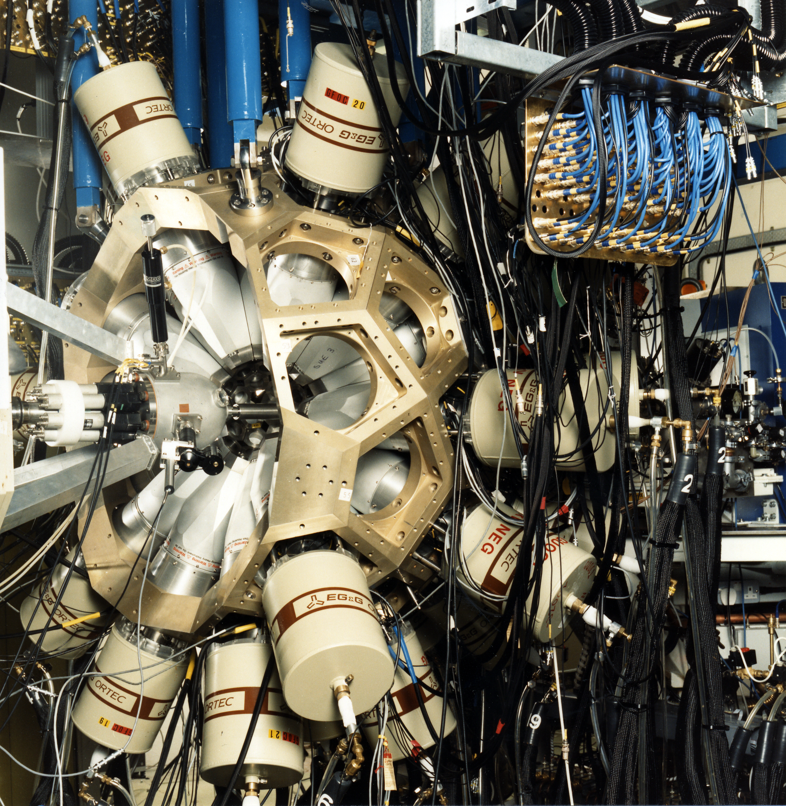
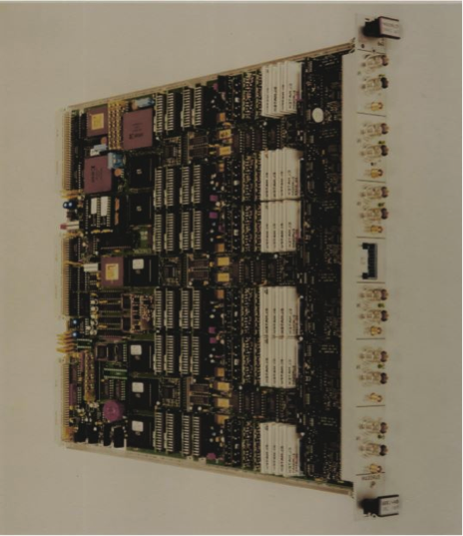
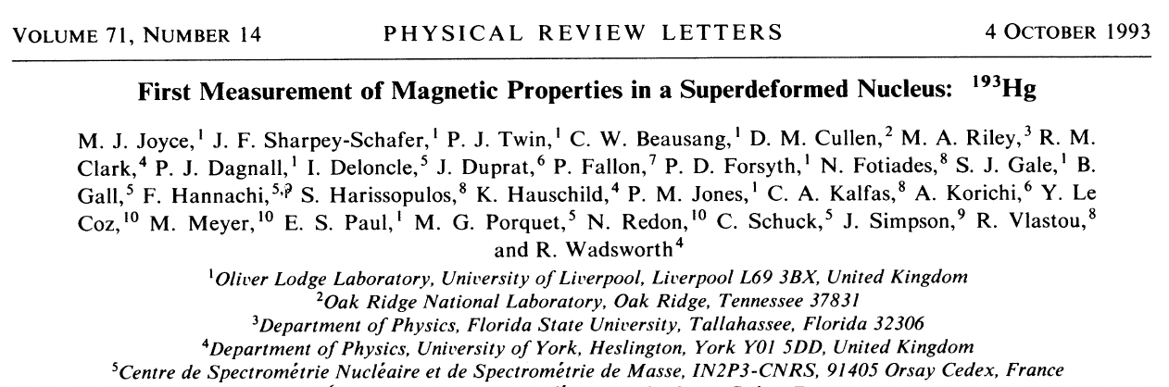
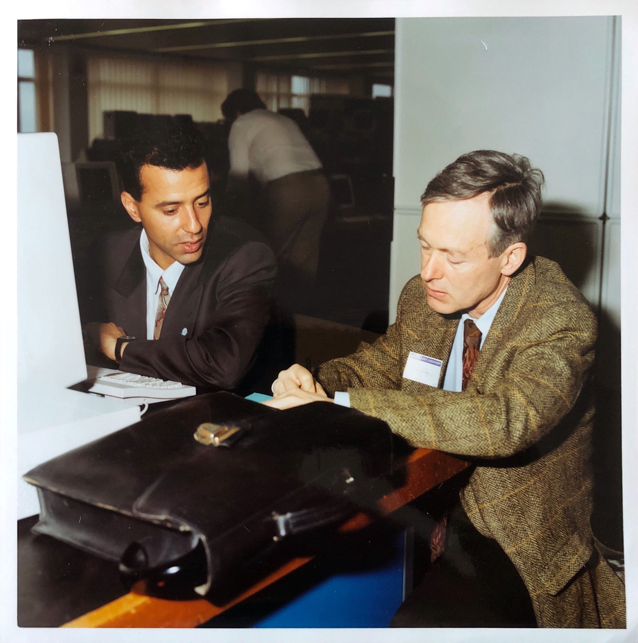
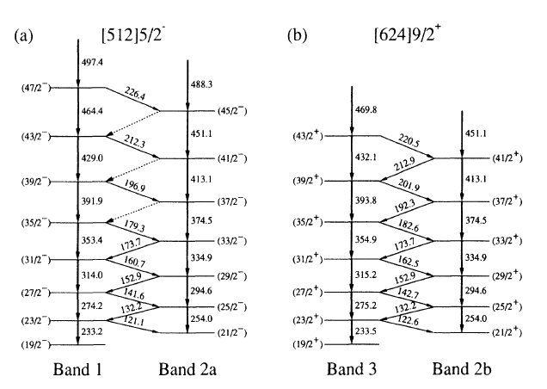
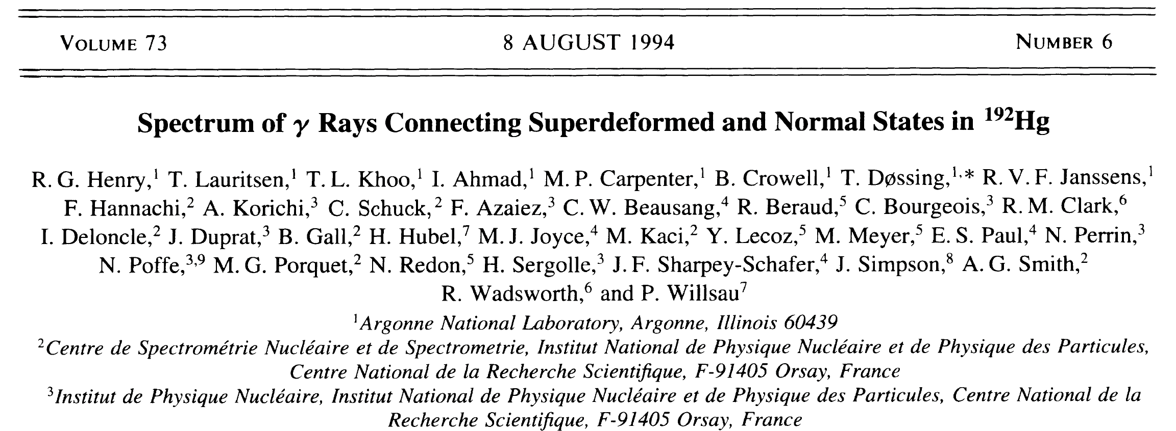
Eurogam 1 @ Daresbury
funded jointly by SERC (UK) and IN2P3 (France)
Integrated Electronics VXI:
(CRN, IPNO, CSNSM, IPNL, ISN, CENBG)
¹⁸³Hg Magnetic Properties
F. Azaiez
Ch. Bourgeois
First Full Spectrum of SD nucleus (¹⁹²Hg)

Slide 8
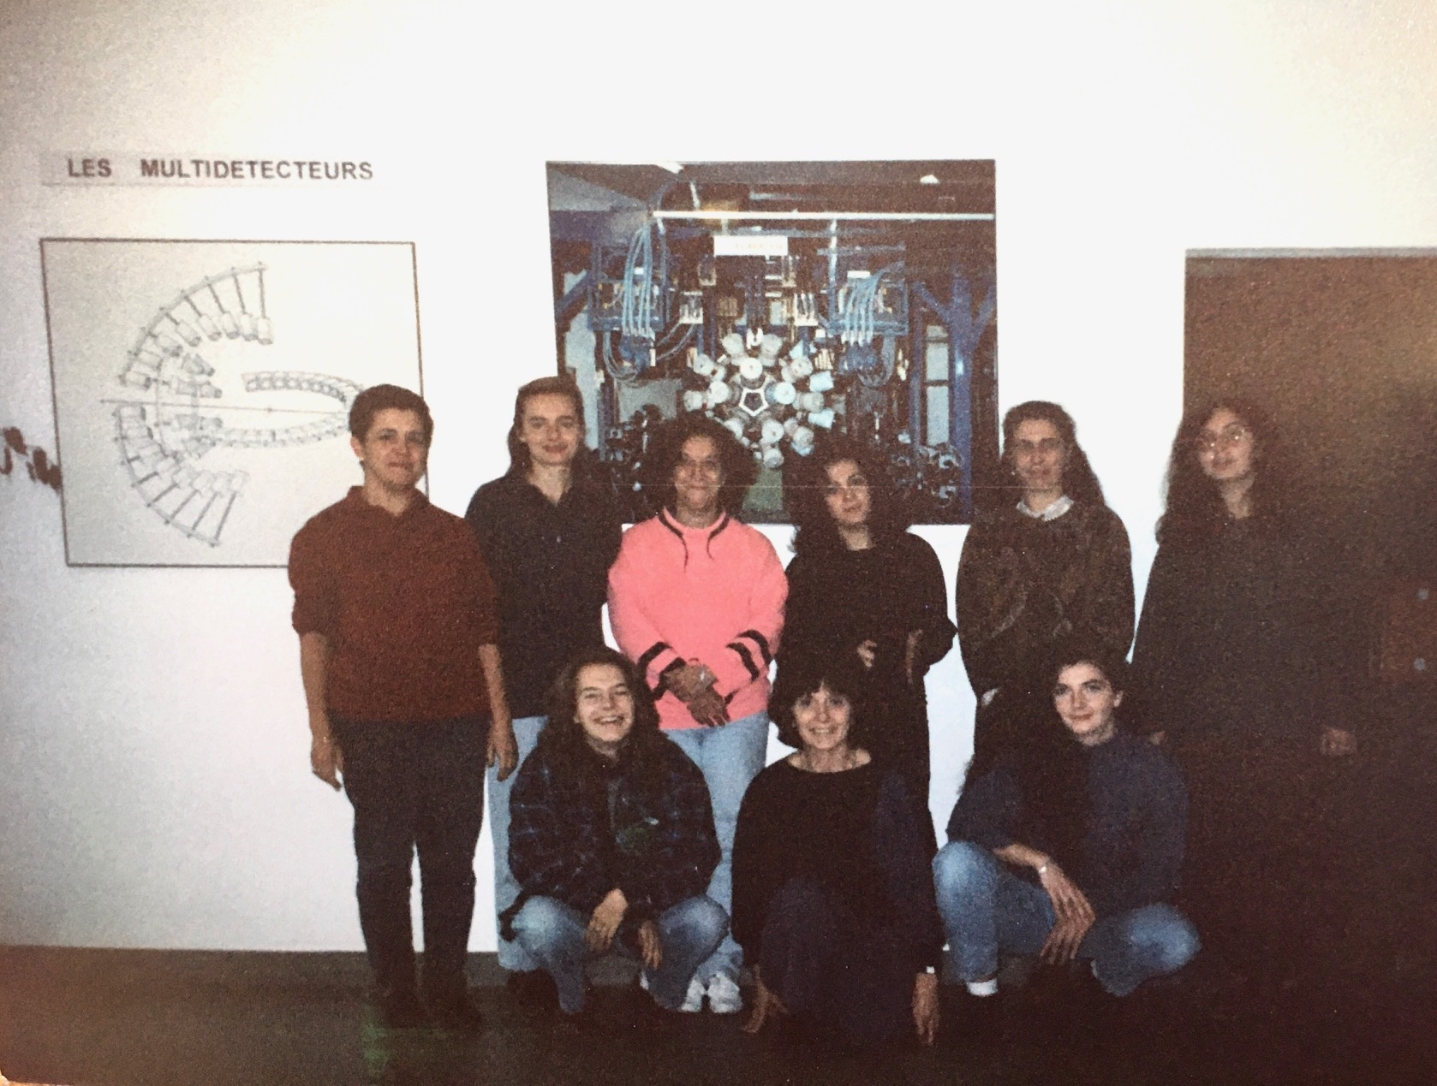
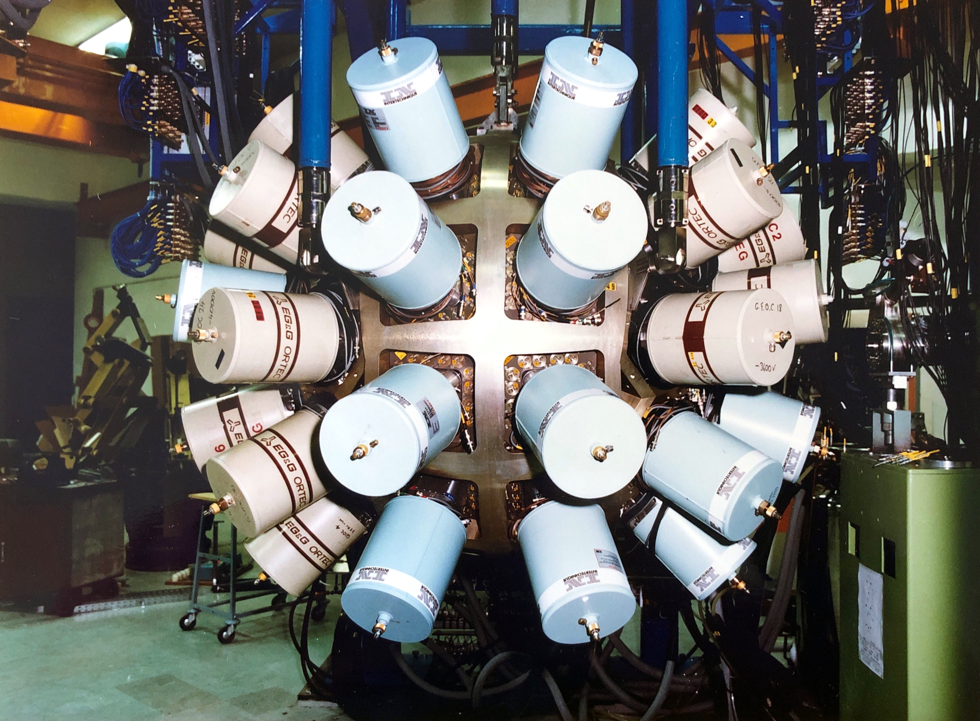
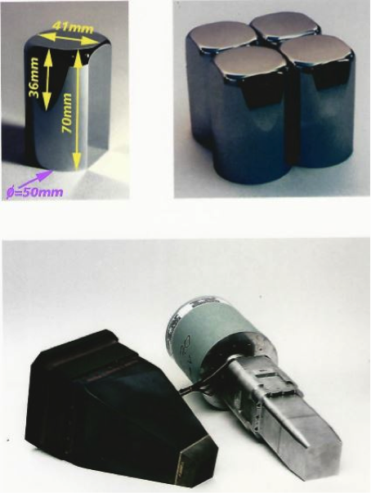
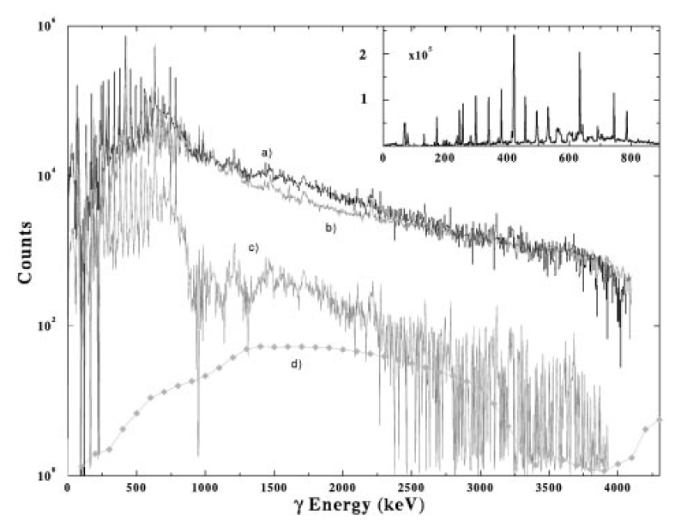
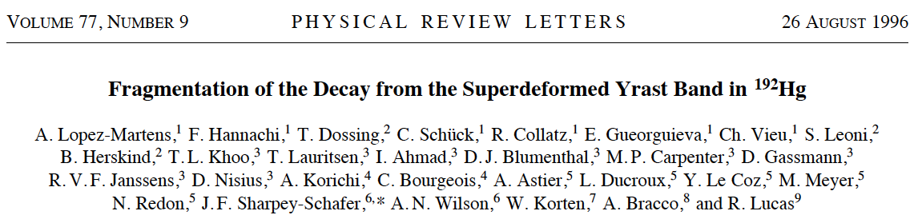
Eurogam 2 @ Strasbourg
funded jointly by SERC (UK) and IN2P3 (France)
9 girls
in action!
First use of Composite detectors
CLOVER array
A. Lopez-Martens et al., Phys. Lett. B 380 (1996) 18
First evidence of the COMPLEXITY of decay-out spectrum:
the SD decay goes via ~10³ decay paths

Slide 9
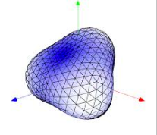

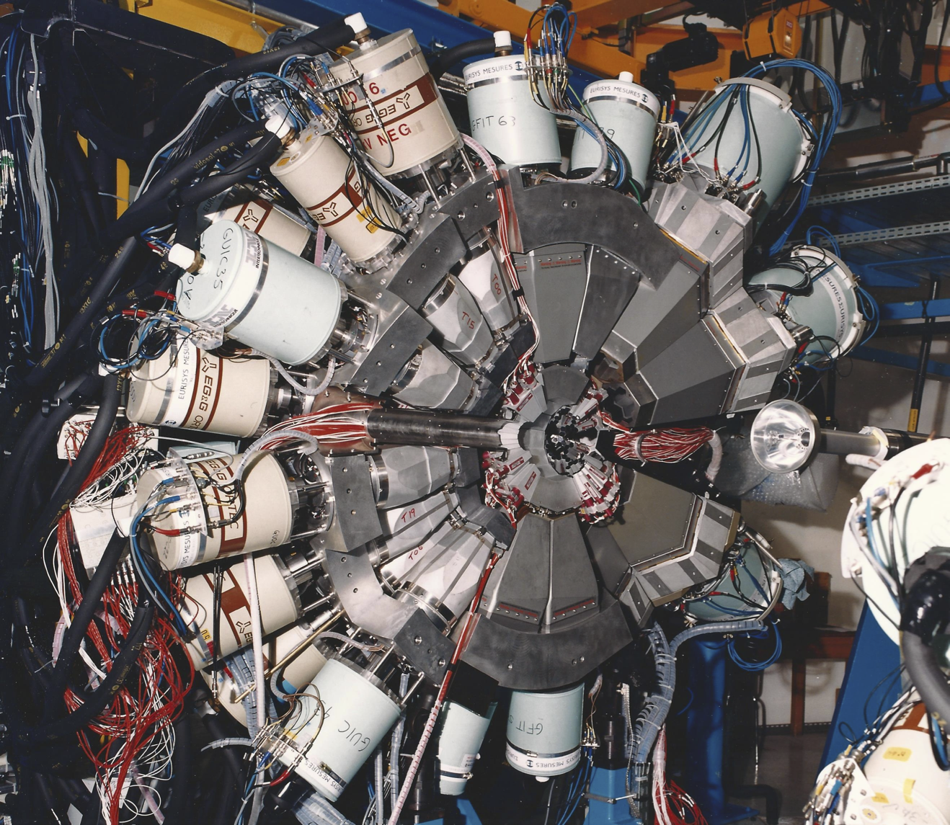
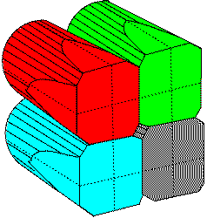
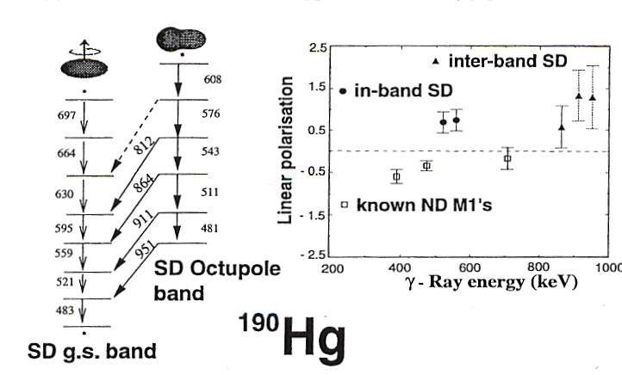
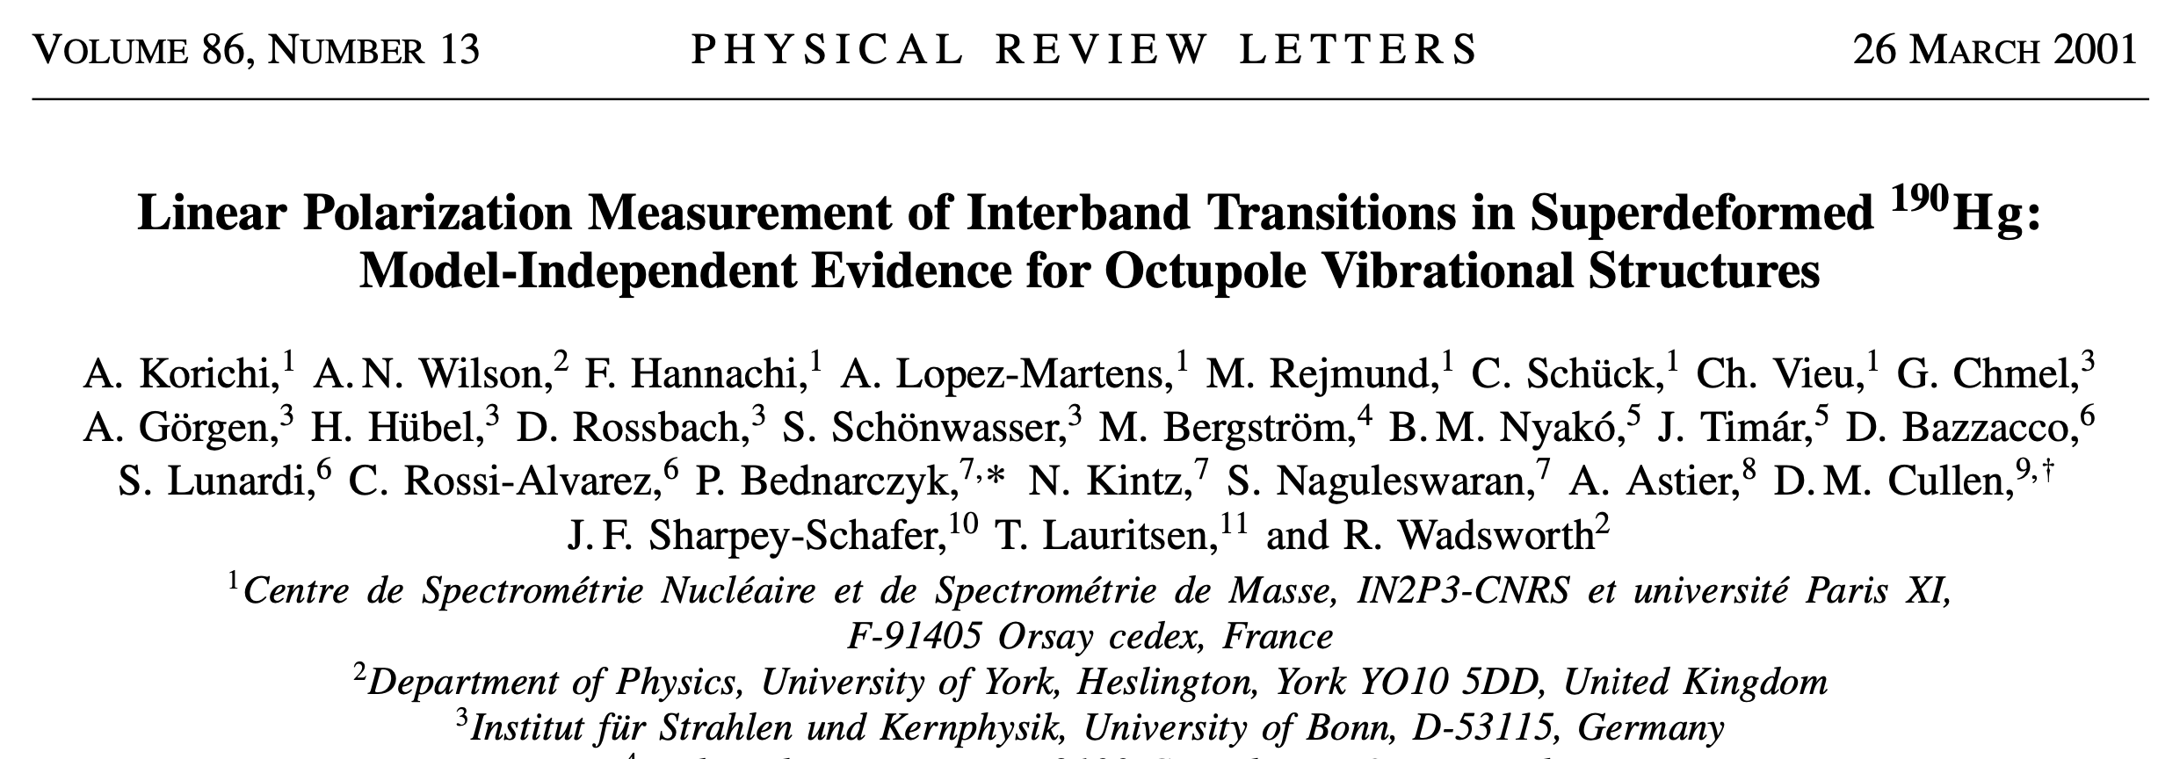
Euroball @ Legnaro & Strasbourg
First Large European Project
Clovers
239 HPGe detectors
⊥
||
γ
Octupole Vibrations
A. Lopez-Martens et al., Phys. Lett. B 380 (1996) 18
anomalously LARGE electric dipole moments
associated with charge asymmetry of vibration

Slide 10
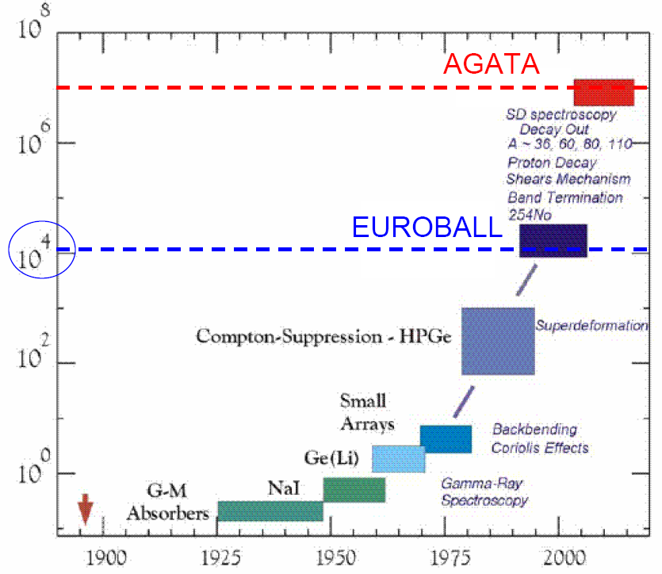
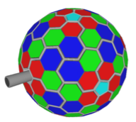
AGATA (Europe) & GRETA (USA)
Tracking array
> 100
Conventional technology
(monovolume, Anti-Compton shields)
Increase in sensitivity
for gamma-arrays
over the years

Slide 11














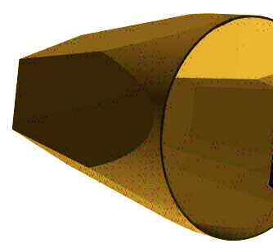
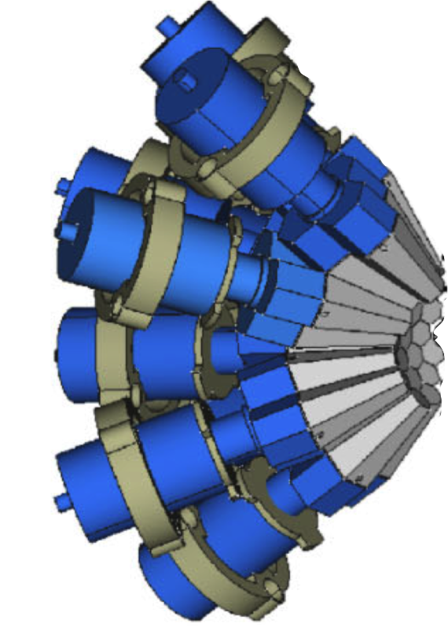
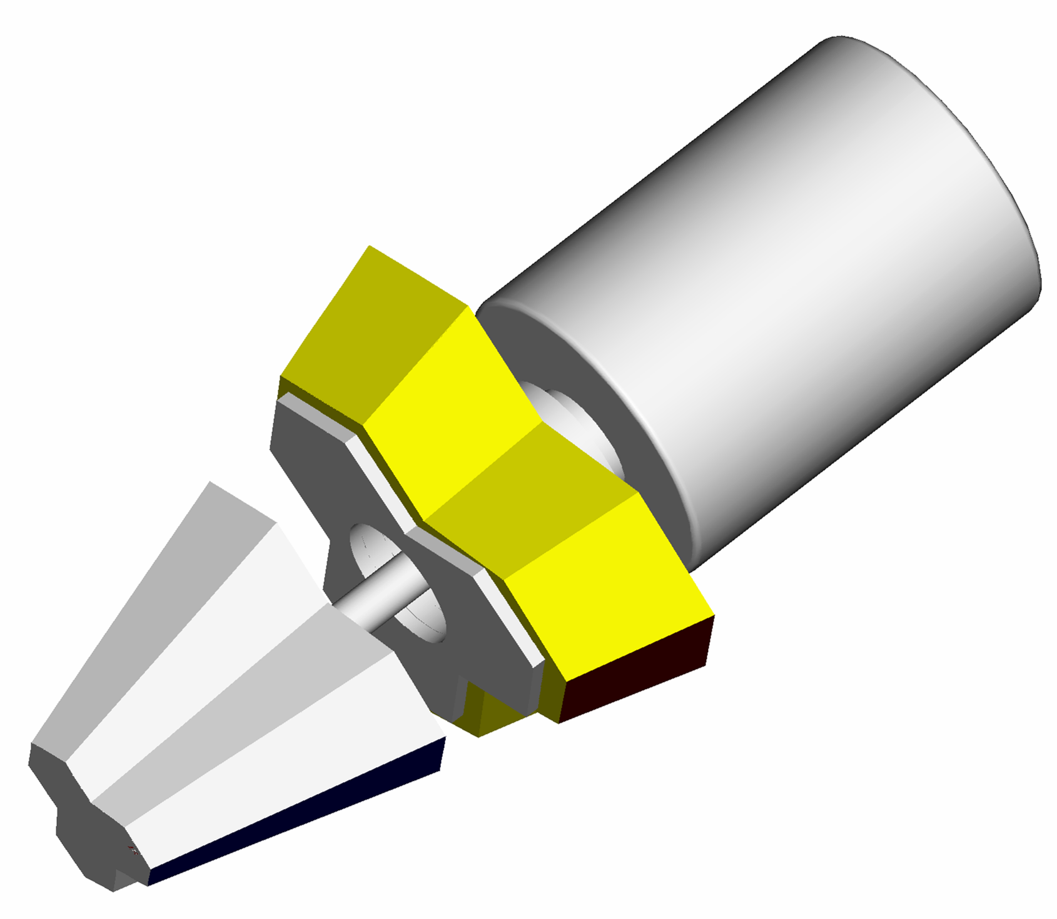
AGATA, 180 HPGe, 6480 segmentów
AGATA
Advanced Gamma Tracking Array
High Purity Ge detectors, segmented, fully digital electronics
Ge capsule
36 segments
180 hexagonal crystals in 60 ATCs
Amount of Ge: 362 kg
Solid angle coverage: 82 %
36-fold segmentation: 6480 segments
Singles rate: > 50 kHz
Peak/Total: 58% (M_{g}=1)
Efficiency: 43% (M_{g}=1)
Angular resolution of
γ interaction point (θ~1º)
Perfect Doppler Correction
(6 keV @ 1 MeV, β=50%)
The “Ultimate Array”
10 cm
Partial array
13 clusters
cluster
3 capsules

Slide 12
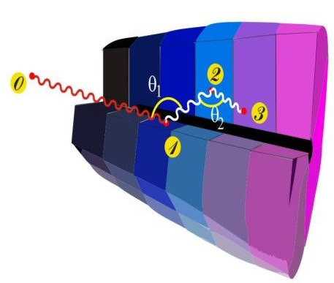
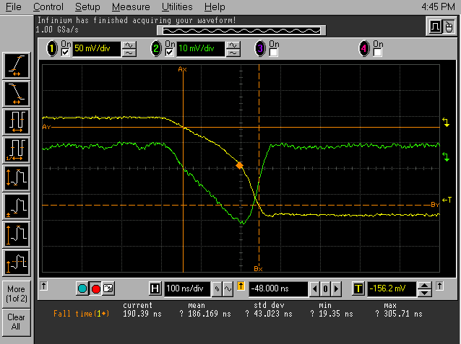
The concept of γ-ray tracking
4
1
Identified
interaction points
Highly segmented
HPGe detectors
Evaluation of permutations of interaction points
(tracking)
(x,y,z,E,t)_{I}
(few mm)
γ
·
·
Pulse Shape Analysis
to decompose
recorded waves
·
·
3
2
Digital electronics
to record and
process signals
Reconstructed
γ-rays
Notes:
What has to be done to perform tracking
What are the ingredients
Detectors highly segmented, encapsulated, cryostats
Electronics Digital
PSA to extract Energy Time and Position
Algorithm development particularly for position
Tracking algorithms, reconstruction of the events for full array
Obtain full energy
Many technical development in all areas.

Slide 13
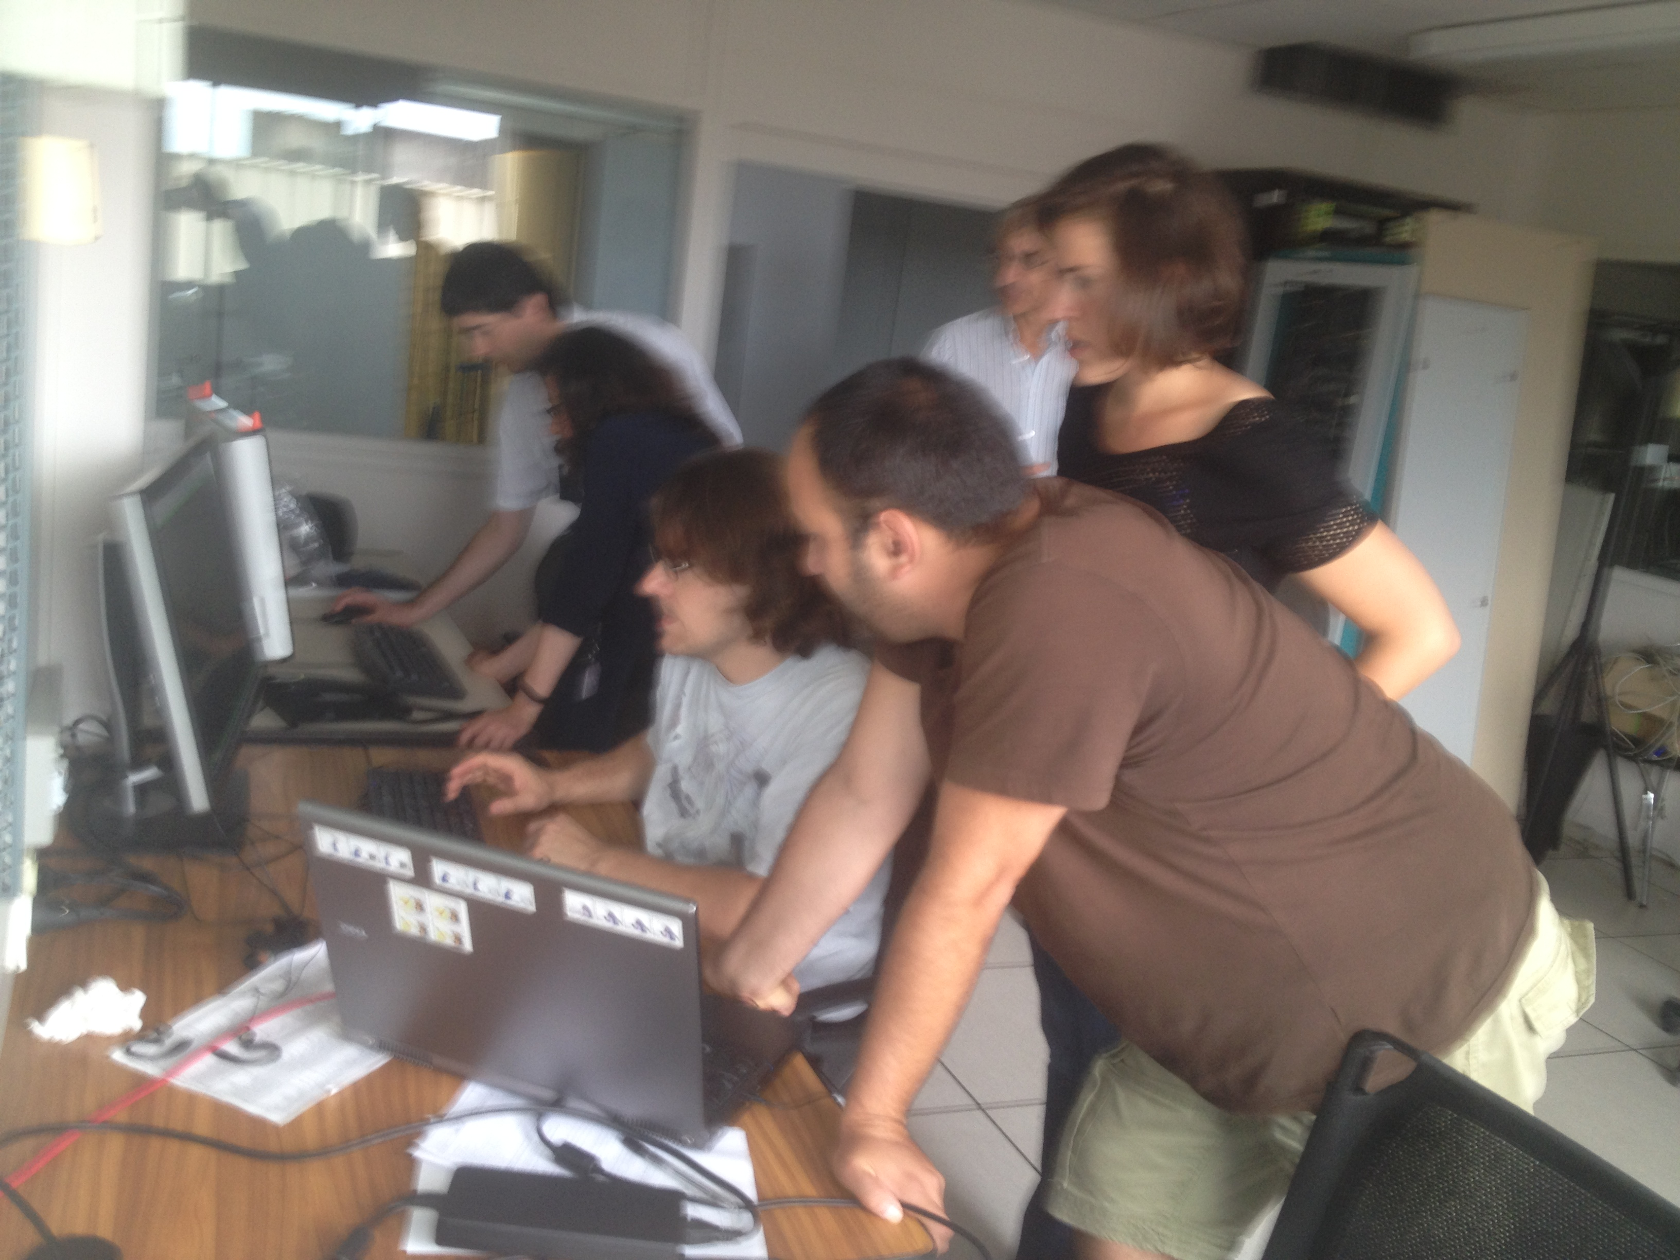
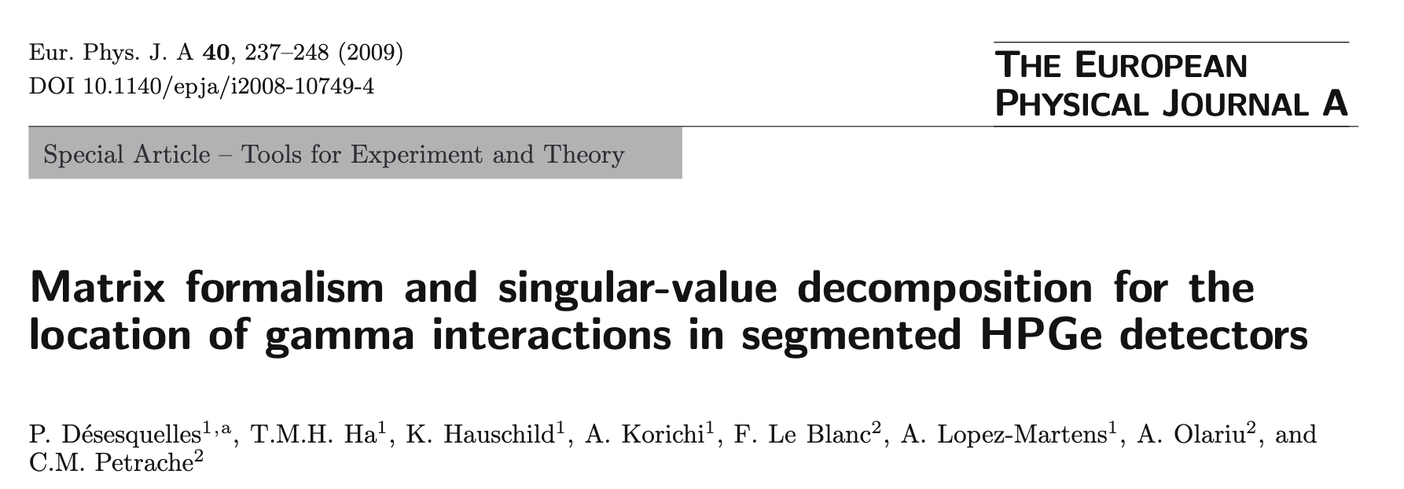
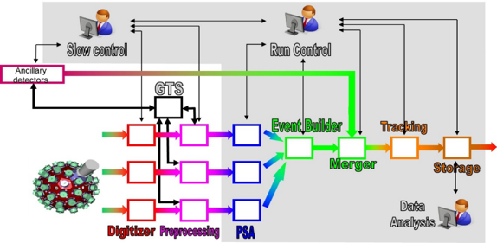
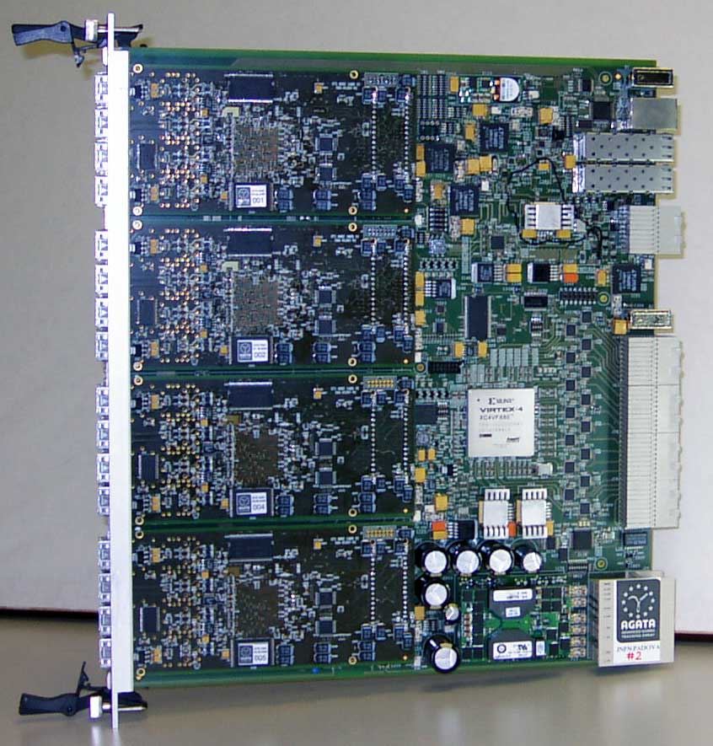
Strong Contributions of IPNO in
Electronics, DAQ and PSA/Tracking Algorithms
Development of PSA algorithms
more computing
power is needed
Development of tracking algorithms
Orsay Forward Tracking is the official AGATA tracking algorithm
A. Lopez-Martens et al., Nucl. Instr. Meth. A 533 (2004) 454
NARVAL is chosen as the
AGATA data acquisition system (2005)
X. Grave, R. Canedo, J.-F. Clavelin, S. Du, E. Legay,
14th IEEE-NPSS Real Time Conference, 2005, p5 Stockholm, Sweden
IPNO & CSNSM develop
ATCA front-end electronics for AGATA
P. Edelbrouk, Ch. Oziol, D. Linget, N. Karkour,
Sebastien Lhenoret, Lounis Benallegue,
Bruno Travers & INFN-Padova
First version tested at IPNO Tandem (1997)
System used in different Laboratories:
J. Pouthas (IPNO) becomes
technical director AGATA France
CEA Bruyère le Chatel, CSNSM Orsay, GANIL Caen, IPN Orsay, LNL Legnaro,
LPC Caen, LPNHE Paris, NSCL, RIKEN

Slide 14
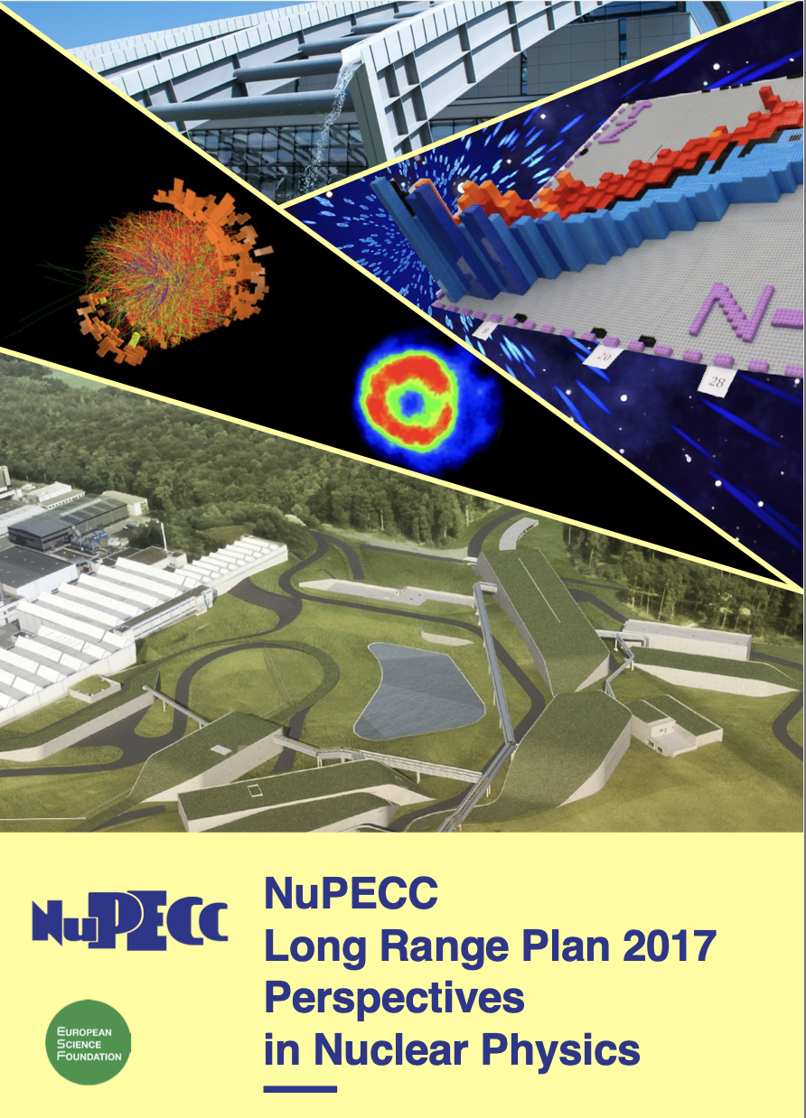
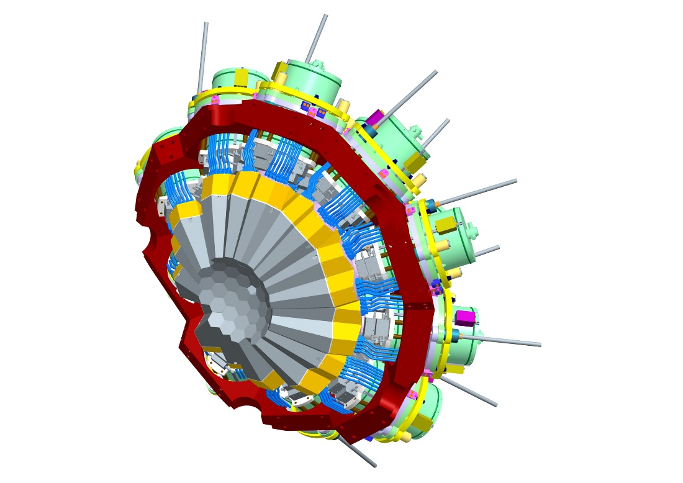
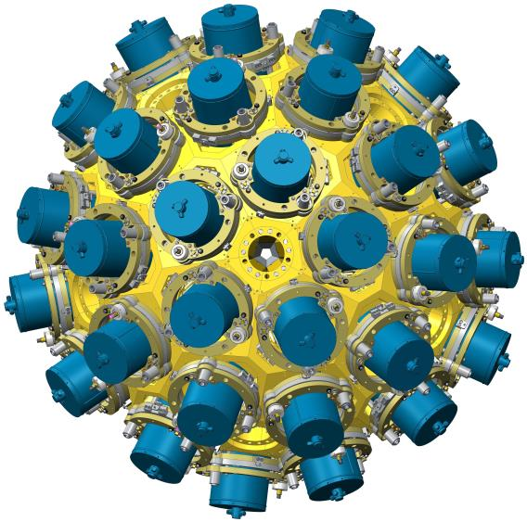
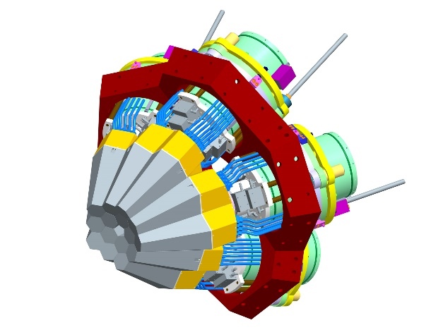


The AGATA phases
I MoU
AGATA 15
Demonstrator
2003-
II MoU
AGATA 60
2008-2020
III MoU
AGATA 180 = 4π
Support
to the completion of AGATA in full geometry
3π ready by 2030
Main contributors
20% FR, 20% IT, 20% DE, 15% UK
Countries, 40 Institutions
From IJCLAB:
A. Lopez-Martens (IN2P3 Sci. Coord. 2016-22)
A. Korici (AMB, Head of DAQ and IJCLAB Sci. Coord.)
Notes:
FROM WAELY: I was scientific coordinator from 2016-2022 for agata at the in2p3 level…now it is Emmanuel.
Amel was part of the AMB when she was head of the daq working group (I think it was during the gsi and ganil campaigns - after Theisen and before stezowski). She is now scientific coordinator for agata at ijclab (she has been always at csnsm and for ipno it was Verney until both labs fusionned).

Slide 15
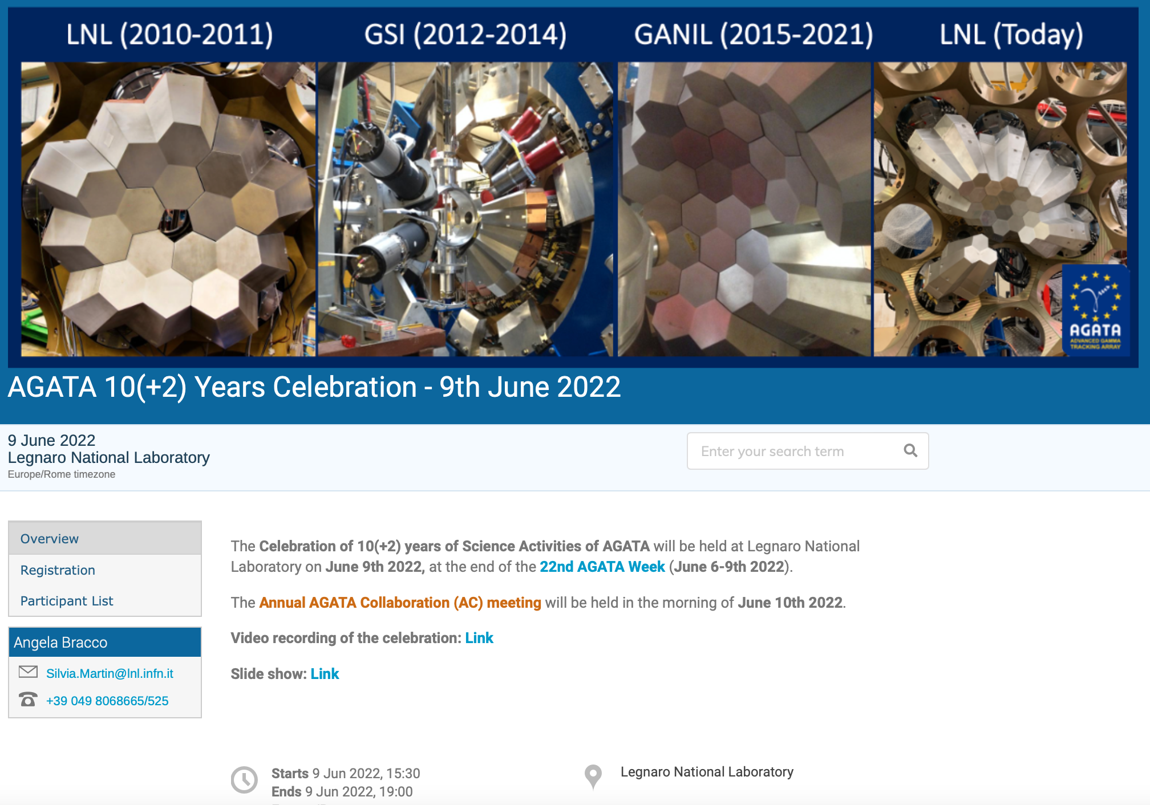
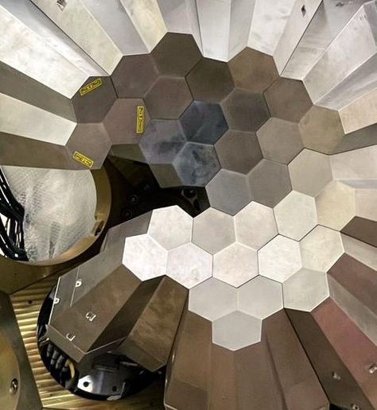
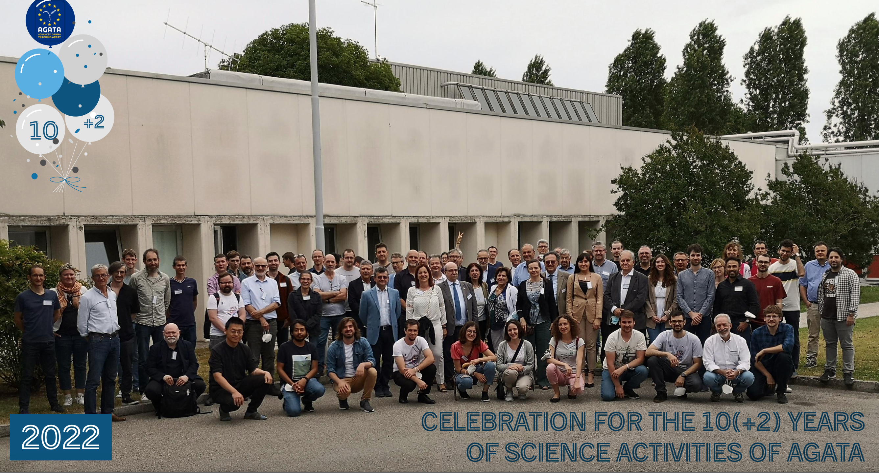
Phase 2
AGATA Campaign
at Legnaro in 2022
J.J. Valiente-Dobon (INFN LNL)
Local Project Manager
at Legnaro Laboratory
AGATA web page: https://www.agata.org

Slide 16
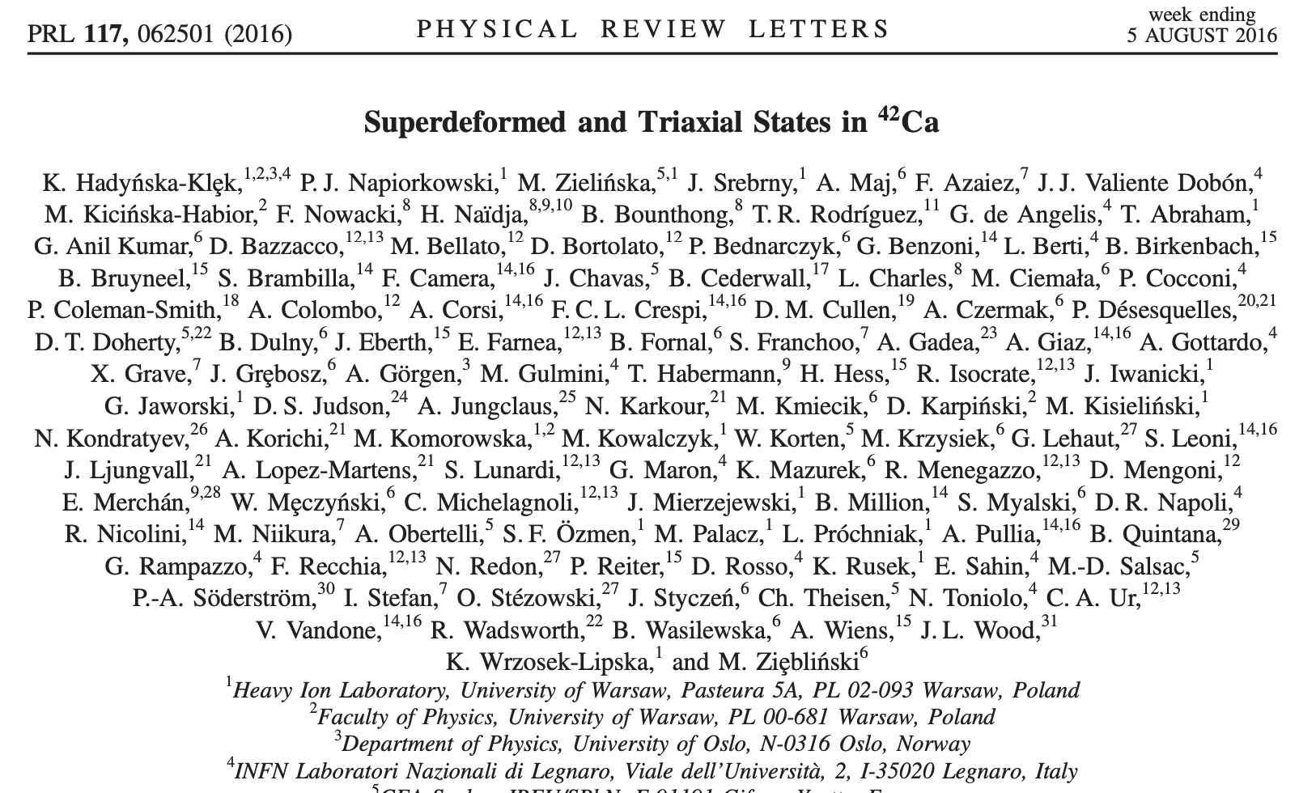
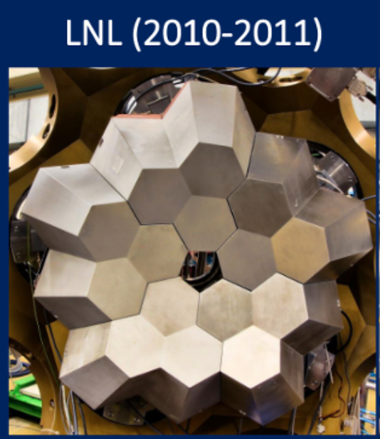
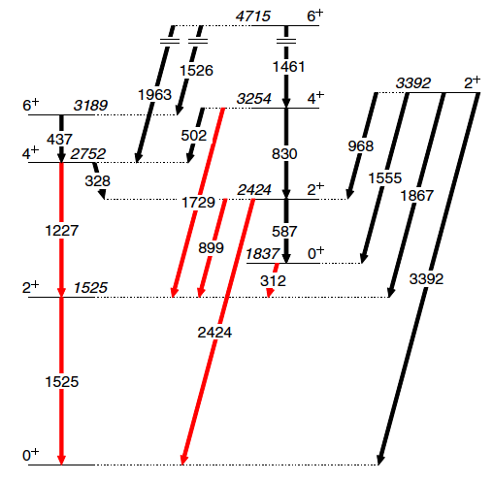
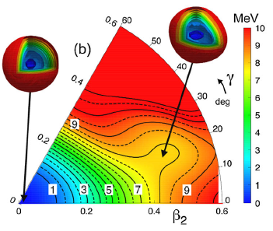
AGATA-Demonstrator 1° experiment
Legnaro Laboratory
Spokespersons: A. Maj (IFJ-PAN), F. Azaiez (IPN)
Shape parameters determined
from E2 matrix elements from Coulex
First ever
Coulomb excitation
of Superdeformed
band
(Triaxial)
⁴²Ca

Slide 17
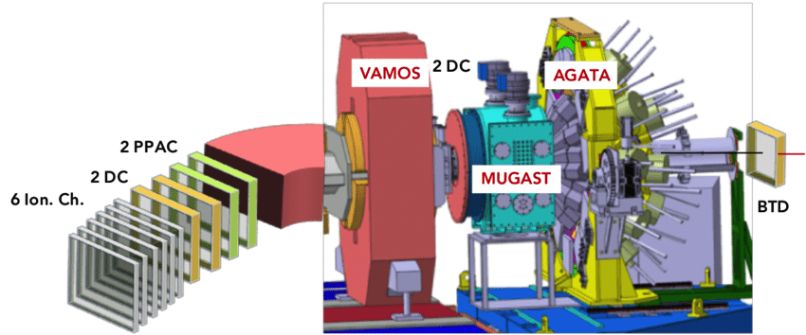
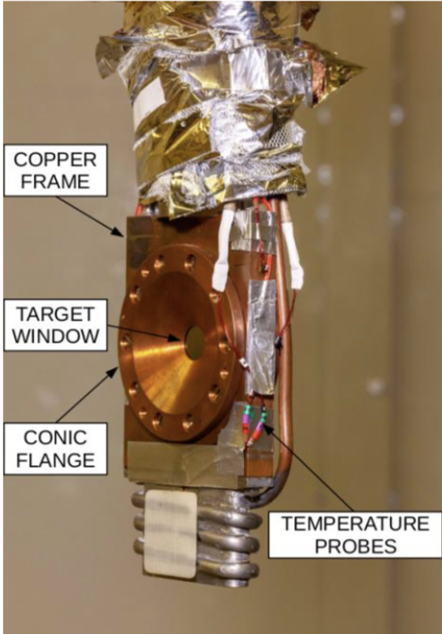
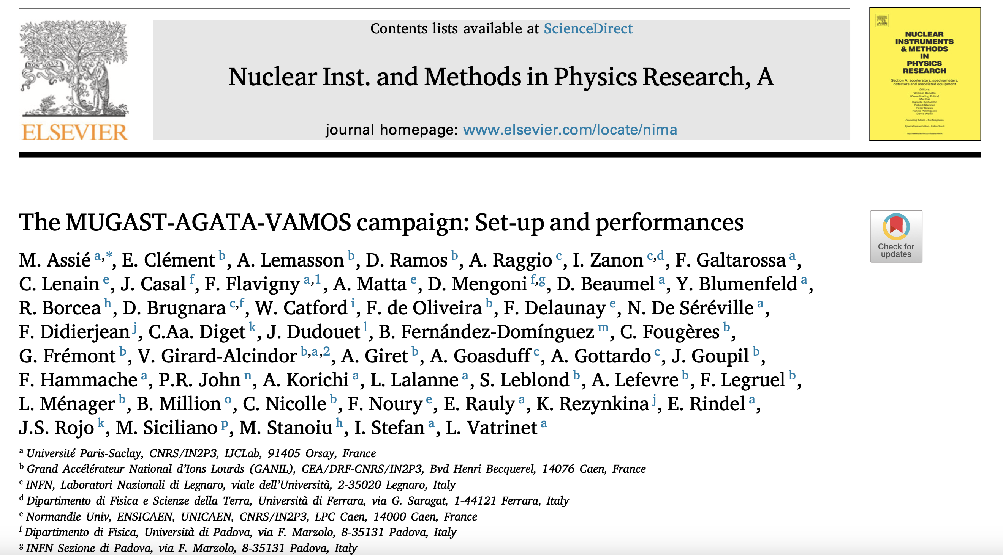

AGATA+MUGAST+VAMOS @ GANIL
(2019-2021) – Campaign with SPIRAL1 beams
Inverse kinematics
transfer reaction
measurements
(d,p), (⁷Li,t), (³He,d)
SPIRAL1 beam
^{14,15,19}O, ⁴⁷K, ⁴⁶Ar
10⁴-10⁵ pps
particle-γ
coincidences
HeCTOr:
the ORSAY
cryogenic
³He target
Galtarossa et al.,
NIMA1018(2021)
M. Assiè (IJCLAB) – MUGAST Campaign Spokesperson
highly segmented
charged particle array

Slide 18



New narrow resonances observed in the unbound nucleus ¹⁵F
V. Girad-Alcindor, A. Mercenne, I. Stefan, … PRC Letter 105, L051301 (2022) – Editor Suggestion
AGATA-MUGAST-VAMOS Campaign GANIL
¹⁴O radioactive beam on CH₂ target: ¹H(¹⁴O, p)¹⁴O
Near-Threshold states
are a universal phenomenon
(most famous example
is Hoyle state in ¹²C)
Strong impact on
Nuclear Structure and
Nuclear Astrophysics
γ−decay branches <= 10⁻⁵
AGATA is needed
Further investigation
with AGATA at Legnaro (2025)
proton dripline

Slide 19





IPN tradition of direct reactions with exotic beams
M. Assiè, D. Beaumel, Y. Blumenfeld, A. Matta, …
Granularity,
Resolution,
Identification,
Transparency
EUROPEAN
Collaboration (MoU)
France, Italy
Spain, UK
IN2P3 strong
electronics commitment
Breakdown
of Z=8
Reduction
factor vs. asymmetry
E. Becheva , PRL (2006)
A. Matta, PRC (2015)
D. Suzuki, PRL (2009)
Magicity at N=14

Slide 20
Nuclear Structure
~3000
discovered
r
^{Vibrations}
^{Temperature}
r - process
^{GIANT DIPOLE}
^{RESONANCE}
dripline
> 7000 estimated
in the Universe
^{Rotations}
Proton number Z
a research field
with enormous
discovery potential
248 Stable
^{Isospin (exoticity)}
^{angular momentum}
IPN always contributed with pioneering, top-class research
Neutron number N

Slide 21






The DIPOLE Response In Nuclei
n
RESONANCES
PYGMY
¹⁸⁸Pt
triaxial
S_{n}
Few %
GIANT
β=0.16
γ=−40°
0.66(4) ns
Important probe of SHAPE
and SHAPE Fluctuations
IPN-Milano Collaboration in THEORY:
N. Van Giai, Bohigas, Krivine e Treiner
P.F. Bortignon, R.A. Broglia, G. Colò …
¹⁸⁸Pt
prolate
β=0.2
γ=−6°

Slide 22




IPN/IJCLAB Campaign for High-Energy γ rays with PARIS
13 experiments 2016-2023: standalone, with nuBall and nuBall2, BEDO, Corset, …
A. Maj (Proj. Man.), M. Ciemala (IFJ-PAN), I. Matea, J. Wilson (IJCLAB), …. PARIS Collaboration
90 detectors today → 150 final
Modular Geometry:
Clusters
Wall
Cube
rectangular
phoswiches
(LaBr₃/CeBr₃+NaI)
Under Construction, MOU with 10 Partners:
France (IN2P3, GANIL), Poland, Italy, UK, Germany, …
at Orsay: I. Matea (Mechanical Integration), J. Wilson (Scientific Council)
MAJOR CAMPAIGNS:
with AGATA at GANIL (2017-2018), and LNL (2024., ..)
with NUBALL at IJCLAB (2016-2023)
with VAMOS, and at LISE, NFS at GANIL (since 2017, ..)
Krakow (since 2016 - ..)
Mumbai (2023-2024)
PARIS@Nu-Ball
(2016-2023)

Slide 23




The DIPOLE Response In Nuclei
Limiting Temperature of Nuclear Existence
No More GDR above E*=250 MeV → E∗/A = 2.1 MeV
n
RESONANCES
PYGMY
Vanishing
GDR Signal
MEDEA
multidetector
at GANIL
(180 BaF₂)
Y. Blumenfeld
et al., ...
S_{n}
Few %
GIANT
¹¹⁶Sn + ¹²C
Giant Dipole Resonance as a probe
of Compound Nucleus existence

Slide 24





Caloric Curve of nuclei
No More GDR above E*=250 MeV → E∗/A = 2.1 MeV
The Liquid-Gas phase transition in nuclei
MULTI-Fragmentation
Vaporization
E* ~ 3-7/A MeV
E* >> 10/A MeV
high efficiency for
high-multiplicity events
Thermodynamical
description
Fermi
GAS
CN
multifragmentation
and its links to the
liquid-gas phase
transition in nuclei
Caloric curve of nuclei
B. Borderie and J.D. Frankland
Prog. Part. Nucl. Phys.105 (2019) 82

Slide 25






Current experimental program:
FAZIA-INDRA@ GANIL (2018- …)
Collaboration:
France, Italy, Poland, Romania, Spain, Turkey
Nuclear equation of state at low density, phase transitions in exotic systems, ISOSPIN transport ….
Dream:
A ident. up to 50
in first member Si detector
INDRA
FAZIA
Si-Si-CsI(Tl)
PSA, ∆E-E
for A,Z identifications
beam
INDRA:
fragments
and particles at θ > 14°
B. Borderie
First R&D coordinator (2000-2005)
IPN Orsay:
FEE Design, construction

Slide 26
Nuclear Structure
~3000
discovered
r
^{Vibrations}
^{Temperature}
r - process
^{GIANT DIPOLE}
^{RESONANCE}
dripline
> 7000 estimated
in the Universe
^{Rotations}
Proton number Z
a research field
with enormous
discovery potential
248 Stable
^{Isospin (exoticity)}
^{angular momentum}
IPN always contributed with pioneering, top-class research
Neutron number N

Slide 27






Moving into the exotic: fission studies at IPN Orsay
Nuclear Structure of fission products
Study of Fission Dynamics
n + ²³⁸U
n + ²³²Th
82
most
neutron rich
126
Exoticity
Proton number Z
50
82
Too hot!
28
50
20
8
28
Complementary
Techniques
2
20
2
Neutron number N
8

Slide 28


The LICORNE Fission program (J.N. Wilson, Project Manager)
Inverse kinematics neutron production
LICORNE:
The unique
inverse kinematics neutron source
of the ALTO facility
Primary beam (400ns – pulsed)
2 x 10¹¹ /s
Samples
population of very
neutron-rich
fission fragments
Gas target
Secondary beam
2 x 10⁷ /s
up to 10⁵ fissions/s
⁷Li (16 MeV)
H₂
1.5 MeV neutrons
²³⁸U
²³²Th
~100 g
200 nA
3 x 10²⁰ atoms/cm²

Slide 29








10 years of LICORNE@ALTO (inverse kinematics neutron production)
Study of prompt emission in fission
Fast neutron tomography
Dark matter TPC tests
MINIBALL
Campaign (2015)
Since 2013: 33 publications, 8 Ph.D. theses
Notes:
In slide 1 there are just a series of photos from over the last 10 years of experiments with LICORNE. They are not arranged in any particular order. On the right, the setup was the first ever "real" experiment with LICORNE in 2014 to study prompt fission gamma rays with neutrons + ionisation chamber. This led to the first publication in PRC. The Miniball picture is from the successful coupling with Miniball in 2015 (first PRL) There is also the first ever 2D plot identifying prompt neutrons produced by LICORNE by TOF and PSD, and also the scalers during the gas target comissioning where we were detecing 320 kHz of neutrons (a lot!) at Zero degrees and only 1.9 kHz at 90 degrees. There is a photo of the first attempt at fission calorimetry with chateau de cristal detectors. The photo on the top left is a setup with CEA/DAM to measure prompt fission neutron spectra for the thesis of Alix Sardet. Best Regards, Jon

Slide 30


The most recent campaigns at LICORNE (>70 international users)
Nuball1 & Nuball2 Hybrid γ-ray spectrometer
Very Innovative Instrument
nuclear fission:
2.3 x 10¹⁰ events (²³⁸U(n,F))
neutron rich isotopes
lifetimes/nuclear moments
PARIS@Nu-Ball
The core of the array:
Gamma detectors
Coupled Devices
TFGIC (European Commission, JRC Geel)
DSSD silicon detectors (HIL Warsaw)
LICORNE neutron source (ALTO)
OUPS plunger (IJC Lab)
OPSA charged particle detctor (IJC Lab)
28 Clover Ge’s(GammapoolEU consortium)
15 Coaxial Ge’s (UK/France loan pool)
36 FATIMA LaBr3 (FATIMA collaboration)
72 PARIS phoswich (PARIS collaboration)
March 2022 – June 2023: 15 approved experiments, 2900 hours beam time

Slide 31





NUBALL Highlight: Angular momentum generation in nuclear fission
J.N. Wilson et al., Nature 590, 566 (2021)
The experiments (7 weeks beam)
γ-spectroscopy of neutron-induced fission with ν-ball/LICORNE@ALTO
+ 3 PRC papers on ^{134,136,138}Te, ^{135,137,139}I and ⁹⁴K
+ xx in preparation
${\vec{S}}_{1}+{\vec{S}}_{2}+{\vec{S}}_{o}=0$
Sizable orbital angular momentum,
S_{o} explains spin independence
MAIN Findings:
Fragment spins are uncorrelated !!!!
Average fragment spin depends only on mass, no dependence on fissioning system
Spin-mass relationship is a universal saw-tooth curve
(well-described by statistical theory for two independent excited nuclei)
Large Interest from Theory community: 5 PRL + PRC ... in 2 years, dedicated Workshops organized
12/05/2023
COPIL ALTO IN2P3
31

Slide 32



Moving into EXOTIC regions
(first beam in 2006, full operation since 2012)
Linear Accelerator
at Orsay Tandem
ISOL facility at Orsay:
50 MeV, 10 μA e⁻ beam
(LEP pre-injector)
- UC_{x} target
10¹¹ fissions/s
(photofission from bremsstrahlung)
FIRST of this type in the world
Surface and laser ionization
14.8 MV
STABLE and RADIOACTIVE beams
in parallel
Notes:
Two traditional approaches to reach the most exotic nuclei on the neutron-rich side are embodied in fission induced by protons (like Isolde at Cern) and by thermal neutrons (like for instance ILL at Grenoble). Fast neutrons produced in the break-up of deuterons have been proposed for future facilities (Spiral-2 at Caen). Over the last years, photofission has emerged as a particularly attractive alternative. In this technique an electron beam is slowed down in a thick uranium target that act as a converter. The bremsstrahlung that is generated excites the giant dipole resonance of the uranium nuclei, provoking photofission. Compared to the competing methods, photofission offers the advantage of a low cost for the electron accelerator, while the cross sections are not dissimilar.

Slide 33






The ALTO production
The pioneering photofission experiment at CERN
M. Lebois, M. Cheikh Mahmed
Measured productions yields
at the detection point at PARRNe
June 2006
Production /s/100nA
5 10⁶ – 5 10⁷
10⁶ – 5 10⁶
5 10⁵ – 10⁶
10⁵ – 5 10⁵
5 10⁴ – 10⁵
×100
10⁴ – 5 10⁴
5 10³ – 10⁴
10³ – 5 10³
Hot plasma ion source
100nA electrons
50 MeV
10⁹ fissons/s inside the target
10² – 10³
Stable
nominal intensity:
10 μA ⇒~ 10¹¹ fissions/s
Taken from D. Verney talk at IPNO 1956-2016 : Heritage from the past, legacy for the future – Orsay - 11-13 October 2016

Slide 34


ALTO-LEB : Observation – Room 110
BEDO TAPE STATION
mechanical design
also used at
ISOL-facility SPES (Italy)
iThemba Lab (ZA)
Identification station/COeCO
Conversion Electron
Spectroscopy
PARRNe
Mass separator
(magnet dipole)
TETRA /
FRØZEN
Neutron detection
80 ³He tubes ε(²⁵²Cf)
Kicker-Bender
(35°)
BEDO
BEta Decay in Orsay
up to 5 HPGe, ε = 5-6%
4π β trigger
Fast-timing studies
using LaBr₃ detectors
MLLTRAP
POLAREX
LINO

Slide 35







The “BEta Decay studies in Orsay” - BEDO program – extremely productive !
hot plasma ionization
(1 µA deuteron primary beam)
•O. Perru PhD –2004
Eur. Phys. J. A 28, 307 (2006)
PRC 76 054312 (2007)
(7 µA electron primary beam)
•A. Etilé PhD CSNSM –2014
PRC 91 064317 (2015)
surface ionization
(2-4 µA electron primary beam)
•M. Lebois PhD –2008
PRC 80, 044308 (2009)
•P.V Cuong PhD –2009
•B. Tastet PhD –2011
PRC 87, 054307 (2013)
•C. Delafosse PhD –2018
PRL 118 182501 (2016)
Phys. Lett. B 772 359 (2017)
laser ionization
(10 µA electron primary beam)
•K. Kolos PhD –2012
PRC 88, 047301 (2013)
•D. Testov PhD –2014
NIM A815, 96 (2016)
PRC 95 054320 (2017)
•G. Tocabens PhD -2022
•R. Li PhD - 2022
•L. Al Ayoubi PhD –ongoing
K. Kolos
B. Tastet
L. Al Ayoubi
C. Delafosse
G. Tocabens
⁸⁰Ge
As82
⁸³Ge
Ge79
Ge80
Ge81
Ge85
Ge86
Ga79
Ga80
Ga82
Ga83
Ga84
Ga85
Zn81
Zn82
D. Testov
L. Sagui
M. Lebois

Slide 36


The DIPOLE Response In Nuclei
N=50
%
n
RESONANCES
PYGMY
S_{n}
Few %
GIANT
S. Ebata, T. Nakatsukasa, T. Inakura, Phys. Rev. C90 (2013)024303
Element Abundance
Relevant ENERGY window for
(γ,n) reactions in STARS
Exp
PIGMY Strength increses with neutron skin
(Microscopic Nature not fully clear…)
with pygmy
Theory
→ Important for ASTROPHYSICS
(Nucleosynthesis, Neutron Stars )

Slide 37




γ spectroscopy after β decay
(with high Q values) to probe PYGMY resonances
ALTO experiment
⁸⁰Ge vs ⁸³Ge spectra
(below vs above N=50) up to ≈Q_{β}
2×2×4’’ LaBr3
PYGMY
36
34
Possible other cases
E1
Microscopic Gogny-QRPA calculations (S. Perù et al.)
2p2h
components
M. Scheck et al., Phys. Rev. Lett. 116, 132501 (2016)
A. Gottardo, D, Verney et al., Phys. Lett. B772 (2017) 359–362

Slide 38



Perspectives at ALTO
BEDO with PARIS
High-Energy γ rays
BEDO with MONSTER neutron Array
MOdular Neutron SpectromeTER
(built for FAIR)
International collaboration:
CIEMAT, VECC (India), Univ. de Jyväskylä (Finlandia), IFIC (Valencia), UPC (Barcelona)
100 cylindrical BC501A cell (20 cm x 5 cm)
Intrinsic efficiency (∼50% @ 1MeV)
Energy threshold E_{n} ∼150 keV
Good neutron timing ~1ns
Digital DAQ 14bits & 1 Gsample/s
TETRA
BEDO
Ø=20cm x L=5cm
LINO
First explorative experiment
I. Matea et al., (2019)

Slide 39


Impact of IPN on Facilities Development
NEWGAIN -> NEW GAnil Injector
Purpose:
Have highest stable beam intensity for Spiral2 facility @ GANIL (superconductive ion source and RFQ A/Q=7)
Scientific coordination: I STEFAN IJCLab
Budget for equipment: 21.1 M€
13.7 M€ from Equipex
SI
First beam in 2028
First beam SC source 2031
Strategic for Scientific Programs on
Super Heavy
N=Z nuclei
Fission
Atomic and interdiciplinary physics, ….
large improvement in beam intensity

Slide 40



Further impact in Europe
September 2022- August 2026 (4 years)
33 participants from 18 countries
Effective access to a network of 47 Research Infrastructures (including 3 RIs with Virtual Access)
and
J. Wilson (IJCLab)
ALTO Facility
coordinator
Last Meeting: Krakow October 9 - October 11 2023

Slide 41



Further impact in Europe
The Nuclear Physics European Collaboration Committee is an Expert Committee of the European Science Foundation.
Objective of NuPECC:
develop the strategy for European Collaboration in nuclear science by supporting collaborative ventures between research groups within Europe, and
promote nuclear physics and its trans-disciplinary use in applications for societal benefit.
Marek Lewitowicz
- Claude Detraz (IPN): one of the main founders of NUPECC
First Chair from 1989 to 1992
- Sydney Galles (IPN): NUPECC Chair (1996-1999)

Slide 42

One of the NUPECC mission:
The Long Range Plan for Nuclear Physics in Europe
Silvia Niccolai (IJCLAB)
Jonathan Wilson (IJCLAB)
Denis Lacroix (IJCLAB)
The 2024 Long Range Plan
is currently being prepared:
10 Thematical Working Groups
strong involvement of IJCLAB in TWGs
Nicolas de Sereville (IJCLAB)
https://www.nupecc.org/?display=lrp2024/

Slide 43


Further impact in Europe
NPD - Board - European Physical Society (EPS)
A. Bruce (Chair), A. Fantoni (elected vice Chair)
18 Members (from IJCLAB: S. Niccolai and new member A. Lopez-Martens)
Objective of the Division:
- assist the advancement and
dissemination of knowledge in nuclear physics
- organisation and approval of conferences
(e.g., EUNP, ANP, NPA) and summer schools,
promotion of exchange of scientists and students
  Lise Meitner Prize
  Applied Physics Prize
  Emmy Noeter Distinction
  PhD Thesis Award
  Historic Site
  (Elena Gonzalez Ferreiro and S. Niccolai)

Slide 44
The Institute of Nuclear Physics in Orsay
(IPN, now IJCLAB)
has always contributed to the European Nuclear Physics
providing inspiration and guidance for
top-class activities at the forefront of the field
Thank you for the attention
Special Thanks for providing material:
Marlene Assiè, Bernard Borderie, Michal Ciemala, Amel Korichi, Andrea Gottardo, Francois Le Blanc,
Araceli Lopez-Martens, I. Matea, Enrique Minaya Ramirez, Iulian Stefan, Giuseppe Verde, David Verney,
Marine Vandebrouck, Jonathan Wilson ...

Slide 47





Evolution of Nuclear Properties
as a function of
Angular momentum
(High Spin Physics)
Temperature
(Order-to-chaos,
Hot Resonances,
Multifragmentation)
Isospin
(Exoticity)
p
ENERGY (MeV)
n
50
GR’s
GR’s
GT
CHAOS/
ORDER
HD ?
SOFT
GR’s
SD
2:1
ND
1.3:1
50
SPIN
100
0.2
ISOSPIN
(N-Z)/A
Accelerators
+
Detectors
Special focus on
γ and particle spectroscopy
beam developments
n-halo
n-skin
p-decay
Exotic
Beams
γ-arrays

