Slide 1
A RICH for the proposed EDM experiment
Roger Forty (CERN)
The double-crystal experiment is designed to measure the magnetic moment of short-lived particles, using a bent crystal to channel the beam halo of the LHC to a fixed-target experiment
Adding a RICH detector would help separate the signal decay products and suppress background
The challenge is the high momenta involved, up to ~ 1 TeV → excellent resolution is required
A simple design is proposed, that could be implemented now with minimal development
(mostly related to the photodetector) or could be adapted to use existing commercial devices
3rd Workshop on EDM of Unstable Particles (Orsay), 12 December 2023

Slide 2
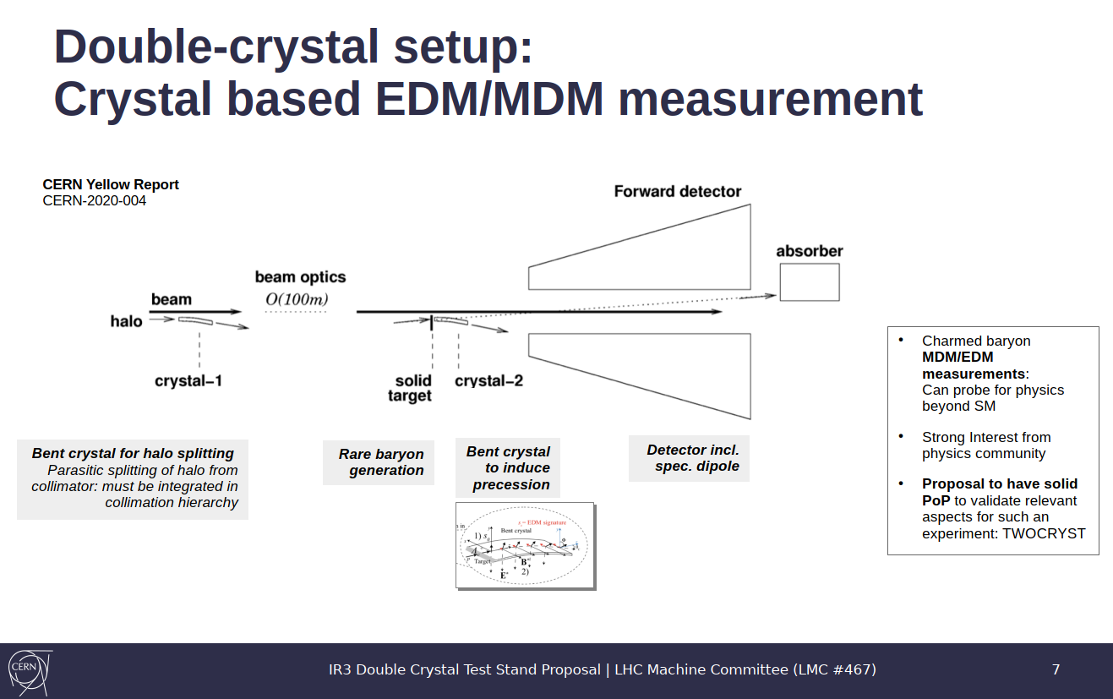
Slide borrowed from Pascal Hermes (CERN-BE)
The initial detector for TWOCRYST
will use VELO pixel chips mounted
in Roman Pots
B-field (~ 1T)
7 mrad
RICH
MUON?
1m
2m
1m
For the subsequent experiment it could be supplemented with a RICH (as well as a muon detector being discussed)

Slide 3
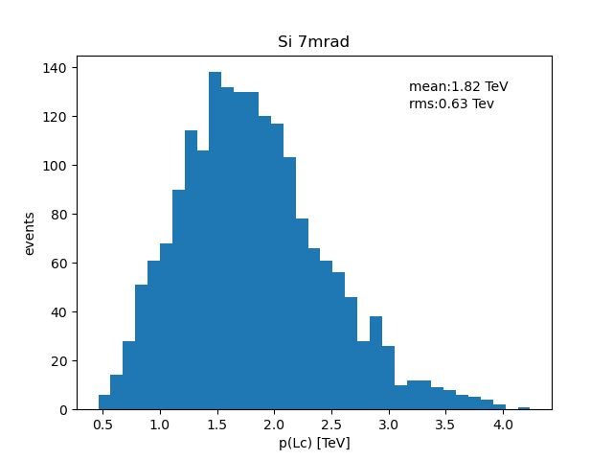
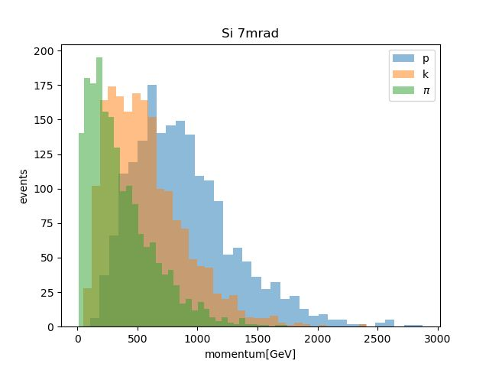
Experimental context
The proof-of-principle machine study (TWOCRYST) will be installed at IR3 for tests during Run 3
but will involve only tracking/vertexing detectors
A Letter of Intent for the subsequent physics experiment is being prepared for submission to the LHCC at the end of this year, and could be installed during LS3, assuming the machine study is successful Options of siting it at IR8 (making use of LHCb) or remaining at IR3 (standalone new experiment)
Processes to be analysed include charmed baryon hadronic decays such as Λ_{c}⁺ → p K⁻ π⁺
Particle identification of charged hadrons would help resolve combinatorics for the signal
+ suppress background from other decays → design a RICH detector suitable for high momenta
Λ_{c}
Decay products
⟨p⟩ = 1.8 TeV/c
Plots from Sara Cesare
Momentum [TeV/c]

Slide 4
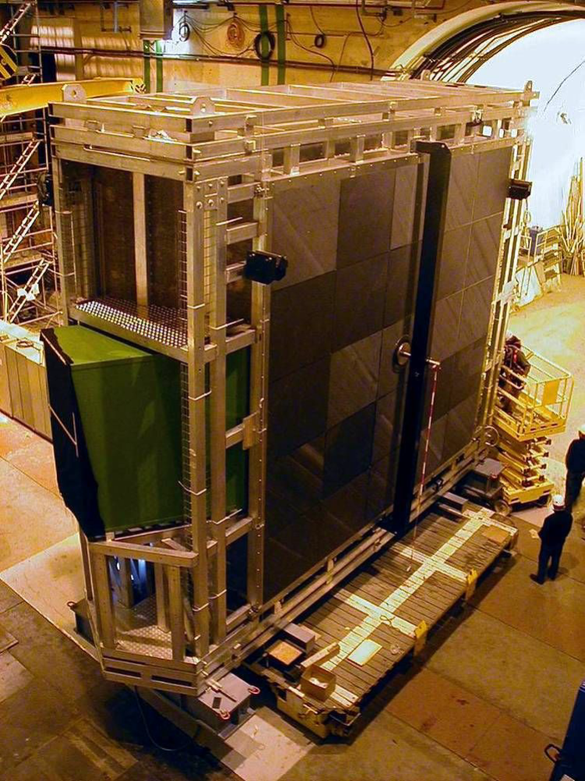
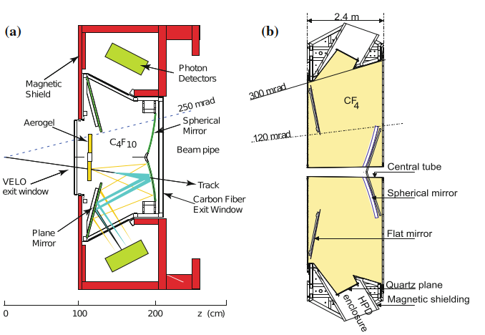
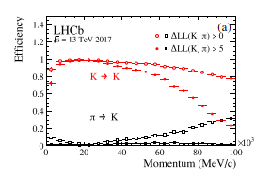
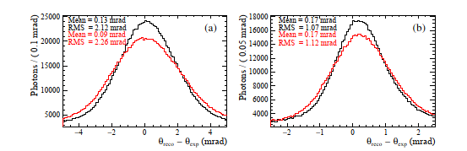
LHCb RICH system
RICH1
RICH2
Highest momentum coverage
in LHCb is provided by RICH2
(with CF₄ gas radiator)
Angular resolution ~ 1 mrad → K-π separation runs out at ~ 100 GeV/c
Current upgrade (where HPDs have been replaced with MaPMTs) → modest improvement in resolution
Unlikely to ever be able to identify particles in the few
x 100 GeV regime: limited by radiator length ~ 2 m
RICH2
Angular resolution
JINST 17 (2022) P07013
→ Better to design a dedicated
detector than reuse LHCb
In Bagli et al, EDMs of charged baryons with bent crystals at the LHC for LHCb option:
“Particle ID is very limited at momentum regime of several hundred GeV/c, and is neglected in this study”
EPJC 77 (2017) 828

Slide 5
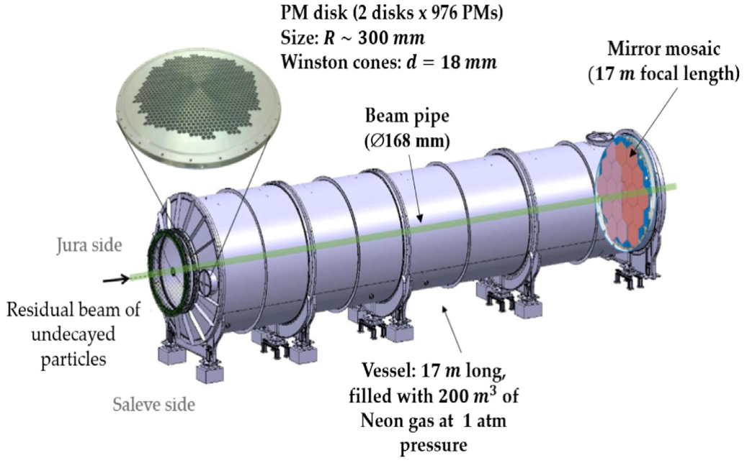
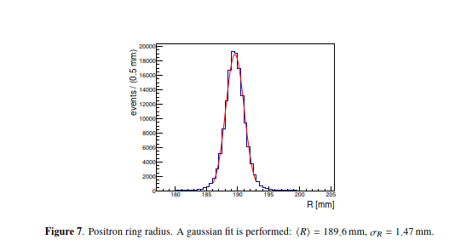
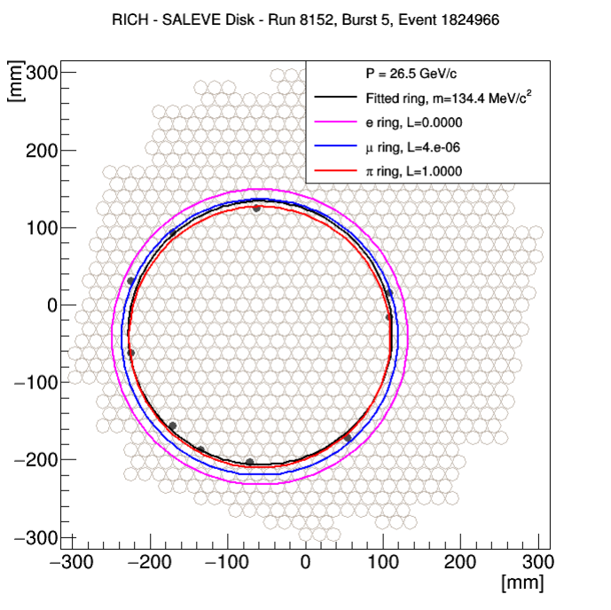
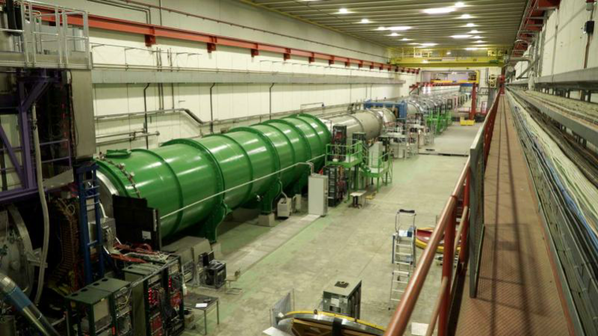
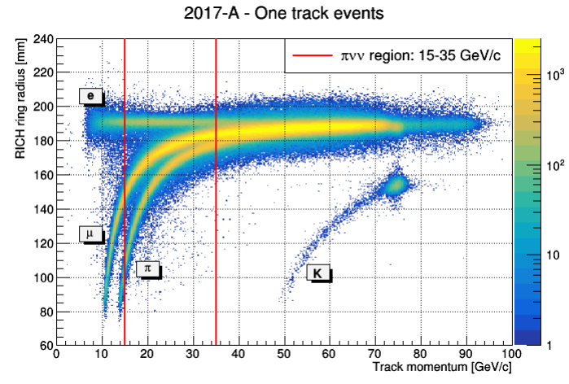
NA62 RICH
Higher resolution device, designed to separate μ from π
Big vessel: 17 m long, filled with neon gas (θ_{C} = 11 mrad)
Resolution measured with
K⁺ → e⁺ν_{e}π⁰ decays → single
(saturated) positron track
Angular resolution = σ_{R} /R x θ_{C}
= 85 μrad per detected photon
JINST 13 (2018) P07012
RICH

Slide 6
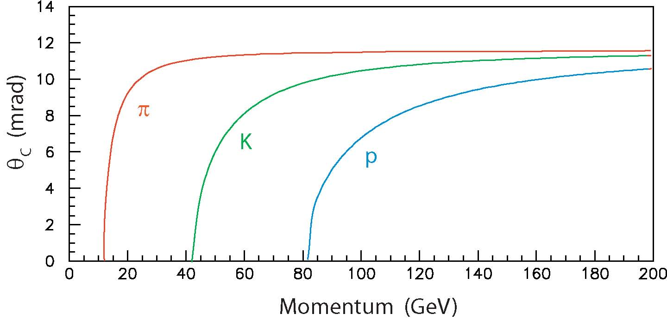
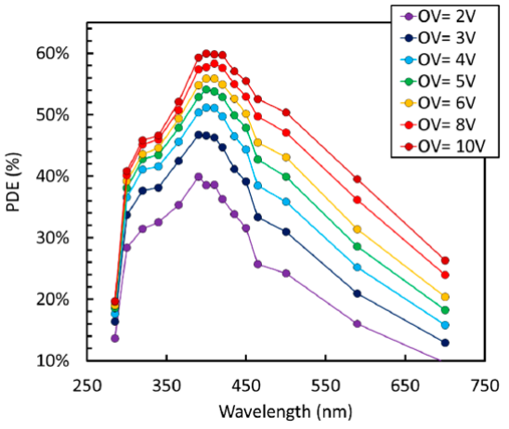
Dedicated RICH design
neon
helium
Aim for scaled-down NA62 RICH, using modern highly pixelated & efficient photosensors (e.g. SiPM) to compensate for reduced size*
Neon (as used by NA62) is well-established as a RICH radiator gas
Refractive index at atmospheric pressure n = 1.000068
Thresholds for π, K, p to produce light are (12, 44, 83) GeV/c
→ almost all signal tracks will be above threshold
Limit of high-momentum separation depends on the resolution
To push upper limit higher, helium is lighter still: n = 1.000035
Bad for vacuum detectors (penetrates windows) but OK for SiPMs?
→ Assume (for now) use of He at atmospheric pressure, but if needed could be replaced with Ne at lower pressure (~ 0.5 bar)
Need a long radiator length to detect enough Cherenkov photons:
N_{pe} = 370 cm⁻¹eV⁻¹ L ∫ε sin² θ_{C} dE ≈ L [cm]/42
Efficiency ε includes PDE of photodetector, its active-area fraction = 0.8, and the mirror reflectivity = 0.9 (assumed)
Choose length L = 500 cm → N_{pe} ≈ 12 for a saturated ring
Assume this PDE (taken from SiPM)
NUV-HD 40 𝜇𝑚 cell SiPM
Gola et al, Sensors 19 (2019) 308
*SiPMs also considered by NA62 for upgrade to HIKE

Slide 7
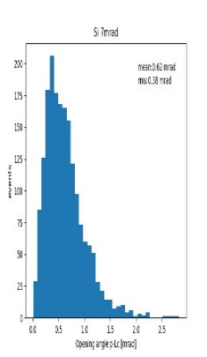
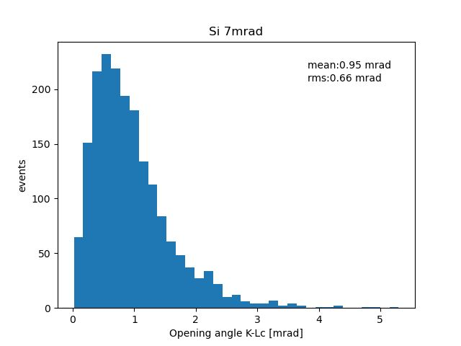
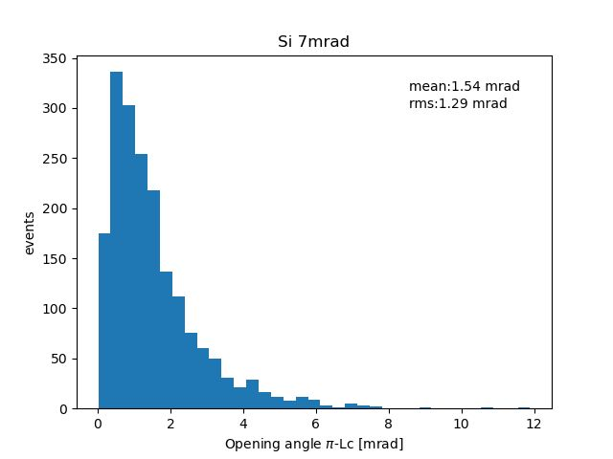
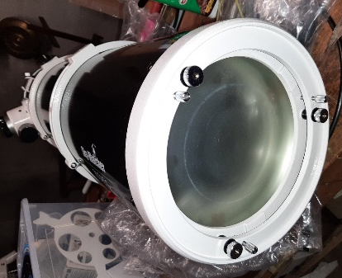
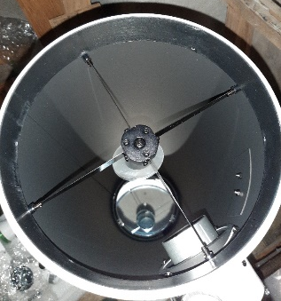
Detector layout
Opening angle of Λ_{c} decay products
Use a spherical mirror at the end of the radiator volume, radius of curvature R = 2L = 10 m; Cherenkov angle = 8.4 mrad for helium
→ ring images are quite small: diameter d = R θ_{C} = 8.4 cm
Angle of Λ_{c} after channeling is 7 mrad → rings offset by 7 cm at photodetector plane, plus any tilt of the focusing mirror
Images spread due to opening angle of decay products < ~ 3 mrad
→ cover the angular range ~ 5 – 11 mrad with photodetectors
Vessel can be a simple cylindrical tube ~ 15 cm in diameter,
with mirror at one end, detector at the other
p
K
π
3 mrad
(like a telescope…)
Beam-pipe with exit window
Commercial Newtonian telescope
Mirror
15 cm
Photosensor
array
Helium (or neon)
Track
500 cm

Slide 8
Photodetector plane
Photon impact points
Photodetector area
Simulate high momentum tracks passing through the RICH volume, with flat angular distribution over 7.0 ± 3.5 mrad
Cherenkov photons ray traced to detector plane and mirror alignment adjusted so
image avoids the entrance window
Material budget should not be an issue, given the high momenta; the photodetectors are anyway located away from the incident tracks
Hits from a single track highlighted
Region to be covered by photodetector
~ 11 cm in diameter (i.e. ~ 95 cm² area)
—can save some area by not instrumenting inner part:
Helium
e.g. SiPM array proposed below
Vessel wall
Entrance window
[cm]

Slide 9
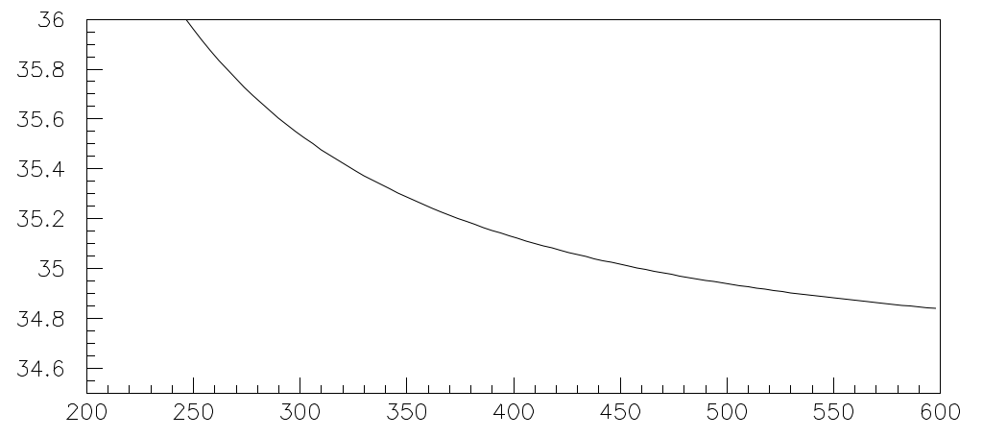
Angular resolution
Cuthbertson 1936
Using the trajectory of the track and the position of the detected photon, the Cherenkov angle at emission can be reconstructed
Checked the contributions to angular resolution: fundamental limit is from chromatic error, variation of refractive index with wavelength → 32 μrad
Emission-point error represents the quality of the focusing: excellent here due to the long focal length and nearly on-axis photons → 6 μrad
Pixel error is due to the finite size of the photodetector pixelization:
≈ 2p/R √12 for pixel size p and mirror radius R; choose 0.5 x 0.5 mm² pixels to match chromatic error → 30 μrad
Switching on all contributions at the same time
in my toy simulation → σ_{θ} = 42 μrad per photon
Tracking angular resolution should be excellent
with 55 μm VELO pixels over a lever-arm ~ 1m
→ < 16 μrad from the measurement error
+ multiple scattering in window + extrapolation
→ should be simulated (but expect to be sufficient)
Helium
n-1 [x10⁶]
Wavelength [nm]
Chromatic
Combined resolution
Emission-point
Pixel
Cherenkov angle [mrad]
Cherenkov angle [mrad]

Slide 10
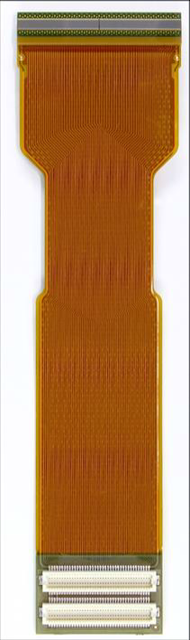
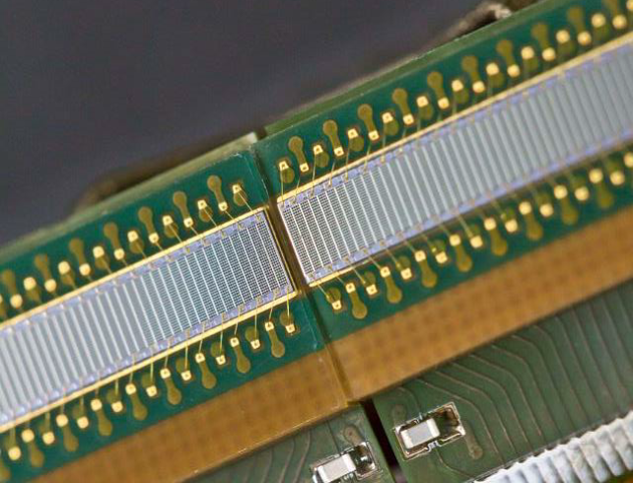
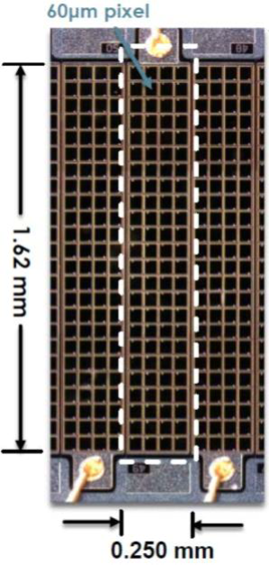
Photodetector choice
SiPM array (2 x 64-channel):
Hamamatsu MPPC S13552-H2017 + Kapton flex-PCB
4096 used in LHCb SciFi
0.5 mm-scale pixels are not commonly available in current photodetectors, but SiPMs have intrinsically high granularity
As an example: those used to read out scintillating fibres of the LHCb SciFi, which have 0.25 x 1.62 mm² pixels arranged in 64-channel linear arrays of dimension 16.25 x 1.62 mm²
I arranged them (by hand) to cover the photodetector area required, with the fine pixel direction oriented radially
228 x 64-channel units required ≈ 15k channels total
Active-area coverage (within the instrumented anulus)
is ~ 75% for the example shown—however, this is only for illustration: there are wire bonds that would get in the way, and connecting the readout electronics would be challenging…
A higher active-area fraction and simpler readout layout should be achievable with a dedicated development—
R&D on SiPM arrays with mm-scale pixellization is one of the key goals for the new DRD4 collaboration, just being set up
60 μm sub-pixels (SPADs)
Lukas Gruber,
Vienna 2019
Noise can be controlled with cooling, or by timing cuts

Slide 11
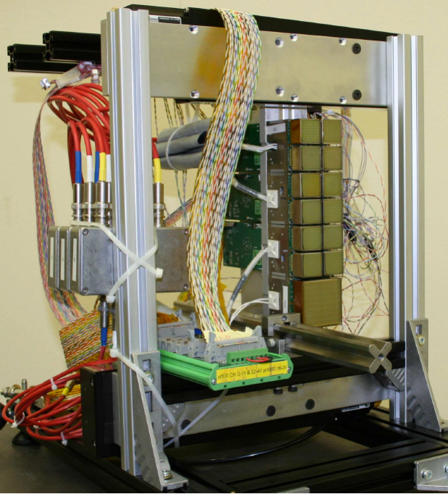
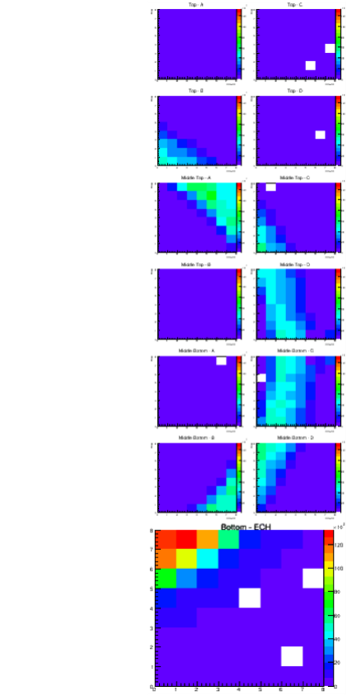
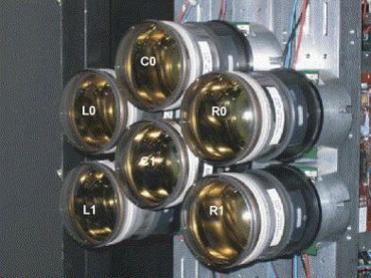
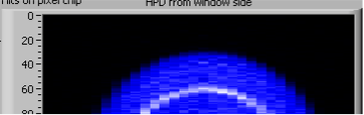
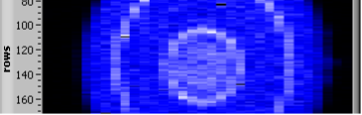
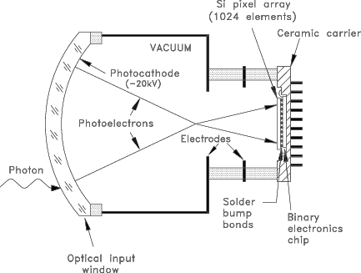
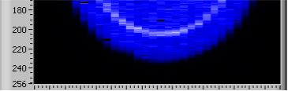
Alternative photodetectors
MaPMTs in a test-beam setup
LHCb RICH currently uses MaPMT photodetectors: commercially available (Hamamatsu R13742) but pixel size = 2.9 x 2.9 mm²
→ may be OK for prototyping, but pixel size would limit resolution
The previous photodetectors of the LHCb RICH were HPDs with nominal pixel size at the photocathode 2.5 x 2.5 mm², but they
had a high resolution “ALICE” readout mode → 2.5 x 0.3 mm²
HPDs probably still available, but associated readout may not be…
HPD readout in ALICE mode
HPDs
HPD construction
8 cm

Slide 12
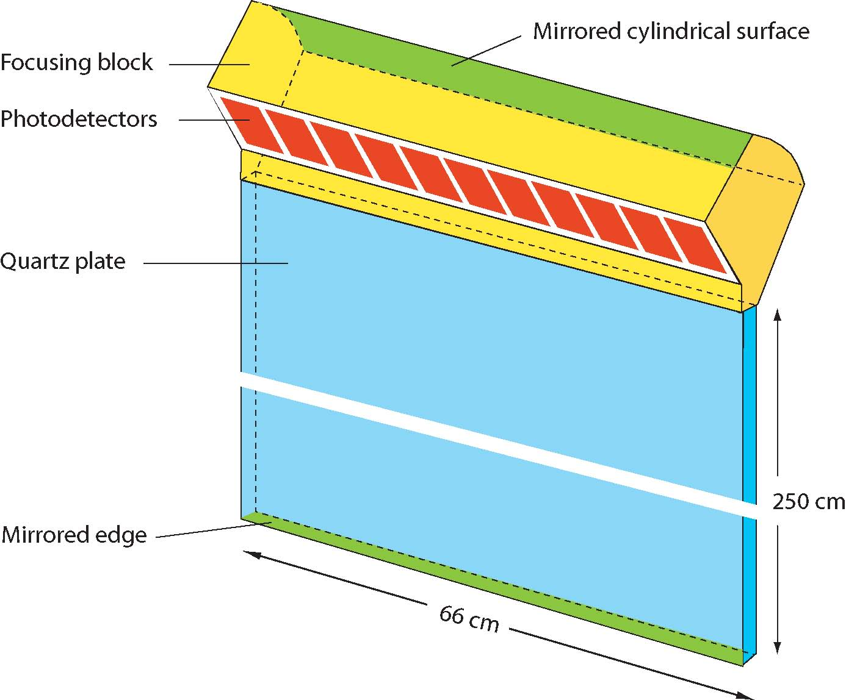
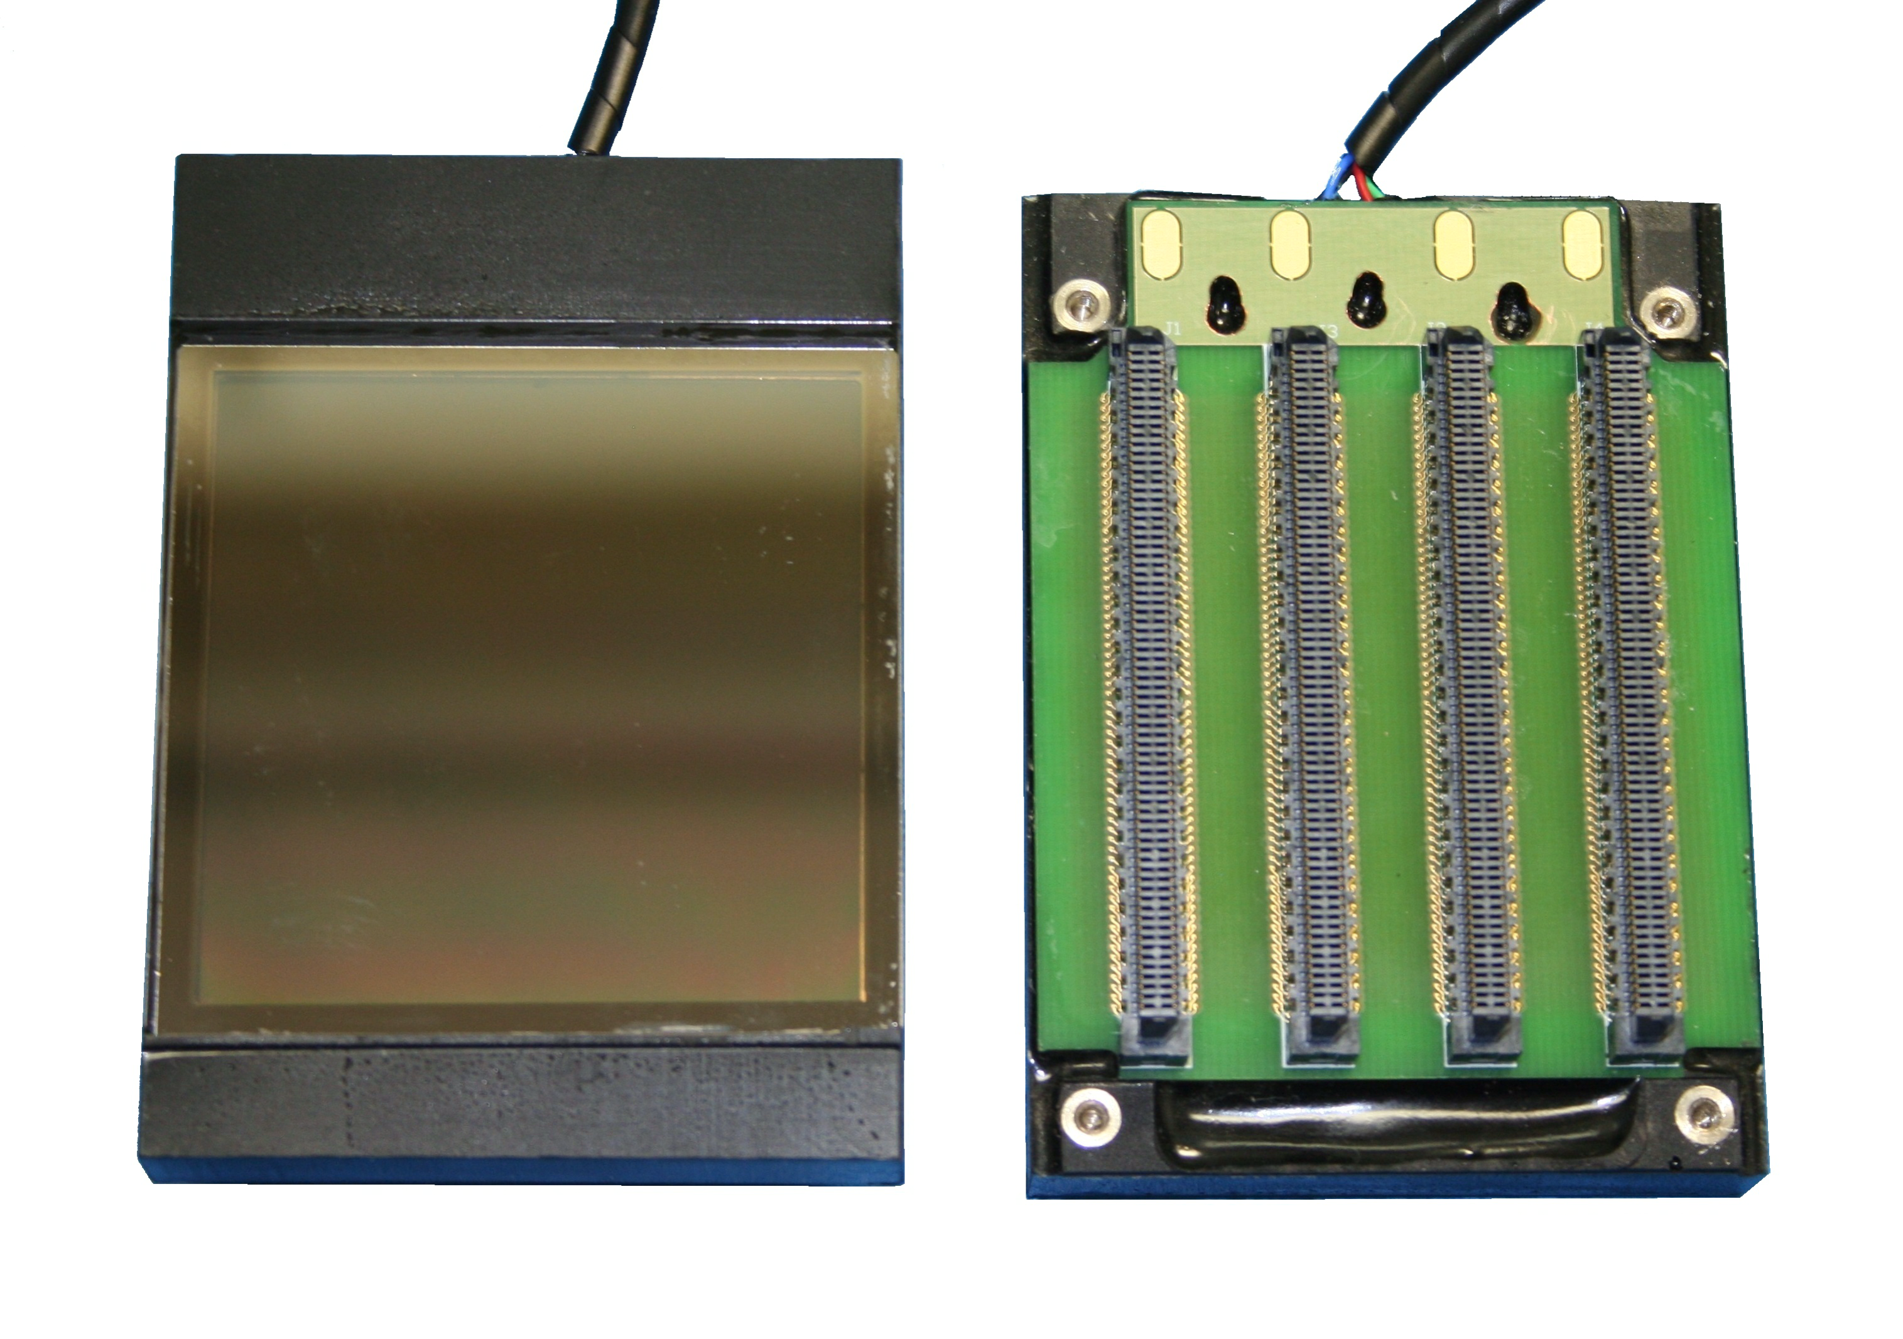
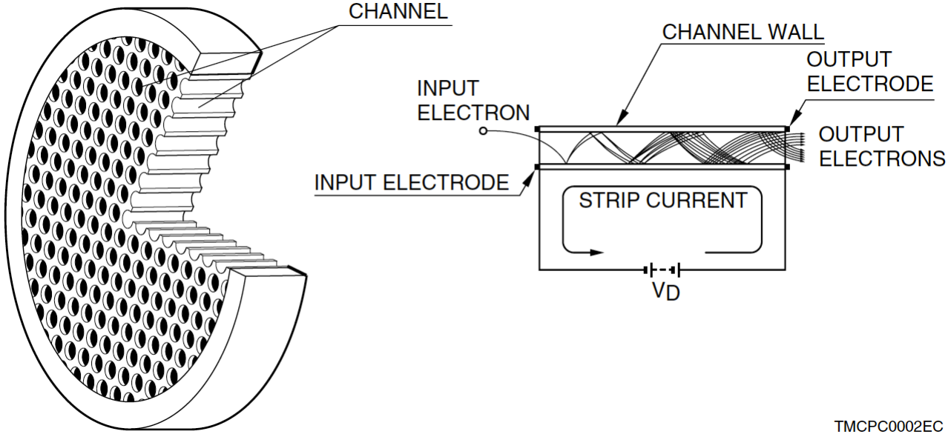
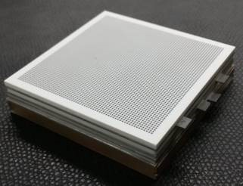
Alternative photodetectors (2)
TORCH module
TORCH project for LHCb Upgrade II also requires high granularity photodetectors, for precision time-of-flight
Fast microchannel plate PMTs have been developed
Latest version will have 0.55 x 0.55 mm² pads
The challenge would be coupling suitable electronics
readout, if you want to exploit the full granularity
In the end, development of an adapted SiPM solution
is probably the most promising, if there is time to do so
Front of MCP-PMT
Rear (with readout PCB)
MCP
64 x 64 pads on ceramic anode
60 mm
JINST 10 (2015) C05003

Slide 13
Pattern recognition
Simply plot the radius of all detected photon hits relative to each track in turn (here shown for the central track, b)
Hits from that track form peak that can be easily identified
Repeat for the other tracks in the event
Simulated event display:
For 0.5 x 0.5 mm² pixels (38k channels over full detector plane) occupancy is very low ~ 0.1% from signal tracks → there is plenty of headroom for additional background tracks
Photon hit
Typical Λ_{c} event, from data provided by Sara Cesare
Track
(impact point on
detector plane as if
reflected in mirror)
p
c
π
b
K
a
π
K
p
Radius (cm)

Slide 14


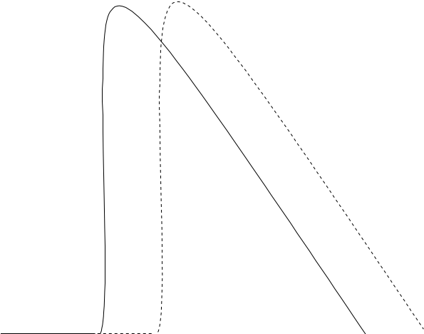
Predicted performance
Separation on a linear scale
compared to daughter momenta
The separation in sigma of two particle types is given by:
N_{σ} = |m₁² – m₂²|
2 p² (σ_{θ} /√N_{pe}) √(n² – 1)
Plot K-π and p-π separation, for the parameters given earlier:
N_{σ}
K-π
p-π
Analytic calculation for isolated tracks
K-π
p-π
Threshold behaviour comes
from the √N_{pe} term ∝ sin θ_{C}
Upper limit for 3σ K-π (p-π)
separation: 610 GeV/c (1.2 TeV/c)
→ fulfils the requirements
The upper momentum limit could be pushed further by reducing the gas pressure or reducing the photodetector bandwidth
A longer radiator length would then be required to maintain same yield of detected photons—e.g. 20 μrad resolution + 7 m length would allow 3σ K-π separation up to 870 GeV/c—is that needed?
100
Separation (sigma)
10
3σ
1
100
1000
Momentum (GeV/c)

Slide 15
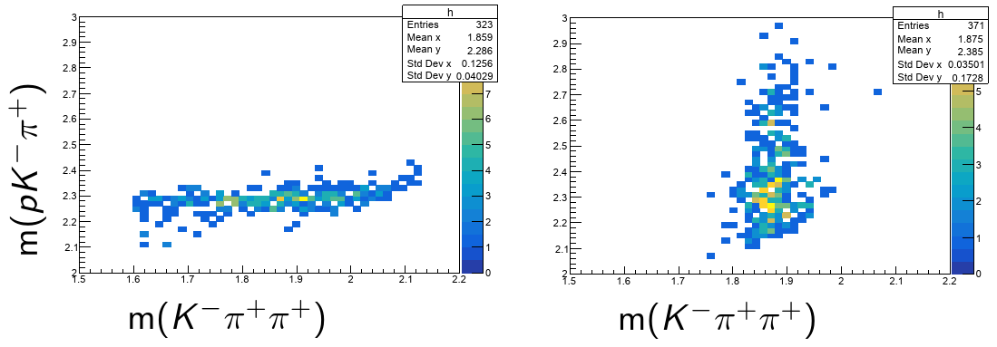
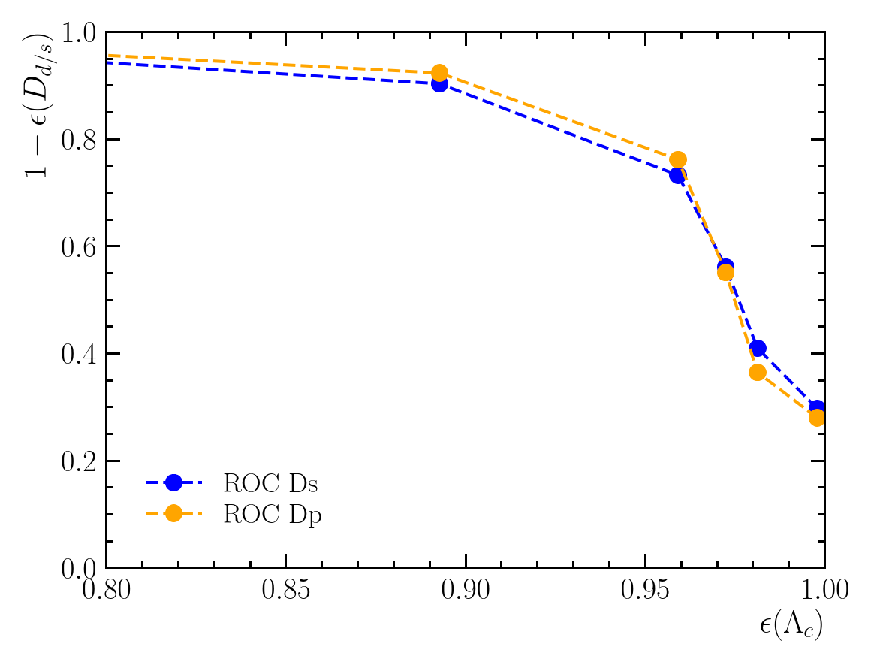
Background suppression
Λ_{c} sample
D⁺ sample
Performance for physics of the current design has been studied by Jascha Grabowski
Calculate RICH separation N_{σ} significance from parametric formula given on previous slide, take sign from true ID, draw PID response for each track from unit Gaussian shifted by N_{σ} /2
Compare efficiency for signal Λ_{c}⁺ → p K⁻ π⁺ and suppression of background decays D⁺ → K⁻ π⁺ π⁺ and D_{s}⁺ → K⁺ K⁻ π⁺ —they would pollute peak in m(Λ_{c}⁺) when the decay products are misidentified
Achieve 90% rejection for 90% signal retention
→ performance of the RICH appears sufficient, for the baseline design, 5 m long: no need to pursue even higher resolution (for now, at least)
Background rejection
Signal efficiency

Slide 16

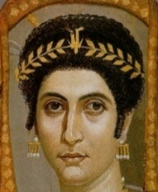
Conclusions
A gaseous RICH detector has been designed for the double-crystal experiment, to suppress background in the measurement of the magnetic moment of charmed baryons
It would need to be part of a dedicated experiment—but that might anyway be advantageous, allowing the physics goals to be broadened, e.g. EDM of the tau?
With the use of helium gas as radiator and high performance SiPMs as photodetector,
excellent (p,K,π) separation is achieved for momenta out to several hundred GeV/c, as required
This performance relies on achieving an excellent angular resolution of ~ 40 μrad per photon,
which in turn requires high spatial granularity (sub-mm) for the photodetector
The proposal has been illustrated using SiPMs like those of the LHCb SciFi, but could be adapted to other photodetector solutions—developing this detector would fit well in the context of the new DRD4 collaboration for R&D on Photodetectors and Particle ID that has just been launched
e.g. as in Fu et al, Novel Method for the Direct Measurement of the τ Lepton Dipole Moments
PRL 123 (2019) 011801
If such a RICH detector does go ahead, I suggest to name it DIADEM
(Decay Identification Apparatus for Dipole Electromagnetic Moments)

