Slide 1
X-Ray Characterisation of the TCCS and TCCP Crystals
Eloise Matheson, Santiago Andres Solis Paiva, Mario Di Castro
TWOCRYST Workshop: 12th December 2023

Slide 2
Contents
X-Ray Characterisation
The Crystals
TCCS crystal results
TCCP crystal results
Future X-Ray Diffractometer

Slide 3
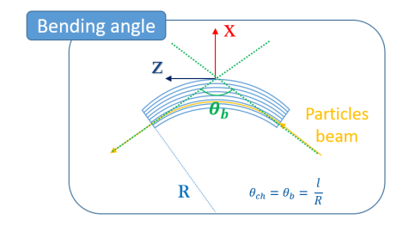
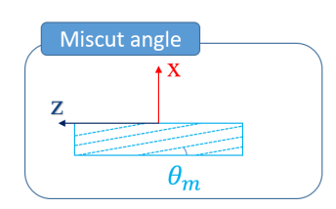
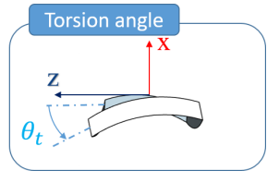
X-Ray Characterisation of Crystals
Use X-Ray diffractometry to measure;
Bending angle / deflection angle
Angle between incoming and outgoing planes of a crystal
Miscut angle
Angle between crystal plane and optical surface
Torsion
Vertical dependence of crystal plane orientations
Relies on x-rays having wavelength λ typically on the same order of magnitude as the spacing d between planes in the crystal (1 - 100 angstroms)
Bragg’s Law: 2 𝑑 sin⁡(θ)=𝑛 λ
θ
θ
d
Illustration of crystalline diffraction.

Slide 4
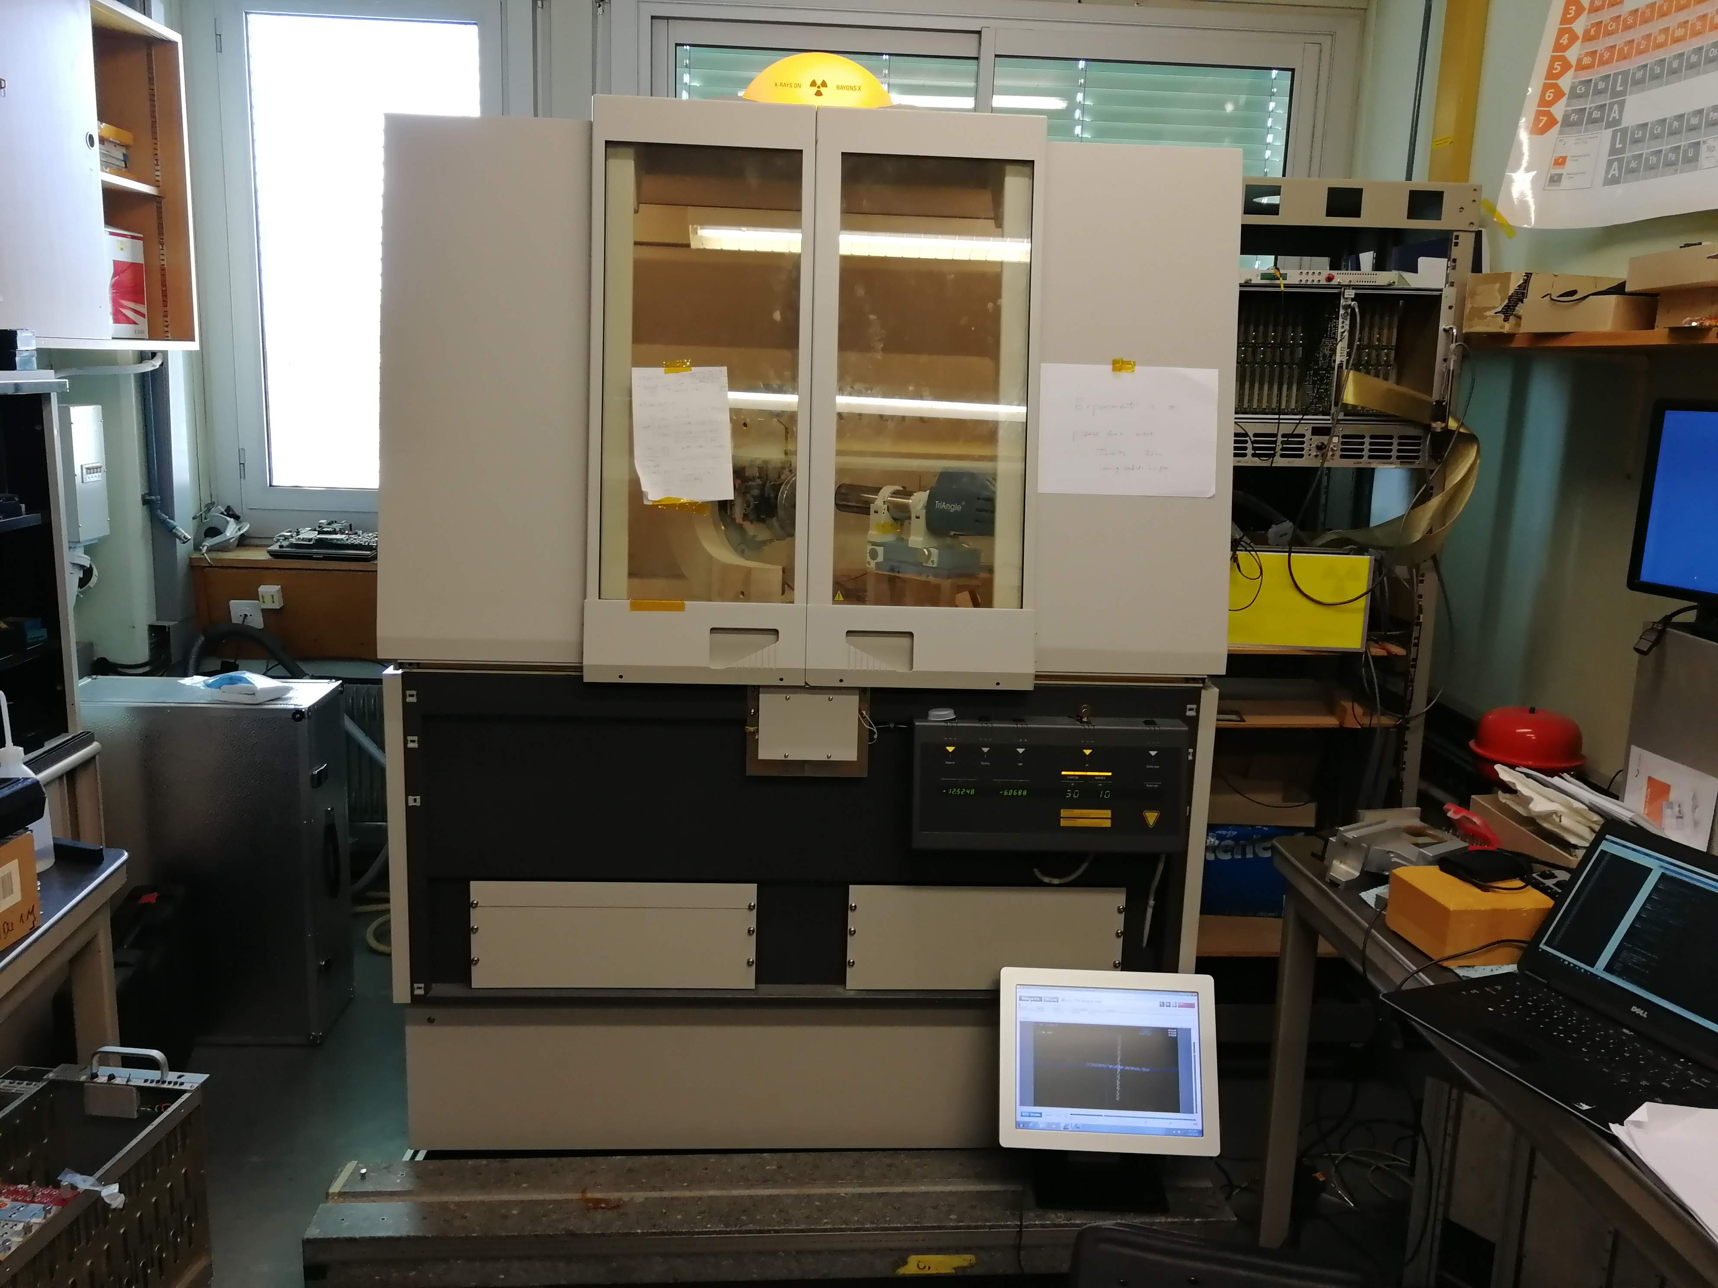
X-Ray Characterisation of Crystals
Flat surface
Angle
a
a
a
a
a
x
x
0
Cylindrical surface
Line plot → cylindrical surface
Angle
σ
R , m
σ, μrad/mm
x
X’Pert Panalytical machine for X-Ray diffractometer
x
0
Diagrams from Yury Gavrikov, ‘Characterization of crystals for LHC’

Slide 5
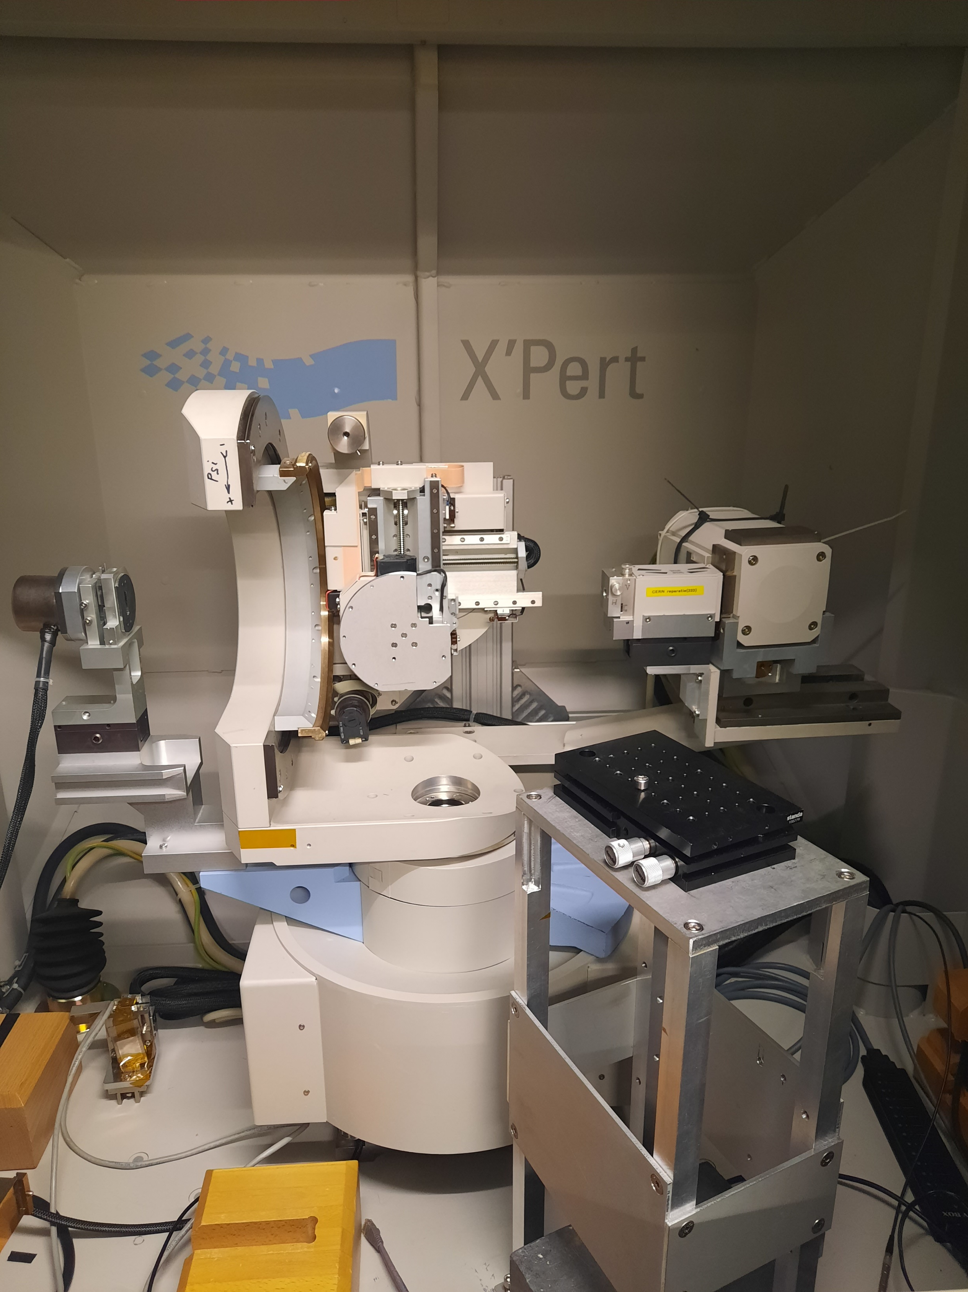
X-Ray Characterisation of Crystals
Measurement system necessary improvements
Modernisation of the sample table
Uncertainty on bending and miscut angles -> ± 2 µrad
Uncertainty on torsion -> ± 1 µrad
Thermal stability: < 3 µrad/hour
Beam parameters 130 µm width, 1150 µm height
Adaption of attachment plate for the crystal holder
Addition of reference mirror
Addition of custom-made digital autocollimator (PNPI)

Slide 6
X-Ray Characterisation of Crystals
The efficiency of crystals cannot be measured with x-rays, must be tested with beam e.g. SPS-H8 beam
Sources of difference between X-Ray machine and SPS-H8 beam measurements
Smaller x-ray beam that that uses for SPS-H8, hence more sensitivity to any crystal imperfections as the Bragg’s peak can have higher variations in location
Holder of the crystal may have undergone stress or changes, physically affecting the parameters (bending or torsion angles)

Slide 7
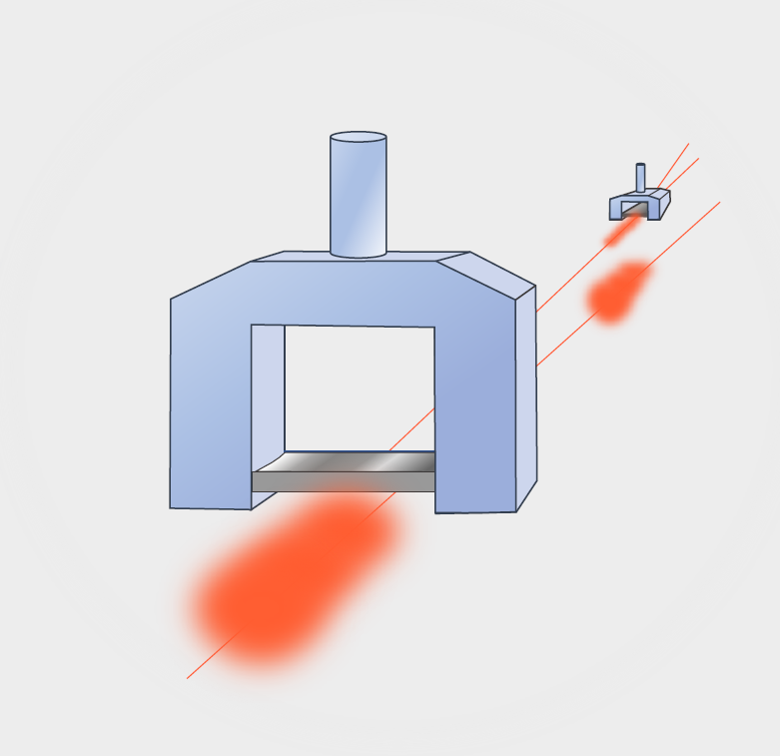
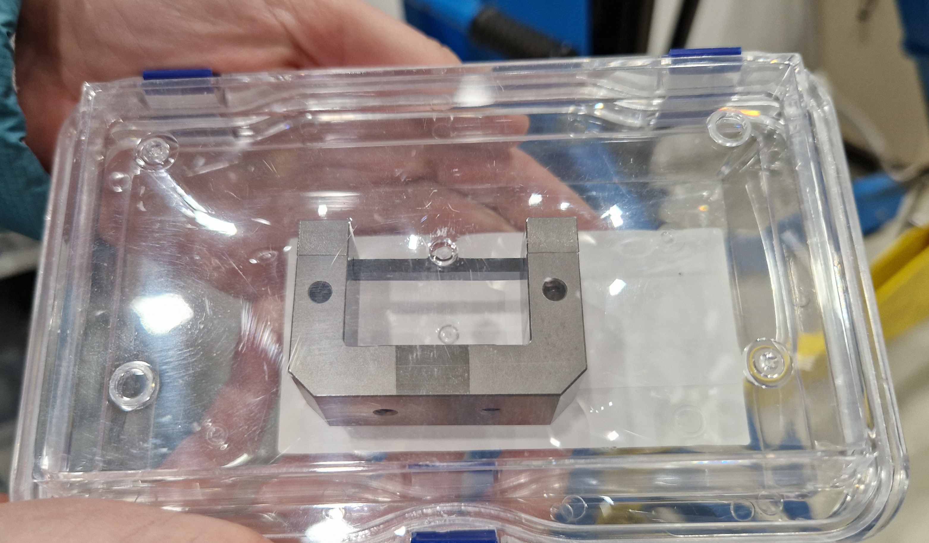
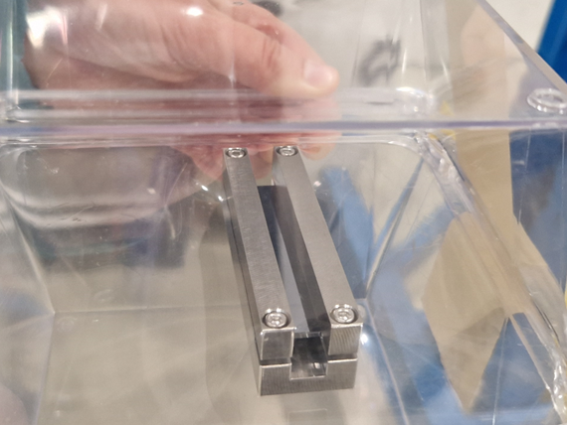
The crystals: TCCS and TCCP
TCCS
TCCP
Arrangement
TCCS
TCCP
LHC protons

Slide 8
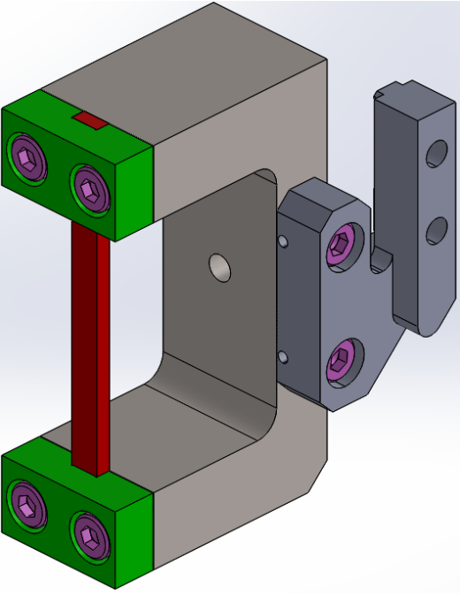
TCCS Crystal Results
STF-138 Assembly Sketch (INFN)
Crystal | Miscut (µrad) |  |  | Bending (µrad) |  |  | Torsion (µrad/mm)
STF-138 | Spec. | INFN | CERN | Spec. | INFN | CERN | Spec. | INFN | CERN
 | < 40 | 1 ± 1 | 2.5 ± 2 | 50 - 55 | 52 ± 2 | 51 ± 2 | < 1 | < 1 | 1.3 ± 1

Slide 9
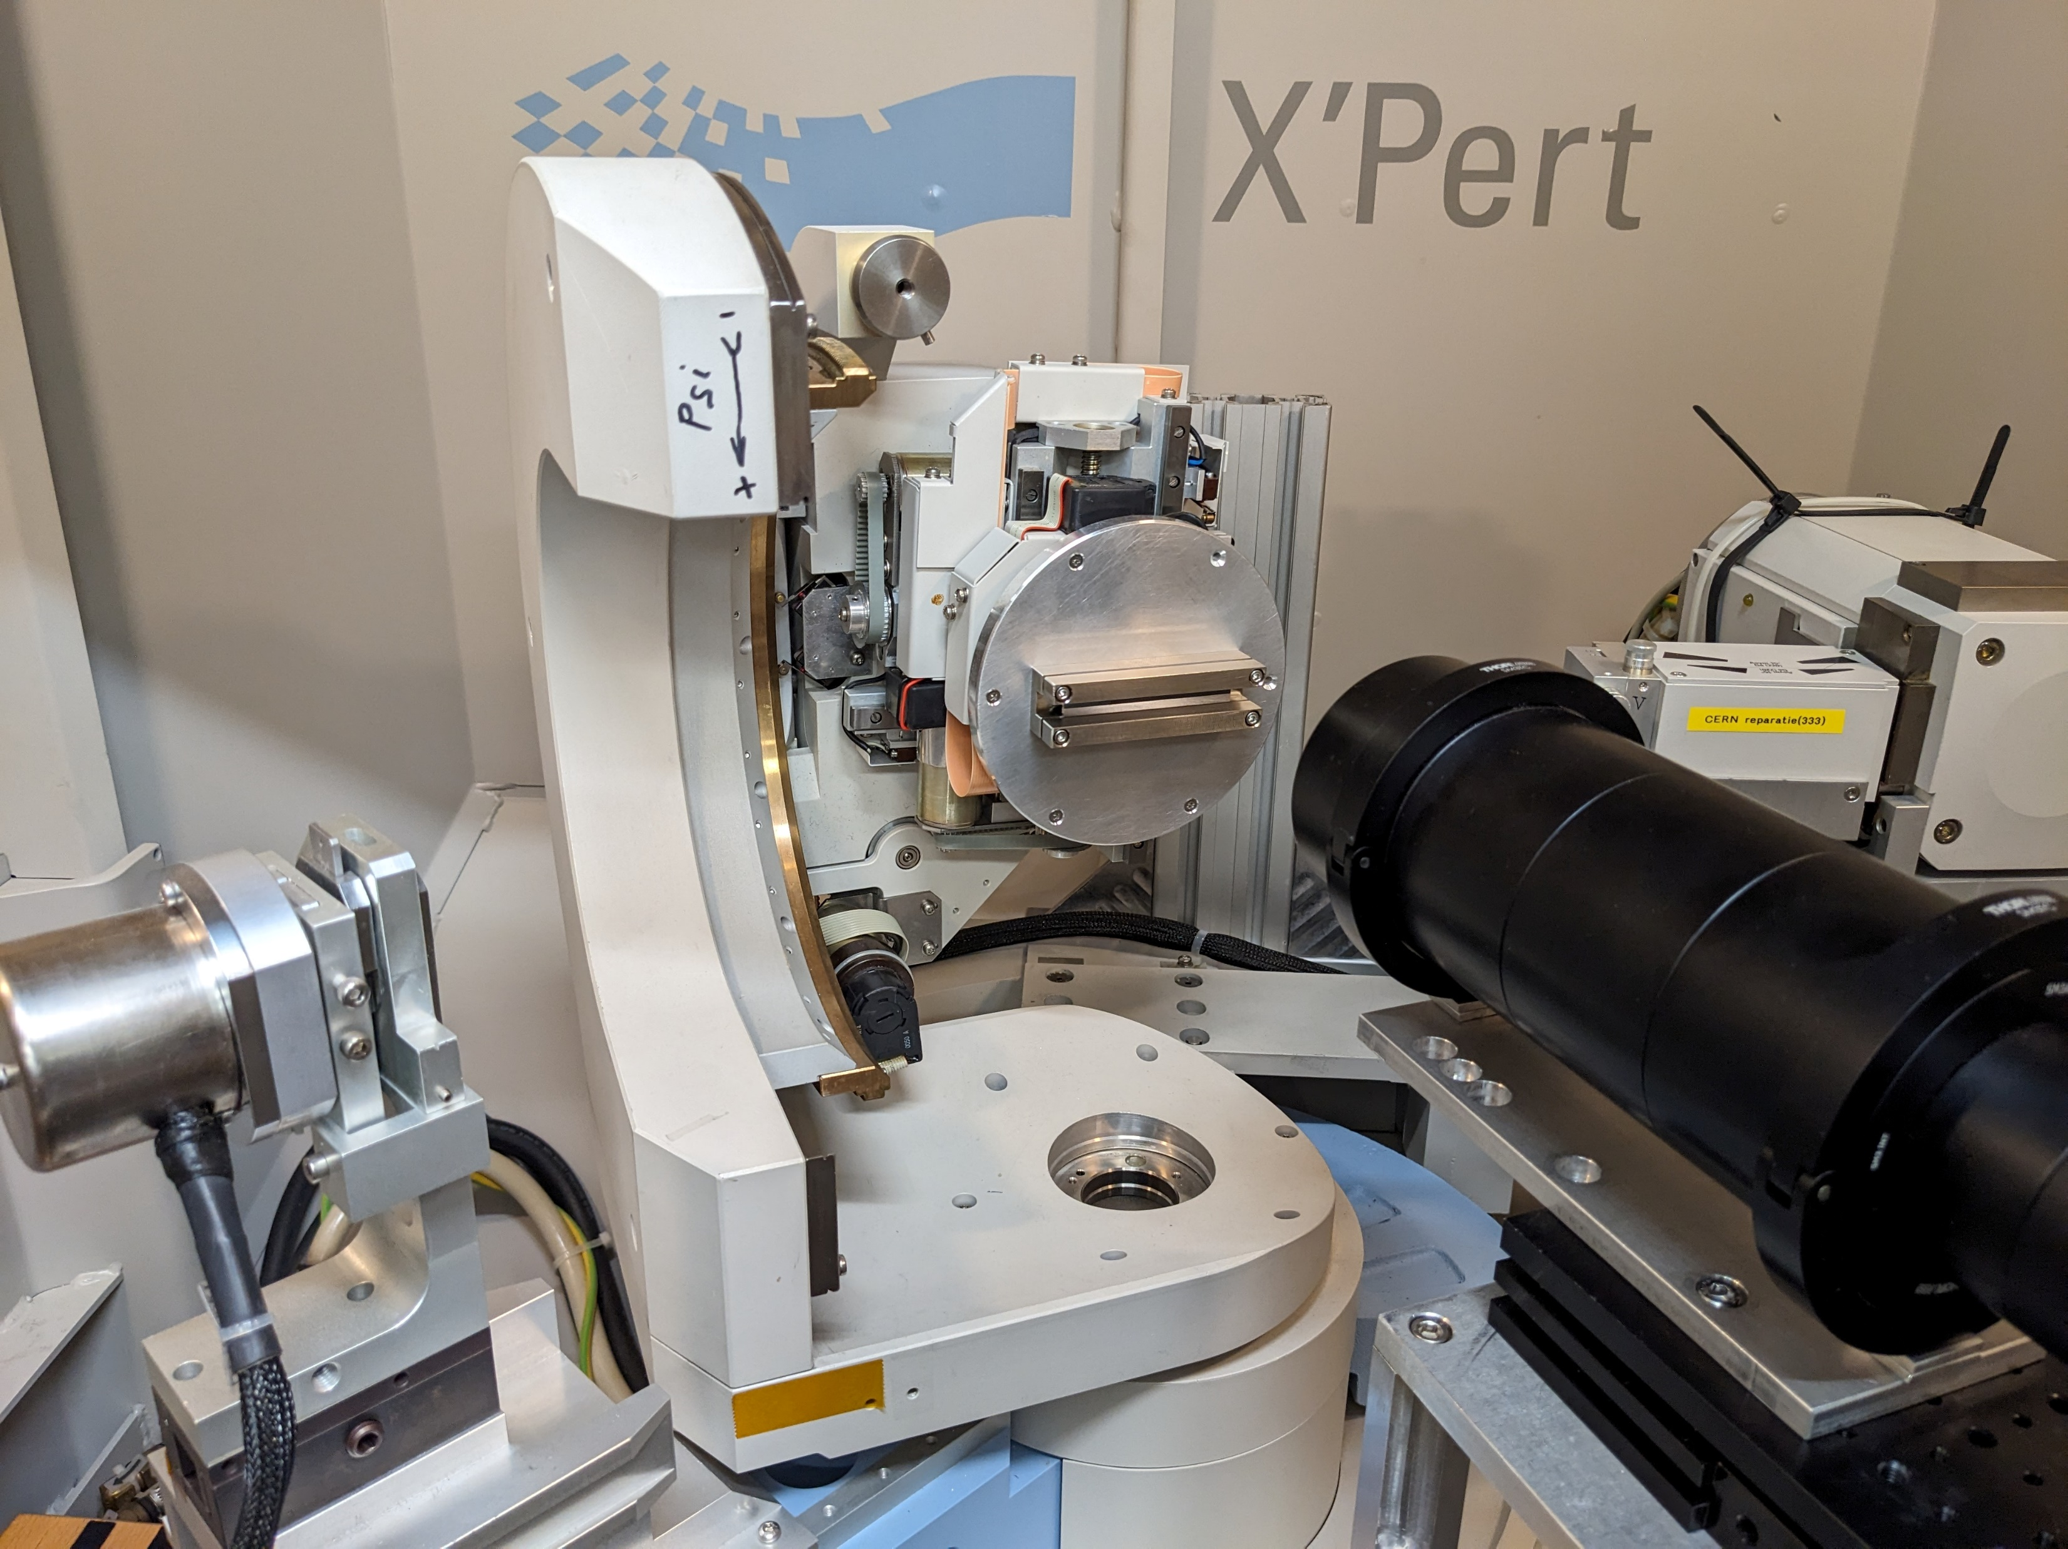
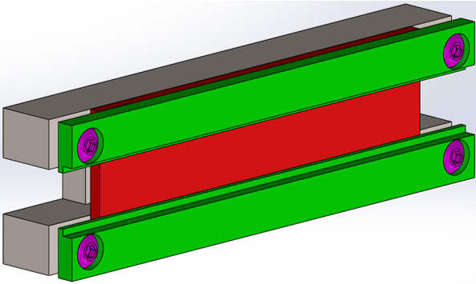
TCCP Crystal Results
2C-3 Assembly Sketch (INFN)
2C-3 Crystal in Machine
Crystal | Miscut (µrad) |  |  | Bending (mrad) |  |  | Torsion (µrad/mm)
2C-3 | Spec. | INFN | CERN | Spec. | INFN | CERN | Spec. | INFN | CERN
 | < 100 | < 200 | N/A | 6 – 7.5 | 6.9 ± 0.3 | 7.07 ± 0.3 | < 200 | < 200 | 12 ± 70

Slide 10
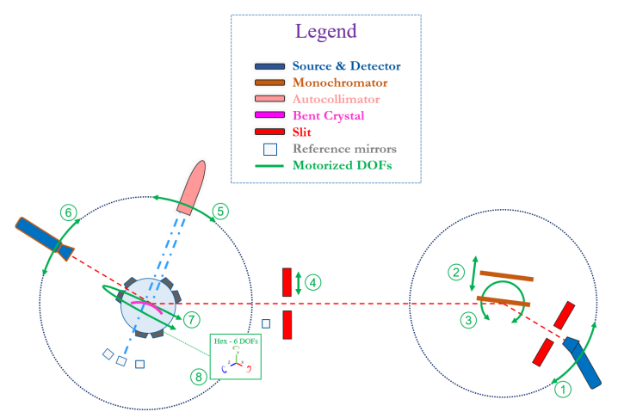
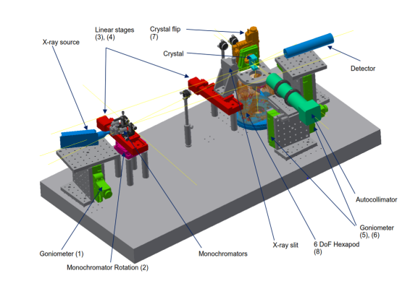
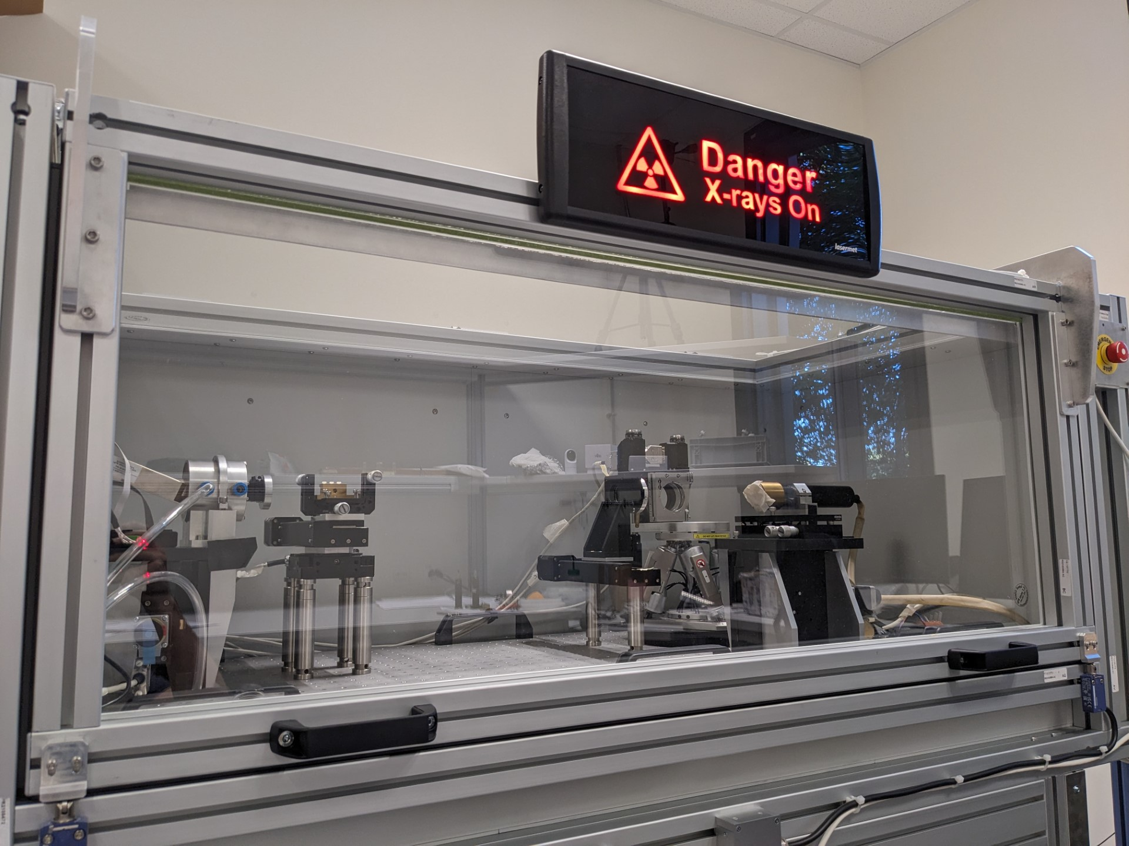
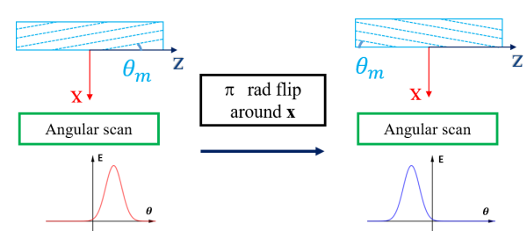
Future X-Ray Diffractometer
Novel in-house X-Ray based diffractometer under commissioning
Can measure crystal wafers and multi-strip crystals
Planned increased machine efficiency and availability keeping uncertainty levels with ± 1 µrad on the measurements of bending angle, miscut angle and torsion for TCPC crystals
Rotational stages and miscut measurement procedure studies
In-house machine layout
New machine under commissioning for 2024 operations

