Slide 1
TCCS Refurbishment Status
Eloise Matheson, Santiago Andres Solis Paiva, Mario Di Castro
TWOCRYST Workshop: 12th December 2023

Slide 2
Contents
Device Requirements
Device Base: TCPC
TCCS Refurbishment Steps
Current Status

Slide 3
Device Requirements
Property | Specification
 | TCCS | TCCP
Linear stroke | > 30mm
Minimum stroke across zero (centre of beam pipe) | 4 mm | 4 mm
Linear resolution | 5 mm | 5 mm
Linear accuracy | +/- 50 mm
Linear reproducibility | +/- 20 mm
Total angular range | +/- 10 mrad | +/- 10 mrad
Yaw angular resolution | 0.1 mrad | 0.1 mrad
Yaw angular precision over the entire linear range | +/- 1 mrad | +/- 1 mrad
Yaw angular overshoot | 10% | Not an issue
Yaw angular settling time | 20 ms | ~ 1 s
Yaw angle max speed in scan mode | 50 mrad/s | 50 mrad/s
Target Collimator for Splitting (TCCS)
Prototype has identical functional specifications as the Target Collimator Primary Crystal (TCPC) devices
TCCS will be a refurbished older TCPC device

Slide 4
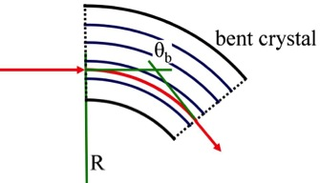
Device Base - TCPC
Crystal collimation, particularly for heavy ion beam run operations
Crystalline materials can trap charged particles in the potential well between atomic planes (channeling)
Bend crystal collimators force the trapped particles to follow curvature: deflection equivalent to hundreds of T at LHC energies
Upgraded devices installed for increased reliability, availability, maintainability and safety in YETS 21-22 (vertical) and YETS 22-23 (horizontal)
Bent crystal
Deflected halo
Massive Absorber
Main promises
Reduced inelastic interactions
Secondary halo
+ hadronic shower & Dechanneling
Reduced off-momentum losses
Circulating
beam
Primary halo
Insertion
Arc
IP
Reduced fragmentation of ions
Significant cleaning improvement
Figures from D. Mirarchi (BE-OP, CERN)

Slide 5
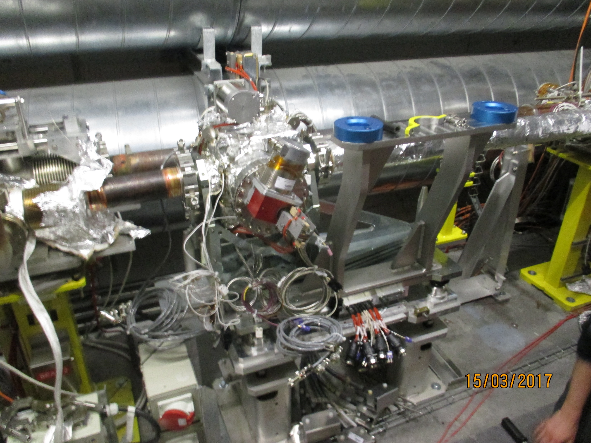
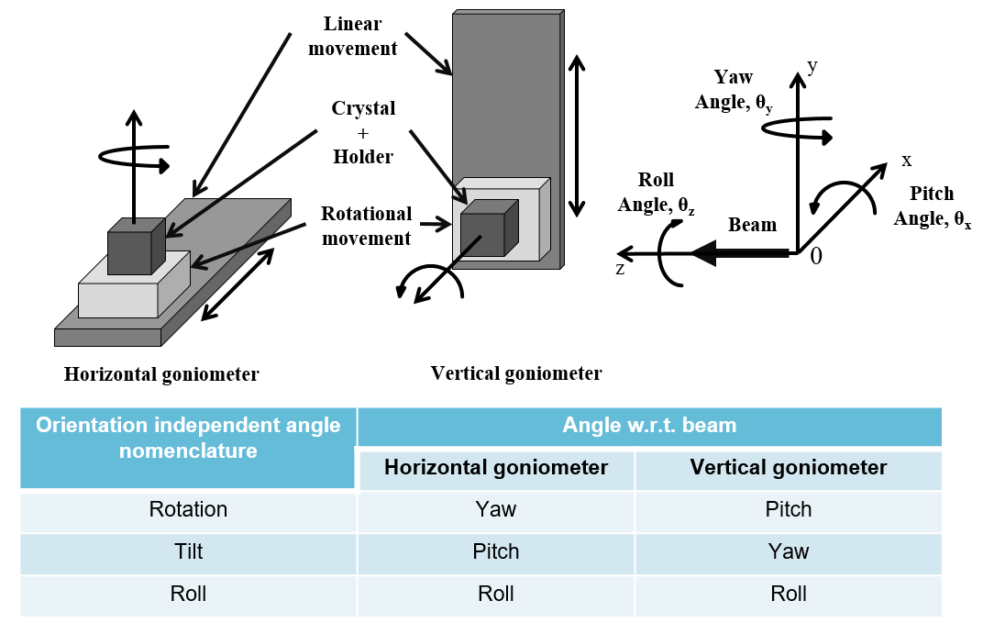
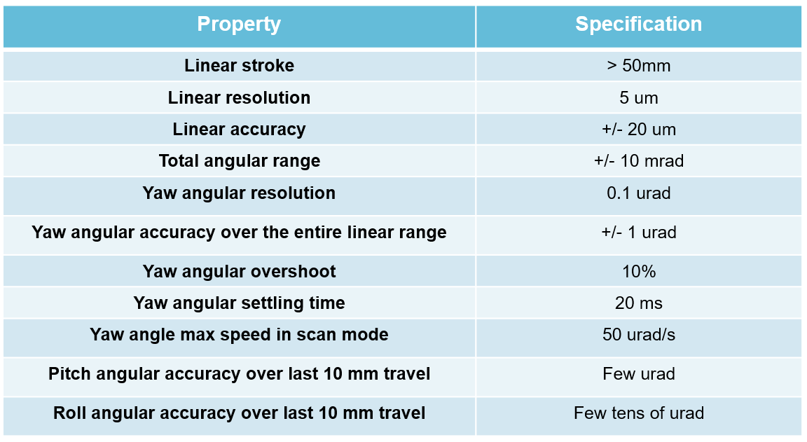
Device Base - TCPC
High-precision angular positioning system
Linear movement: Stepper motor actuated lead screw drive axis
Rotational movement: Piezo actuated rotational stage
TCPCV.A6R7 B2 Vertical

Slide 6
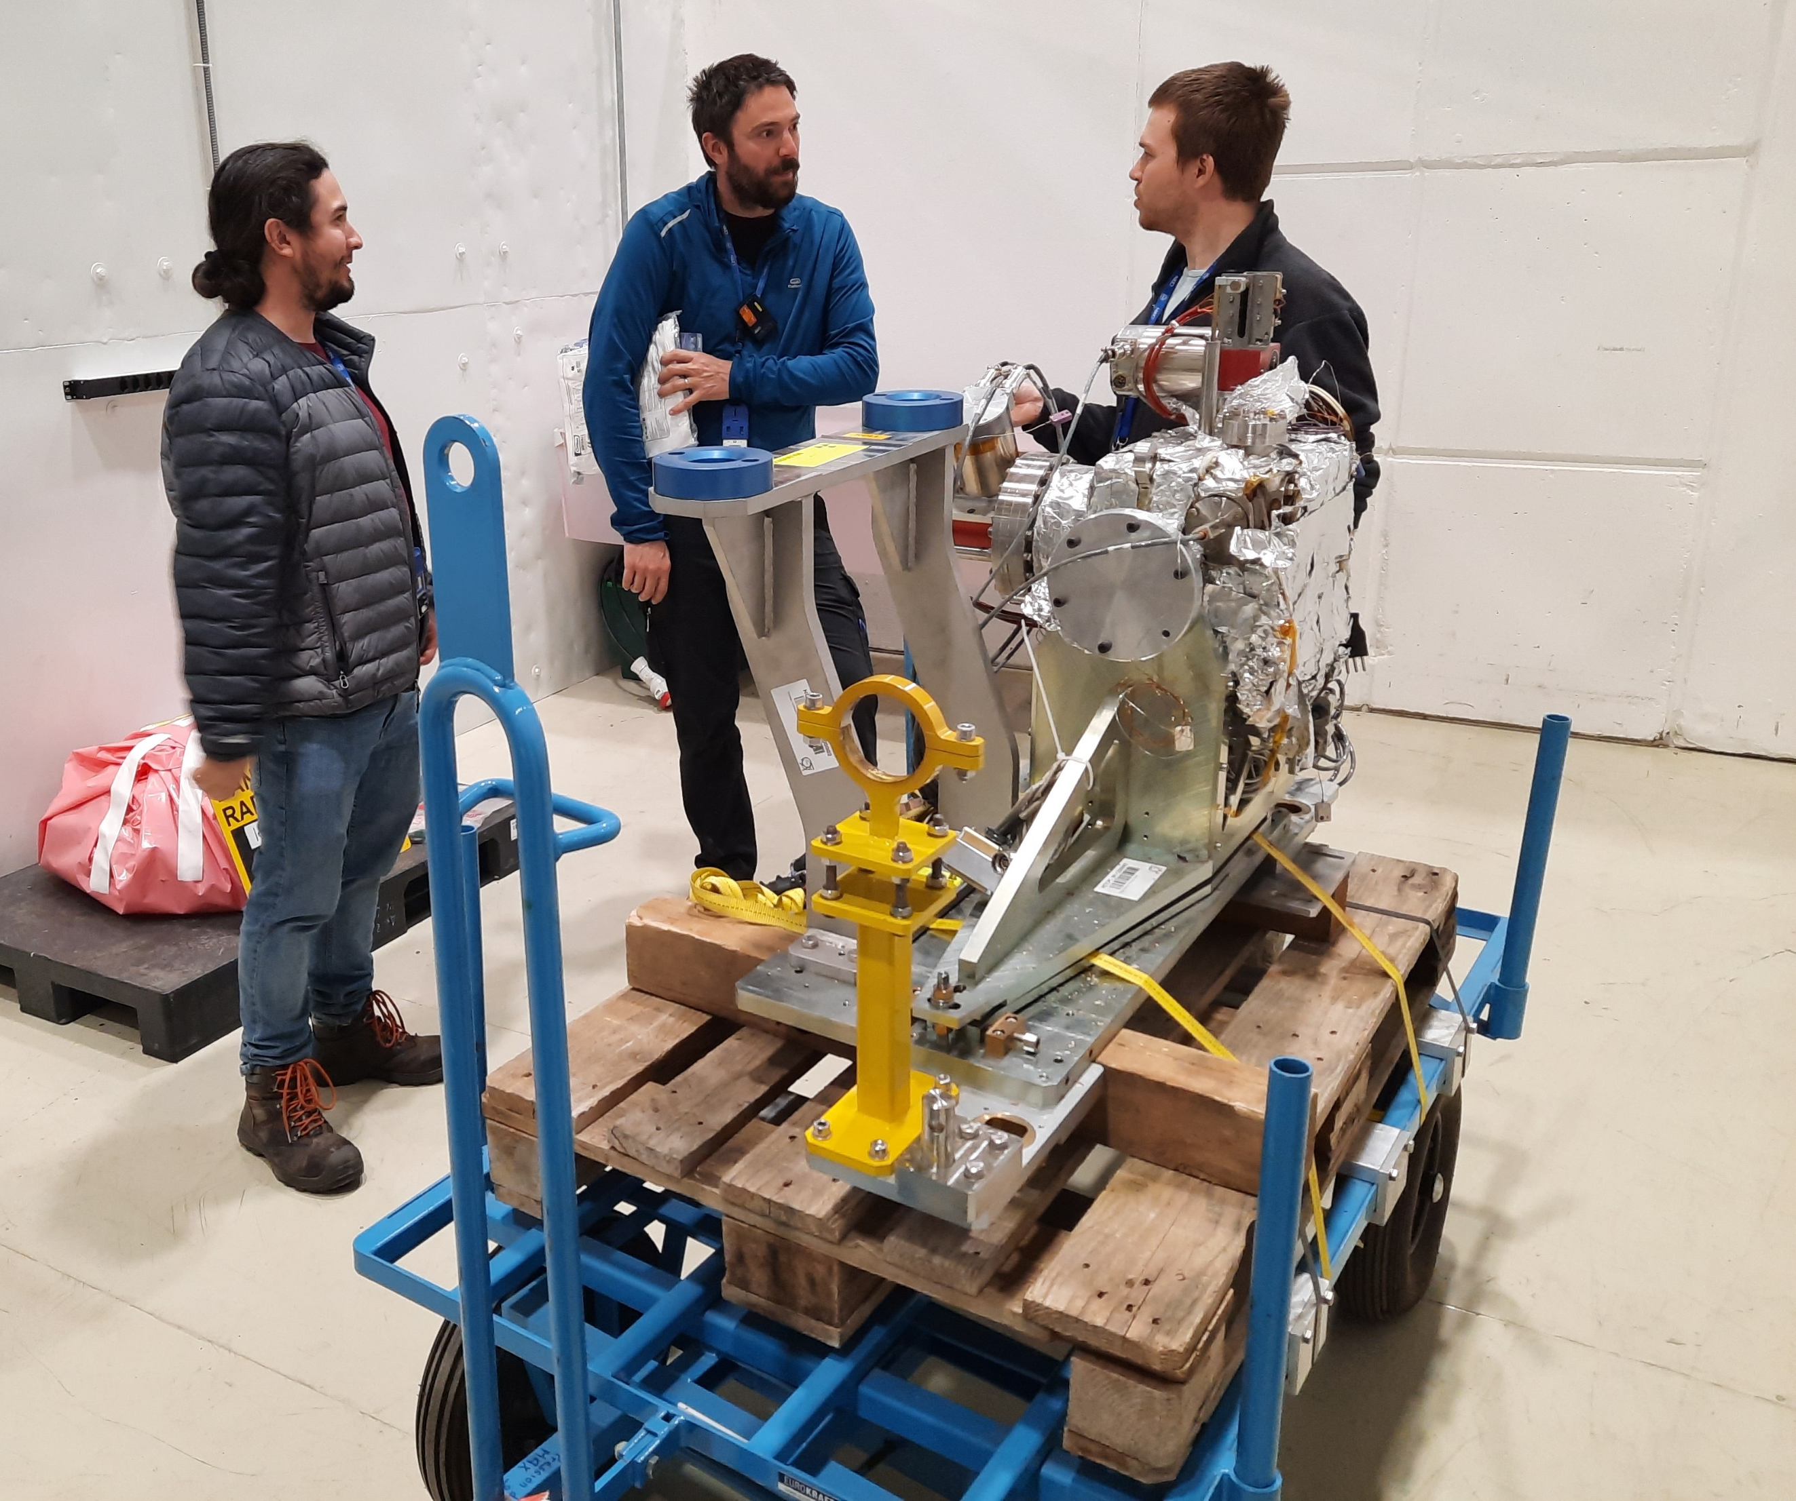
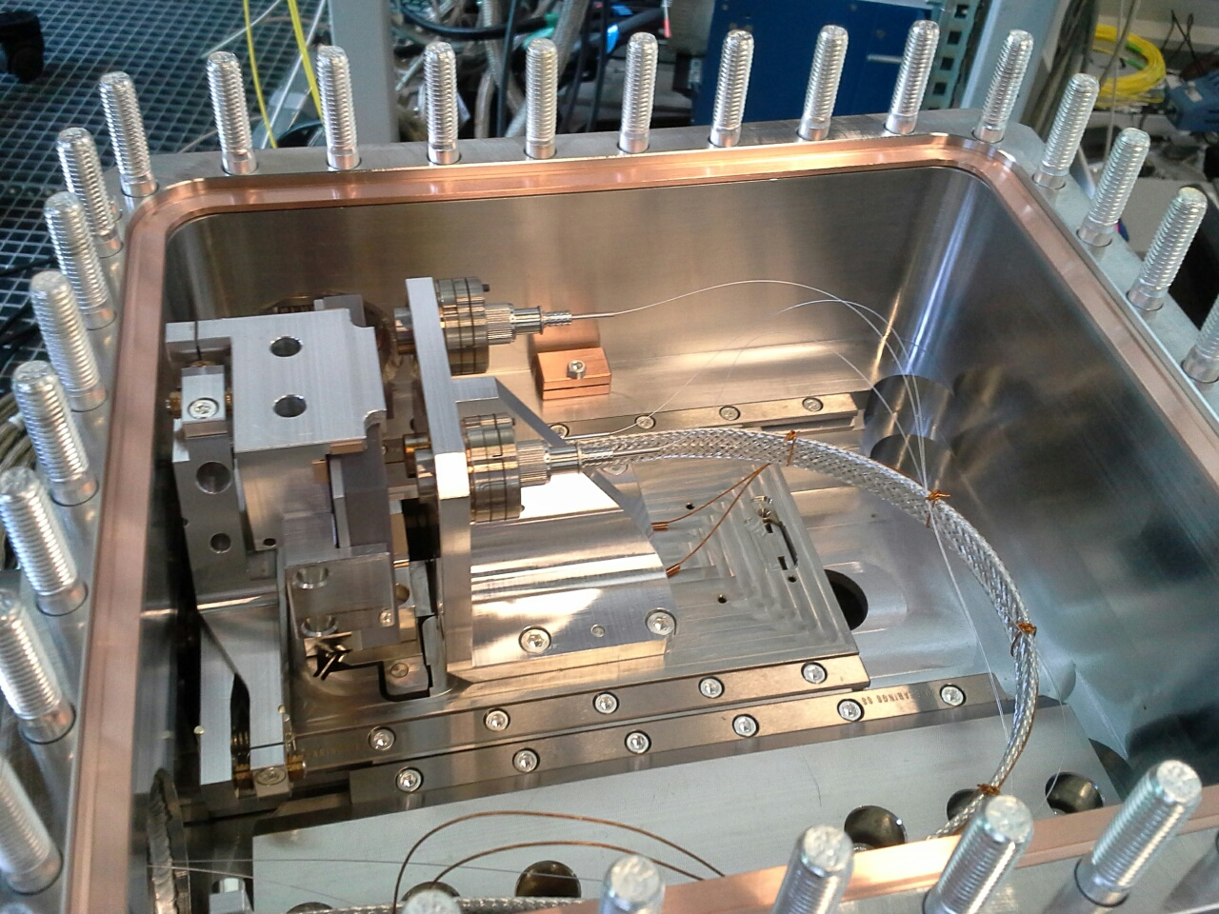
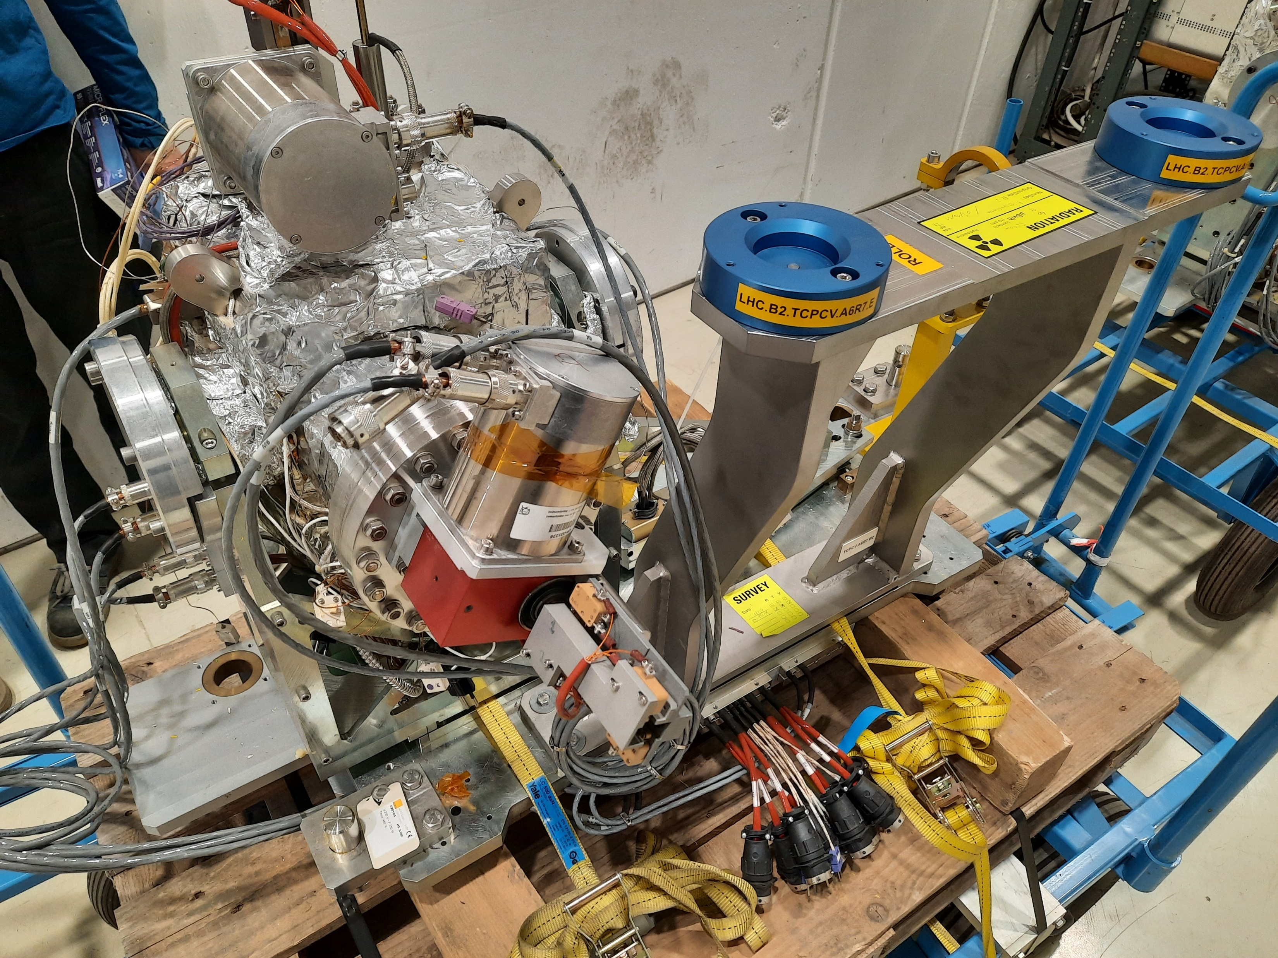
Device Base - TCPC
High-precision angular positioning system
Linear movement: Stepper motor actuated lead screw drive axis
Rotational movement: Piezo actuated rotational stage
Interferometric system (heads and mirrors)
Linear Rail Guides for Stepper Motor
Crystal mounted below
Rotational stage
Rotational stage based on flexible element and piezo-stack (v1)
Similar motion Stages inside the device (normally under vacuum)
TCPCV.A6L7.B1 after LHC uninstallation (built 2013, v1)

Slide 7
TCCS Refurbishment Steps
General inspection after opening the tank
Identification of spare components
Check motion of motors, LVDT feedback and switches
Check fibres and interferometer readings
Removal of old TCPC crystal
Installation and alignment of TCCS crystal
Motion controls calibration
Bakeout and tunnel installation steps

Slide 8
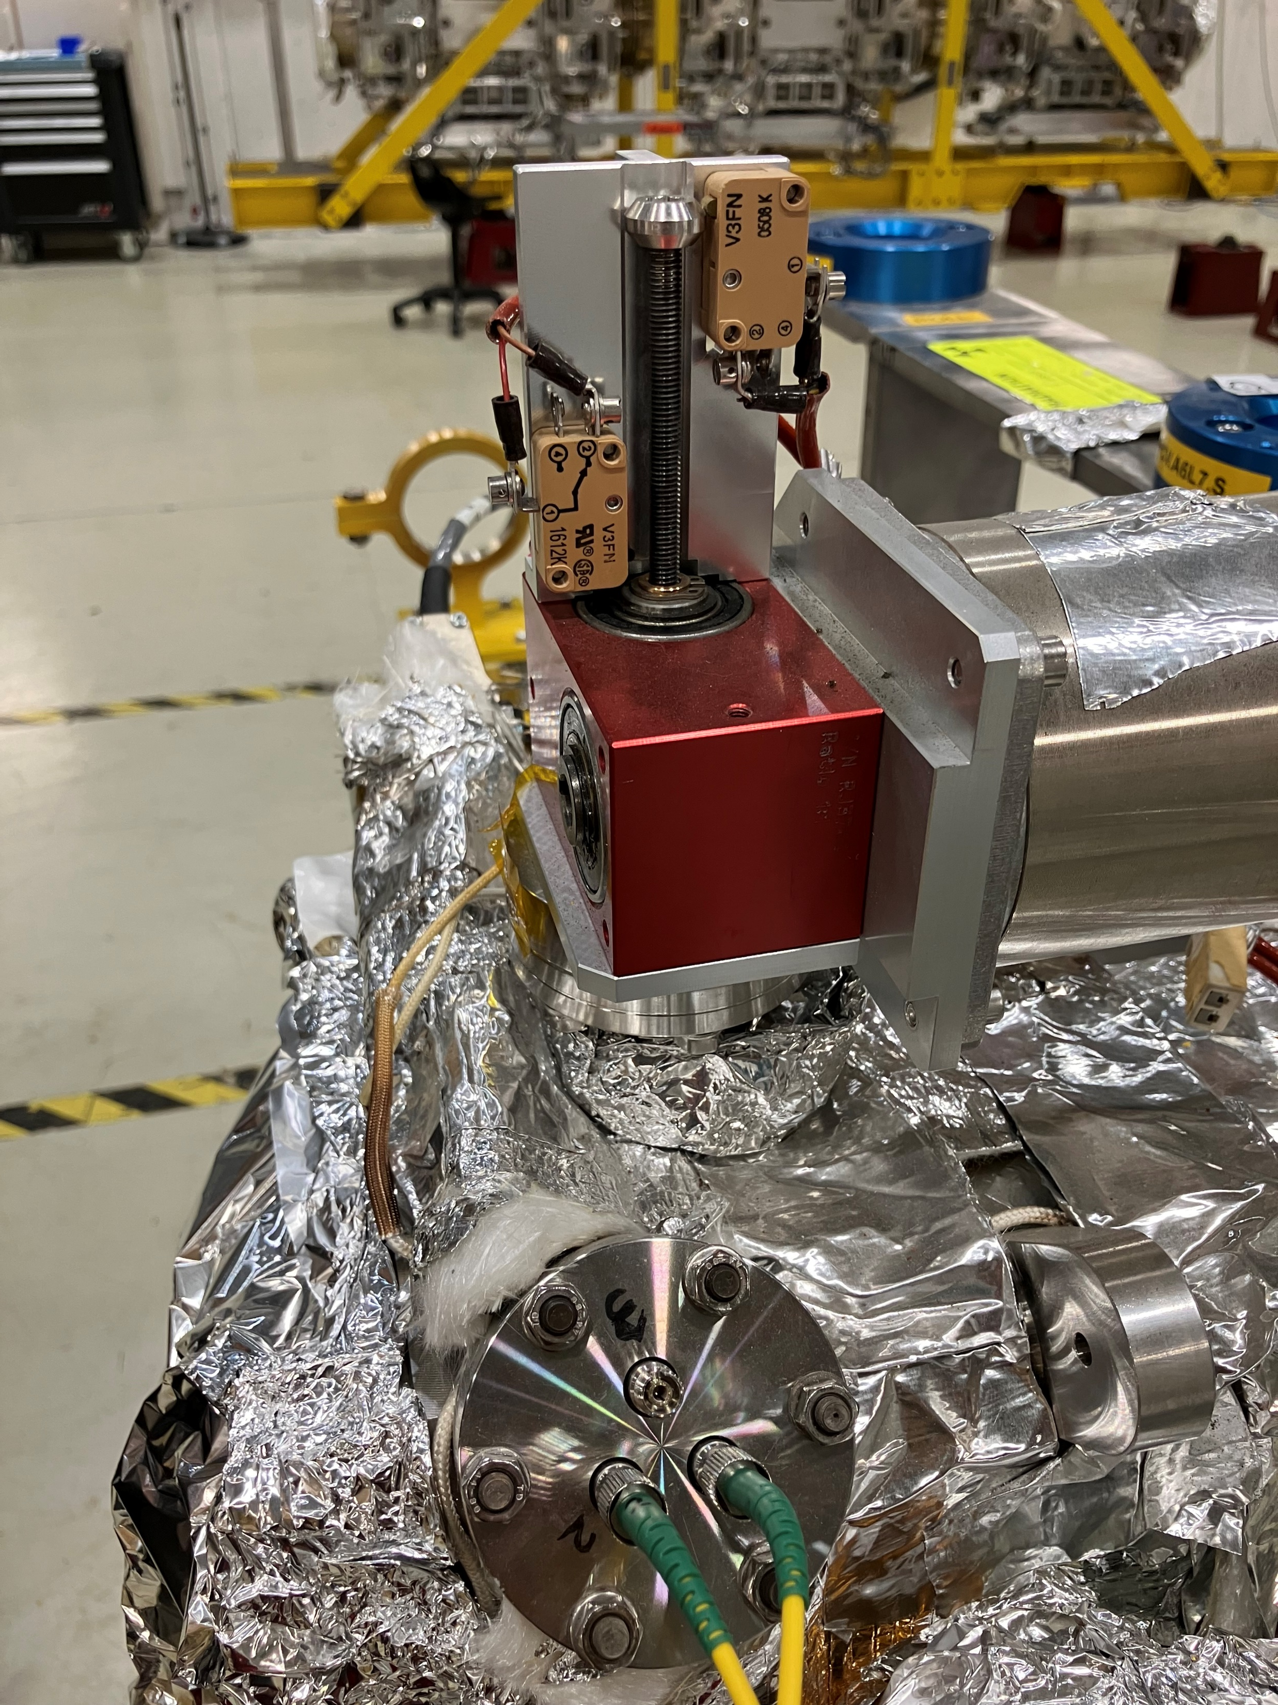
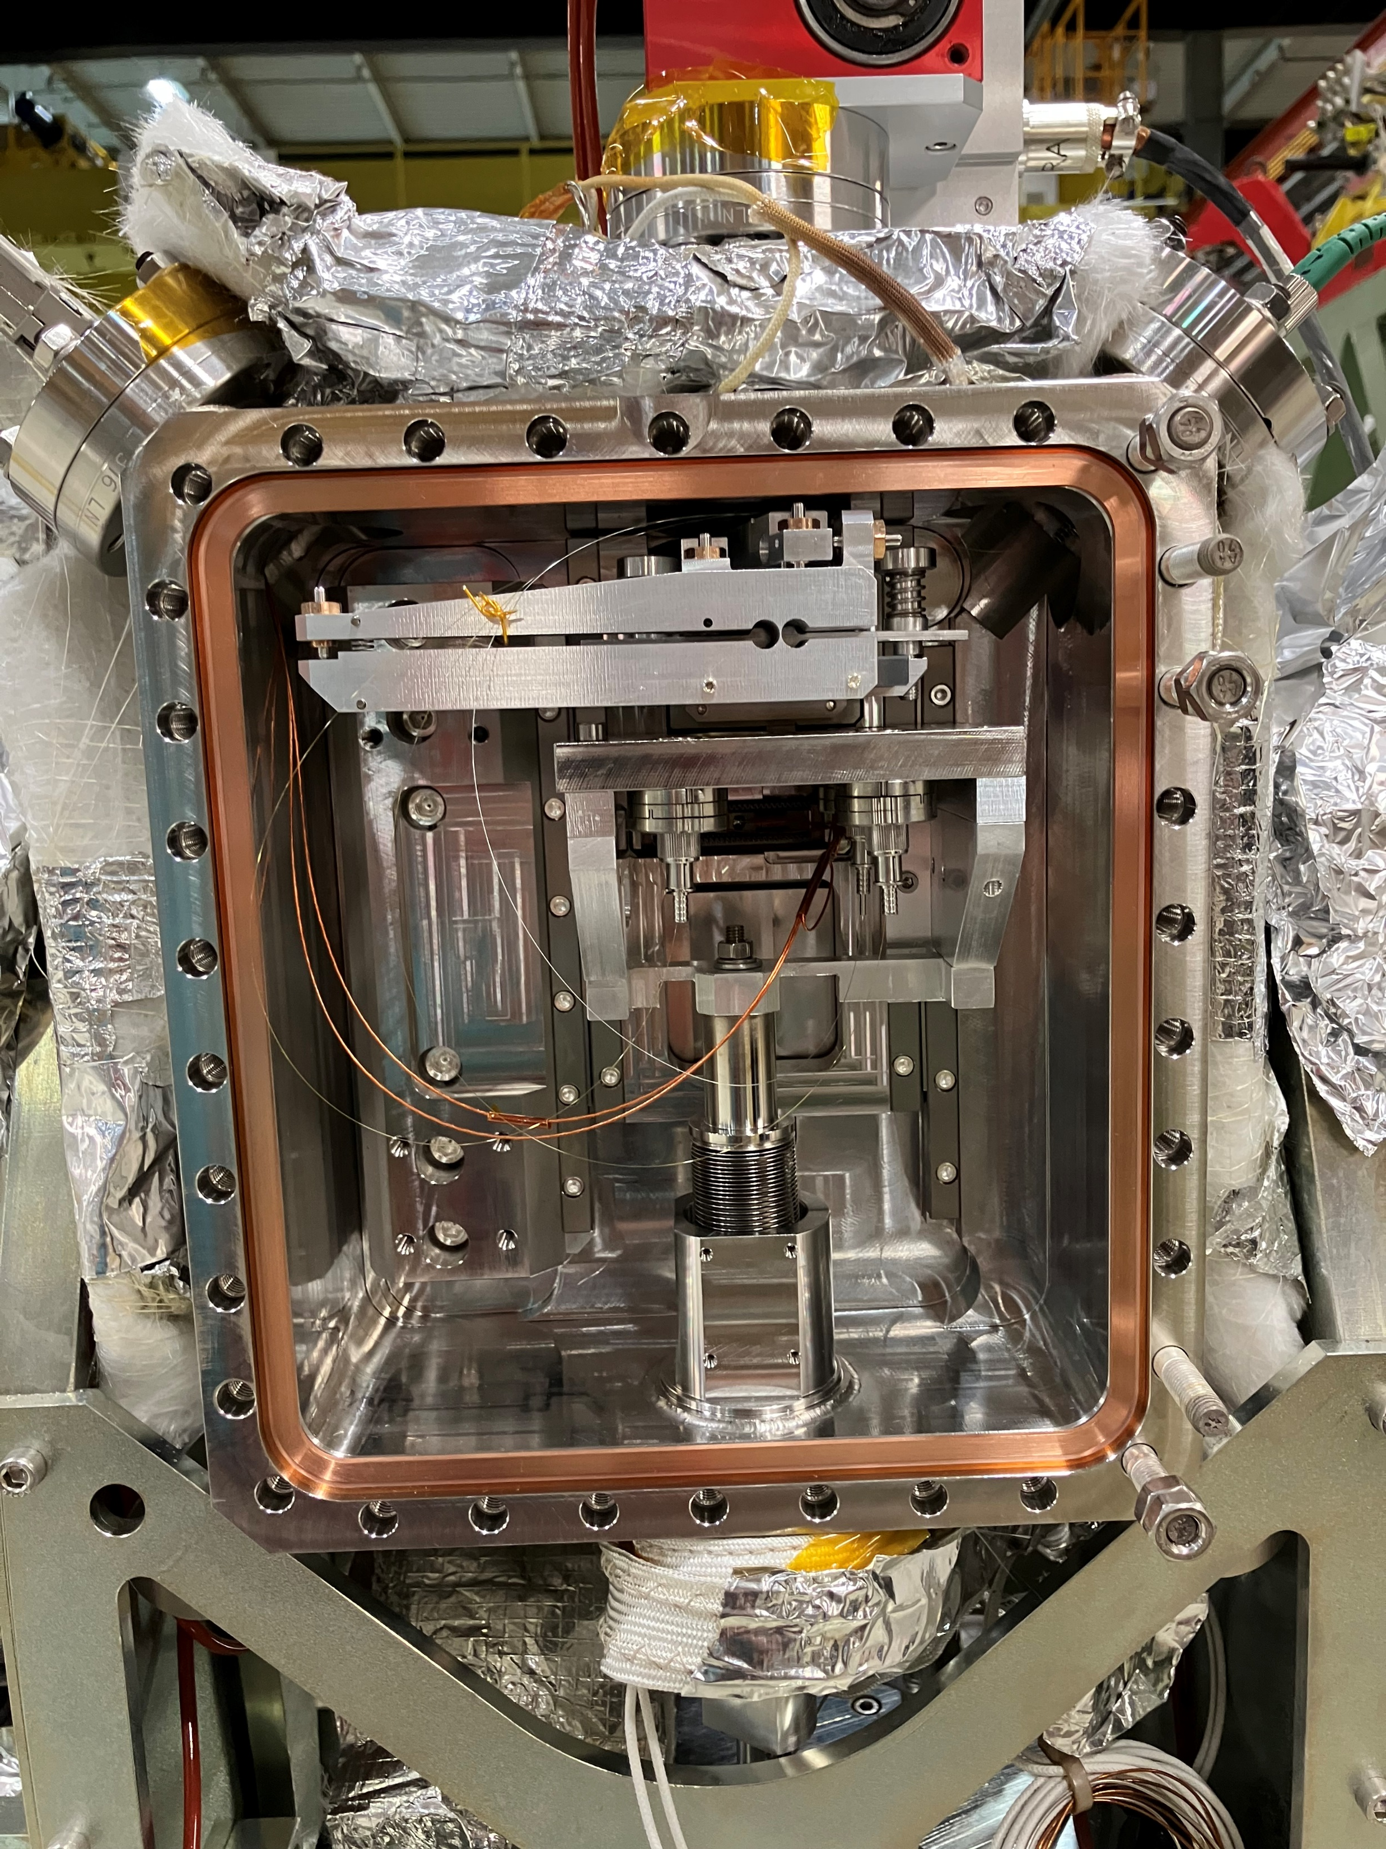
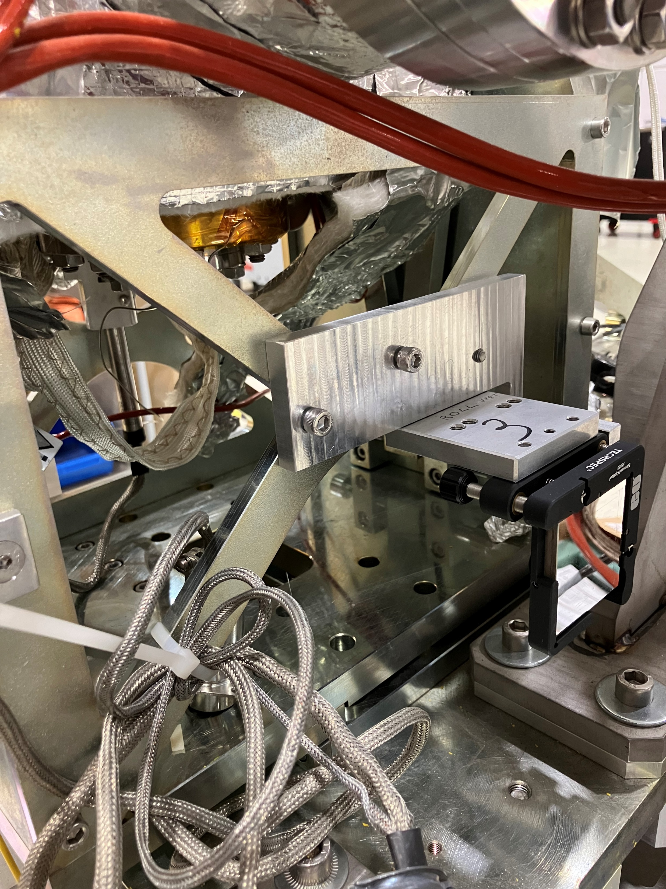
Current Status
Linear Stage Motor and Switches
Rotational stage, interferometry system & fibres
Mirrors mounted in preparation for crystal alignment

