Slide 1
Status of the TCCP assembly
Hana HAVLIKOVA, on behalf of CERN SY-STI-TCD
11/12/2023

Slide 2
Summary
Requirements for TCCP device
From requirements to operational designs
Impedance simulations
Schedule

Slide 3
Target Collimator Crystal for Precession (TCCP)
TCCS
TCCP

Slide 4
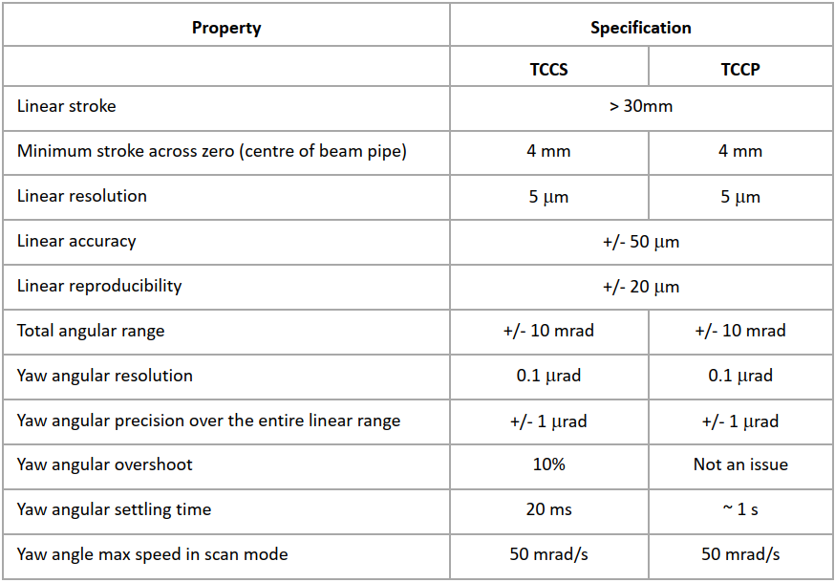
Requirements for TCCPs (Goniometers) devices
Compatibility with UHV and bake-out requirements
Monitoring of crystal motion and temperature
Crystal motion
Linear motion towards the beam
Yaw control to reach channelling angle
Target motion
Linear motion towards the beam (independent from the crystal motion)
Distance target-crystal 100-500 µm
Compatibility with impedance losses in operation position
Low-intensity runs (~$3 bunches of {10}^{11}$ protons at 7 TeV)
Compatibility with impedance losses in parking position
All types of run (including HL runs)

Slide 5
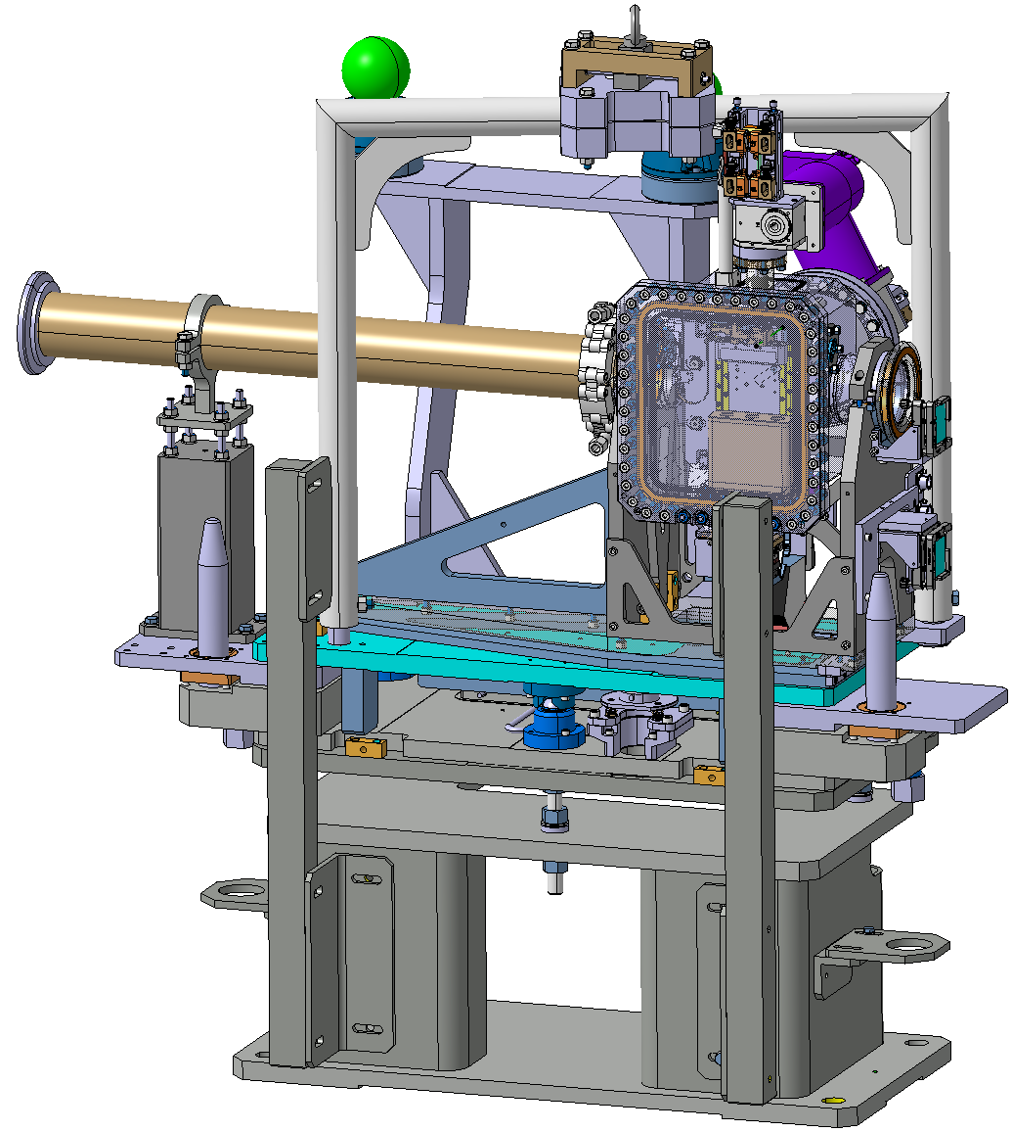
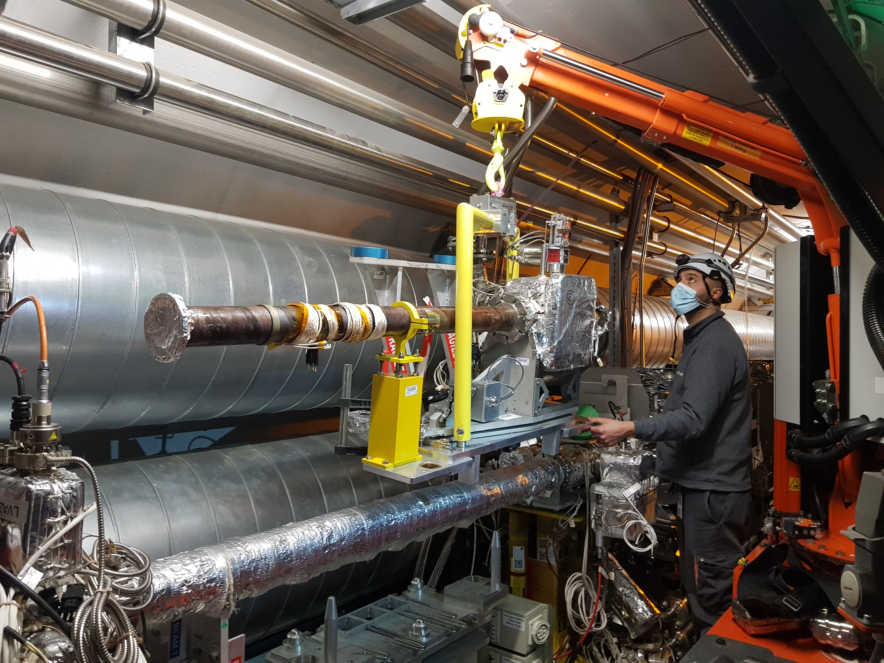
Design to requirement Target Collimator Primary Crystal (TCPC)
Device existing and employed in CERN
Respecting all the requirements regarding the crystal motion
Needed improvements:
No target
Not adapted for the TCCP crystal (size, weight)
Replacement chamber not suited for TCCP due to space constraints

Slide 6
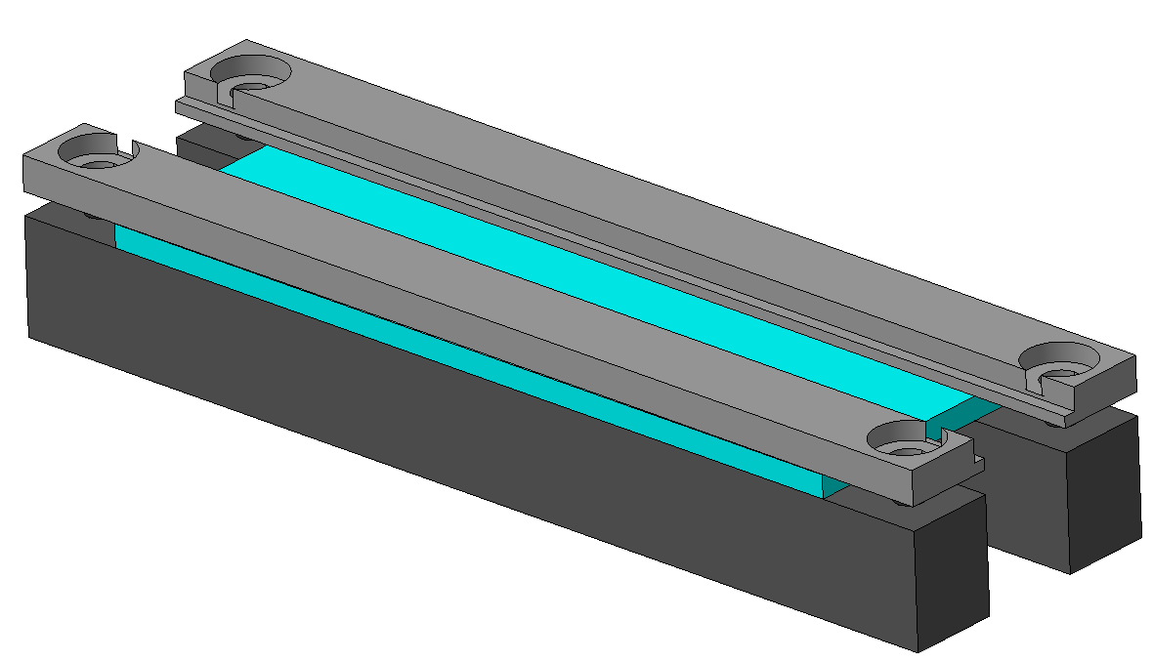
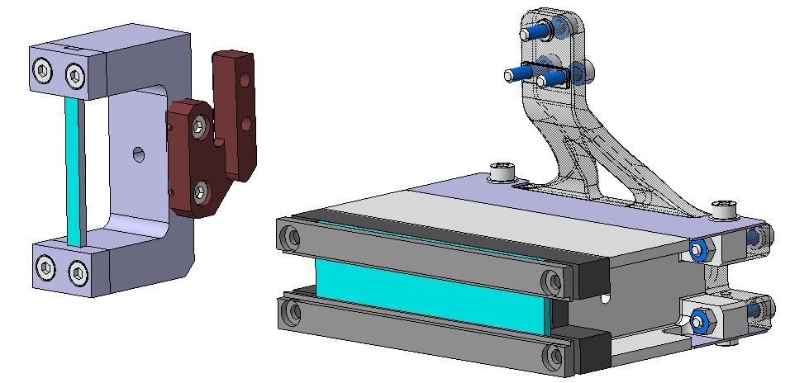
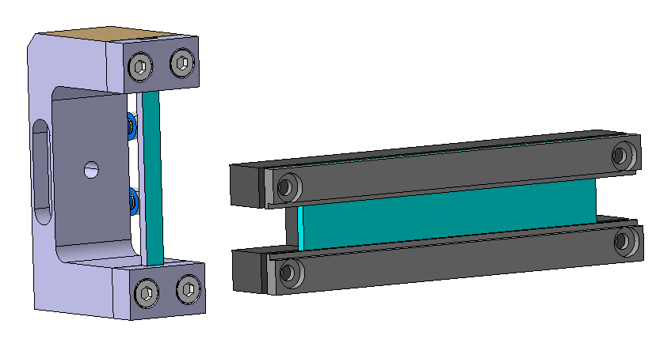
Requirement for TCCP (Goniometers) devices TCCP crystal assembly characteristics
Property | TCPC | TCCP
Crystal length along the beam | 4±0.1 mm | 70±5 mm
Minimal thickness in bending (vertical) direction | 2±0.1 mm | 2±0.1 mm
Minimal width in horizontal direction | 35 mm | 8±0.1 mm
Weight ported by rotational stage | ~100 g | ~350 g
Courtesy of INFN
TCPC
TCCP

Slide 7
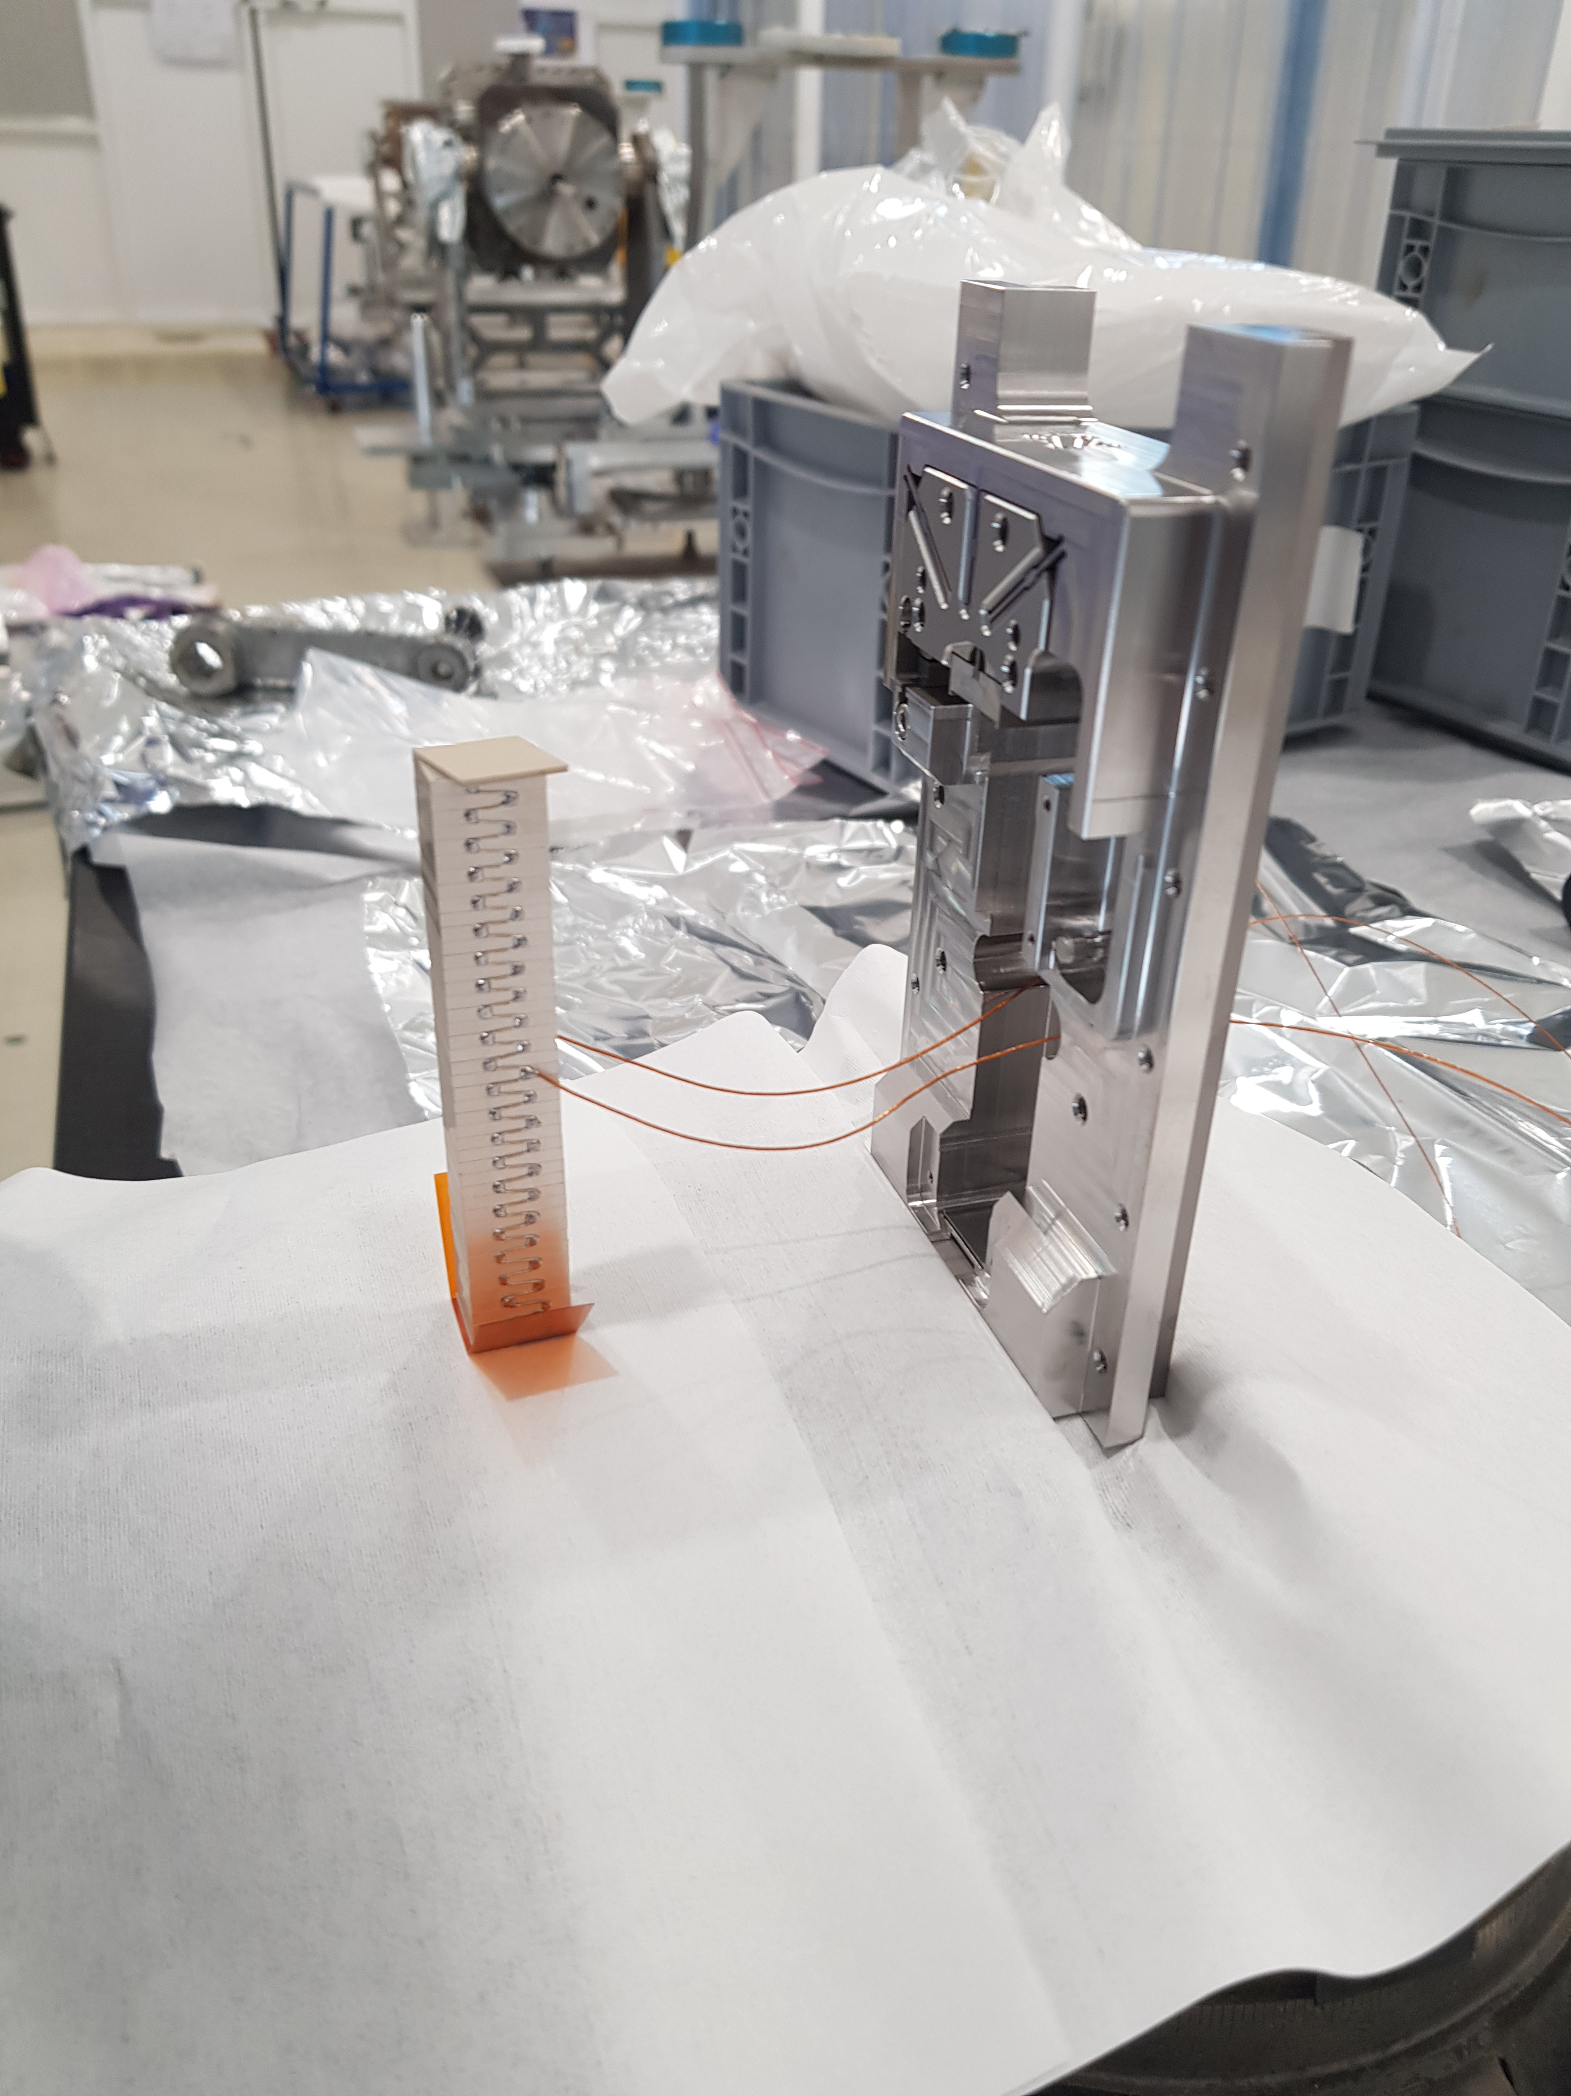
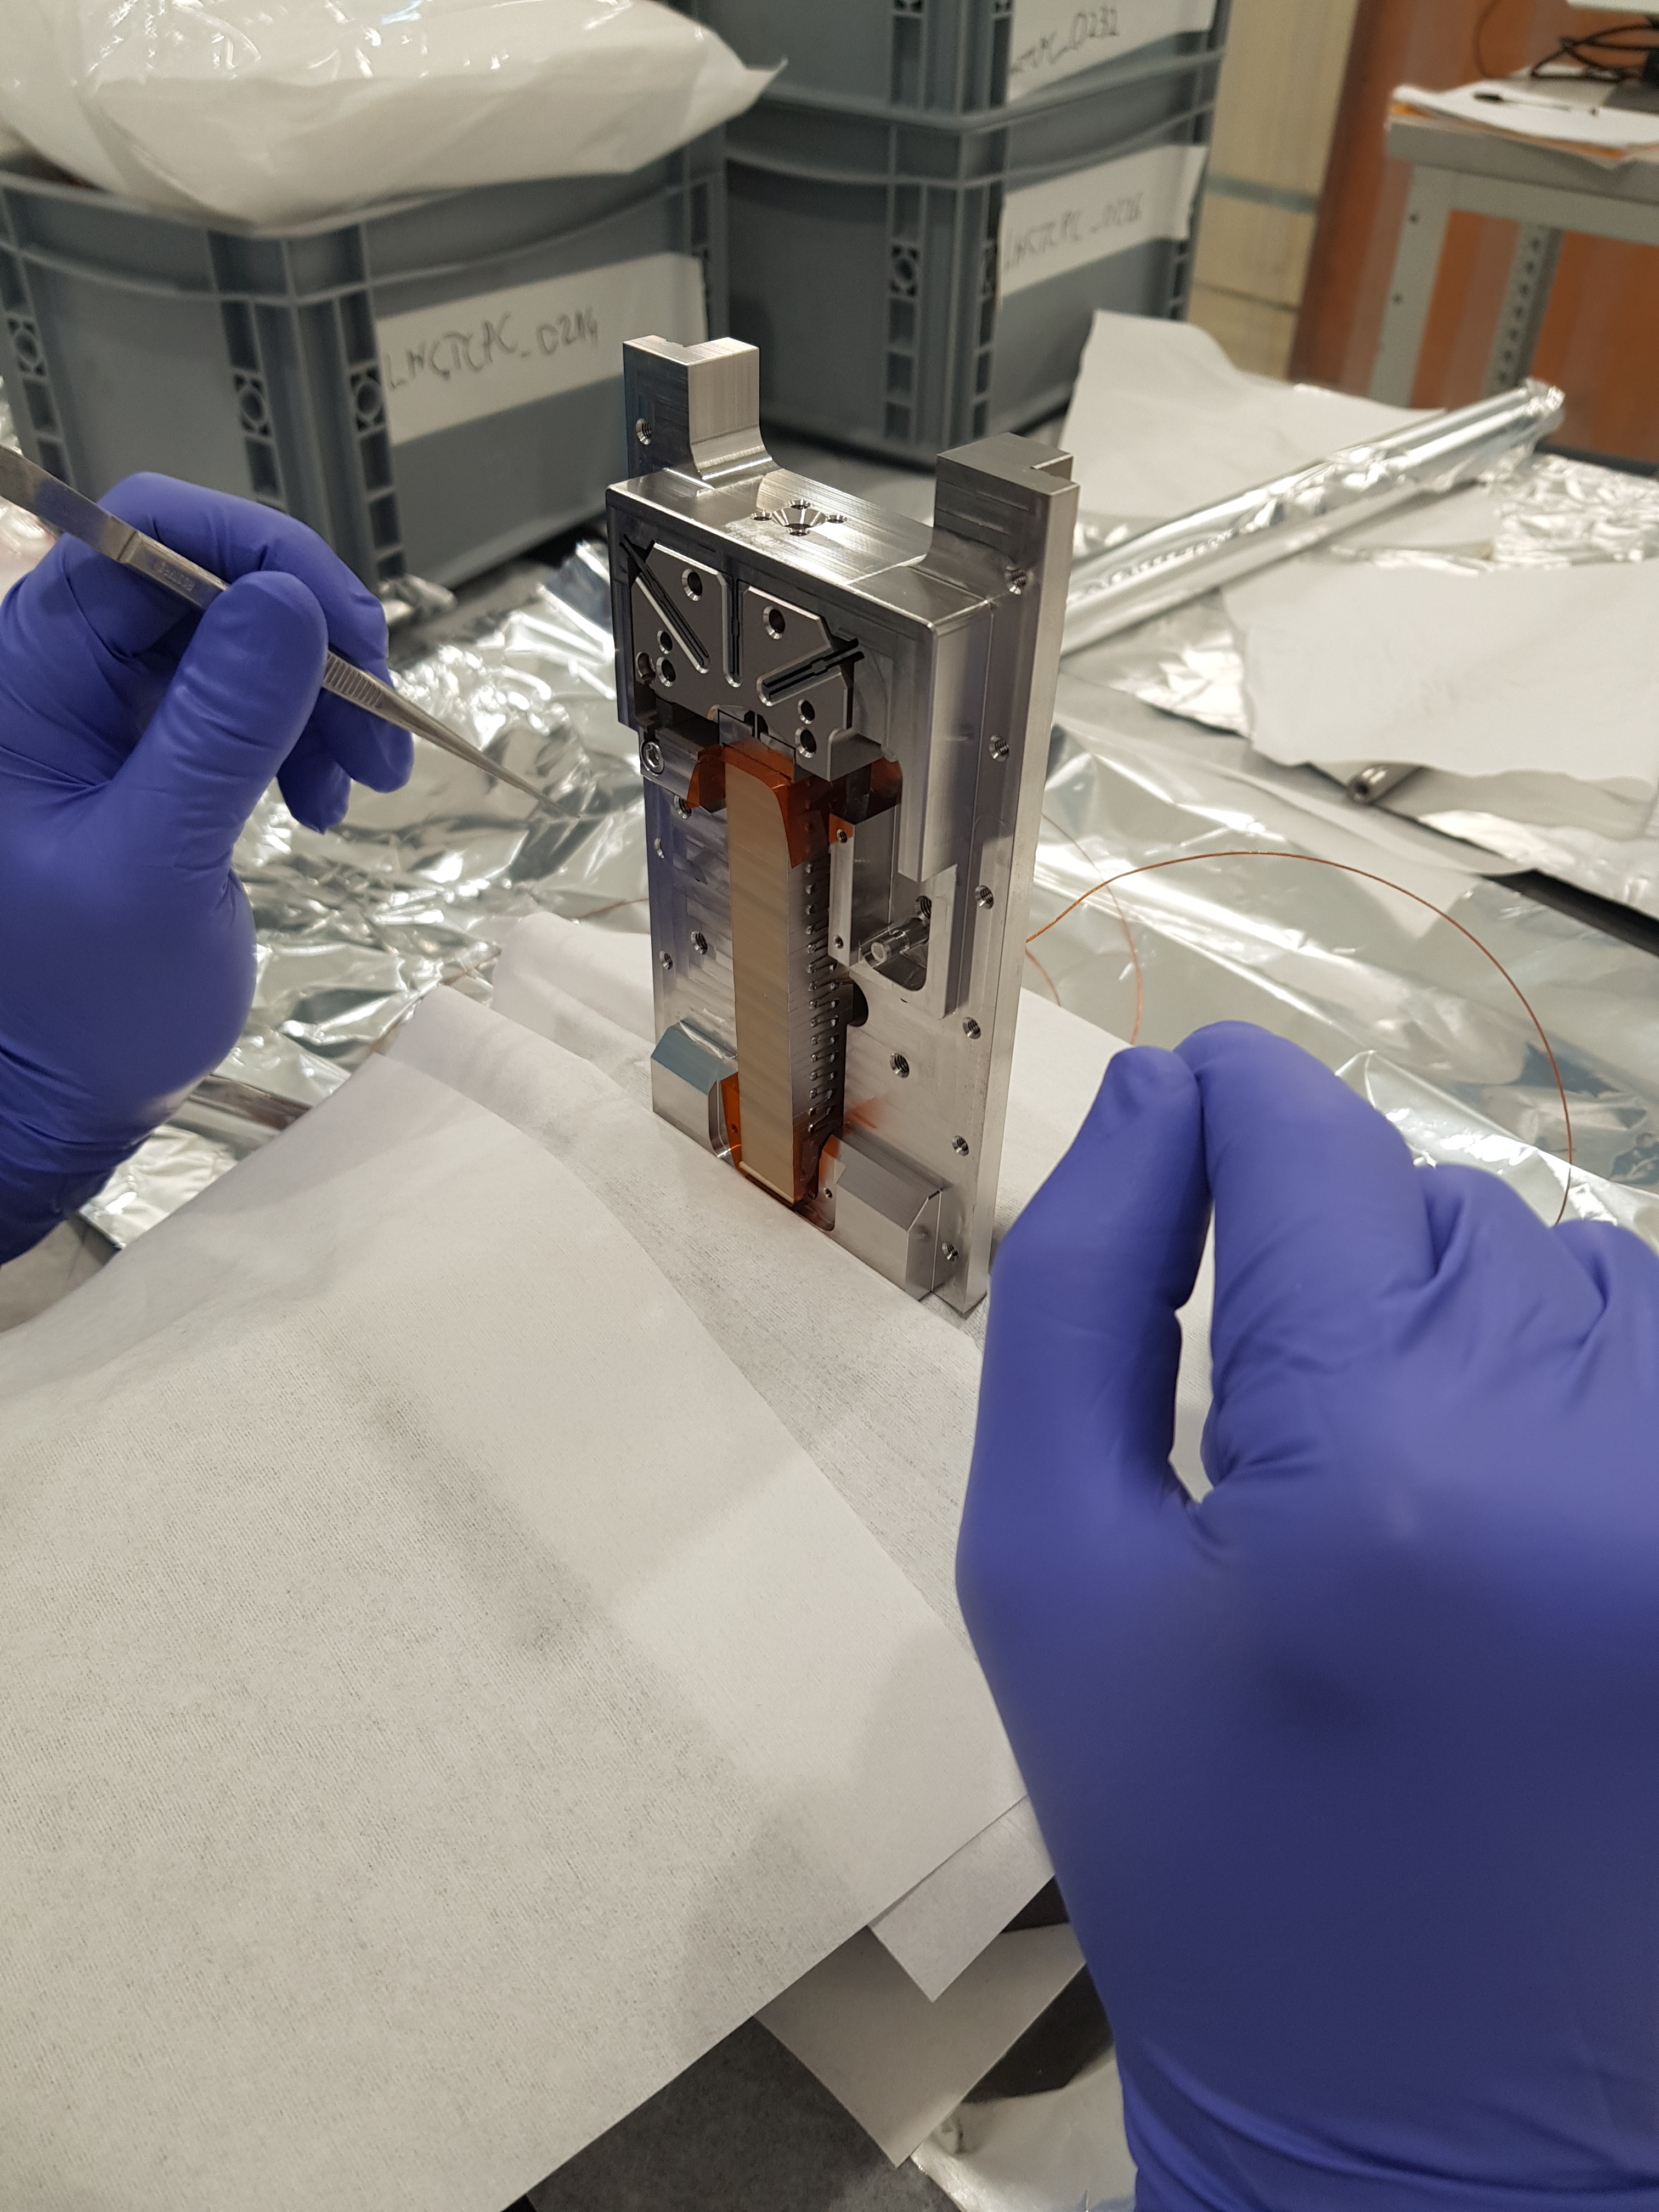
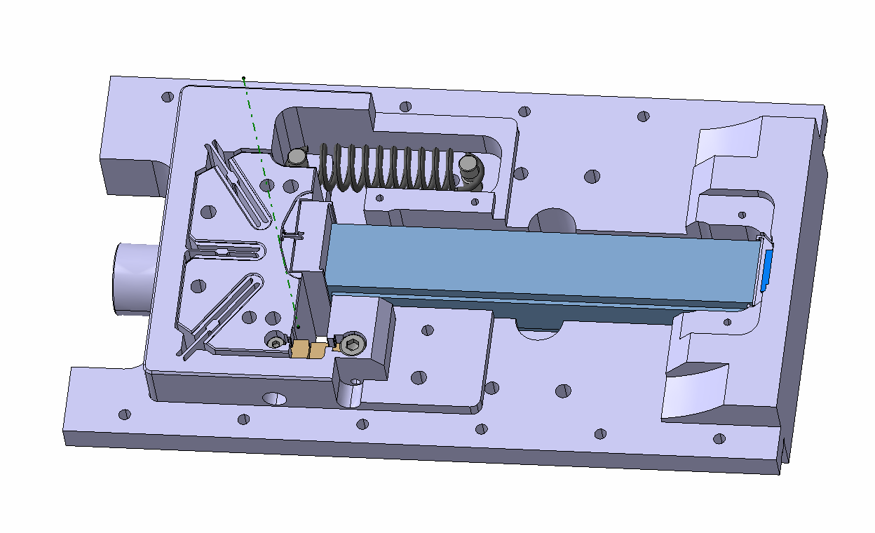
Design to requirement TCPC Rotational stage re-use
Pre-load spring
Piezoelectric material
Rotor
Blades
Stopper
Piston
Wedge
Heavier crystal of the TCCP:
Simulation to evaluate the impact on CoG and inertia
Actuator control tested by CEM on existing rotational stage with a 350g crystal assembly mock-up

Slide 8
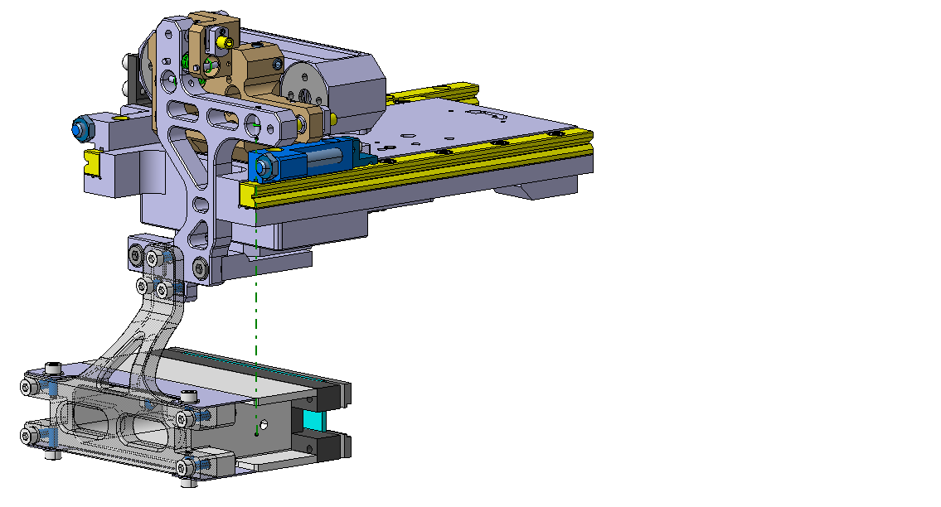
Design to requirement Motion assembly
Rotation actuator
Retroreflectors
Crystal support adjusted for the new shape of the crystal
UHV Linear bearings
Crystal support
Bender + crystal

Slide 9
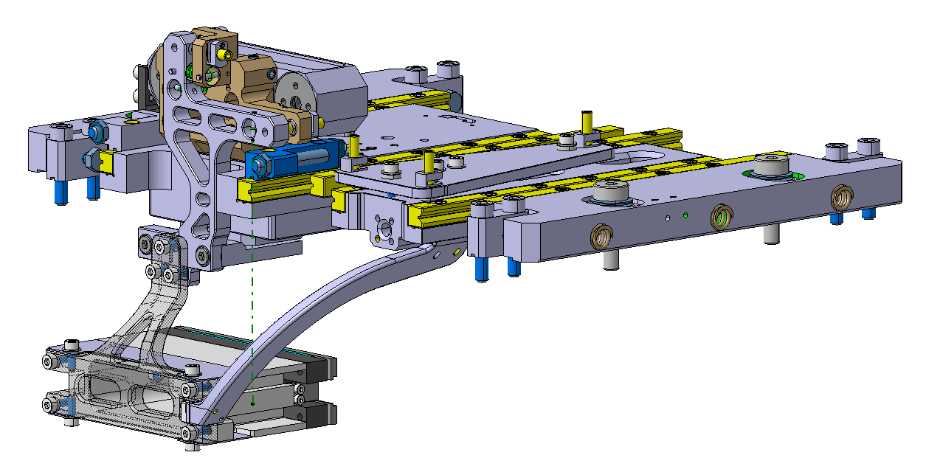
Design to requirement Motion assembly
Target alignment system
Target linear motion system
Linear motion system for target identical to rotational stage
Independent alignment system for target to bring it to the correct distance with respect to the crystal 100 - 500µm
Target holder
Target

Slide 10
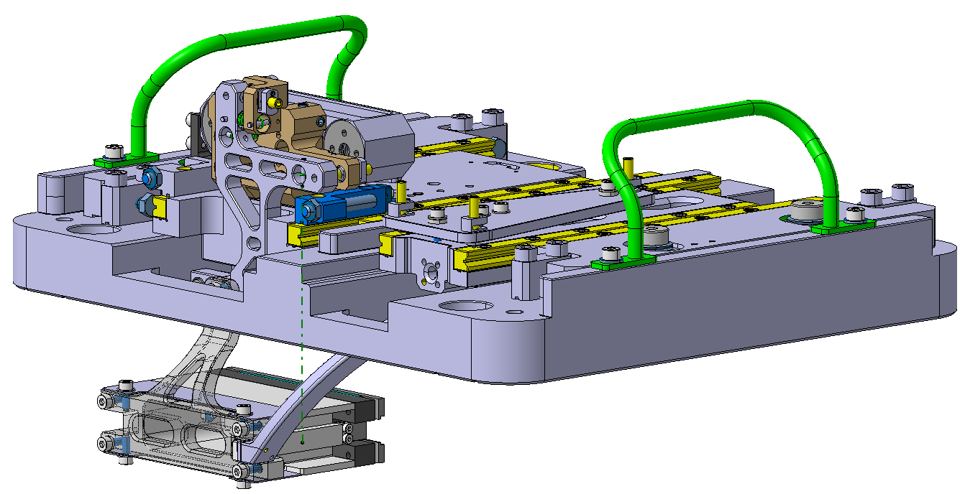
Design to requirement Motion assembly
Support plate for linear motion system made separate from the tank
Allows motion and assembly checks before insertion in the tank
Reduce the complexity of tank machining
Support linear stages

Slide 11
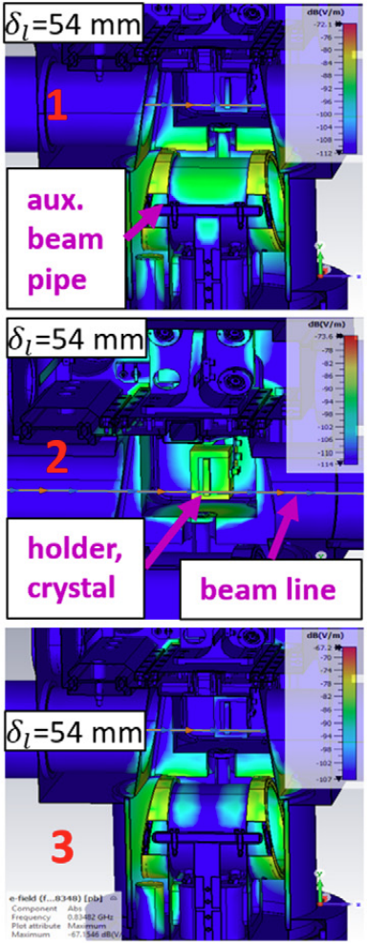
Impedance losses in the TCPCs
TCPC with crystal in operating position for HL ions runs: up to 9W*
TCPC with crystal in parking position for HL protons runs: up to 595W* without replacement chamber
Goals for TCCP design:
Losses with crystal in operating position during low intensity runs acceptable without active cooling
Losses with crystal in parking position during HL proton runs acceptable without replacement chamber and active cooling
TCPC with replacement chamber retracted *
* Quartullo, Danilo et al. “Electromagnetic characterization of the crystal primary collimators for the HL-LHC.” Nuclear Instruments & Methods in Physics Research Section A-accelerators Spectrometers Detectors and Associated Equipment 1010 (2021): 165465.

Slide 12
Impedance losses reduction strategy for TCCP
Design choices:
RF beam tube in the tank cavity
Isolation of crystal bender and target with dielectric supports
RF contacts on cut-outs in the tube to close the RF cavity
RF contacts
Tank cavity
Inner cavity beam tube
«RF closed» cavity

Slide 13
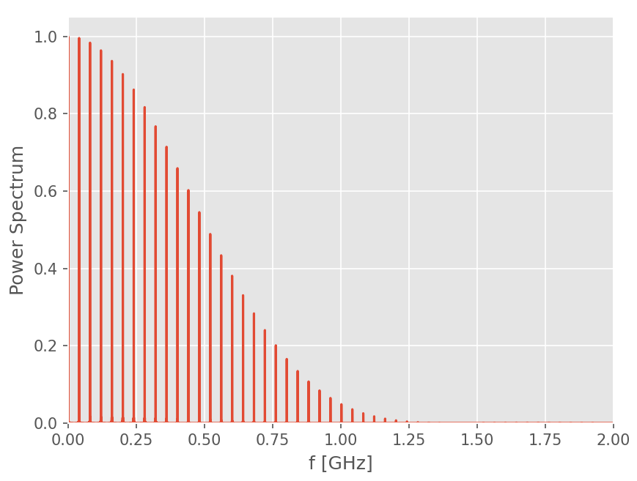
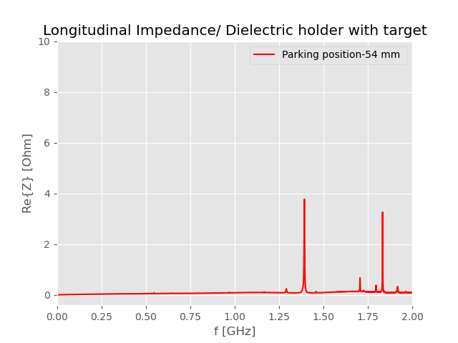
Impedance simulation of TCCP cavity
TCPC parking position HL runs | TCCP parking position HL runs
595 W | 1.6 W
Design greatly reduces losses without use of a replacement chamber
TCCP operation position low intensity runs | TCCP operation position HL runs
<1W | ~100W
Design compatible with PoC settings Still not suitable for use in HL runs
Courtesy of Chiara Antuano, BE/ABP

Slide 14
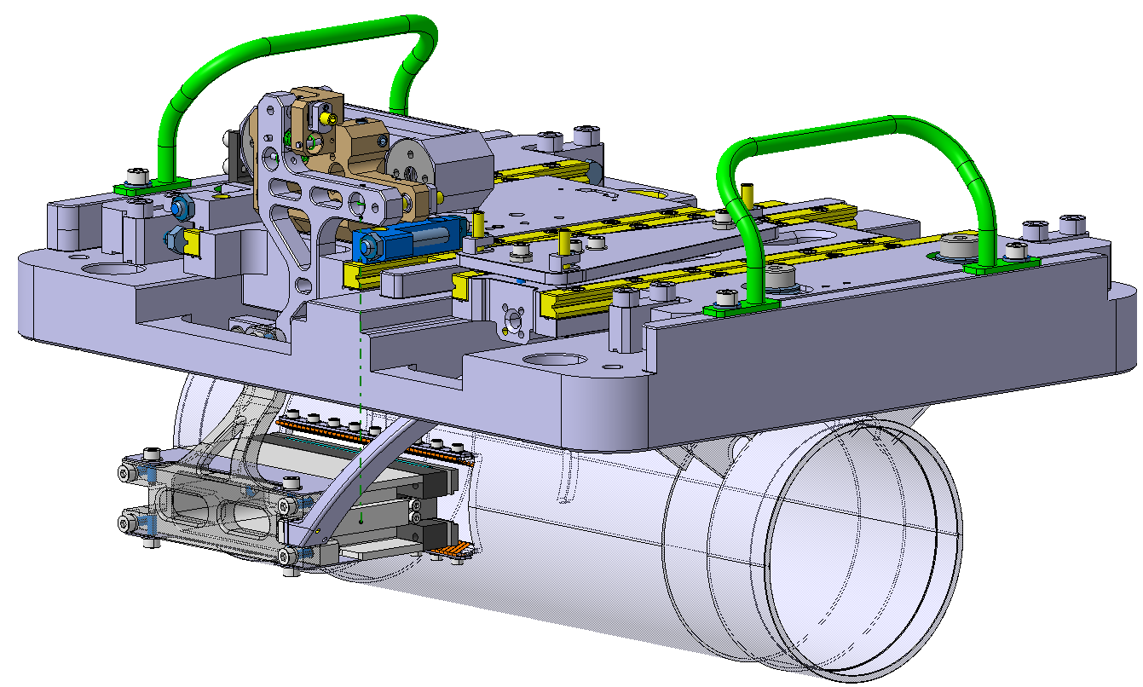
Design to requirement Motion assembly
Metallic plate to create contacts when crystal is in operational position
Metallic plate
Inner cavity beam tube
Dielectric supports
RF contacts

Slide 15
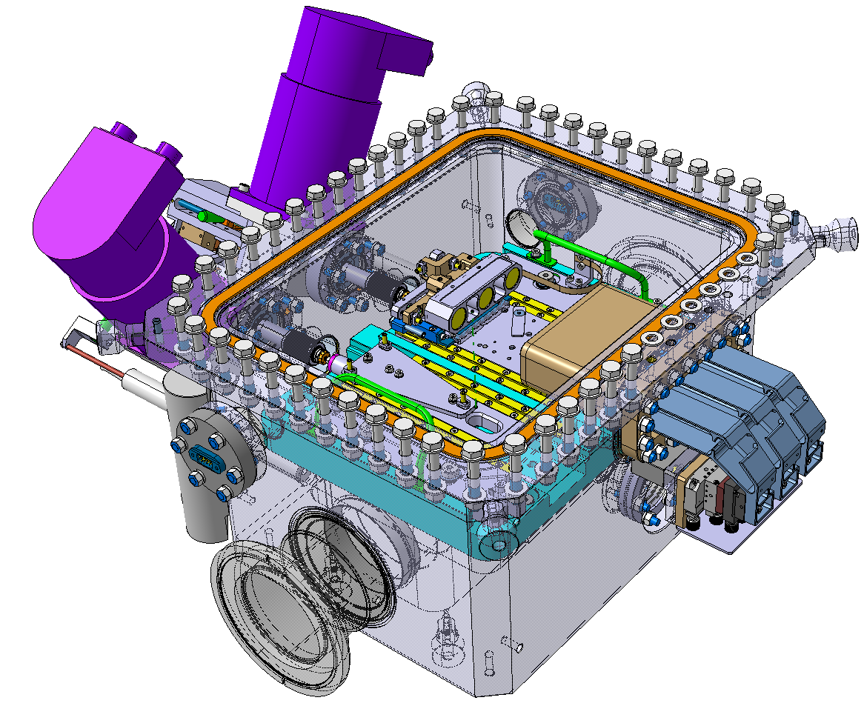
Design to requirement Tank
Improvements
Ease of manufacturing
Separate linear systems support assembly
Survey reference point support installed directly on the tank
Survey reference support

Slide 16
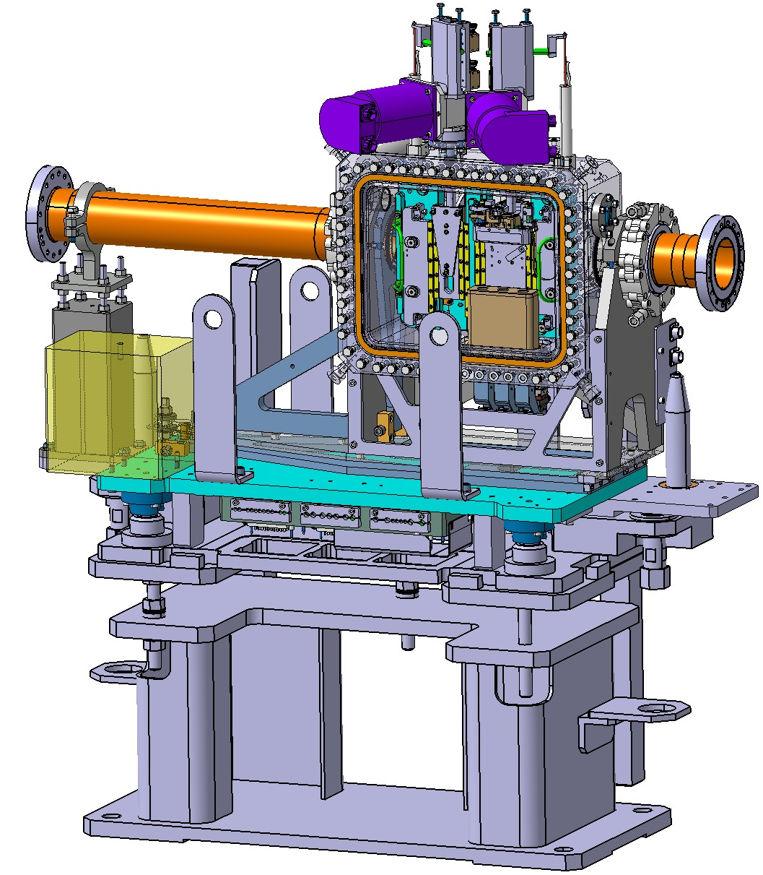
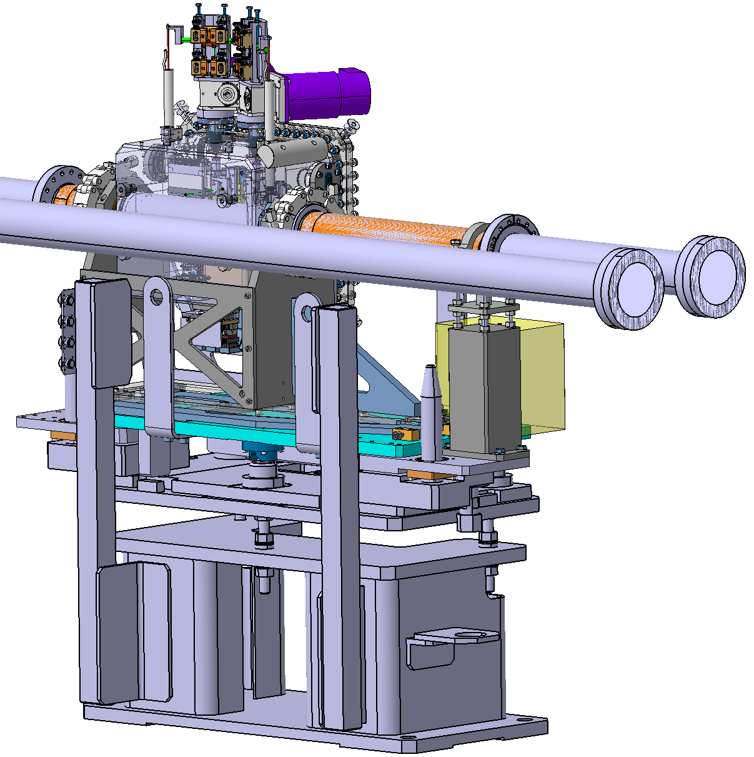
Design to requirement General assembly
Lifting ears
Mounted on standard collimator support
Counter-weight
Lifting ears
Optical heads orientation modified due to B1/B2 organisation
Counterweight
B2
Optical heads
B1
Access from the corridor

Slide 17
From design to operations Schedule
Design
Drawing redaction
Drawing verification, signature
Procurement
Assembly
Validation tests
Device installation
Currently
February - May 2024
October - November 2024
January 2024
June - September 2024
YETS 24-25

Slide 18
Conclusion
New design inspired from existing TCPC
Initial simulation demonstrated the compatibility of design with impedance losses mitigation
3D design of equipment is complete
The equipment will be installed during YETS 24-25
The proposed design is adequate for TWOCRYST PoC but not for final experiment with HL protons

Slide 19
Thank you for your attention!
Questions?

