Slide 1


Patrice Hello
IJCLAB
Université Paris-Saclay

Slide 2

Particules, Hadrons, Energie, Noyau, Instrumentation, Imagerie, Cosmos et Simulation
Subatomic physics, astroparticles, cosmology, applications and interfaces in one doctoral school for Paris-Saclay
https://www.universite-paris-saclay.fr/ecoles-doctorales/particules-hadrons-energie-noyau-instrumentation-imagerie-cosmos-et-simulation-pheniics
Google « pheniics » to easily find our web site

Slide 3
Scientific contour
PHENIICS
Particules, Hadrons, Energie, Noyau,
Instrumentation, Imagerie, Cosmos et Simulation
Astroparticles and Cosmology
Nuclear Astrophysics
Sciences for Nuclear Fuel Cycle, Radioprotection and radiochemistry
Nuclear Energy
Medical Imaging
Physics for Instrumentation
Accelerator Physics
Particle Physics
Nuclear Physics
Physics for Health
Materials Science

Slide 4






LABS
PHENIICS
DAM,DEN,DRT
Irfu
DAM-DIF, DEN-DANS, IAS, IJCLAB
DSM-IRFU (SACM, SEDI, SIS, DPhN, DPhP), IRSN, DRT-LIST, Soleil

Slide 5
Demography
All labs ~ 500 physicists
~ 300 HDR ≡ 300 PhD Directors
ED PHENIICS
~ 200 PhD students (50-60 new PhD students each year)
New PhD students origins :
1/3 from abroad
2/3 from Master2 in France (among them ~ one half from Paris-Saclay masters)

Slide 6
Organisation
Directorate (director+3 deputy directors)
Patrice Hello (IJCLAB, pôle astro-cosmo)
David Verney (IJCLAB, pôle nucléaire)
Guillaume Mention (CEA IRFU DPhN)
Dider Franck (IRSN)
Council 26 members, 5 PhD representatives.

Slide 7
Doctoral School Grants
~15 grants given by UPSaclay (MESRI)
All subjects are being collected and are online on ADUM
https://adum.fr/
(and will be online on our web site as well)
Validated by Lab directors and by the Doctoral School.
  PLANNING :
  From now to May 2024
    Call for applications. Applications closed by ~mid May.
    ONE SINGLE APPLICATION
  May 2024
    Preselection of the best applications
    20-minutes interview with candidates. PhD students as observers. May 29-30-31.
    Ranking and Distribution of ED grants
Contact the teams for other grant sources
Candidates must register on ADUM for applying.

Slide 8
Various grant sources
ED (concours de l'ED)
CFR (CEA)
CNRS/IN2P3
ANR / ERC
CSC (Chinese Scholarship Council)
IDEX Paris-Saclay
Ile de France: DIM (ACAV, ...) et Hors-DIM
LAB fundings (CNRS) / CTBU (CEA)
Cifre
Instituts et fondations: CNES, CFM, DGA
MoU with other countries.
Contrats doctoraux handicap
AMN et AMX
ED PHENIICS OFFERS « ONLY » 15 GRANTS (for ~ 60 new PhD Students / year)
=> Mandatory (for advisors and students) to explore other funding sources

Slide 9
Various grant sources
Whatever the funding source, you have to be accepted by the Doctoral School.
For all other fundings than ED grants, an ad-hoc commitee (admission committee) has to proceed to interviews and propose (or not) acceptance to the Doctoral School.

Slide 10
During the thesis
Annual interview with ED directory : help for problem detection (if any). Same referent person along the 3 yrs.
Meet before each new registration with a follow-up committee (Comité de Suivi Individuel).
Godfather/mother in the labs
PhD conference (once per year) « PHENIICS FEST »
Duration of the thesis : 36 months
Training (ED lectures, summer schools, teaching, professional insertion workshops …). 25 training credits (~100 hours).
« Mission d’enseignement » if you want to teach. Inside PHENIICS a full « mission d’enseignement » (64h/yr, 3 yrs).
Thesis charter to be respected in particular concerning the funding (Paris-Saclay charter+PHENIICS internal rules).

Slide 11
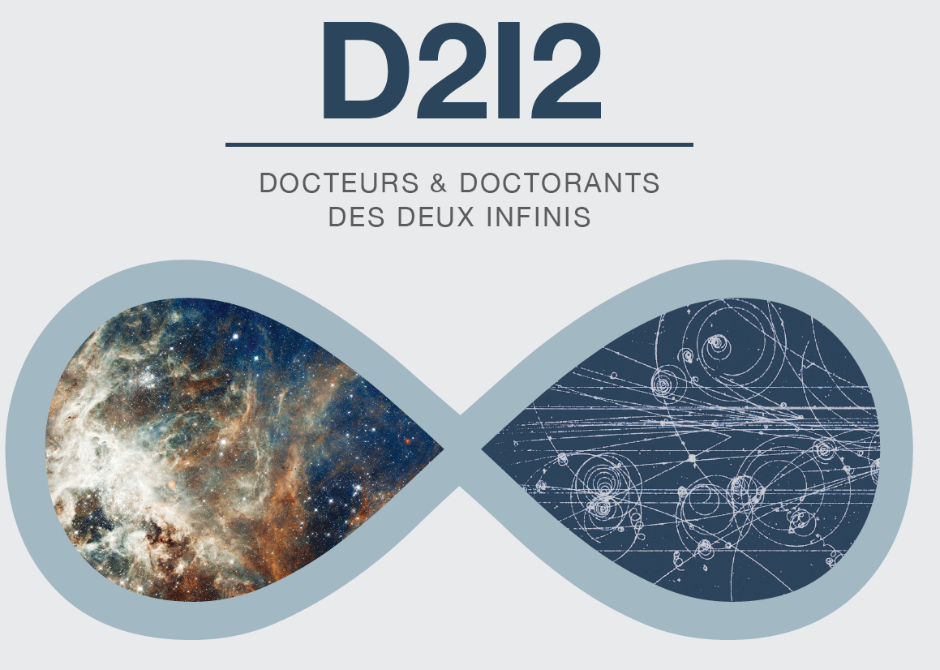
After the Thesis
Positions in academic institutions and industry
PhD and Postdoc association created in 2010 (“PhD league”).
(workshop “perspectives” organized each year)

Slide 12
contact
ed_pheniics@universite-paris-saclay.fr

Slide 13
reminder
everything takes place on adum
(Applications, registrations …)

