Slide 1
Search for the nominal RF freq & current status D1Thomx_017_064_r56_02_chro00 MCF=0.0143 chro=0/0
Data from 2023-10-06

Slide 2
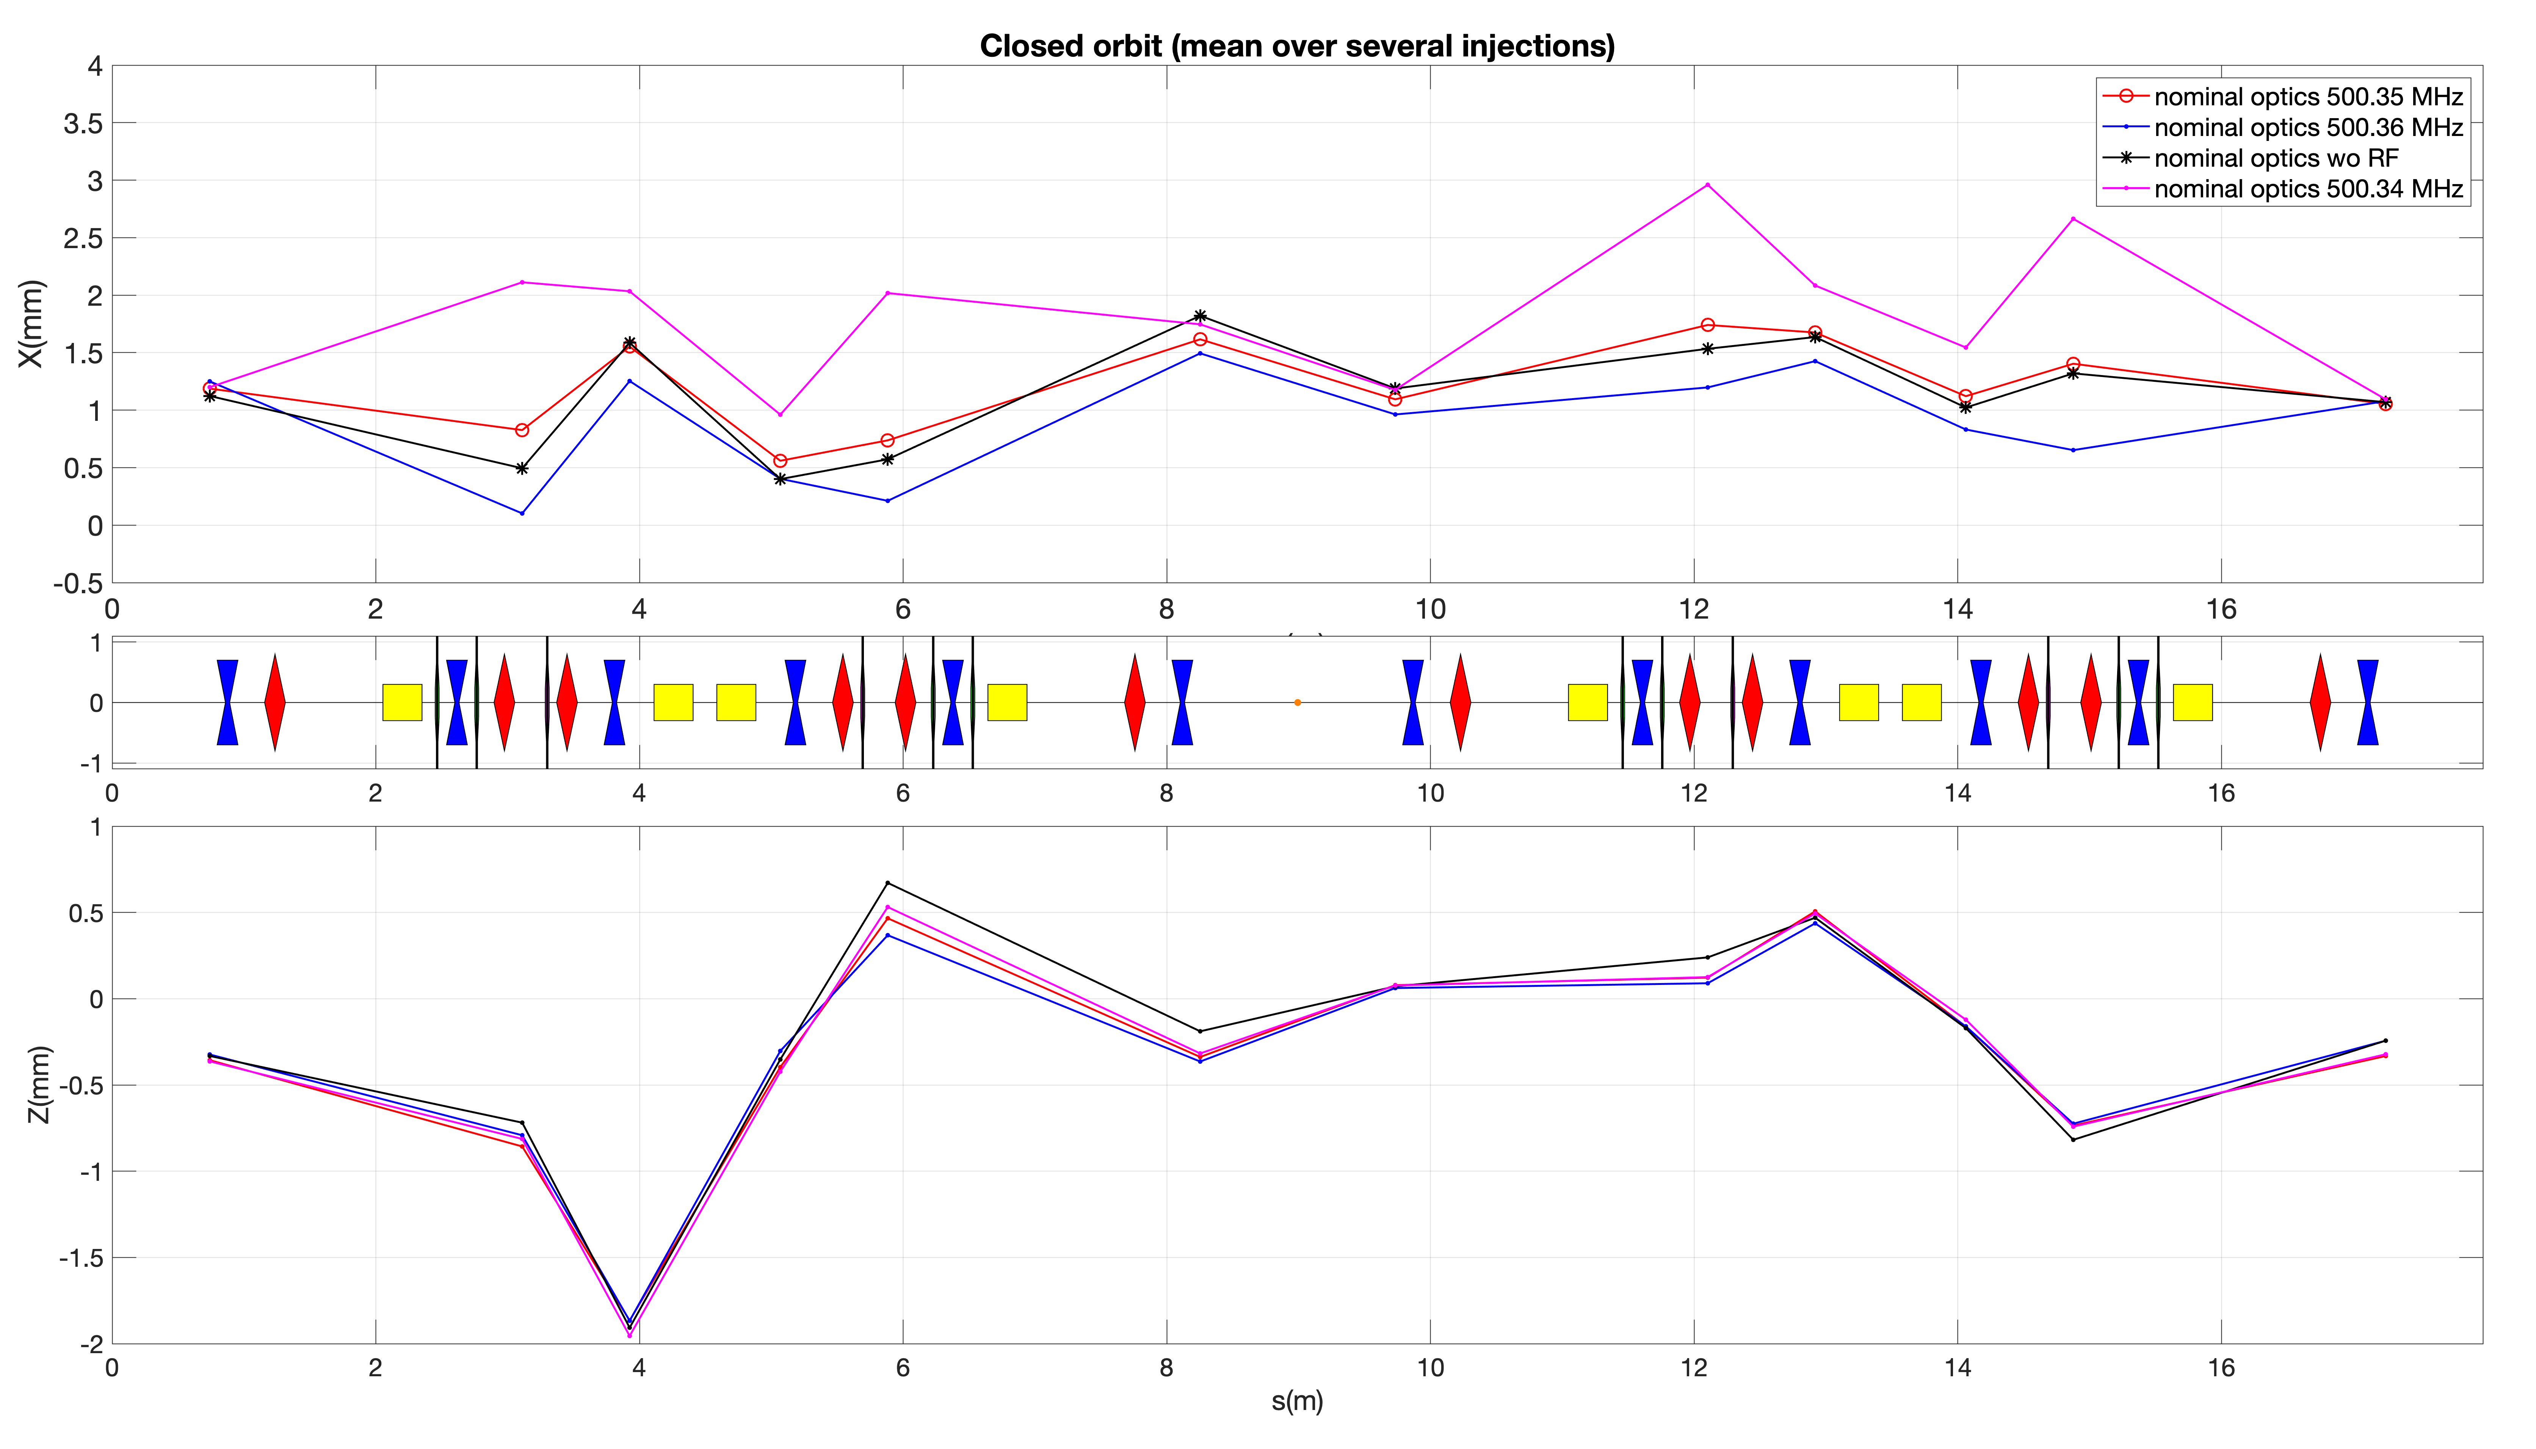
Orbits
Based on the simulations
ΔRF = 342 kHz
From measurem.
F_{RF} = 500.35 MHz to be

Slide 3
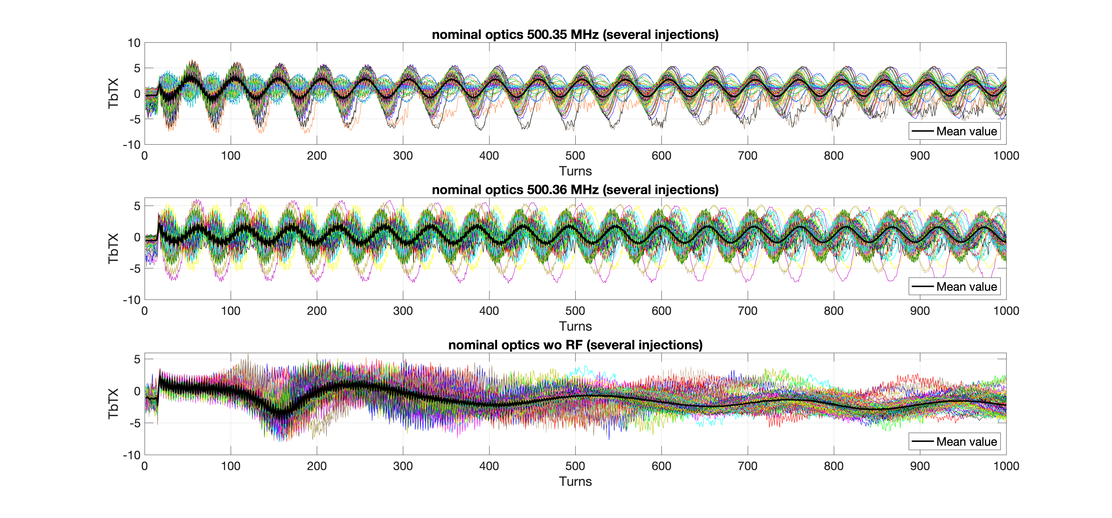
Synchrotron oscillations

Slide 4
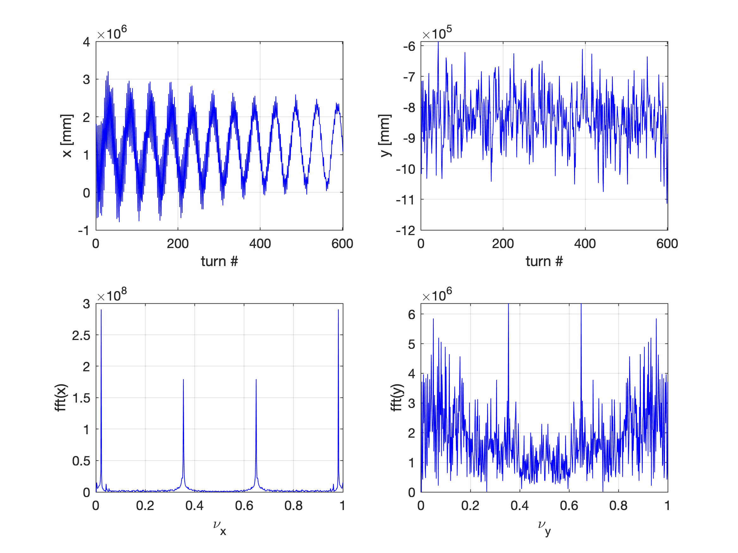
Tune
Tune (hor.) = 0.1764
Tune model = 0.17

Slide 5
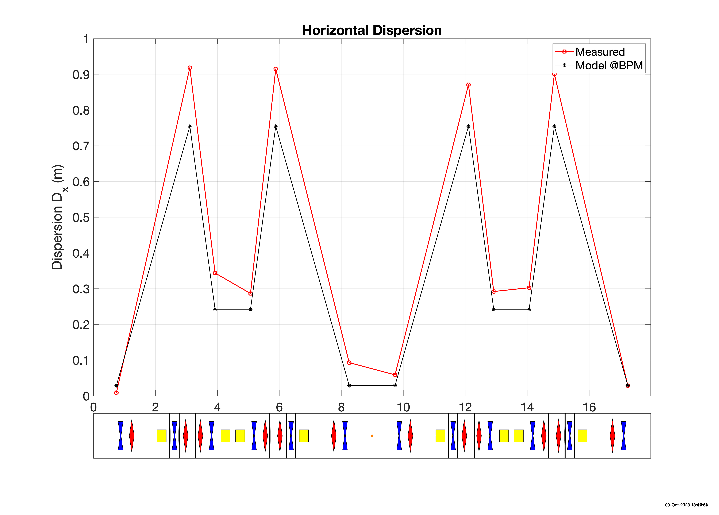
Dispersion measurements
DeltaRF = 0.010 MHz;
dpp =0.14%

Slide 6
Nominal RF frequency: solutions
Mechanical intervention
Discussion with Rodolphe (2 possible scenarios)
Impact on the optics/new optics studies
Work in progress
Dipole fringe field limitation (help from Fabrice, Alex, SOLEIL)
The OPERA fieldmaps obtained (with and w/o metallic plates/La plaque de garde)
First results: dL reduciton from 12.3 mm to 5.4 mm !
Confirmation with the full simulations in the RF-track
Fabrice will visit ThomX to measure the available space at the dipoles for more realistic simulations
Work in progress

Slide 7
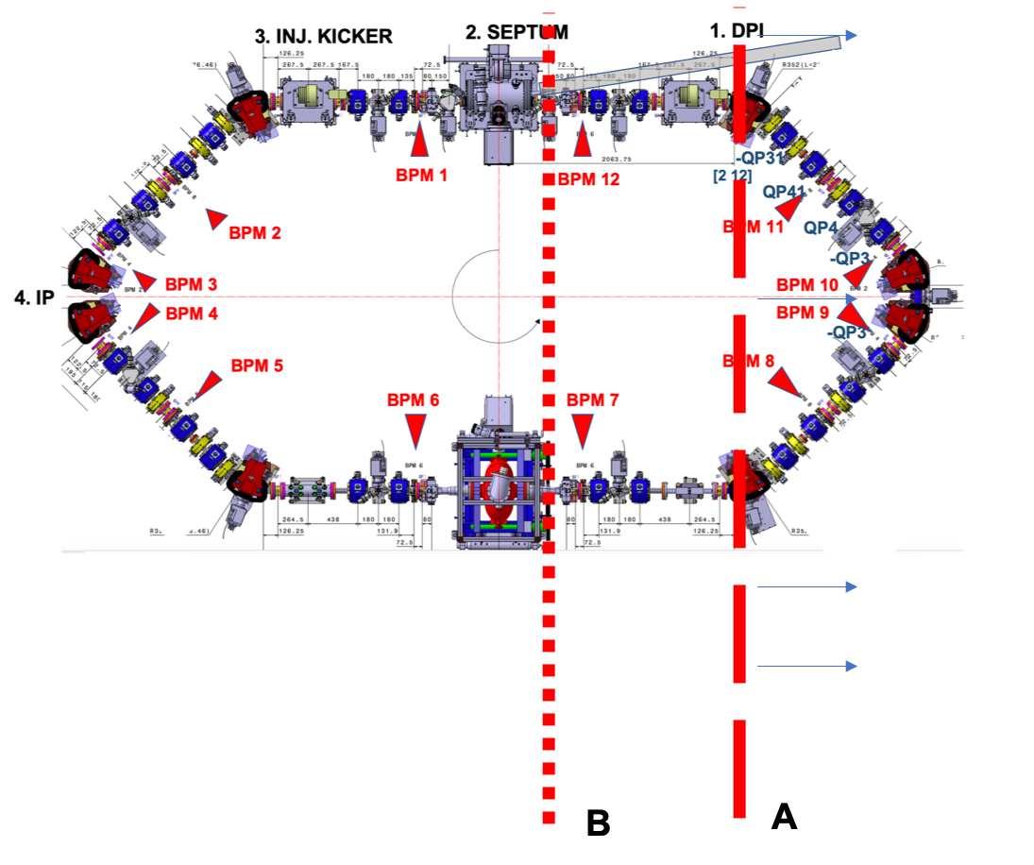
Mechanical intervention

Slide 8
Summary discussion with Rodolphe (~2 weeks ago)
Two possibilities A and B . Verified at place that there are sufficient of margins for the movement at girder. Solution A is less perturbative for vacuum. Pompes can be closed and there is no risque on the soufflets.
Solution B is more difficult, since it is necessary to touch kicker. Vacuum more difficult. More elements to move, realign. Solution B keeps 4 fold symmetry.
From mechanical point of view it is possible to install metallic plates around dipoles (“ouvre bobine”). There are necessary holes on dipoles to fix metallic plates. Need to understand the effect numerically. Field map have been received from Fabrice. Risque: need to have magnetic expert to support this scheme if it will be chosen, do measurements on test bench.
Rodolphe: Check model 3d if it is compatible with new Catia licence (before it was under educational license). New positions for elements need to be calculated from 3d.
Need to fabricate ~7 mm “spacers” to maker ring longer. Precise dimensions will be provided to Rodolphe.
For intervention : Need infra and 4 mechanicians. After intervention new alignment is needed. Time of execution ~ 2 weeks. Should not be done simultaneously with linac replacement, because this is the same team who will be occupied.
Intervention could be done in Jan 2024
Risques:
casse jonction chambre a vide
casse soufflet( there are 2 spares)

