Slide 1
Lattice design and beam optics optimization of the PERLE facility
Assemblée Générale du Pôle Accélérateurs
December 2023
Presented by
Rasha ABUKESHEK
Under the direction of
Achille STOCCHI & Hadil ABUALROB
rasha.abukeshek@ijclab.in2p3.fr

Slide 2
Outline
Introduction
PERLE optics
Magnet design
B-com magnet
Quadrupole magnets
Preliminary study of PERLE lattice errors
Misalignment errors
Field errors
250 MeV PERLE machine

Slide 3
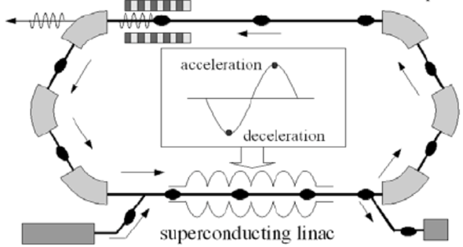
ERL (Energy Recovery Linac) concept
Acceleration:
RF power provided to cavities
The idea:
ERL Loop
(1’)
(1)
New beam injected in ERL loop
Acceleration to the top energy
(2’)…
(2)
acceleration
deceleration
ERL Loop
Kinetic energy of used beam recycled to re-excite cavities
Superconducting Linac
(4)
Beam used in IP
(3)
Injector
Beam dump
The benefits:
Reduce accelerator power consumption
Dumping the beam at injection power
Multi-pass configuration: High average current carrying capability (no more RF power limit) + High average beam power in a compact machine
Deceleration:
180° RF Phase shift
Courtesy of Walid Kaabi

Slide 4
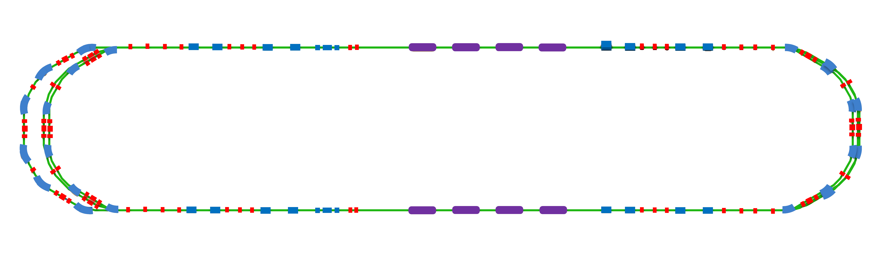
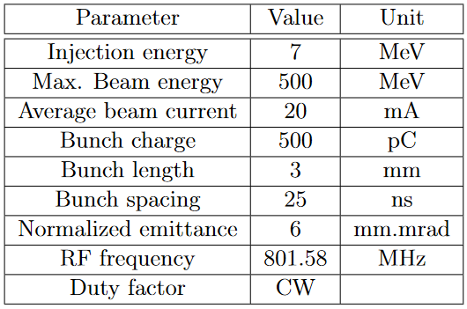
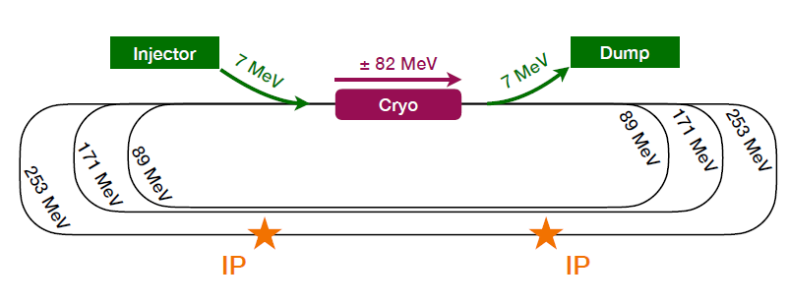
PERLE: Powerful ERL for Experiments
PERLE: first high-power multi-turn ERL, based on SRF technology, designed to operate at 10MW (20 mA, 500 MeV) power regime
ERL technology development for future energy and intensity frontier machines (same technological choices of LHeC).
Facility platform for nuclear applications (DESTIN).
7 MeV
2 : 4 : 6
1 : 3 : 5
ΔE = 82.2 MeV
5.5 m
Top view
Dipole
29 m
Quadrupole
RF cavity
ΔE = 82.2 MeV
Staging with 250 MeV version
Demonstration of ERL with 6 passes at high current (with half of the power)
Three straight sections replacing spreader, recombiner, and 2nd Linac
10 m
7 MeV
10 m
9 m
LINAC
Two cryomodules each of four 5-cell SRF cavities.
Arcs
6 arcs for a three-turn configuration.
Spreader/Recombiner
Connect LINAC to arcs section.
One common dipole magnet called the B-com magnet.

Slide 5
PERLE Optics
Name | Number |  | L, cm | |B|, T
 | 250 MeV | 500 MeV |  | 250 MeV | 500 MeV
B-Com 3-lines | 2 | 4 | 33 | 0.451 | 0.866 | 0.866
B-Com 2-lines | 2 | 4 | 33 | 0.451 | 0.866 | 0.866
R-Bend 33cm | 8 | 16 | 33 | 0.451 | 0.873 | 0.873
S-Bend 33cm | 6 | 12 | 33 | 0.472 | 0.907 | 0.907
 | 18 |  |  | 0.472 | 1.342 | 1.342
S-Bend 66cm | 18 |  | 66 | 0.453 | 1.323 | 1.323
ERL Quads | 127 | 148 | 15 | Max |G|, T/m
 |  |  |  | 23 |  | 55
 |  |  | 10
Injector/Dump Quads | 15 |  | 5 | 1.2
Total number of dipole (ERL only):
60 dipoles for 250 MeV version
78 dipoles for 500 MeV version
R-Bend 33 cm is used in the spreaders for Arcs 3, 4, 5, and 6.
S-Bend 33 cm is used in the spreader of Arcs 1, and 2 (vertical) and in Arcs 1, 2, and 3 (horizontal).
Courtesy to Alex Fomin

Slide 6
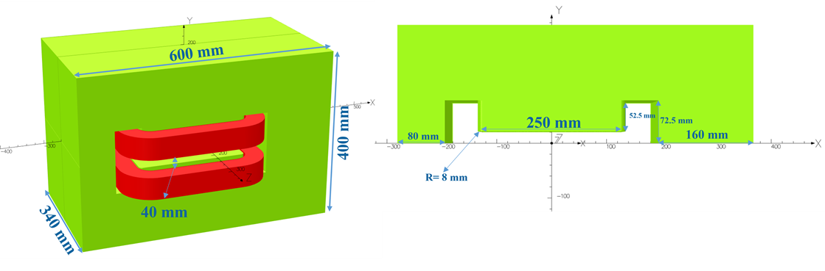
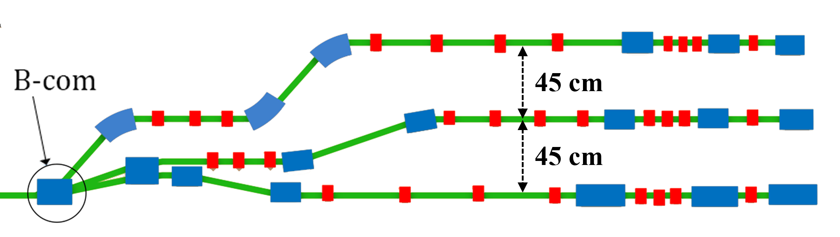
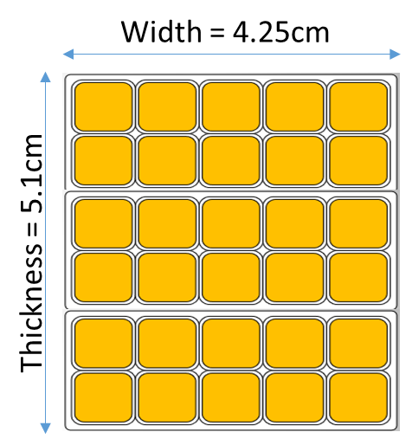
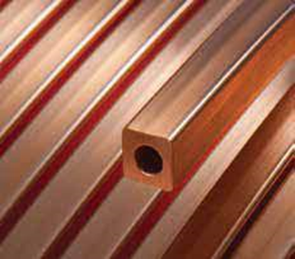
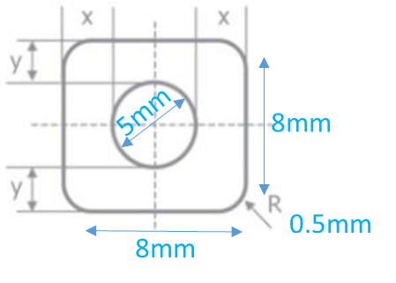
B-com Magnet
Specification and design
Tool: Opera 3D
Yoke material: standard steel (C content < 0.1%)
Common between the three arcs.
Horizontal field magnet → Vertical beam split at three different energies.
30° bending angle.
Coil design
This work is in collaboration with Jay Benesch from JLab.

Slide 7
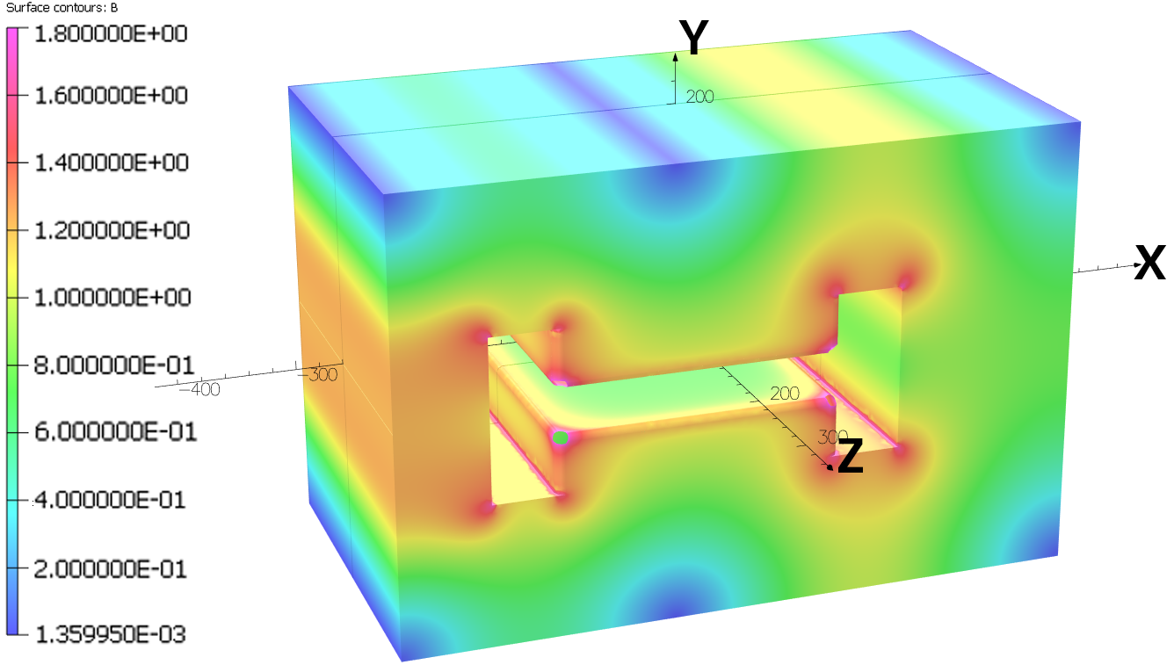
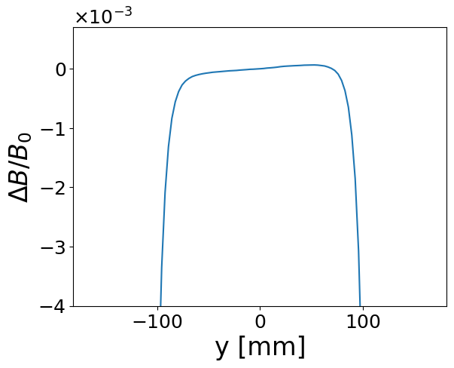
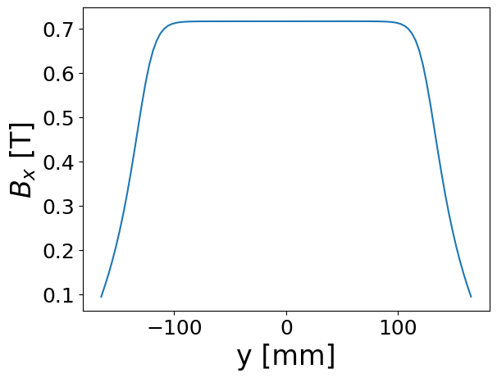
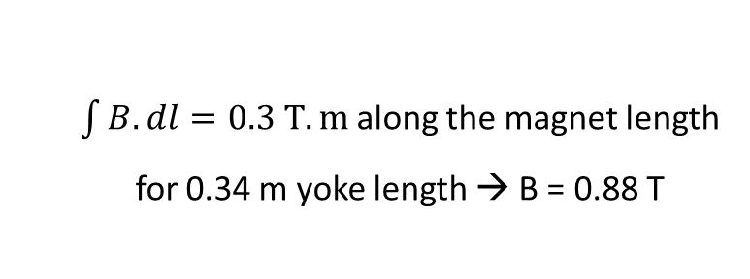


B-com Magnet
Field calculations
$\int{B.dl}=0.3 T.m$along the magnet length
for 0.34 m yoke length → B = 0.88 T
A Pole blend radius of 8 mm with edge chamfer of 6 mm radius
$$By (0, 0, 0) = 0.716382 T$$
$$\frac{ΔB}{B_{0}}=\frac{B\left(x\right)−B_{0}}{B_{0}}$$
Field uniformity within ±100 mm which is suitable for the 88 mm shift for the lowest energetic beam.

Slide 8
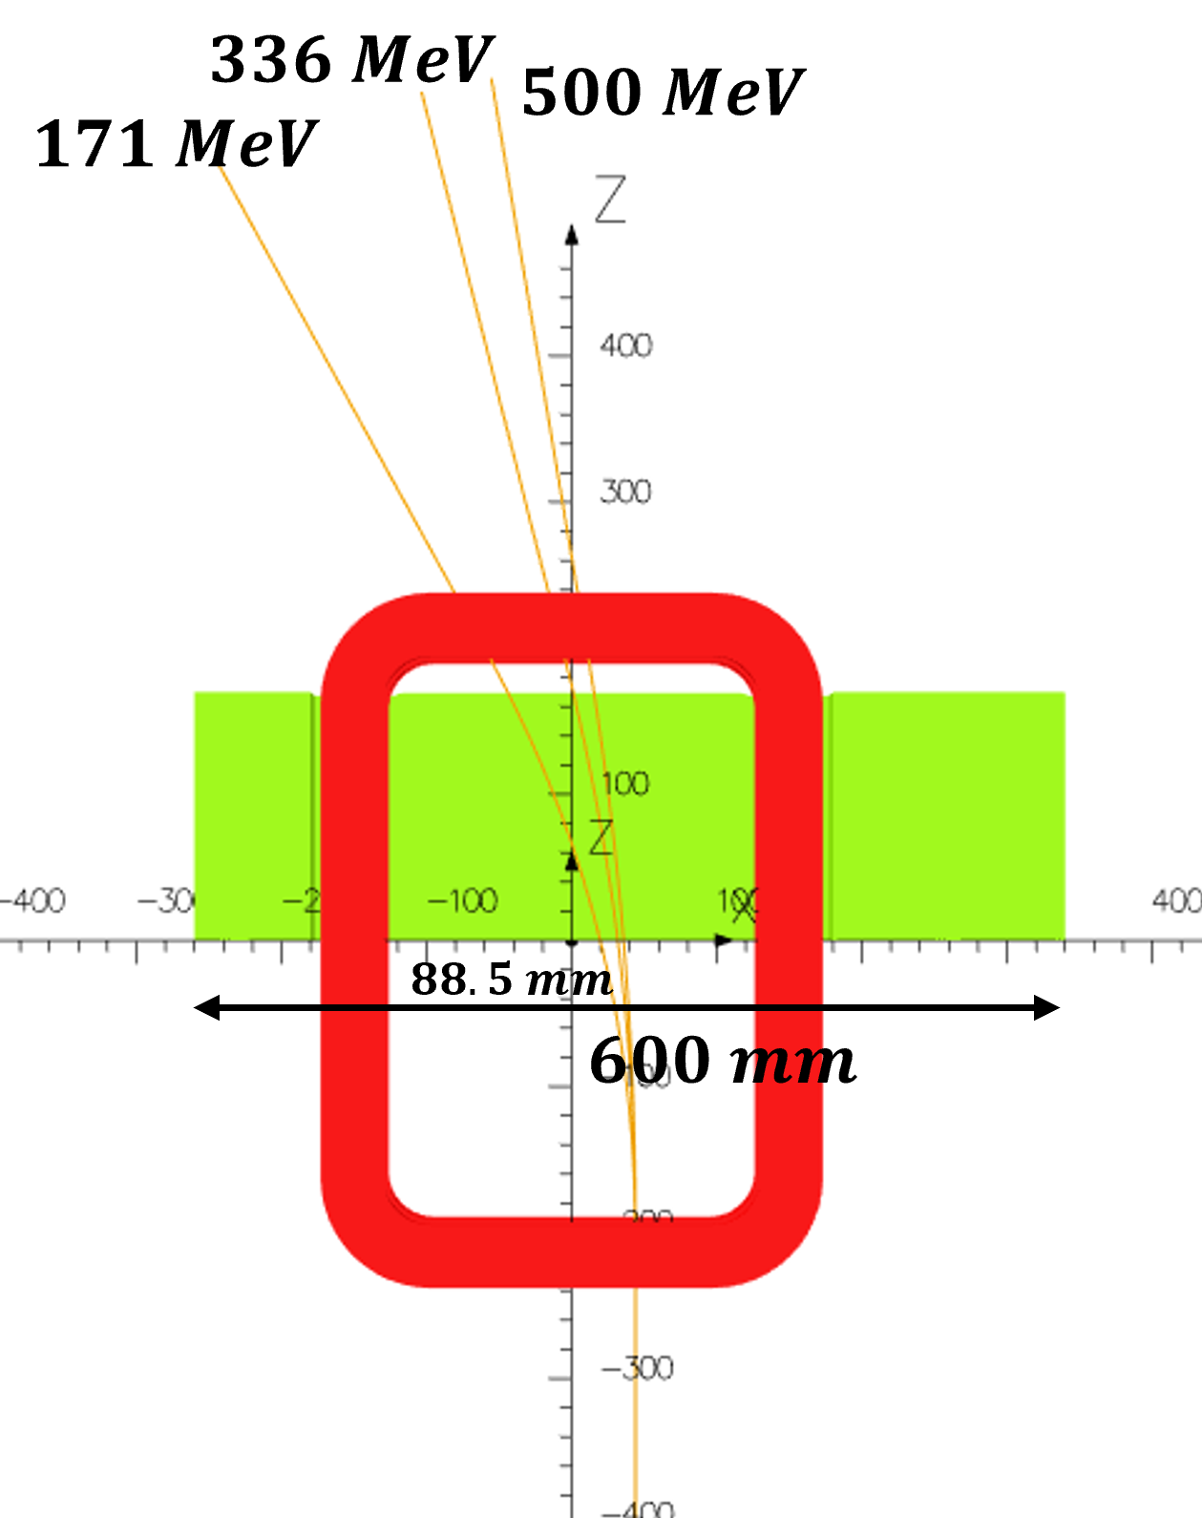
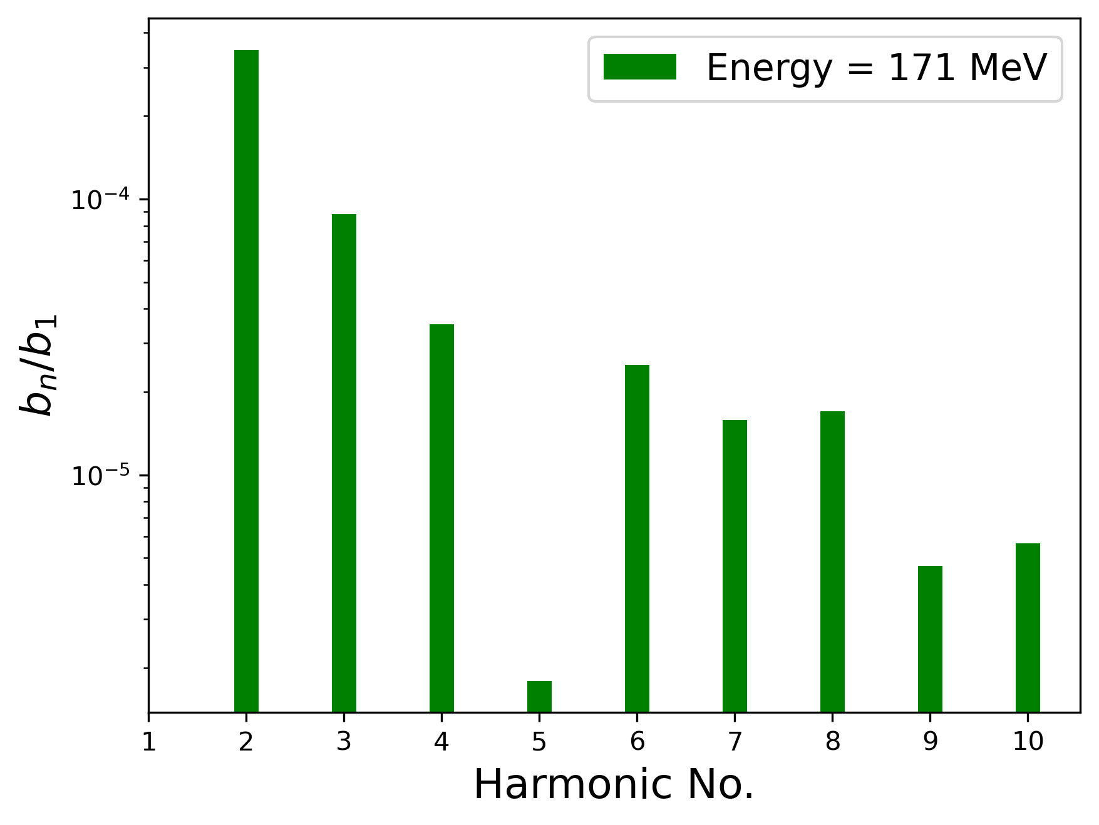
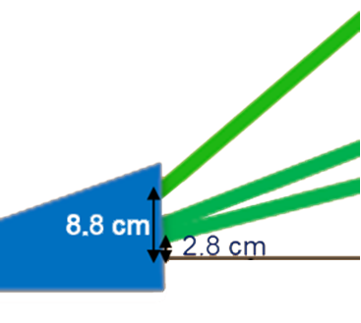
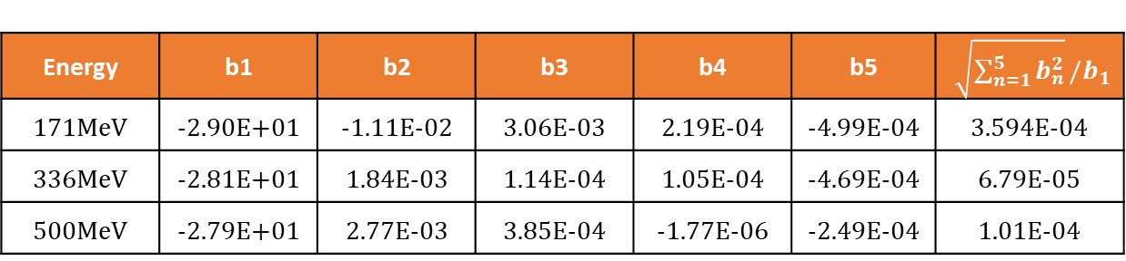
B-com Magnet
Harmonic content
Energy | b1 | b2 | b3 | b4 | b5 | $\sqrt{\sum_{n=1}^{5}{b_{n}^{2}}}/b_{1}$
171MeV | -2.90E+01 | -1.11E-02 | 3.06E-03 | 2.19E-04 | -4.99E-04 | 3.594E-04
336MeV | -2.81E+01 | 1.84E-03 | 1.14E-04 | 1.05E-04 | -4.69E-04 | 6.79E-05
500MeV | -2.79E+01 | 2.77E-03 | 3.85E-04 | -1.77E-06 | -2.49E-04 | 1.01E-04
To ensure the quality of the field used to guide the electrons along a certain trajectory with a precise bending angle
0.036% field homogeneity along the beam path.
Quadrupole and sextupole components can be dealt with in the lattice.

Slide 9
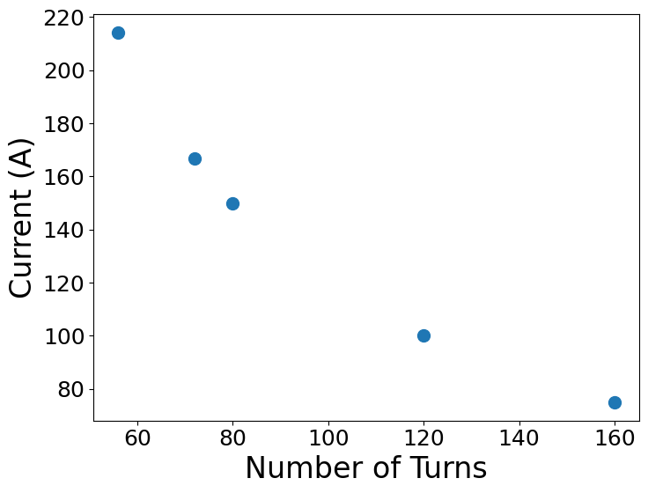
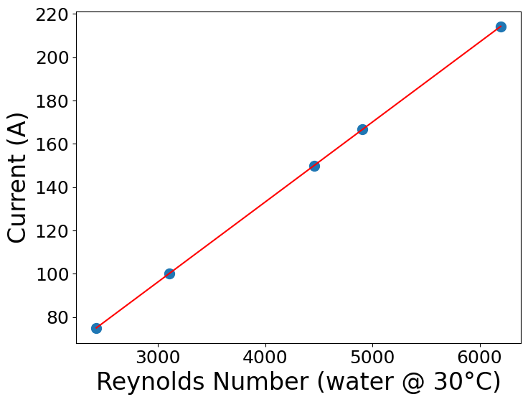
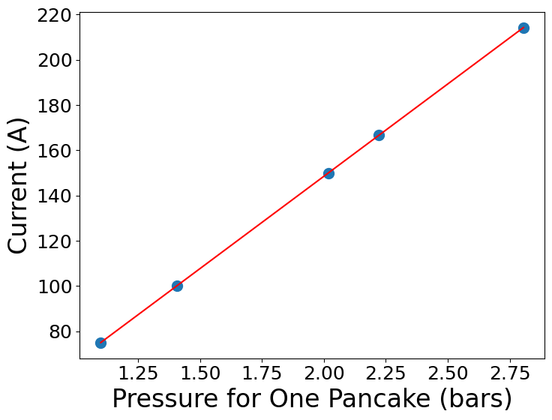
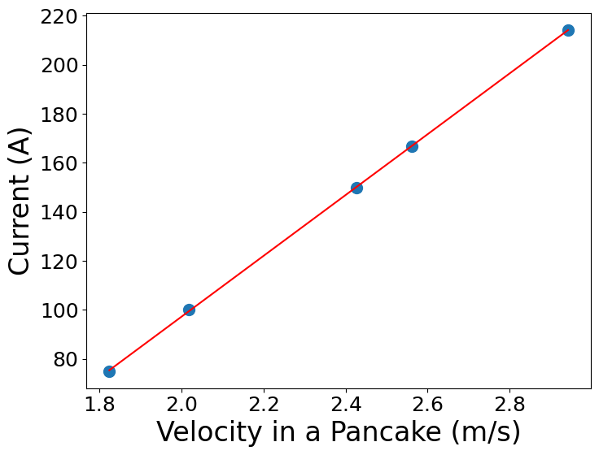
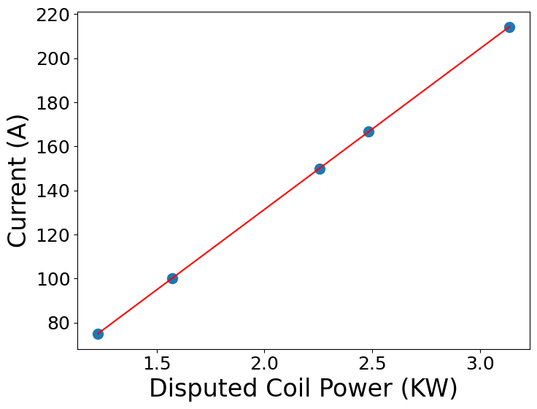
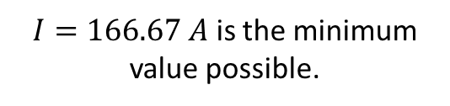
B-com Magnet
Coil and cooling circuit
Excitation current calculated for B = 0.87 T
is
NI = 11520.263 A.turn
The cooling circuit parameters were calculated for different current values.
Goal: achieve the minimum possible current to power the magnet while ensuring adequate coil cooling.
Turbulent water flow must be achieved → Reynolds number > 4000
$I=166.67 A$ is the minimum value possible.
Courtesy of Abdalrhman Marshoud – Internship student from An-Najah University

Slide 10
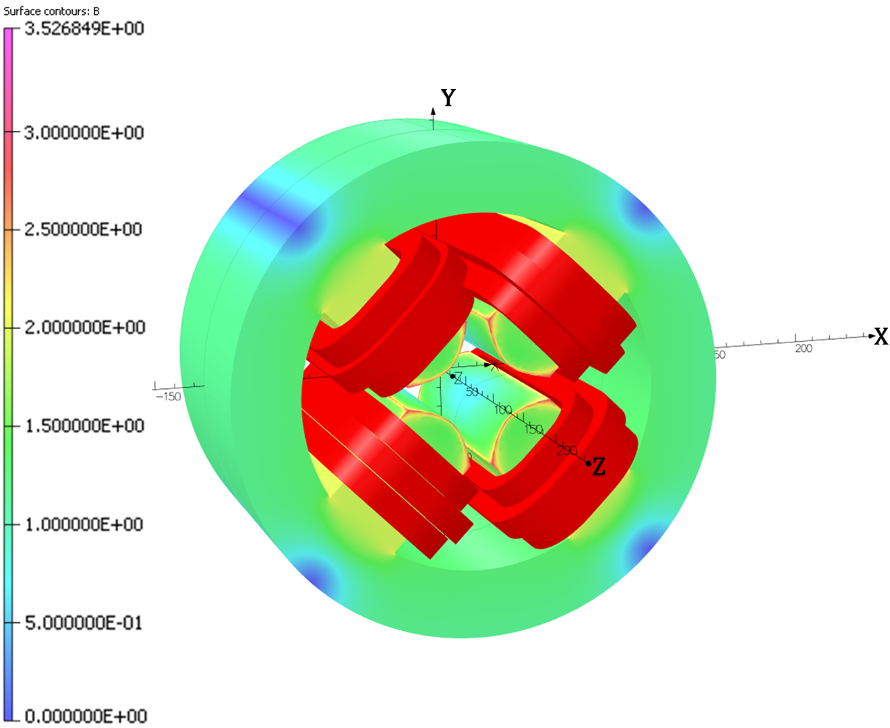
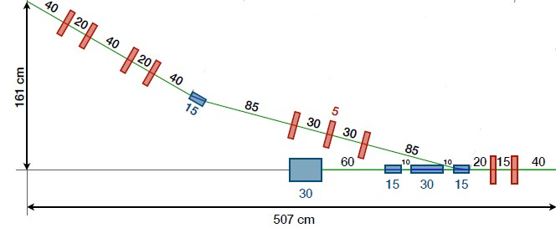
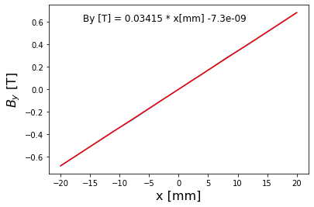
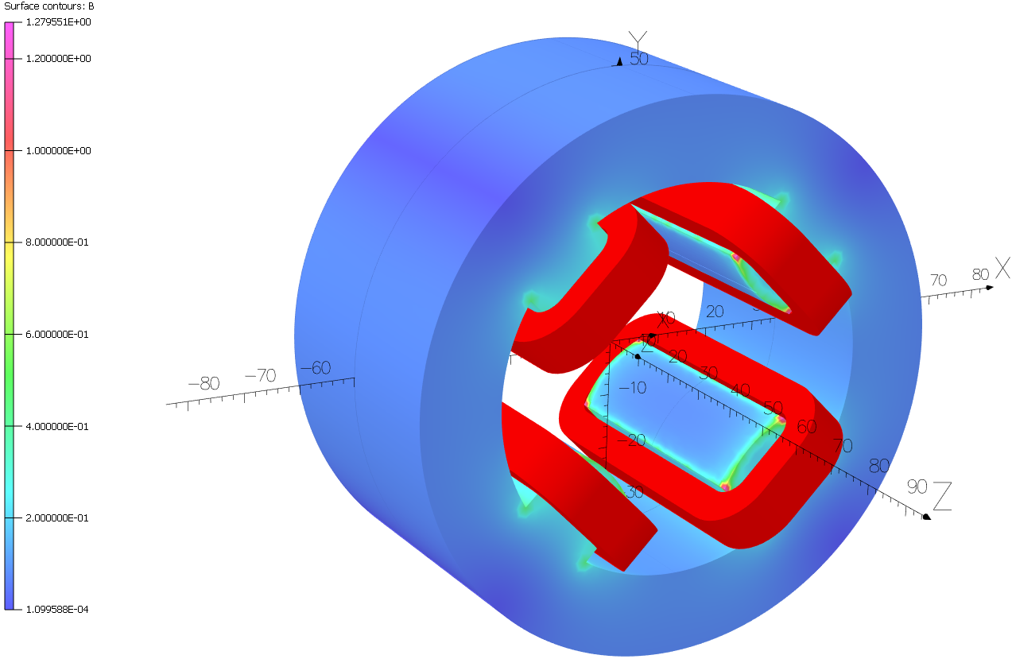
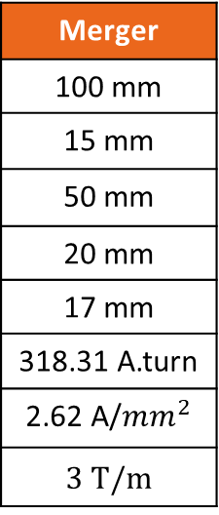
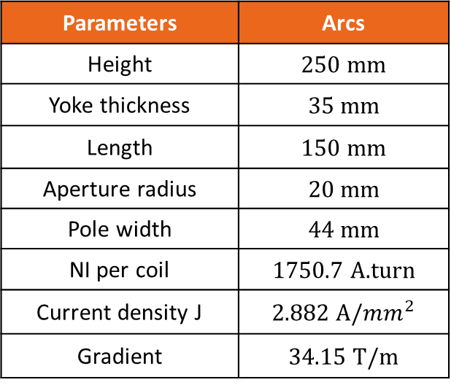
Quadrupole Magnets
Arcs Section
Merger Section
Quadrupole series of 15 cm long was designed.
Maximum gradient of 1.2 T/m.
Available vertical space from the B-com magnet of around 33 cm.
Parameters | Arcs
Height | 250 mm
Yoke thickness | 35 mm
Length | 150 mm
Aperture radius | 20 mm
Pole width | 44 mm
NI per coil | 1750.7 A.turn
Current density J | 2.882 A/${mm}^{2}$
Gradient | 34.15 T/m
Merger
100 mm
15 mm
50 mm
20 mm
17 mm
318.31 A.turn
2.62 A/${mm}^{2}$
3 T/m
Max. gradient (250 MeV) = 23 T/m
Twice the required gradient

Slide 11
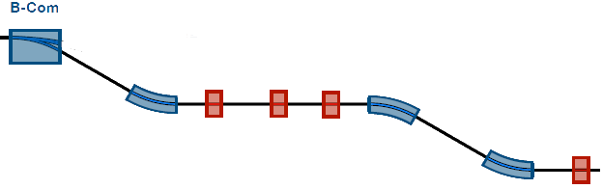
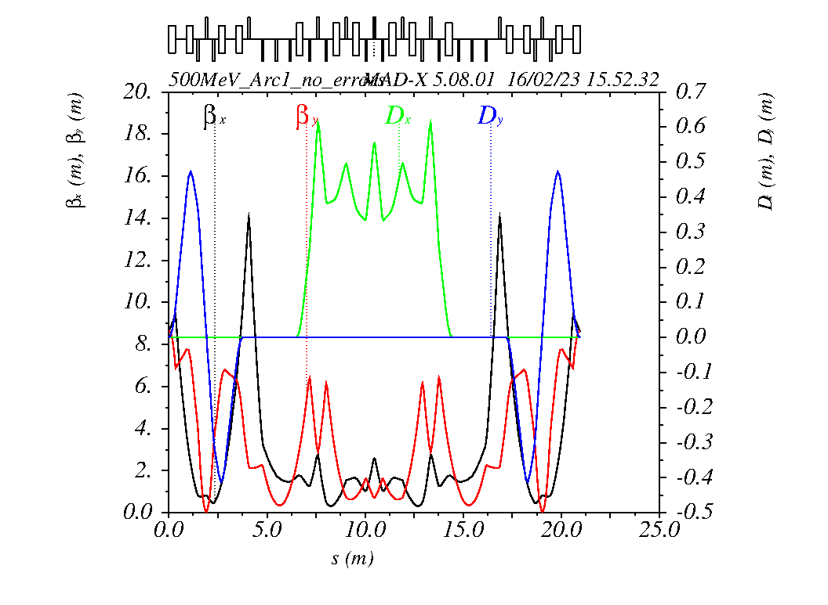
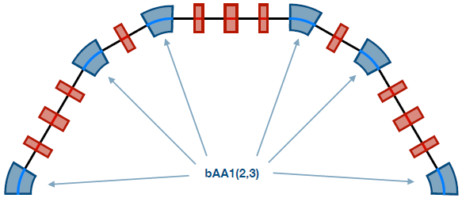
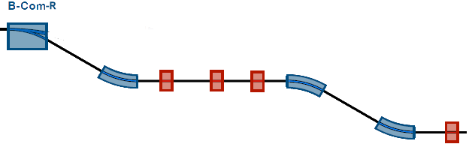

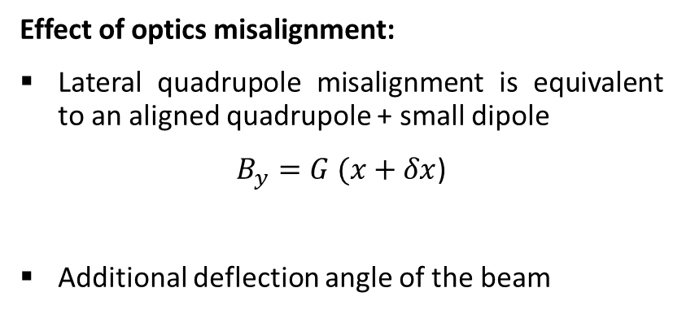
Beam Optics
Effect of optics misalignment:
Lateral quadrupole misalignment is equivalent to an aligned quadrupole + small dipole
$B_{y}=G (x+δx$)
Additional deflection angle of the beam
The following work is for 500 MeV version
Small offset $\sim 0$
The lattice is tuned so that
The Dispersion function is Zero at the exit of each arc.
The Beta function is the same at the entrance and exit of each arc.
The Alfa function changes the sign between the arc entrance and exit.
Twiss functions through Arc1 for the first-order 500 MeV lattice with perfect elements on MADX.

Slide 12
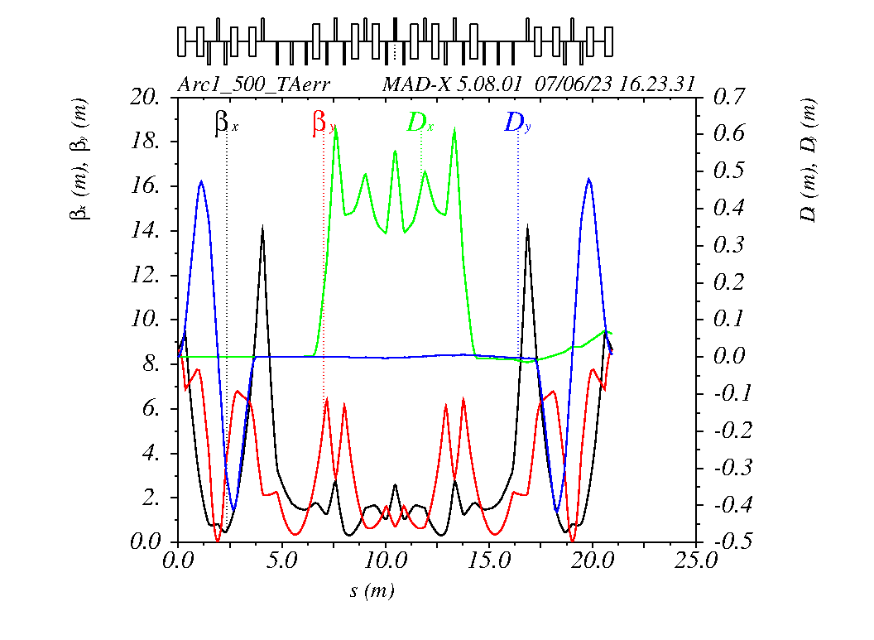
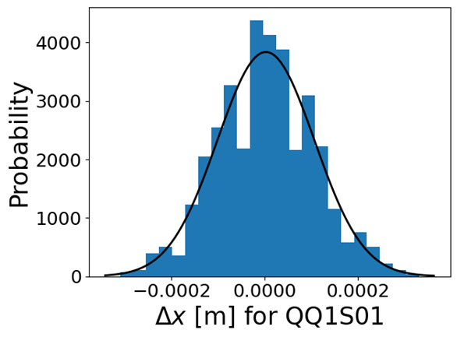
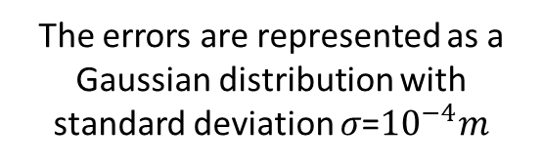
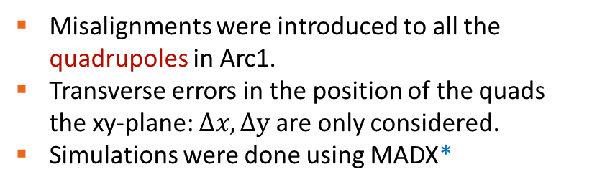
Optics misalignments
Misalignments were introduced to all the quadrupoles in Arc1.
Transverse errors in the position of the quads the xy-plane: $Δx,Δy$are only considered.
Simulations were done using MADX*
The errors are represented as a Gaussian distribution with standard deviation 𝜎=${10}^{−4}m$
* https://madx.web.cern.ch/madx/

Slide 13
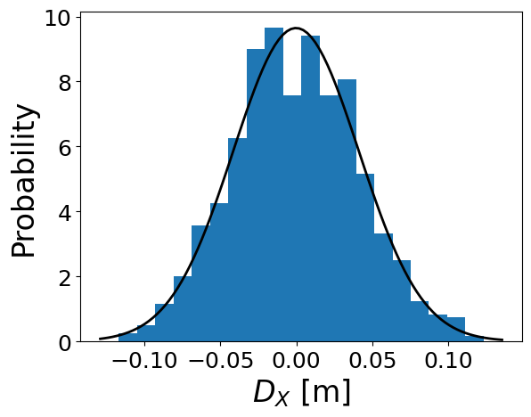
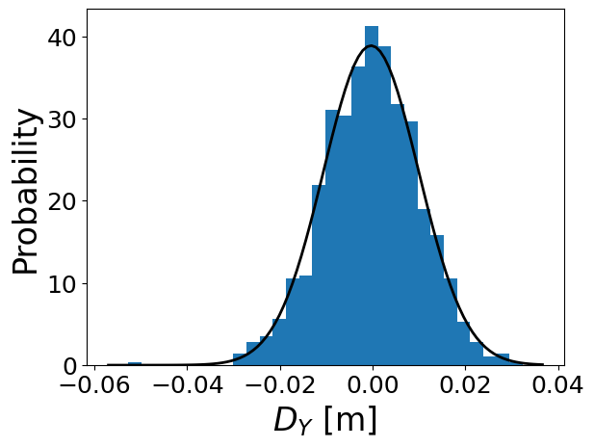
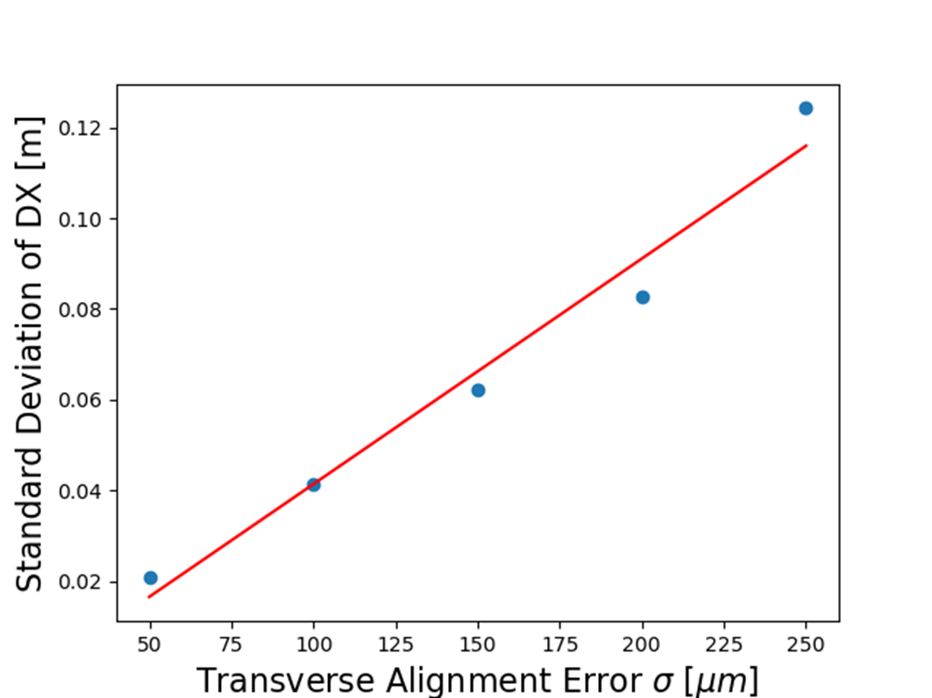
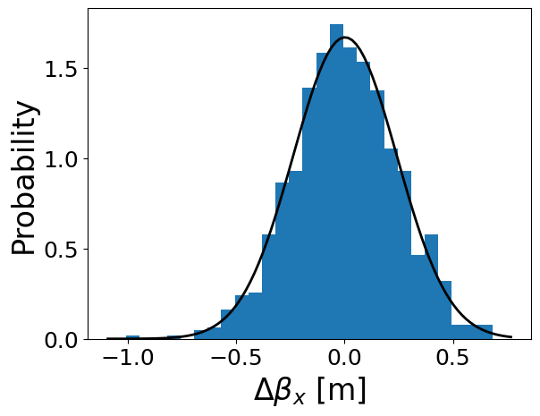
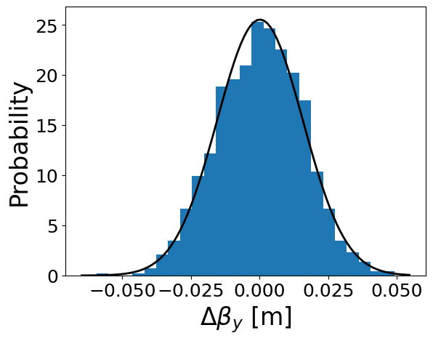




Optics misalignments
1000 simulations were performed.
Twiss functions were deduced at the exit of the arc.
Different values of the transverse alignment errors were introduced.
The standard deviation of DX at the exit of the Arc is extracted.
Standard deviation $\sim 40 mm$
Standard deviation $\sim 10 mm$
The error value affects linearly the dispersion
Standard deviation $\sim 24 mm$
Standard deviation $\sim 15 mm$

Slide 14

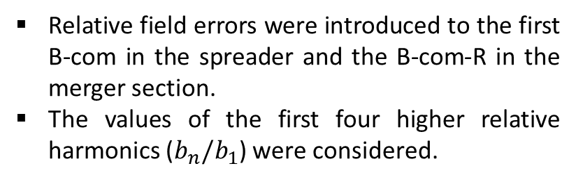
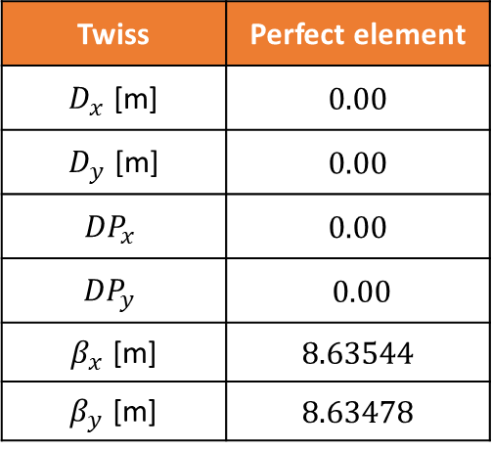
Field errors
Relative field errors were introduced to the first B-com in the spreader and the B-com-R in the merger section.
The values of the first four higher relative harmonics ($b_{n}/b_{1}$) were considered.
An increase in the Beta function is noticed at the exit
→ Additional quadrupole component change the beta function and possibly increase the beam size
Twiss | Perfect element
$D_{x}$ [m] | 0.00
$D_{y}$ [m] | 0.00
$${DP}_{x}$$ | 0.00
$${DP}_{y}$$ | 0.00
$β_{x}$ [m] | 8.63544
$β_{y}$ [m] | 8.63478
With field errors
0.00
-0.00301
0.00
0.00059
8.70493
9.73175
Twiss functions at the exit of Arc1

Slide 15
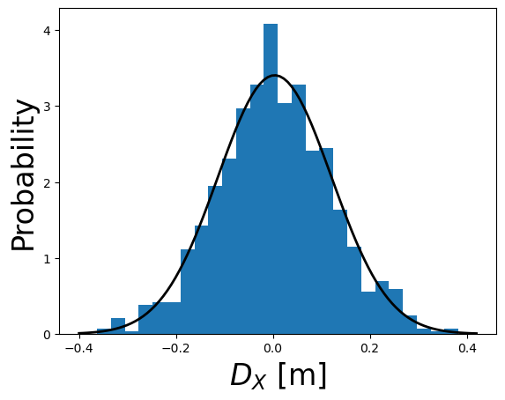


250 MeV PERLE Lattice
No errors
With errors
Primary studies of lattice errors for the 250 MeV machine.
Quadrupole misalignments affected the dispersion function.
$$σ\sim 0.117m$$
The standard deviation of the dispersion showed an exaggerated value.
Studies will be carried out using BMAD instead of MADX.

Slide 16
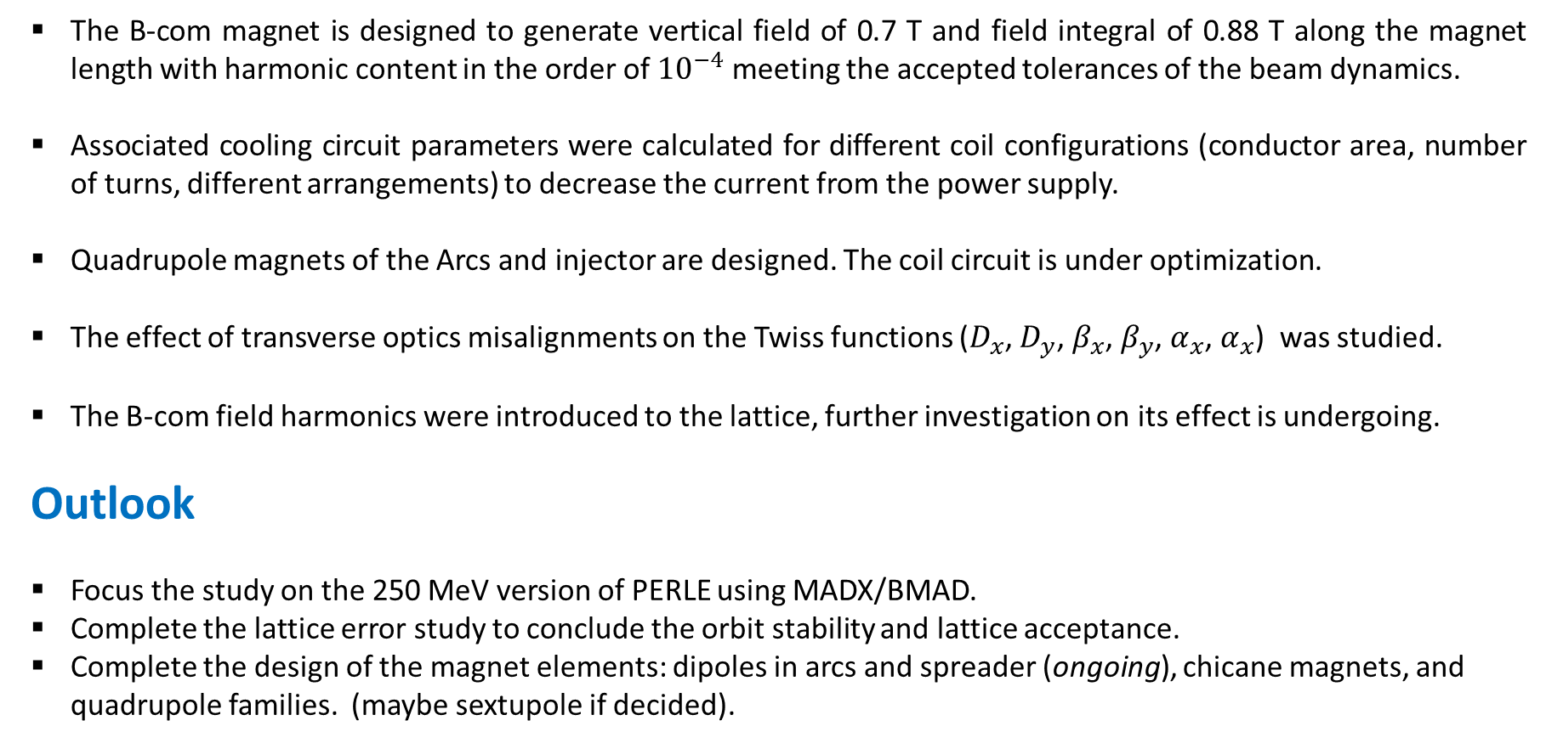
Conclusion
The B-com magnet is designed to generate vertical field of 0.7 T and field integral of 0.88 T along the magnet length with harmonic content in the order of ${10}^{−4}$ meeting the accepted tolerances of the beam dynamics.
Associated cooling circuit parameters were calculated for different coil configurations (conductor area, number of turns, different arrangements) to decrease the current from the power supply.
Quadrupole magnets of the Arcs and injector are designed. The coil circuit is under optimization.
The effect of transverse optics misalignments on the Twiss functions ($D_{x}$, $D_{y}$, $β_{x}$, $β_{y}$, $α_{x}$, $α_{x}$) was studied.
The B-com field harmonics were introduced to the lattice, further investigation on its effect is undergoing.
Outlook
Focus the study on the 250 MeV version of PERLE using MADX/BMAD.
Complete the lattice error study to conclude the orbit stability and lattice acceptance.
Complete the design of the magnet elements: dipoles in arcs and spreader (ongoing), chicane magnets, and quadrupole families. (maybe sextupole if decided).

Slide 17
Merci Beaucoup!

Slide 18
Back-up Slides

Slide 19
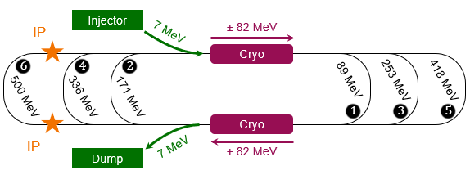
PERLE @ Orsay
PERLE is the first multi-turn, high current ERL based on SRF technology to operate at 10 MW power.
Cryomodule with 82 MV accelerating gradient.
3 acceleration passes → maximum energy 500 MeV
Dump energy: 7 MeV.
Same technological choices of LHeC → PERLE will be a demonstrator for the multi-turn ERL for the LHeC.
PERLE will also be a facility platform for nuclear applications (DESTIN).

Slide 20
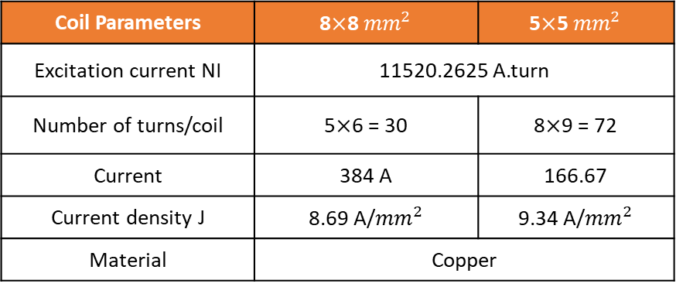
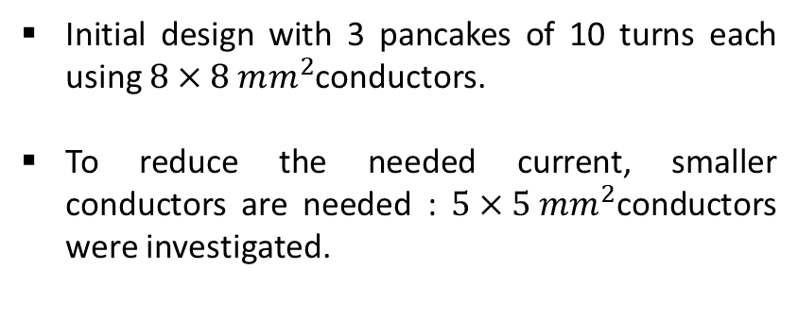
B-com Magnet
Coil and cooling circuit
Initial design with 3 pancakes of 10 turns each using $8×8 mm^{2}$conductors.
To reduce the needed current, smaller conductors are needed : $5×5 mm^{2}$conductors were investigated.
Coil Parameters | 8$×$8 ${mm}^{2}$ | 5$×$5 ${mm}^{2}$
Excitation current NI | 11520.2625 A.turn
Number of turns/coil | 5$×$6 = 30 | 8$×$9 = 72
Current | 384 A | 166.67
Current density J | 8.69 A/${mm}^{2}$ | 9.34 A/${mm}^{2}$
Material | Copper

Slide 21



Quadrupole Magnet
Arcs Section
Quadrupole series of 15 cm long was designed.
Parameters | Value
Height | 250 mm
Yoke thickness | 35 mm
Length | 150 mm
Aperture radius | 20 mm
Pole width | 44 mm
NI per coil | 1750.7 A.turn
Current density J | 2.882 A/${mm}^{2}$
G = 34.15 T/m

Slide 22

Quadrupole Magnet
Merger Section
Parameters | Value
Height | 100 mm
Yoke thickness | 15 mm
Length | 50 mm
Aperture radius | 20 mm
Pole width | 17 mm
NI per coil | 318.31 A.turn
Current density J | 2.62 A/${mm}^{2}$
Pole tip field | 0.07 T
Gradient | 3 T/m
All merger quadrupoles are 5 cm long (in z).
Maximum gradient of 1.2 T/m.
Available vertical space from the B-com magnet of around 33 cm.
Pole tip field = 0.07 T
Gradient G = 3 T/m

Slide 23




Introducing Errors (500 MeV)
Field errors
1000 simulations using Gaussian distribution around the relative quadrupolar component.
Mean value = 0.2055 m
Standard deviation $σ=1.971 m$
Mean value = 0.622 m
Standard deviation $σ=1.016 m$

Slide 24


250 MeV PERLE Lattice
250 MeV lattice from Alex Fomin by MADX.
Injector optics are not included, only the chicane magnet → Using predefined initial Betas.
For misalignments, the simulation is done turn by turn.
Turn1 (89 MeV) consists of: Spr1, Arc1, Str1, Arc2, Mrg1.

Slide 25



Transverse Misalignment to Turn 1 (250 MeV)
Dispersion Function
Mean value = 0.00
Standard deviation $σ\sim 0.117m$
Mean value = 0.00
Standard deviation $σ\sim 0.0935m$

Slide 26




Transverse Misalignment to Turn 1 (250 MeV)
Beta Function
Mean value = 0.00
Standard deviation $σ\sim 0.6628m$
Mean value = 0.00
Standard deviation $σ\sim 0.0478m$

Slide 27
Outlook
Focus on the 250 MeV version of PERLE.
Complete the lattice error study to conclude the orbit stability and lattice acceptance.
Longitudinal misalignments.
Tilt (angular misalignments).
Field errors for all magnetic elements.
Complete the design of the magnet elements: dipoles in Arcs and spreader, chicane magnets, and quadrupole families. (maybe sextupole if decided).

