Slide 1

Some bulk Cu and aC coating preliminary results obtained with the Vacuum Pilot Sector during 2023 run
Quentin DUONG
TE – VSC – VSM
Dr. Vincent BAGLIN (CERN) CERN supervisor
Dr. Gaël SATTONNAY (IJCLab-MAVERICS) Doctoral supervisor
quentin.duong@cern.ch
06/12/2023
Notes:
Hello everybody. I’m Quentin DUONG and it’s been 1 year since I began my contract as a PhD student in the Vacuum Surface and Coating group, studying the ecloud in the Vacuum Pilot Sector. During this presentation I’ll talk about results I got for bulk copper and amorphous coating.

Slide 2
Outline
Set-up description & physics principles
LHC physics fill’s lifetime
Electron cloud of a hybrid physics fill
Electron energy distribution for bulk Copper
TE – VSC – VSM
Notes:
I’ll, therefore, introduce my set-up, give some measurements obtained at 450GeV for 72b and hybrid fills, discuss about a hybrid physics fill during its whole lifetime and I’ll end this presentation by giving a glimpse into the electron energy distribution for copper.

Slide 3
Disclaimer
I present the observations performed on some of the 2023 fills
Results are therefore preliminary
TE – VSC – VSM
Notes:
As a disclaimer, I’d like to stress the point that considering the consequent amount of data I’ve to deal with I can’t give a throrough overview of the whole 2023 run and that the results are therefore preliminary.

Slide 4
Set-up description & physics principles
TE – VSC – VSM
Notes:
Alright, let’s introduce the VPS

Slide 5
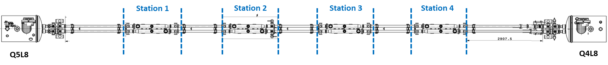
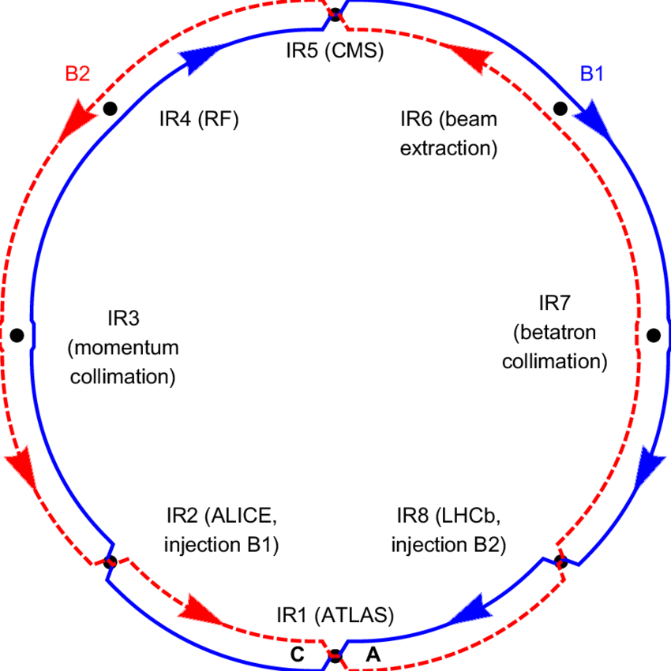
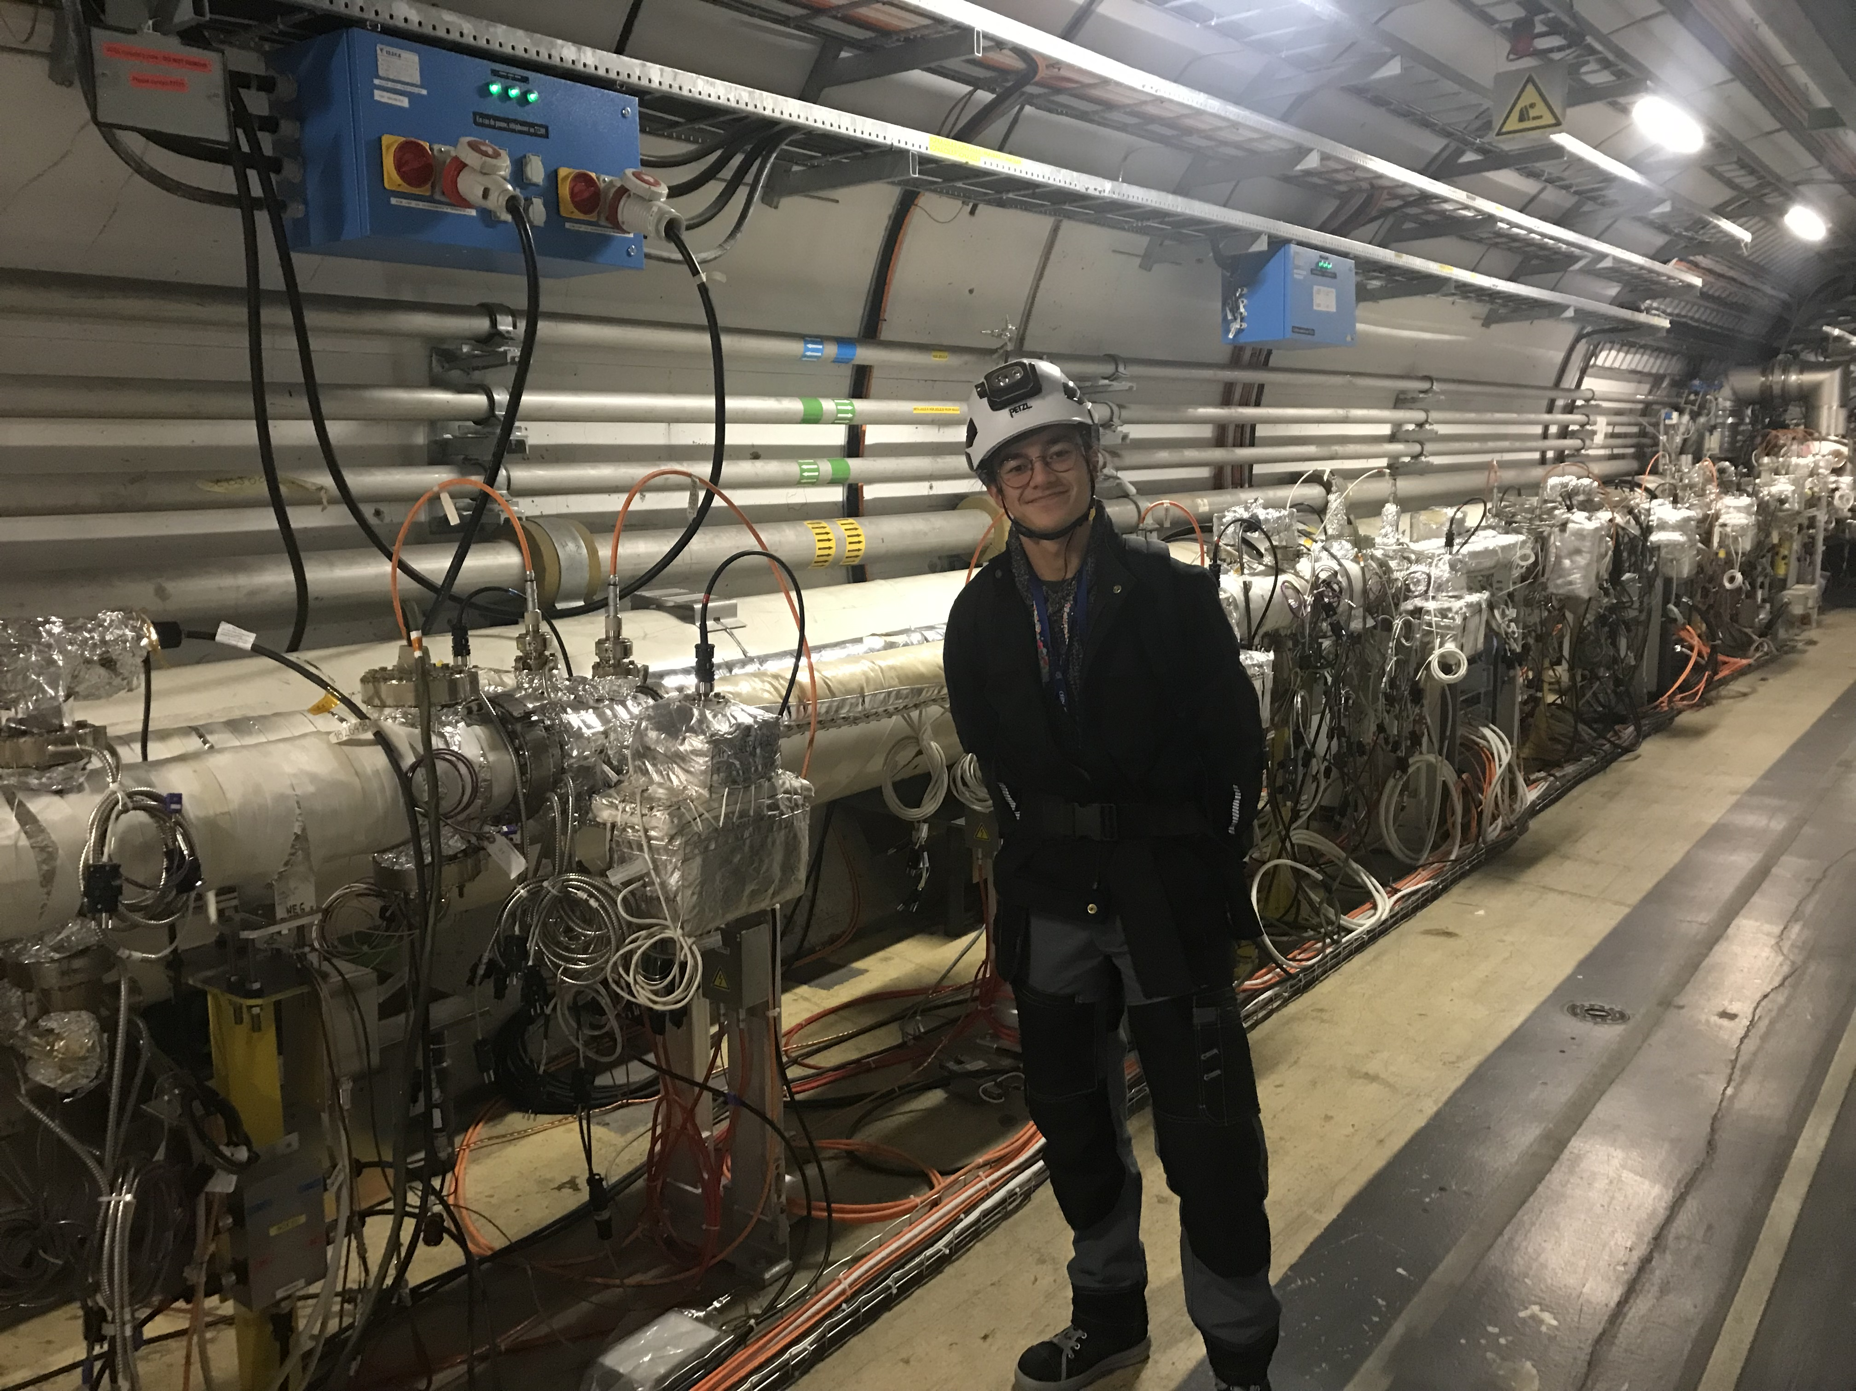
Layout
B2
B1
a-C
Cu
CMS
LHC
ALICE
LHCb
VPS
ATLAS
Vacuum Pilot Sector (VPS)
Location: close to LHCb
2 beamlines
Installed in 2015:
1.4m-long thick a-C coating ~500nm
1.4m-long bulk Cu
TE – VSC – VSM
Notes:
The Vacuum Pilot Sector, or VPS, is a 19m-long setup located in between Q5L8 and Q4L8. It has been initially installed in 2014 but has been modified in 2015, adding the two stations I’ll discuss: a 1.4m-long station of amorphous carbon and one of bulk copper. I’d like to stress the point here that the carbon coating is in my case a thick one of thickness about 500nm.

Slide 6


Electron cloud build-up
Electron cloud = Primary + Secondary electrons
Primary electrons:
Photoelectrons induced by photoelectric effect
Free electrons induced by bunch ionising the residual gas
Secondary electrons: induced by primary electrons, accelerated by successive bunches, hitting the surface
PEY
SEY
accelerated e⁻
$$γ_{SR}$$
secondary e⁻
photoelectron
e⁻
free electron e⁻
Electron
cloud
p+
p+
Two main material properties for ecloud:
Photoelectron Yield (PEY)
Secondary Electron Yield (SEY)
$PEY=\frac{N_{{photo e}^{−}}}{N_{γ}}$ $SEY=\frac{N_{{sec e}^{−}}}{N_{incident e^{−}}}$
ionised gas i⁺
primary e-
Image current
Beam pipe
TE – VSC – VSM
Notes:
As a quick reminder of the ecloud build-up process, it begins with pimary electrons consisting in photoelectrons induced by synchrotron radiation hitting the beamscreen, the PEY, and free electrons induced by proton beam ionising the remaining gas. These primary electrons are then accelerated until a certain energy with which they’re likely to rip some more electrons by hitting the surface, the SEY. Those are also accelerated and so on, leading to the ecloud build-up.
Ecloud being the sum of primary and secondary electrons.

Slide 7
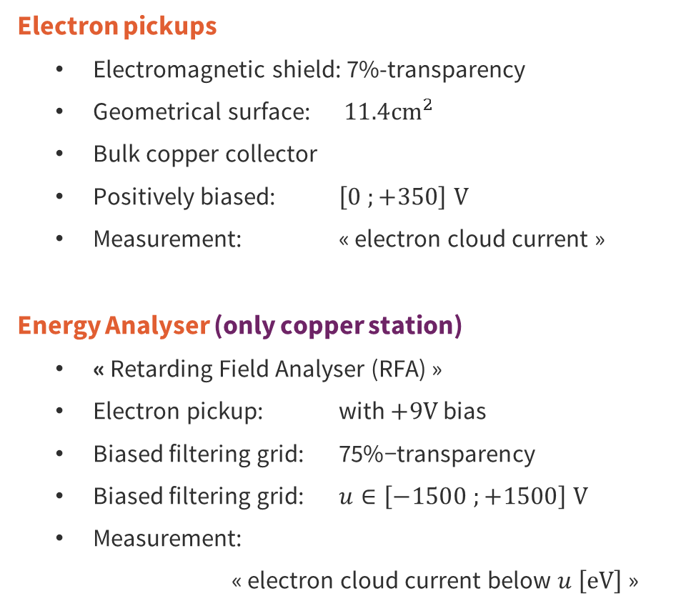
Electron current and energy detection
Electron pickups
Electromagnetic shield: 7%-transparency
Geometrical surface: $11.4{cm}^{2}$
Bulk copper collector
Positively biased: $\left[0 ;+350\right] V$
Measurement: « electron cloud current »
Energy Analyser (only copper station)
« Retarding Field Analyser (RFA) »
Electron pickup: with $+9V$ bias
Biased filtering grid: $\text{7}\text{5}\text{\%−}\text{transparen}\text{cy}$
Biased filtering grid: $u∈\left[−1500 ;+1500\right] V$
Measurement:
« electron cloud current below $u \left[eV\right]$ »
Electron pickups
Energy Analyser
A
+9V
[0 ; 350] V
A
Cu
[-1.5 ; 1.5] kV
Cu
Cu
Cu
Cu
Electron
cloud
p+
p+
Image current
Beam pipe
TE – VSC – VSM
Notes:
To fathom some of the characteristics of ecloud has been installed in the setup electron pickups which collect the ecloud current, and electron energy analysers only available for copper station. The pickup consists in a positively biased bulk copper collector placed behind an electromagnetic shield with a 7% transparency. The energy analyser, which is precisely-speaking, a retarding field analyser or RFA consists in an electron pickup in which a biased filtering grid is inserted.

Slide 8


Total pressure detection
Pressure elevation during LHC functionning
Photodesorbed gas: induced by photons hitting the surface
Electrodesorbed gas: induced by electrons hitting the surface
Total pressure gauges
Bayard-Alpert gauges « VGI »
Measurement: « desorbed gas pressure »
PSD
$$γ_{SR}$$
photodesorbed gas
free electron e⁻
Two main material properties for gas increase:
Photodesorption
Electrodesorption
${PSD}_{gas}∝\frac{{ΔP}_{gas}}{N_{γ}}$ ${ESD}_{gas}∝\frac{{ΔP}_{gas}}{N_{e^{−}}}$
Electron
cloud
p+
p+
ionised gas i⁺
electrodesorbed gas
Image current
Beam pipe
ESD
Total pressure gauges
TE – VSC – VSM
Notes:
In addition to the electron-related instruments, there are also total pressure gauges, Bayard-Alpert ones. They’re aimed at monitoring the pressure rises which can, among other phenomena, be induced by the photodesorption induced by the synchrotron radiation, the PSD, and by the electrodesorption induced by ecloud, the ESD.

Slide 9
LHC physics fill’s lifetime
TE – VSC – VSM
Notes:
Now, let’s have a look on the responses of different filling scheme fills during injection, one consisting in batches of 72 bunches, and one hybrid consisting of a mix of 8b4e and 36 b. These fills were chosen to keep the mean proton per bunch constant.

Slide 10
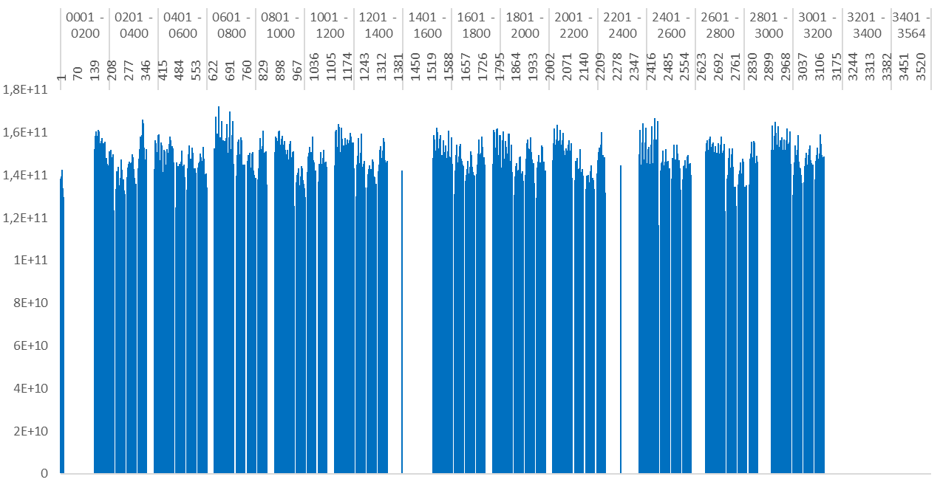
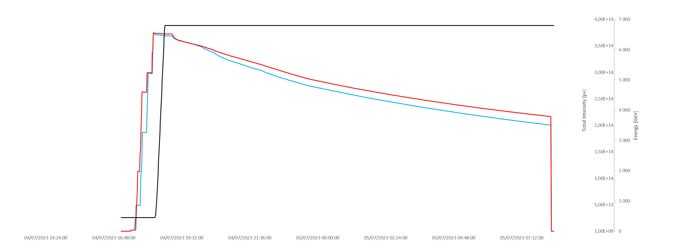
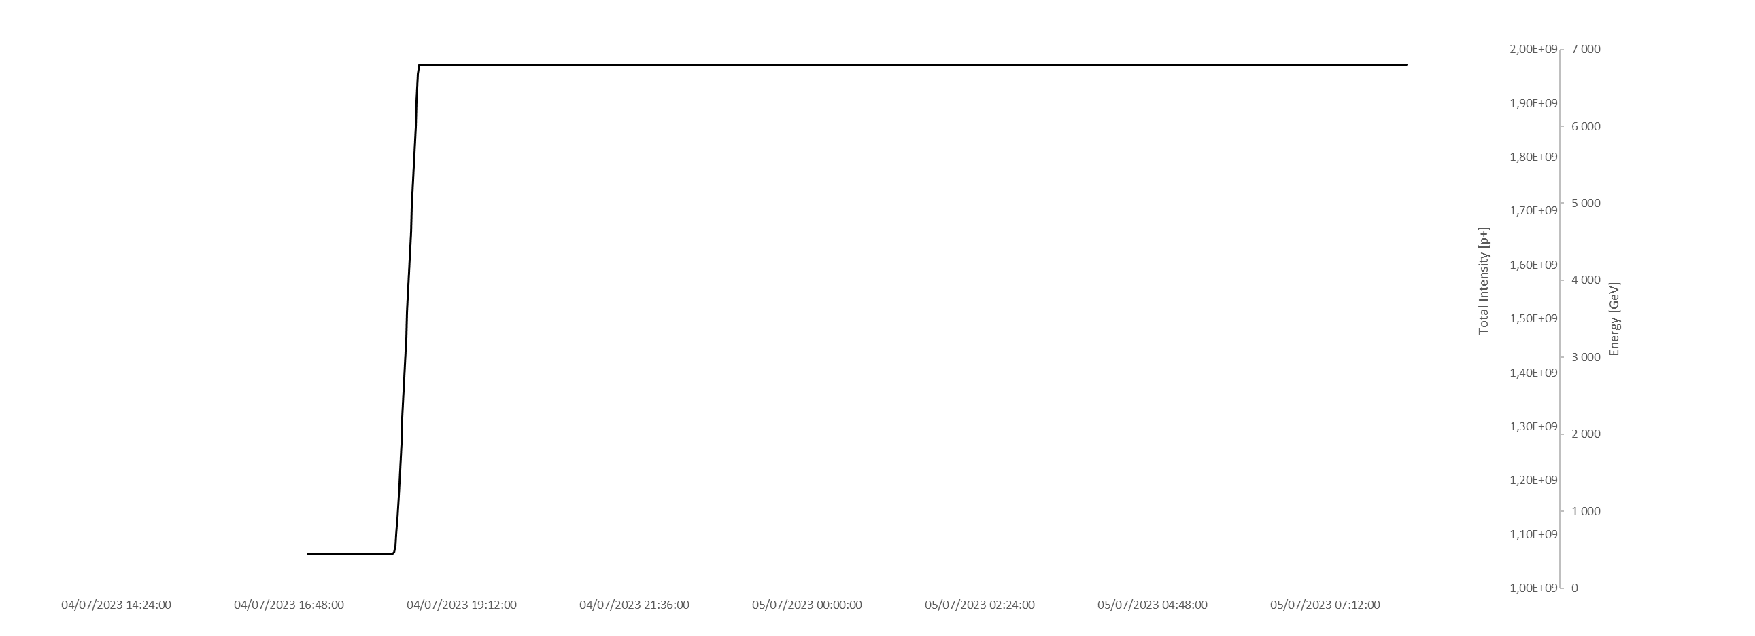













Hybrid scheme injection
ppb
$$\left[{10}^{11}p^{+}\right]$$
1 turn of the LHC: ~89µs
Beam energy
$$\left[GeV\right]$$
Injection phase
$$1.8$$
$$1.6$$
$$1.4$$
6800
Beam energy
$$1.2$$
$$1.0$$
$$0.8$$
B2 intensity
$$0.6$$
$$0.4$$
B1 intensity
$$0.2$$
$$0$$
« hybrid »
7*(8b4e) + 3*(36b)
450
Time
TE – VSC – VSM

Slide 11
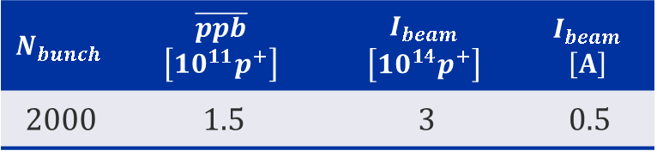
Fill lifetime overview
Beam energy
$$\left[GeV\right]$$
Orders of magnitude of typical beam parameters
A
B
C
D
$$N_{bunch}$$ | $$\overline{ppb}$$ $$\left[{10}^{11}p^{+}\right]$$ | $$I_{beam}$$ $$\left[{10}^{14}p^{+}\right]$$ | $$I_{beam}$$ $$\left[A\right]$$
2000 | 1.5 | 3 | 0.5
6800
Beam energy
ppb: proton per bunch
B2 intensity
B1 intensity
Phases
Injection (A): batch injections at 450GeV
Energy ramp-up (B): beam accelerated until 6800GeV
Stable beam (C): bunch collisions for the experiments
Ramp-down (D): beam dumped and RF ramp-down
450
Time
TE – VSC – VSM

Slide 12
Electron cloud of a hybrid physics fill
TE – VSC – VSM
Notes:
Next, I’ll show a few results obtained for the physics hybrid fill during its whole lifetime.

Slide 13
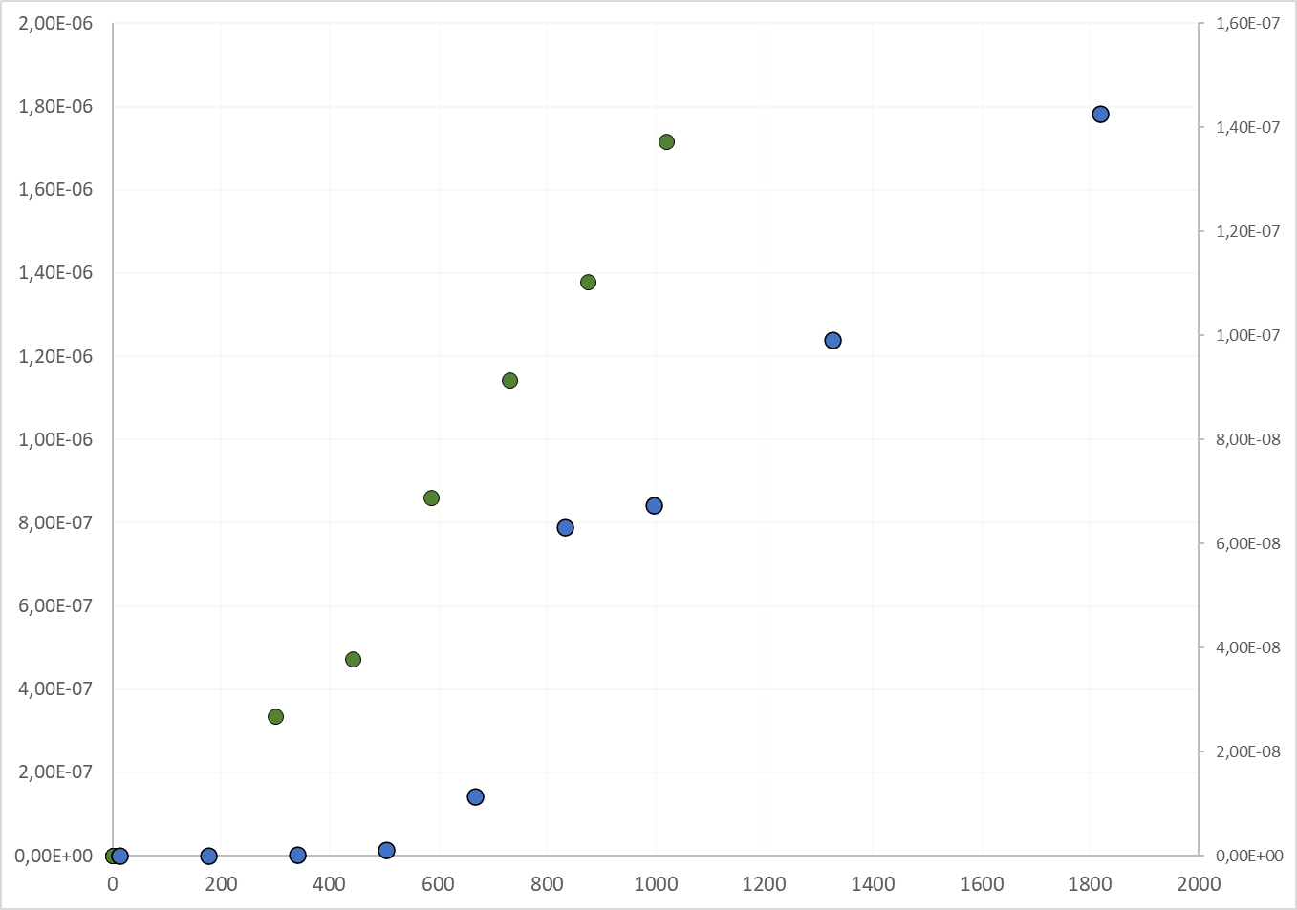









Electron cloud response of copper during injection
Electron flux
[A.cm⁻²]
1
2
3
4
5
6
8
11
Hybrid trains
$${16×10}^{−8}$$
$${14×10}^{−8}$$
$${12×10}^{−8}$$
$$I_{hybrid}\left[nA.{cm}^{−2}\right]≈0.1×{(N}_{bunch}−400)$$
$${10×10}^{−8}$$
$${8×10}^{−8}$$
Electron cloud’s linear behaviour after a certain number of bunches injected
$${6×10}^{−8}$$
$${4×10}^{−8}$$
$${2×10}^{−8}$$
$$0$$
0
400
800
1200
1600
2000
Number of bunches
TE – VSC – VSM
Notes:
Here is plotted the electron flux as a fonction of the number of bunches injected only for copper as carbon signals are too close to the detection limit.
You have the electron flux for 72b in green and on the left side and the hybrid one in blue and on the other side.
Equivalent number of trains are also given on the top and very bottom of the plot.
As you can see, both start to behave linearly after a few hundred of bunches. One advantage of hybrid on 72b is thatit needs more bunches before that linear regime, plus its linear cofficient is also 20 times lower than the other one.

Slide 14
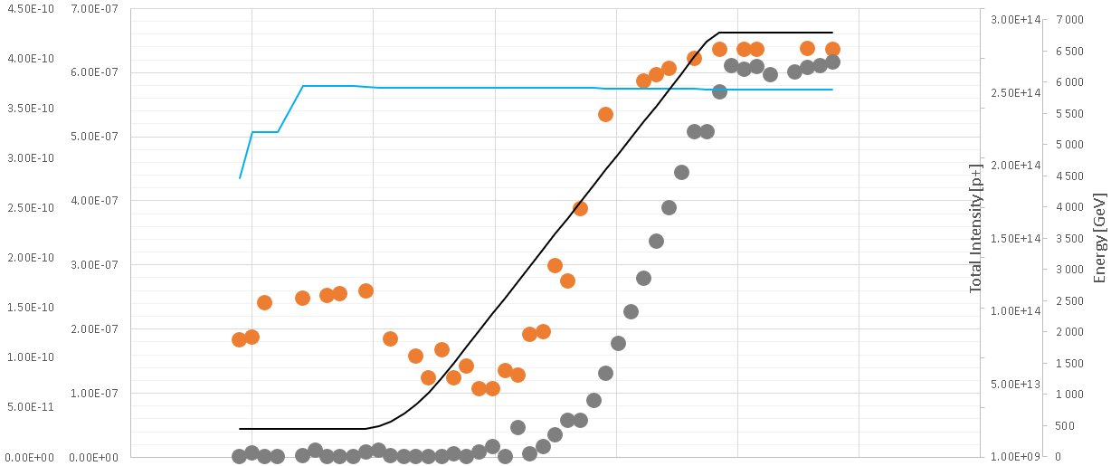










































Photoelectrons during energy ramp-up
a-C Cu
$${4.5×10}^{−10}$$
$${7×10}^{−7}$$
$${3.0×10}^{14}$$
$$7000$$
$${4.0×10}^{−10}$$
$${6×10}^{−7}$$
B1 intensity
$${2.5×10}^{14}$$
$$6000$$
$${3.5×10}^{−10}$$
Cu B1
$${5×10}^{−7}$$
$$5000$$
$${3.0×10}^{−10}$$
$${2.0×10}^{14}$$
$${2.5×10}^{−10}$$
$${4×10}^{−7}$$
$$4000$$
a-C B1
Beam energy [GeV]
Electron flux [A.cm⁻²]
Total beam intensity [p⁺]
$${1.5×10}^{14}$$
$${2.0×10}^{−10}$$
$${3×10}^{−7}$$
$$3000$$
$${1.5×10}^{−10}$$
$${1.0×10}^{14}$$
$${2×10}^{−7}$$
$$2000$$
$${1.0×10}^{−10}$$
$${1×10}^{−7}$$
$${0.5×10}^{14}$$
$$1000$$
$${0.5×10}^{−10}$$
Energy
$$0$$
$$0$$
$$0$$
$$0$$
$$0$$
$$7$$
$$14$$
$$28$$
$$35$$
$$42$$
$$49$$
$$56$$
$$Time [min]$$
Photoelectrons detected by electron pickup at $\sim 2500GeV$ which corresponds to a synchrotron radiation critical energy of 2 eV, matching the work function of copper or carbon (~ 4-5 eV)
TE – VSC – VSM
Notes:
First, you have here the electron flux versus time plot during to the energy ramp-up. In comparison with previous plots there’s here the beam energy plotted in black with its scale in GeV on the right.
As you can see, electron fluxes curb start to increase around 2500GeV showing the presence of photoelectrons. Indeed, for that beam energy the synchrotron radiation critical energy is about 2eV, which matches the work function of copper or carbon (about 4/5 eV).

Slide 15
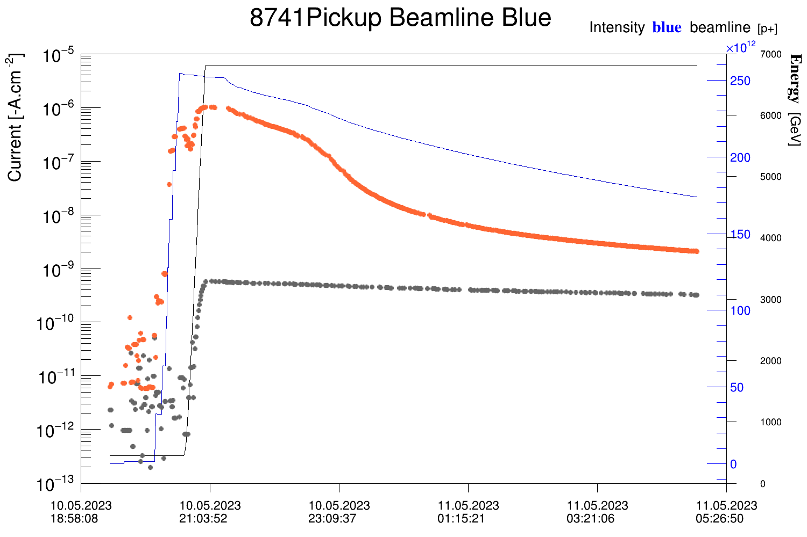



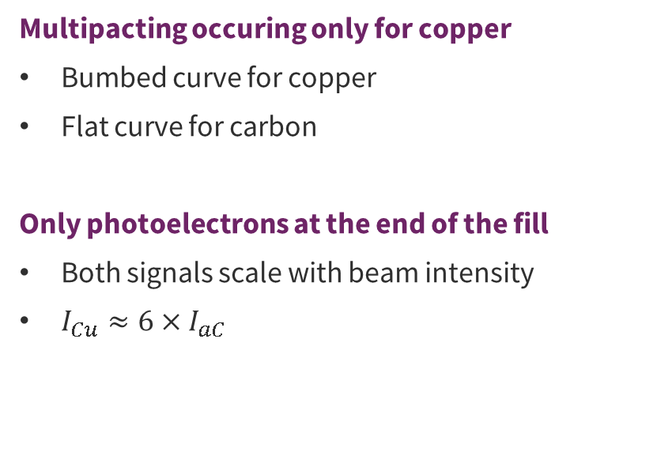




Electron cloud current evolution during a fill
Multipacting occuring only for copper
Bumbed curve for copper
Flat curve for carbon
Only photoelectrons at the end of the fill
Both signals scale with beam intensity
$I_{Cu}≈6×I_{aC}$
Energy
B1 intensity
Cu B1
Electron flux [A.cm⁻²]
a-C B1
Multipacting induces orders of magnitude of difference between copper and carbon electron cloud signals.
$$0$$
$$2$$
$$4$$
$$6$$
$$8$$
$$10$$
$$Time [h]$$
TE – VSC – VSM
Notes:
Now, if the plot is zoomed out to the whole fill lifetime, an indication of multipacting in the copper station can be noticed with this bumped curve while amorphous carbon response stays flat.
Moreover, by taking a look to the very last 30minutes of the fill, one can see a linear relation between electron flux and beam intensity, clueing us in a regime of pure photoelectrons. Moreover, one can also measure a factor 6 between copper photoelectrons flux and carbon one and provided the knowledge of the number of photons absorbed in the stations, one can compute their PEY.

Slide 16
Electron energy distribution for bulk Copper
Hybrid (7*8b4e+5*36b): 9072
TE – VSC – VSM
Notes:
Now, let’s move on the last topic of my talk, the electron energy distribution for copper.

Slide 17
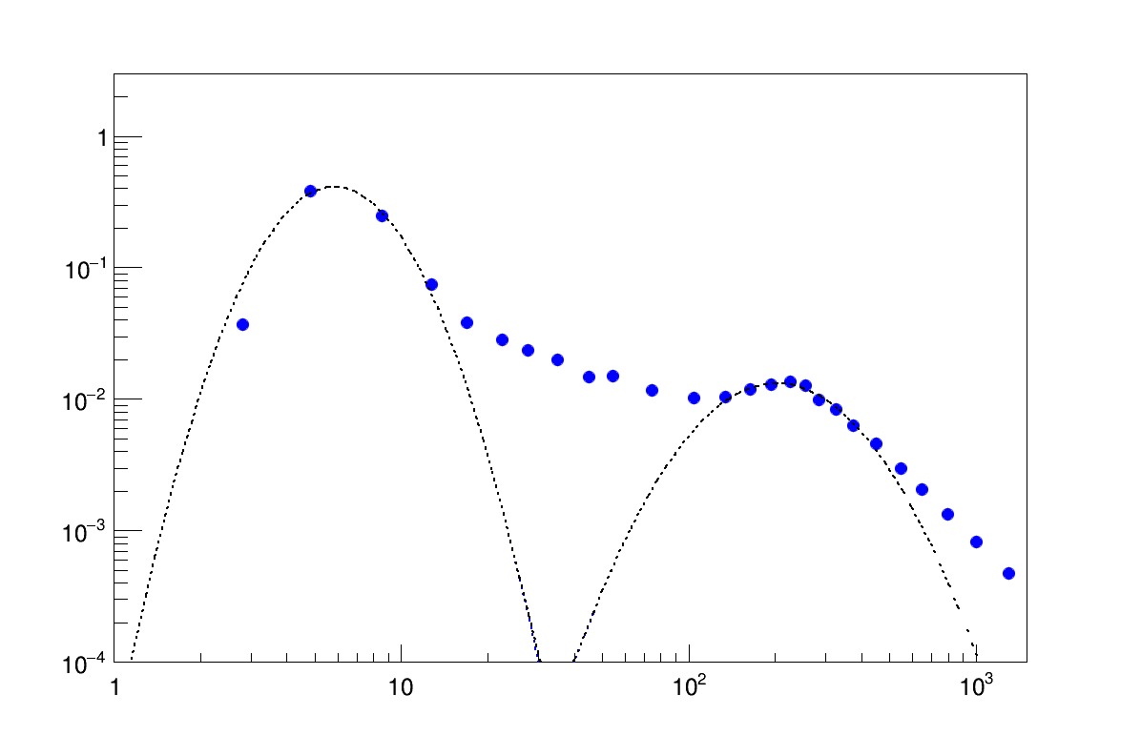
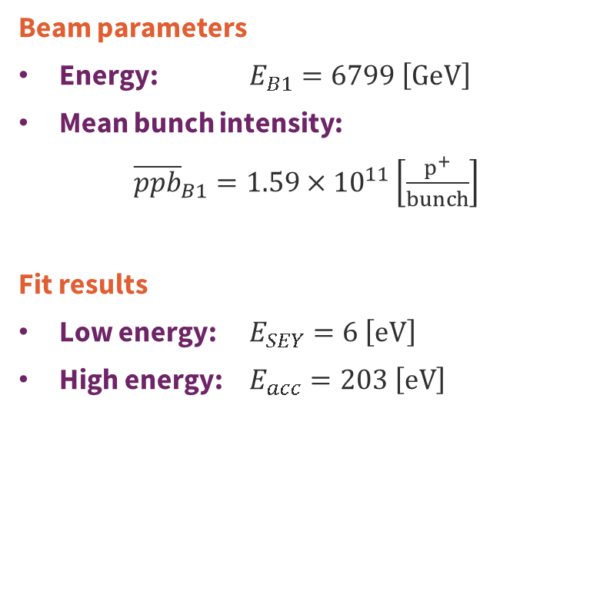




At Stable Beam: t = 0h
Electron energy spectrum: Fill 9072
Beam parameters
Energy: $E_{B1}=6799 \left[GeV\right]$
Mean bunch intensity:
${\overline{ppb}}_{B1}=1.59×{10}^{11}\left[\frac{p^{+}}{bunch}\right]$
Fit results
Low energy: $E_{SEY}=6 \left[eV\right]$
High energy: $E_{acc}=203 \left[eV\right]$
Normalised signal $\left[a.u\right]$
$$E_{SEY}$$
$$E_{acc}$$
$$E_{e^{−}} \left[eV\right]$$
TE – VSC – VSM
20/12/2023
TE – VSC – VSM
Notes:
Subsequently, energy scans have been done all along beam lifetime, for instance at the begin of stable beam

Slide 18
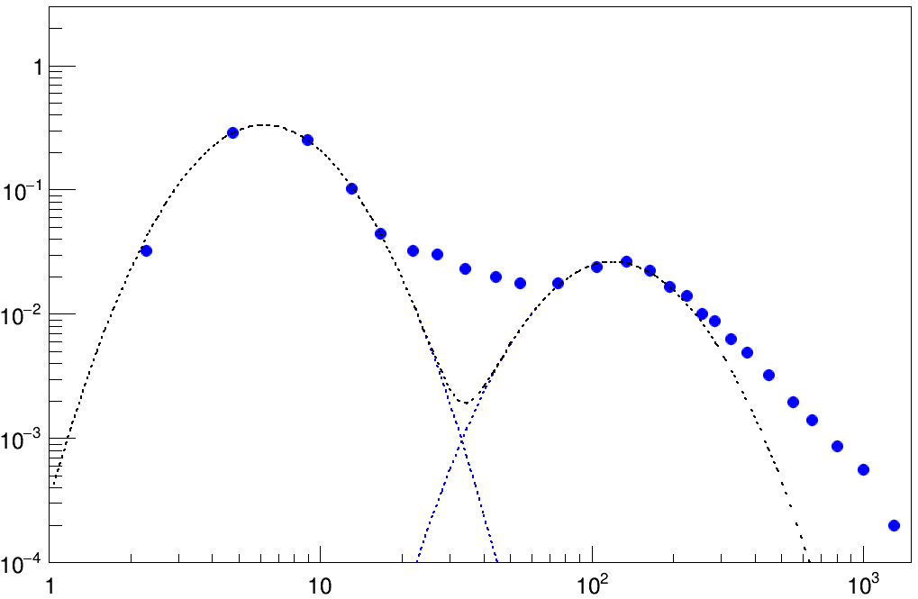



At Stable Beam: t = 6h
Electron energy spectrum: Fill 9072
Beam parameters
Energy: $E_{B1}=6799 \left[GeV\right]$
Mean bunch intensity:
${\overline{ppb}}_{B1}=1.23×{10}^{11}\left[\frac{p^{+}}{bunch}\right]$
Fit results
Low energy: $E_{SEY}=6 \left[eV\right]$
High energy: $E_{acc}=120 \left[eV\right]$
Normalised signal $\left[a.u\right]$
$$E_{SEY}$$
$$E_{acc}$$
$$E_{e^{−}} \left[eV\right]$$
TE – VSC – VSM
20/12/2023
TE – VSC – VSM
Notes:
After 6h of stable beam

Slide 19
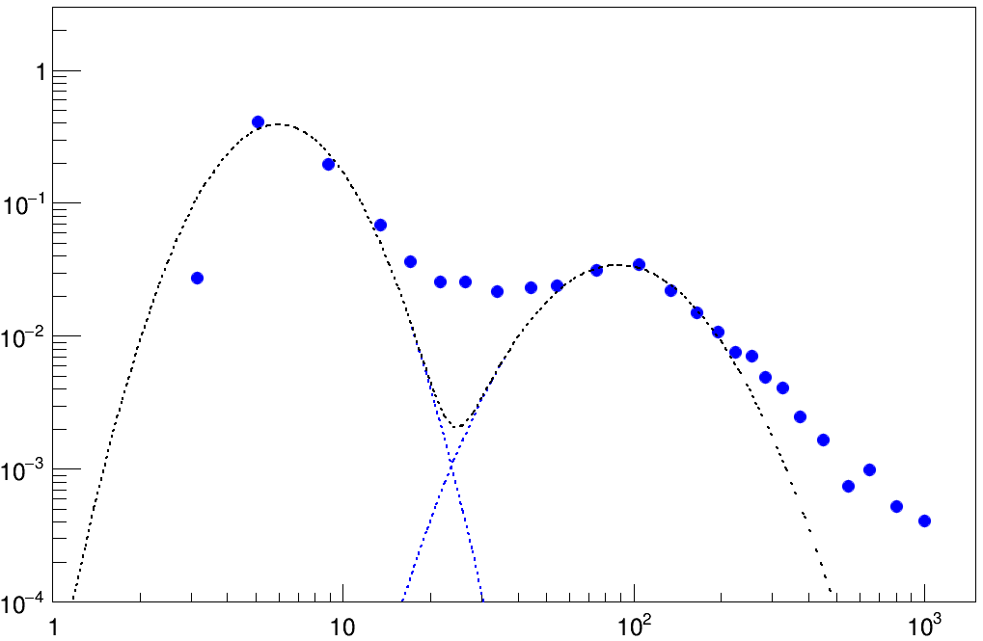


At Stable Beam: t = 11h
Electron energy spectrum: Fill 9072
Beam parameters
Energy: $E_{B1}=6799 \left[GeV\right]$
Mean bunch intensity:
${\overline{ppb}}_{B1}=0.99×{10}^{11}\left[\frac{p^{+}}{bunch}\right]$
Fit results
Low energy: $E_{SEY}=6 \left[eV\right]$
High energy: $E_{acc}=89 \left[eV\right]$
Normalised signal $\left[a.u\right]$
$$E_{SEY}$$
$$E_{acc}$$
$$E_{e^{−}} \left[eV\right]$$
TE – VSC – VSM
20/12/2023
TE – VSC – VSM
Notes:
And after 11h

Slide 20
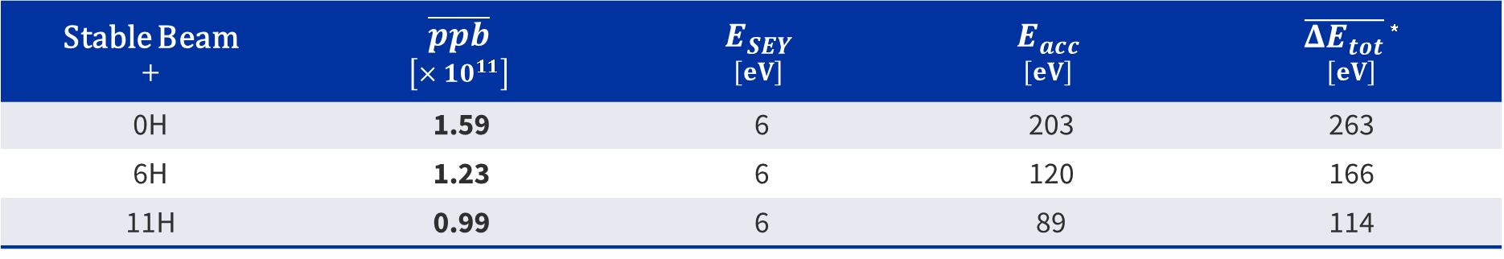

Impact of the beam intensity at 6800GeV
$$\overline{{ΔE}_{tot}}∝{ppb}^{2}×\ln\left|\sqrt{ppb}\right|$$
Stable Beam $$+$$ | $$\overline{ppb}$$ $$\left[×{10}^{11}\right]$$ | $$E_{SEY}$$ $$\left[eV\right]$$ | $$E_{acc}$$ $$\left[eV\right]$$ | $\overline{{ΔE}_{tot}}$ * $$\left[eV\right]$$
0H | 1.59 | 6 | 203 | 263
6H | 1.23 | 6 | 120 | 166
11H | 0.99 | 6 | 89 | 114
*J. Scott Berg. CERN LHC Project Note 97, July 1997.
No impact of the bunch intensity on the energy of the secondary electrons.
Decrease of the energy gained by accelerated electrons with bunch intensity.
Kick energy formulae gives a reasonable energy assessment at 30%
TE – VSC – VSM
20/12/2023
TE – VSC – VSM
Notes:
For your consideration I’ve just summarised here the different peak energies for the three previous scans and it can be pointed out that the secondary electron energy peak has remained the same while the accelerated electrons energy peak decreased with the proton per bunch.
That is consistent with the formulae given by Scott Berg.

Slide 21
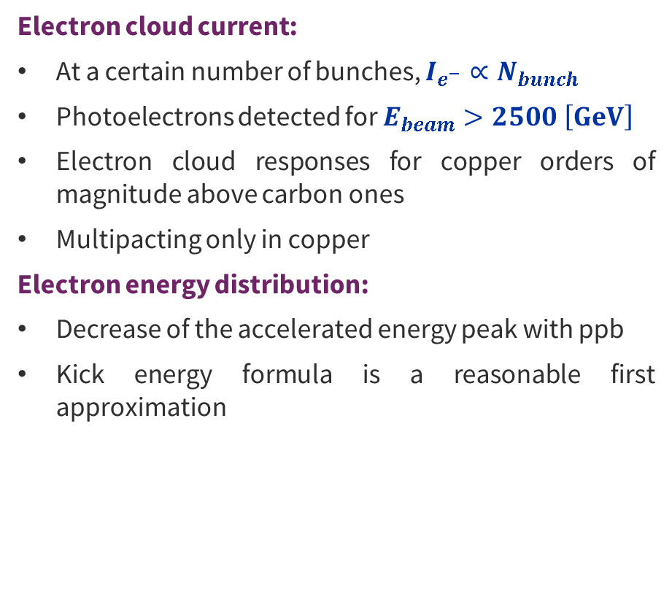
Summary
Perspective
Electron cloud current:
At a certain number of bunches, $I_{e^{−}}∝N_{bunch}$
Photoelectrons detected for $E_{beam}>2500 \left[GeV\right]$
Electron cloud responses for copper orders of magnitude above carbon ones
Multipacting only in copper
Electron energy distribution:
Decrease of the accelerated energy peak with ppb
Kick energy formula is a reasonable first approximation
Electrostimulated and Photostimulated Desorption (ESD, PSD) computations with Residual Gas Analyser
Photoelectron Yield (PY) estimations
Secondary Electrons Yield (SEY) evaluation with RFA by refining measurements around electron peaks
Measurements of the electron cloud bunch by bunch with a scope
Heat load evaluation with calorimeters
Confrontation of measurements and parameter evaluations against simulations
TE – VSC – VSM

Slide 22
Backups
TE – VSC – VSM

Slide 23
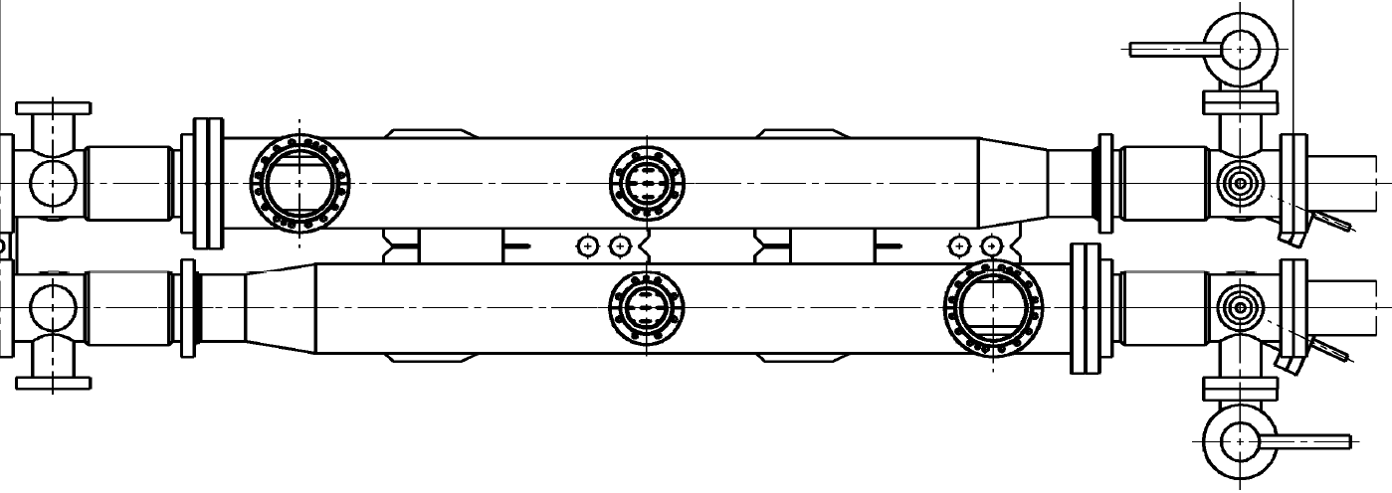
Station 2 – Amorphous carbon
Dash line : Downer side
Red line : Scope
Blue line : Keithley with variable bias
Liner B23
Position :
129
124
122
121
120
119
118
116
110
.5L8.
B
R
Ext
X
X
K4
7%
Canon 1-12
K6
7%
St 1
K5
Sc3a
St 3
z
7%
7%
K16
K18
Canon 1-12
Int
X
Sc3b
K17
X
Liner R25
NU : Unused
cal : calorimeter
Unused
xx % : pickup with a xx%-transparent grid
VGPB : Penning Gauge
ph : photodetector
VGI : Bayard-Alpert Gauge (BAG)
Trig : trigger
VQM : Vacuum Quality Monitor
RGA : Residual Gas Analyser
kick : kicker (Electron Kicker Detector)
VF : Vacuum Flange
VGRB : Pirani gauge​
RFA : Retarding Field Analyser
VPIA : Vacuum Pump
X
N : NEG cartridge
TE – VSC – VSM

Slide 24
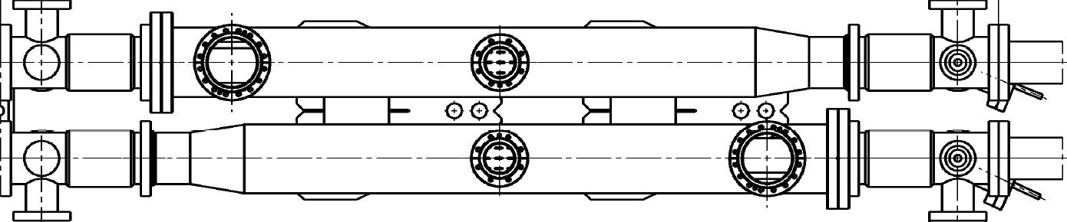
Station 3 – New unbaked copper
Dash line : Downer side
Red line : Scope
Blue line : Keithley with variable bias
Liner B26
Position :
92
87
85
84
83
82
81
79
73
.5L8.
B
R
Ext
X
X
Sc1a
7%
15%
50%
Canon 1-12
K8
7%
K9
St 2
K7
Sc2a
St 4
z
15%
7%
Sc1b
K21
7%
K26
Canon 1-12
50%
Int
X
Sc2b
K27
X
Int
Liner R27
NU : Unused
cal : calorimeter
Unused
xx % : pickup with a xx%-transparent grid
VGPB : Penning Gauge
ph : photodetector
VGI : Bayard-Alpert Gauge (BAG)
Trig : trigger
VQM : Vacuum Quality Monitor
RGA : Residual Gas Analyser
kick : kicker (Electron Kicker Detector)
VF : Vacuum Flange
VGRB : Pirani gauge​
RFA : Retarding Field Analyser
VPIA : Vacuum Pump
X
N : NEG cartridge
TE – VSC – VSM

Slide 25
Station 4 – Old unbaked copper
Dash line : Downer side
Red line : Scope
Blue line : Keithley with variable bias
Liner 7
Position :
55
50
48
46
44
42
36
4
.5L8.
B
R
Ext
X
X
Pt100 air B
SHV1
7%
0,2%
K12 + SHV2
St 3
HV BIAS 28
K11
Canon 1-12
LHCb
z
SHV3
7%
0,2%
K22 + SHV4
K23
K24
Canon 1-12
X
Pt100 air R
X
Int
Liner 8
NU : Unused
cal : calorimeter
Unused
xx % : pickup with a xx%-transparent grid
VGPB : Penning Gauge
ph : photodetector
VGI : Bayard-Alpert Gauge (BAG)
Trig : trigger
VQM : Vacuum Quality Monitor
RGA : Residual Gas Analyser
kick : kicker (Electron Kicker Detector)
VF : Vacuum Flange
VGRB : Pirani gauge​
RFA : Retarding Field Analyser
VPIA : Vacuum Pump
X
N : NEG cartridge
TE – VSC – VSM

Slide 26
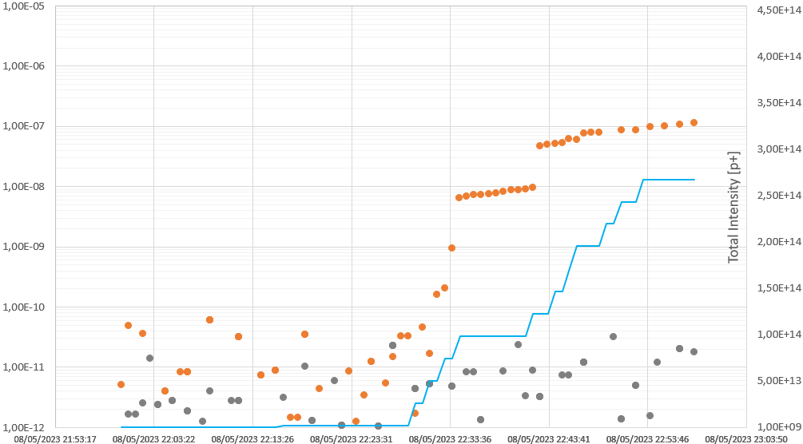

















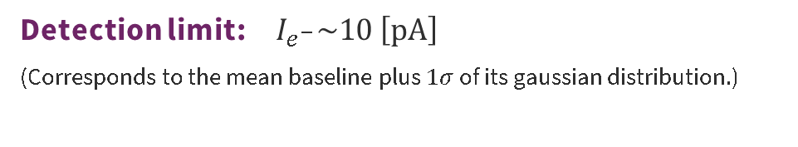











Electron cloud for hybrid fills
Electron flux [A.cm⁻²]
$${10}^{−5}$$
$${4.5×10}^{14}$$
$${10}^{−6}$$
$${4.0×10}^{14}$$
Cu B1
$${3.5×10}^{14}$$
$${10}^{−7}$$
$${3.0×10}^{14}$$
$${10}^{−8}$$
$${2.5×10}^{14}$$
Total beam intensity [p⁺]
$${10}^{−9}$$
B1 intensity
$${2.0×10}^{14}$$
a-C B1
$${1.5×10}^{14}$$
$${10}^{−10}$$
$${1.0×10}^{14}$$
$${10}^{−11}$$
$${5×10}^{13}$$
$${10}^{−12}$$
$${1×10}^{13}$$
$$0$$
$$10$$
$$20$$
$$30$$
$$40$$
$$50$$
$$60$$
$$70$$
$$Time [min]$$
Detection limit: $I_{e^{−}}\sim 10 \left[pA\right]$
(Corresponds to the mean baseline plus $1σ$ of its gaussian distribution.)
Copper is 4 orders of magnitude above carbon.
Carbon below detection limit for 8b4e.
For copper: $I_{72b}≈20×I_{hybrid}$
TE – VSC – VSM
Notes:
As a first result, you’ve here plots of the electron flux in ampere per cm² versus time for both filling schemes and for copper in orange and carbon in grey. Plotted in purple you have the detection limit of my measurements, which is about 10pA and corresponds to the mean baseline of the station plus 1 sigma of its gaussian distribution. Finally you’ll find the beam intensity in blue, withh it scale on the right side.
Two points can be noticed:
One is that copper gives responses orders of magnitude above carbon, which is even under the detection limit for the hybrid fill.
The other is that for copper signals are 20 times higher for 72b than hybrid scheme at same beam intensity.

Slide 27
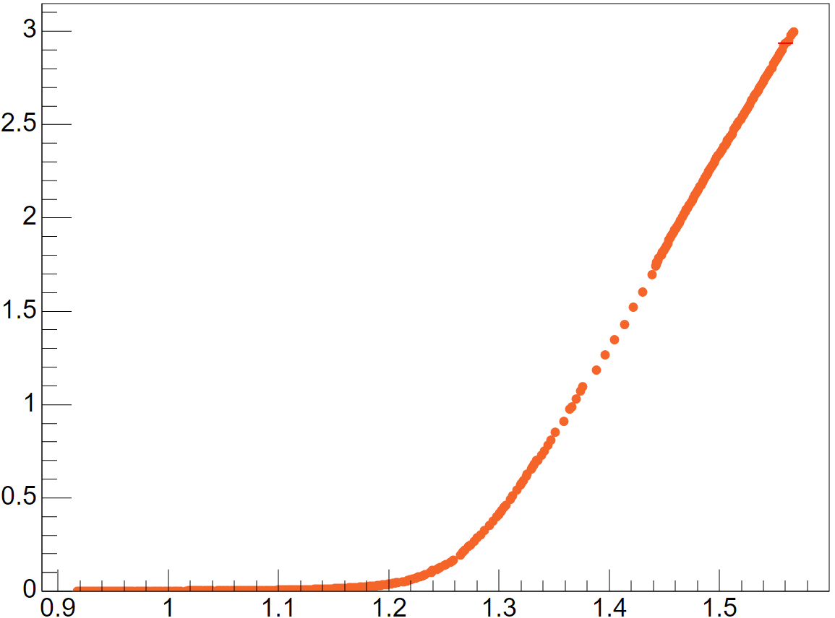
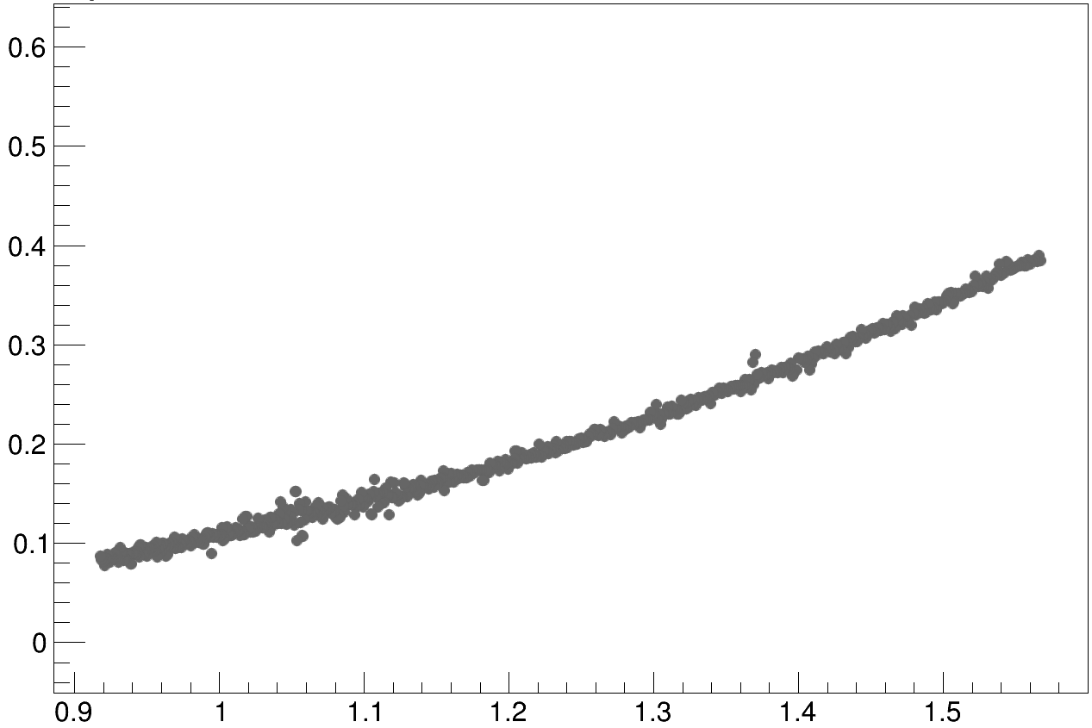


Ecloud as a function of beam mean ppb
$$×{10}^{−6}$$
Electron flux vs Mean ppb: Fill 9072
$$×{10}^{−9}$$
Multipacting presence
Barely present for carbon: ecloud mainly dominated by photoelectrons
Huge contribution for copper
Assymptotic root method
Root of linear asymptotic behaviour for high ppb
Method to assess the variations of multipacting with time
new-Cu B1
a-C B1
linear
multipacting
regime
Electron flux [A.cm⁻²]
Mean ppb $\left[{10}^{−11}×\frac{p^{+}}{bunch}\right]$
primary electrons
regime
Assymptotic root method is NOT aimed at giving a multipacting threshold as ecloud effect has been identified for lower ppb.
Mean ppb $\left[{10}^{−11}×\frac{p^{+}}{bunch}\right]$
TE – VSC – VSM

Slide 28
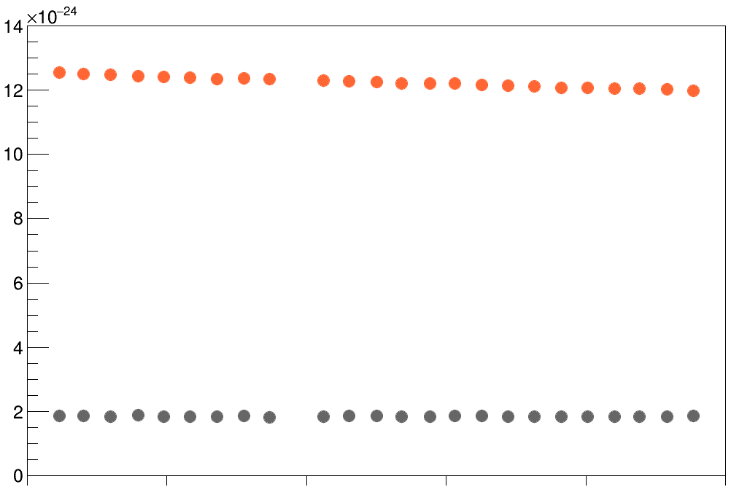






Electron flux scaling with beam intensity at end of fill
Electron flux normalised by beam intensity vs Time: Fill 8741
Cu B1
Normalised electron flux [A.cm⁻²]
$$0$$
a-C B1
$$Time [min]$$
$$6$$
$$12$$
$$18$$
$$24$$
$$30$$
TE – VSC – VSM

Slide 29
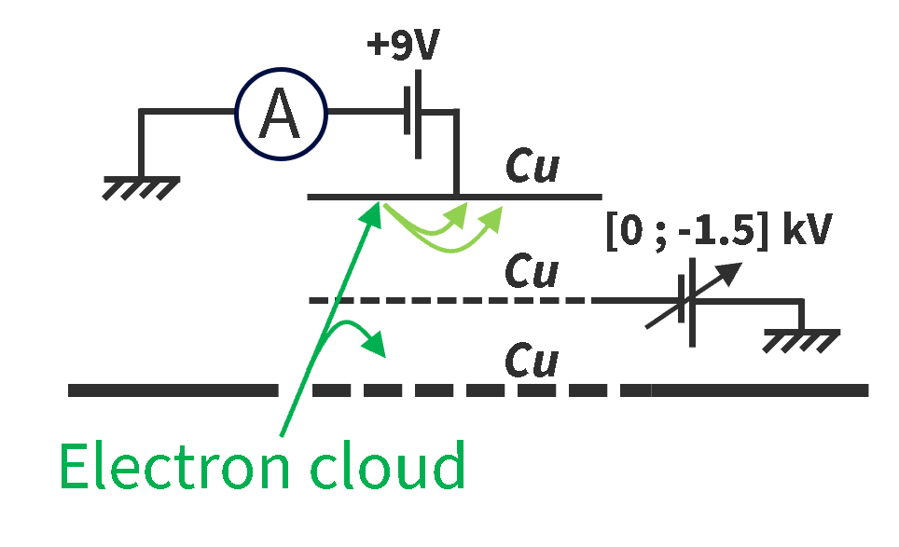
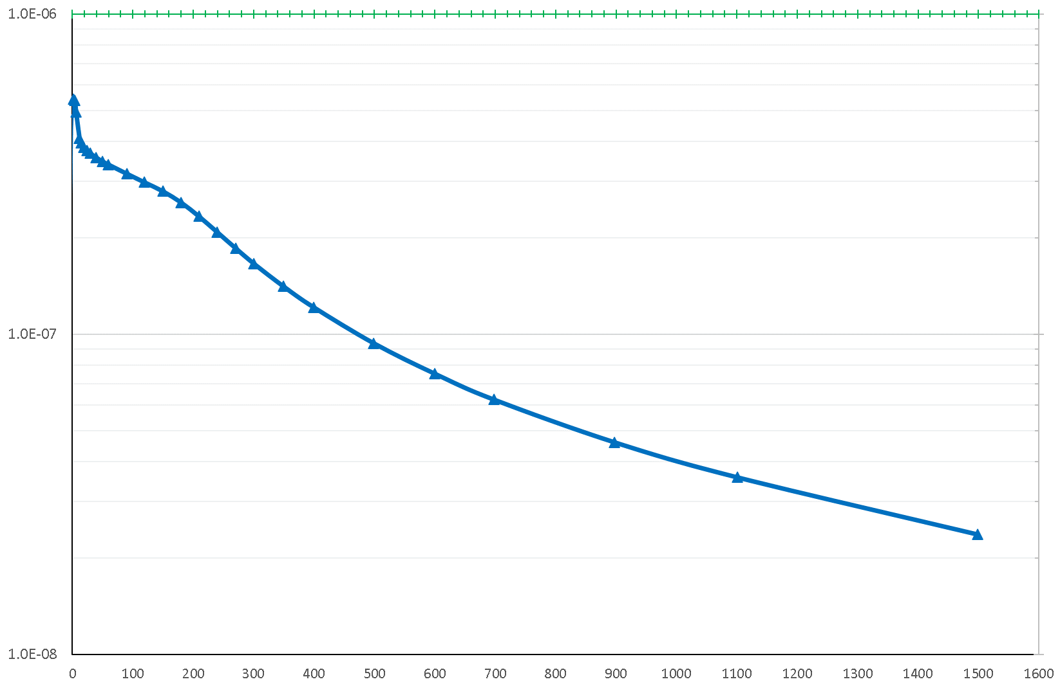
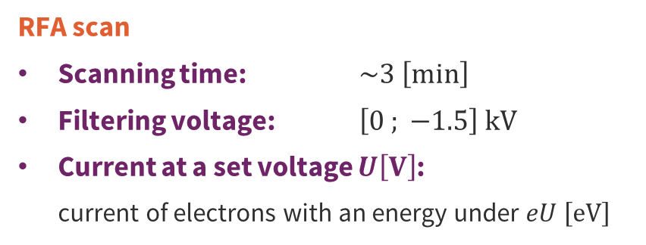


RFA raw data
Electron current vs Filtering voltage: Fill 9072
RFA scan: Fill 9072
RFA scan
Scanning time: $\sim 3 \left[min\right]$
Filtering voltage: $\left[0 ; −1.5\right] kV$
Current at a set voltage $U\left[V\right]$:
current of electrons with an energy under $eU \left[eV\right]$
Electron current $\left[A\right]$
The energy spectrum of the electrons can be obtained by derivating this curve.
$${−V}_{filter} \left[V\right]$$
TE – VSC – VSM

Slide 30



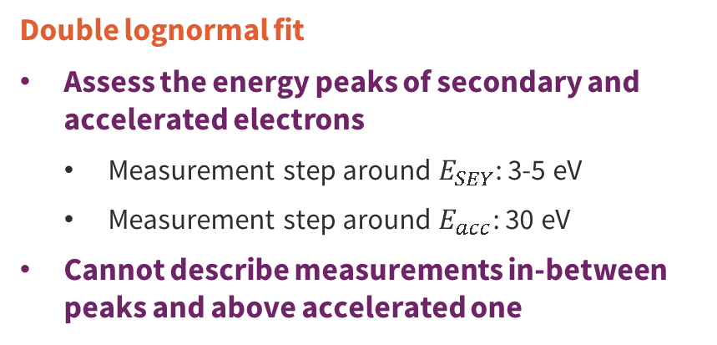

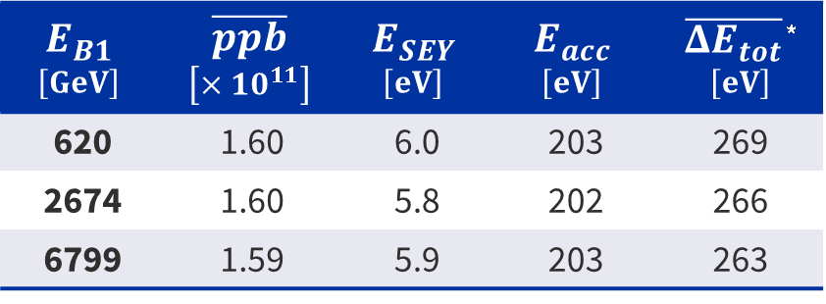

During energy ramp-up
Electron energy spectrum: Fill 9072
Secondary
electrons
Double lognormal fit
Assess the energy peaks of secondary and accelerated electrons
Measurement step around $E_{SEY}$: 3-5 eV
Measurement step around $E_{acc}$: 30 eV
Cannot describe measurements in-between peaks and above accelerated one
Beam kicked
electrons
Normalised signal $\left[a.u\right]$
$$E_{B1}$$ $$\left[GeV\right]$$ | $$\overline{ppb}$$ $$\left[×{10}^{11}\right]$$ | $$E_{SEY}$$ $$\left[eV\right]$$ | $$E_{acc}$$ $$\left[eV\right]$$ | $\overline{{ΔE}_{tot}}$ * $$\left[eV\right]$$
620 | 1.60 | 6.0 | 203 | 269
2674 | 1.60 | 5.8 | 202 | 266
6799 | 1.59 | 5.9 | 203 | 263
$$E_{SEY}$$
$$E_{acc}$$
$$\overline{{ΔE}_{tot}}∝{ppb}^{2}×\ln\left|\sqrt{ppb}\right|$$
$$E_{e^{−}} \left[eV\right]$$
No significant impact of the beam energy ramp-up on the electron energy distribution.
*J. Scott Berg. CERN LHC Project Note 97, July 1997.
TE – VSC – VSM
Notes:
The plot you see on the right gives the energy distribution of the electrons, in blue, and presents two peaks, one around 200eV related to the electons kicked by the beam, and one around 6eV related to secondary electrons.
In order to find the energies related to each peak a double lognormal fit as been used locally around those. However, this fit cannot explains the measurements in-between the peaks and above the second one.
These electron peak energies have been identified at different beam energies and gave similar results, just as for Delta Etot, which is the approximation of the energy gained by electrons in presence of beam established by Scott Berg in its paper. Thus, one can observe no significant impact of the beam energy ramp-up on the electron energy distribution.

Slide 31
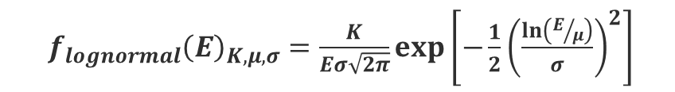

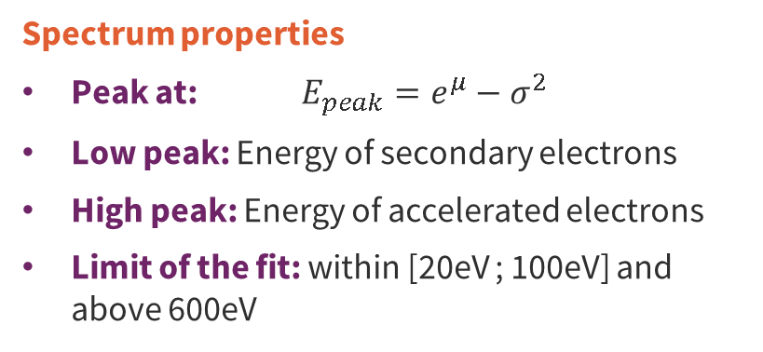

Energy spectrum double lognormal fit
Electron energy spectrum: Fill 9072
$f_{lognormal}{\left(E\right)}_{K, μ,σ}=\frac{K}{Eσ\sqrt{2π}}exp\left[−\frac{1}{2}{\left(\frac{ln⁡\left(E/μ\right)}{σ}\right)}^{2}\right]$
Spectrum properties
Peak at: $E_{peak}=e^{μ}−σ^{2}$
Low peak: Energy of secondary electrons
High peak: Energy of accelerated electrons
Limit of the fit: within [20eV ; 100eV] and above 600eV
Normalised signal $\left[a.u\right]$
$$E_{SEY}$$
$$E_{acc}$$
$$E_{e^{−}} \left[eV\right]$$
TE – VSC – VSM

Slide 32











Kick approximation principle
$${ΔE}_{wall}$$
$$e^{−}$$
$$\overline{{ΔE}_{kick}}$$
$$r_{c}$$
Two different types of motions during the passage of a bunch:
Autonomous approximation: The electrons are strongly pulled by the bunch and begin to oscillate around it.
Kick approximation: The electrons haven’t started to move very much before.
Deciding which approximation to use:
consists of comparing the oscillation period with respect to the time for the bunch to pass
is equivalent to introducing a transition radius to delimit the domains of validity of both approximations
$b=4 \left[cm\right]$
$$\overline{{ΔE}_{auto}}$$
Introduction of the critical radius $r_{c}$ above which the kick approximation is used, and below which the autonomous approximation is used.
Mean energy kick within these regions:
Energy kick for an electron on the wall:
Total mean energy gain:
$$\overline{{ΔE}_{auto}}$$
$$\overline{{ΔE}_{kick}}$$
$${ΔE}_{wall}$$
$$\overline{{ΔE}_{tot}}=\frac{r_{c}}{b} \overline{{ΔE}_{auto}}+\frac{b−r_{c}}{b} \overline{{ΔE}_{kick}}$$
Ref: “ Energy Gain in an Electron Cloud During the Passage of a Bunch ” – J. Scott Berg
TE – VSC – VSM

Slide 33


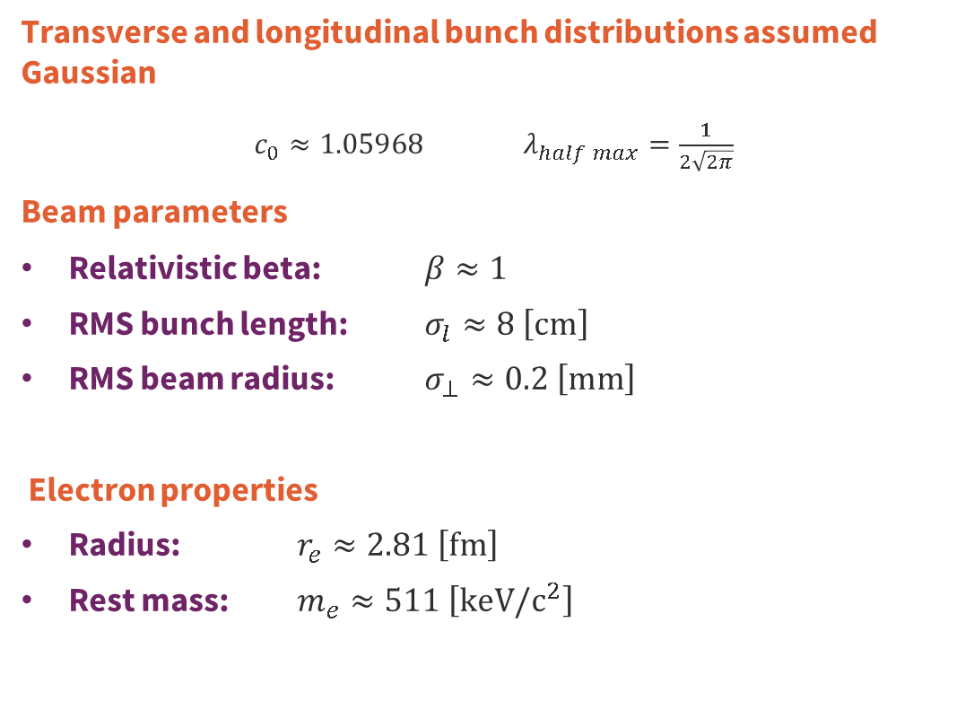

Kick approximation formulae
$${ΔE}_{wall}$$
$$e^{−}$$
$$\overline{{ΔE}_{kick}}$$
Transverse and longitudinal bunch distributions assumed Gaussian
$c_{0}≈1.05968$ $λ_{half max}=\frac{1}{2\sqrt{2π}}$
Beam parameters
Relativistic beta: $β≈1$
RMS bunch length: $σ_{l}≈8 \left[cm\right]$
RMS beam radius: $σ_{⊥}≈0.2 \left[mm\right]$
Electron properties
Radius: $r_{e}≈2.81 \left[fm\right]$
Rest mass: $m_{e}≈511 \left[keV/c^{2}\right]$
$$r_{c}$$
$b=4 \left[cm\right]$
$$\overline{{ΔE}_{auto}}$$
$$r_{c} =2\sqrt{\frac{ppb×r_{e}×σ_{l}}{πβ^{2}λ_{half max}}}$$
$${ΔE}_{wall}=2m_{e}c^{2}{\left(\frac{ppb×r_{e}}{βb}\right)}^{2}$$
$$\overline{{ΔE}_{auto}} =\frac{2}{π}{×ΔE}_{wall}\left[\ln\left(\frac{r_{c}}{c_{0}σ_{⊥}}\right)−\frac{1}{2}\right]$$
$$\overline{{ΔE}_{kick}} =2×{ΔE}_{wall}\ln\left(\frac{b}{r_{c}}\right)$$
Ref: “ Energy Gain in an Electron Cloud During the Passage of a Bunch ” – J. Scott Berg
TE – VSC – VSM

Slide 34
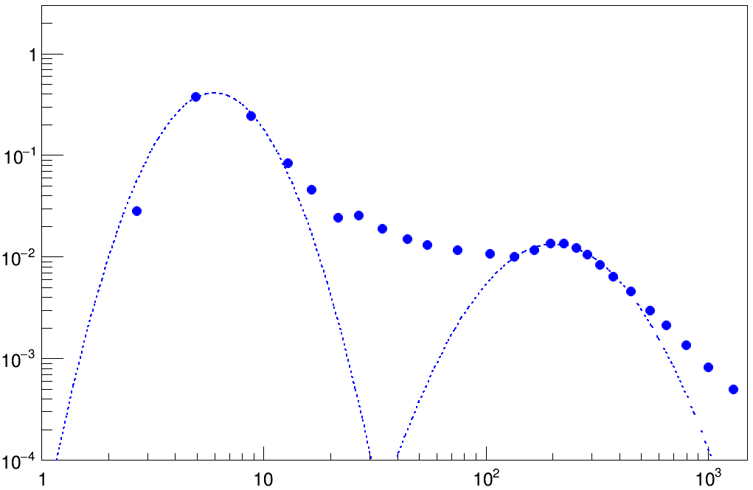
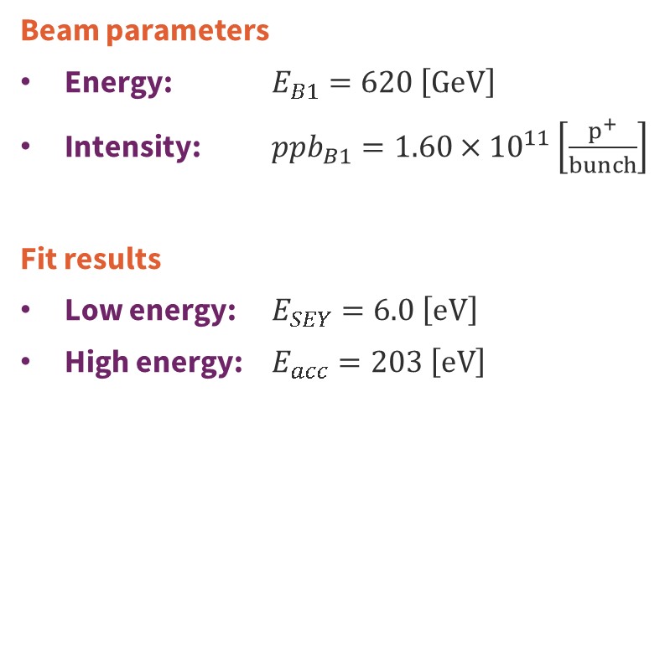
Energy ramp-up at 620GeV
Electron energy spectrum: Fill 9072
Beam parameters
Energy: $E_{B1}=620 \left[GeV\right]$
Intensity: ${ppb}_{B1}=1.60×{10}^{11}\left[\frac{p^{+}}{bunch}\right]$
Fit results
Low energy: $E_{SEY}=6.0 \left[eV\right]$
High energy: $E_{acc}=203 \left[eV\right]$
Normalised signal $\left[a.u\right]$
$$E_{SEY}$$
$$E_{acc}$$
$$E_{e^{−}} \left[eV\right]$$
TE – VSC – VSM
20/12/2023
TE – VSC – VSM

Slide 35
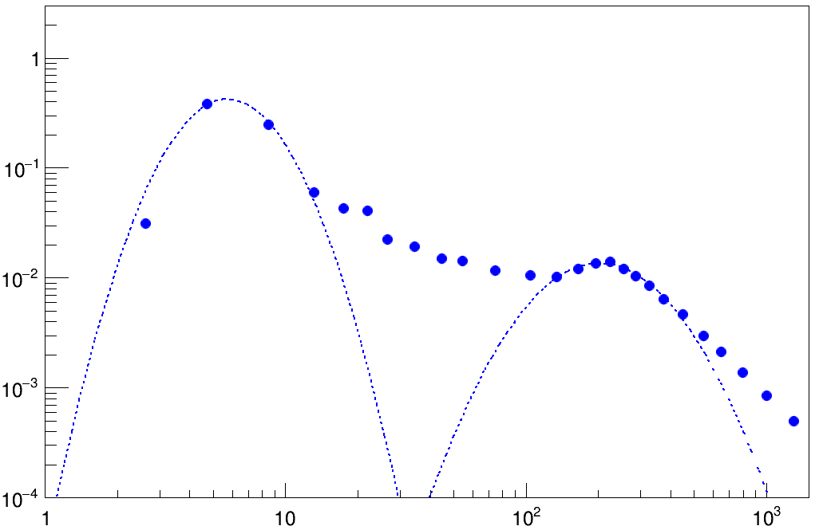

Energy ramp-up at 2074GeV
Electron energy spectrum: Fill 9072
Beam parameters
Energy: $E_{B1}=2074 \left[GeV\right]$
Intensity: ${ppb}_{B1}=1.60×{10}^{11}\left[\frac{p^{+}}{bunch}\right]$
Fit results
Low energy: $E_{SEY}=5.8 \left[eV\right]$
High energy: $E_{acc}=202 \left[eV\right]$
Normalised signal $\left[a.u\right]$
$$E_{SEY}$$
$$E_{acc}$$
$$E_{e^{−}} \left[eV\right]$$
TE – VSC – VSM
20/12/2023
TE – VSC – VSM

Slide 36


Energy ramp-up at 6799GeV
Electron energy spectrum: Fill 9072
Beam parameters
Energy: $E_{B1}=6799 \left[GeV\right]$
Intensity: ${ppb}_{B1}=1.59×{10}^{11}\left[\frac{p^{+}}{bunch}\right]$
Fit results
Low energy: $E_{SEY}=5.9 \left[eV\right]$
High energy: $E_{acc}=203 \left[eV\right]$
Normalised signal $\left[a.u\right]$
$$E_{SEY}$$
$$E_{acc}$$
$$E_{e^{−}} \left[eV\right]$$
TE – VSC – VSM
20/12/2023
TE – VSC – VSM

